Slide 1


Ensemble methods in northern Australian monsoon projections
Josephine Brown, Aurel Moise and Rob Colman
Climate Research Section, Bureau of Meteorology
Thanks to: Huqiang Zhang, Leon Rotstayn, Robin Chadwick
This research is supported by the Earth Systems and Climate Change Hub of the Australian Government's National Environmental Science Program
Bureau of Meteorology R&D Workshop – 29 November 2018

Slide 2
Outline
Multi-model mean Australian monsoon projection
Exploring model spread and uncertainty: "dividing the ensemble"
  Models with wetter vs drier futures
  Representation of anthropogenic aerosols
A more robust projection for northern Australian monsoon rainfall?
Notes:
Multi-model mean Australian monsoon projection
Model spread and uncertainty: "dividing the ensemble"
Models with wetter vs drier futures
Representation of anthropogenic aerosols
A more robust projection for northern Australian monsoon rainfall?

Slide 3
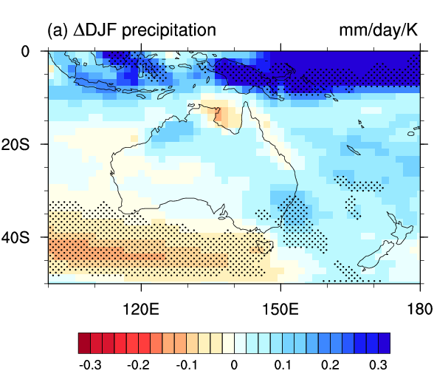
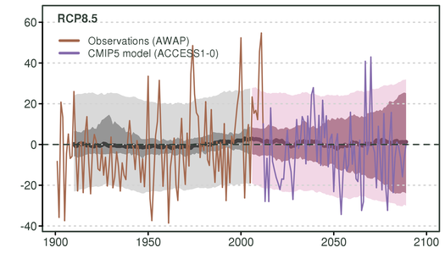
Australian monsoon rainfall projections under RCP8.5 (high emissions scenario)
Multi-model mean
DJF rainfall change: RCP8.5 - Historical
Time series of northern Aus rainfall
MMM and inter-model range
RCP8.5
From Climate Change in Australia Technical Report, 2015
MMM summer rainfall change is positive, but low model agreement on sign of change (stippling shows 80% agreement)
MMM indicates little change, but large spread (uncertainty) of 25% wetter/drier
Notes:
Shown here is MMM change per degree of warming

Slide 4
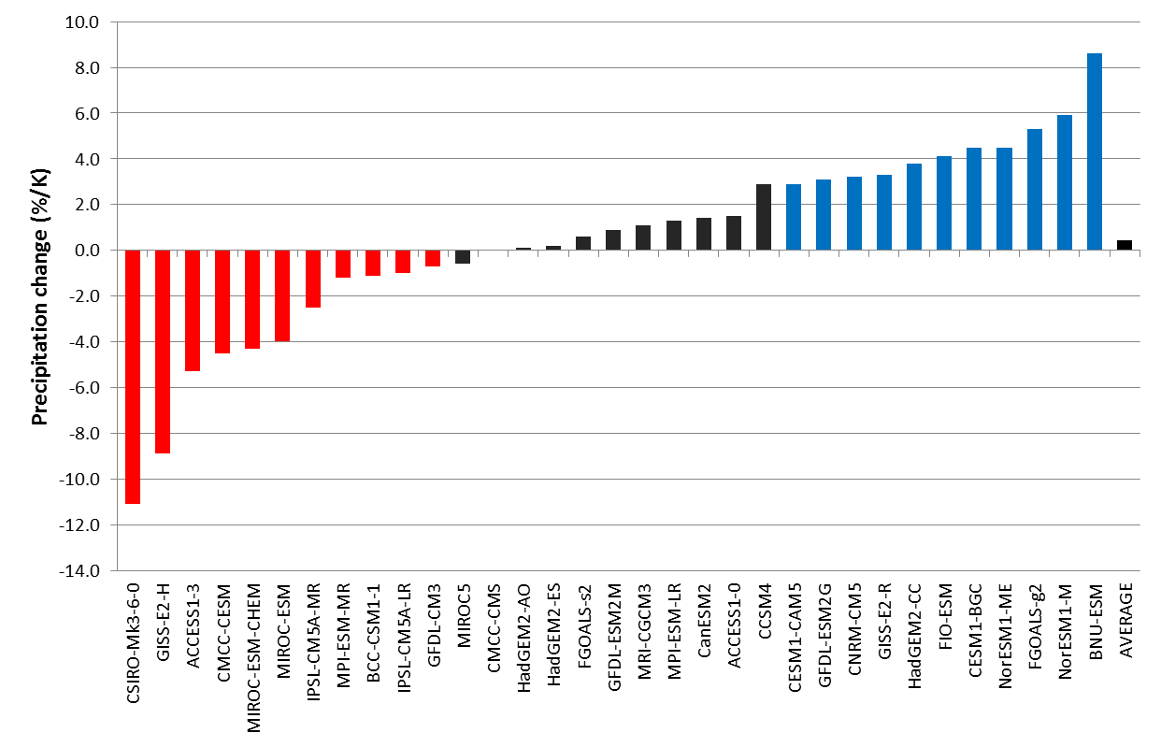
Model spread in rainfall projections
Change in DJF Australian monsoon rainfall (%/K) for RCP8.5 minus Historical
(Monsoon rainfall is calculated for land grid points in the domain 10-20S, 120E-150E)
+37%
(8.6%/K)
11 “WET” models
+1.1%
(0.4%/K)
11 “DRY” models
-43%
(-11.1%/K)
Model simulations of change in Australian summer monsoon rainfall under high emissions scenario RCP8.5 show a wide spread in projected changes

Slide 5
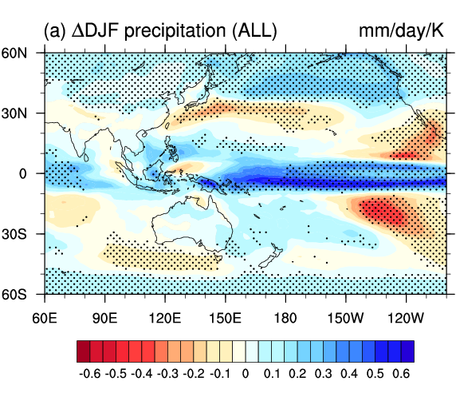
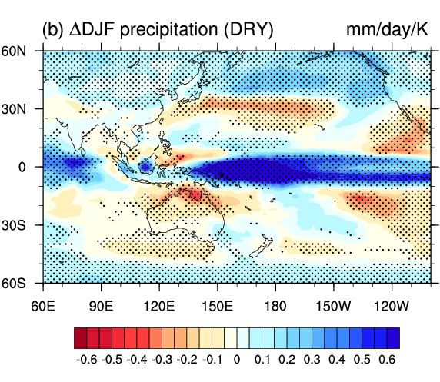
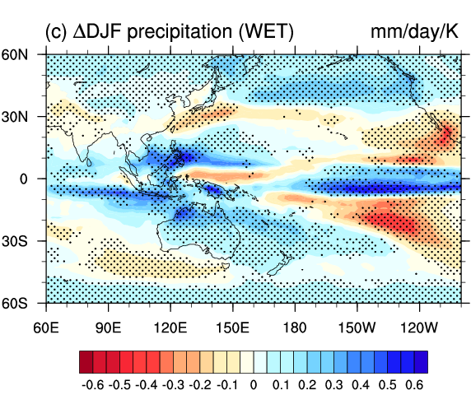
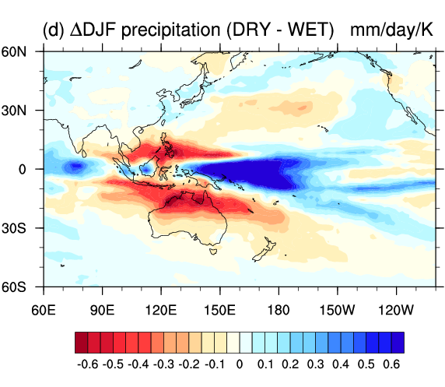
Drier vs wetter models: rainfall change
ALL model mean
DRY model mean
DRY model mean has largest increase over western equatorial Pacific
WET MM has moderate increases over Australia and south-west Pacific
Difference between DRY and WET MM includes large positive anomaly in the western equatorial Pacific
WET model mean
DRY minus WET
DJF rainfall change (mm/day/K) for RCP8.5 (2070-2099) – Historical (1970-1999)

Slide 6
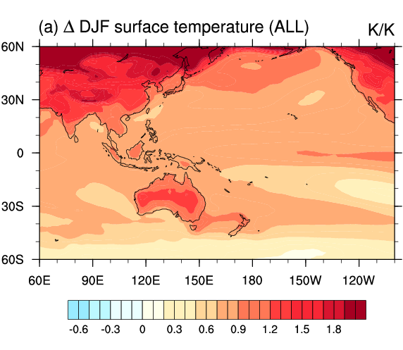
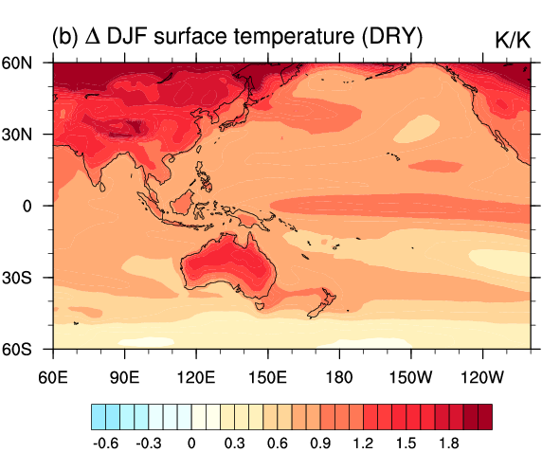
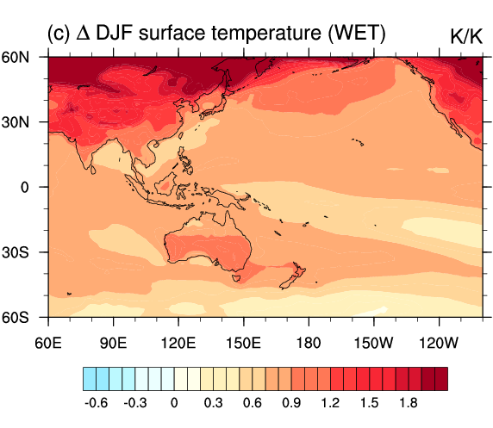
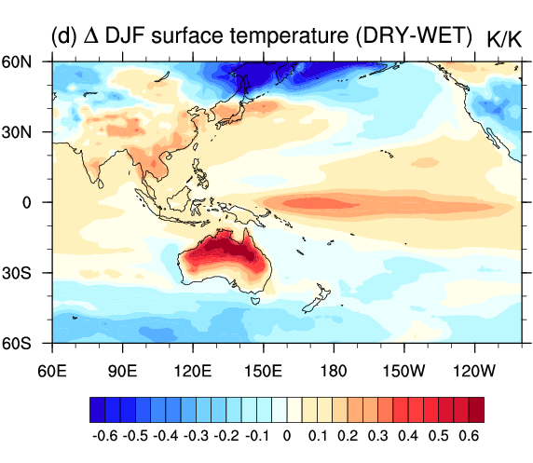
Drier vs wetter models: temperature
ALL model mean
DRY model mean
DRY model mean has enhanced equatorial warming
WET MM has less warming in equatorial Pacific and over Australia
DRY minus WET MM has positive anomaly in the western and central equatorial Pacific
WET model mean
DRY minus WET
DJF surface temperature change (K/K) for RCP8.5 (2070-2099) – Historical (1970-1999)

Slide 7
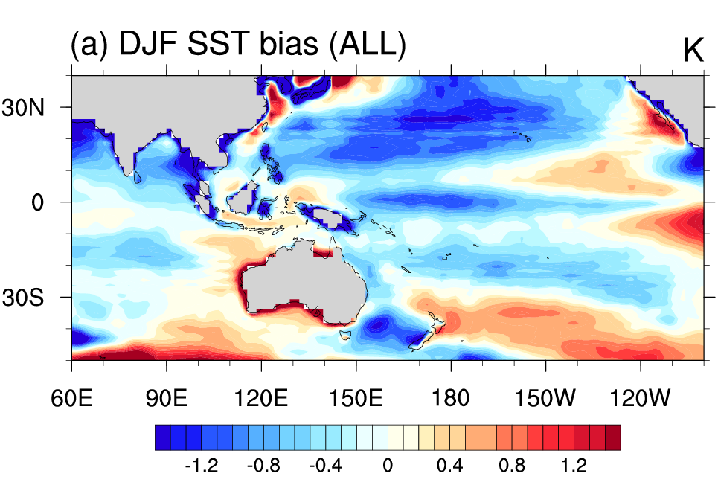
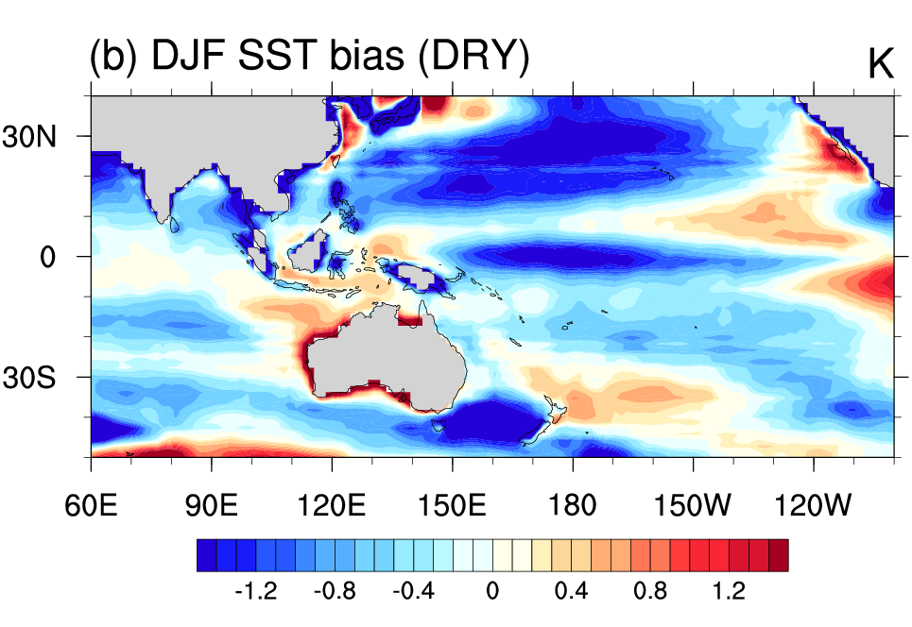
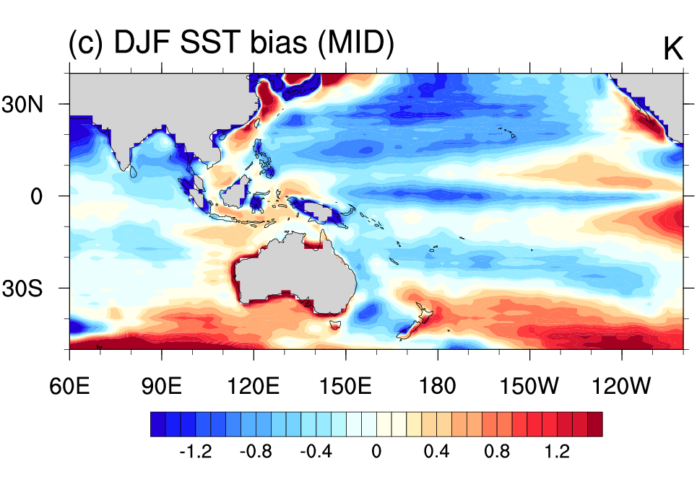
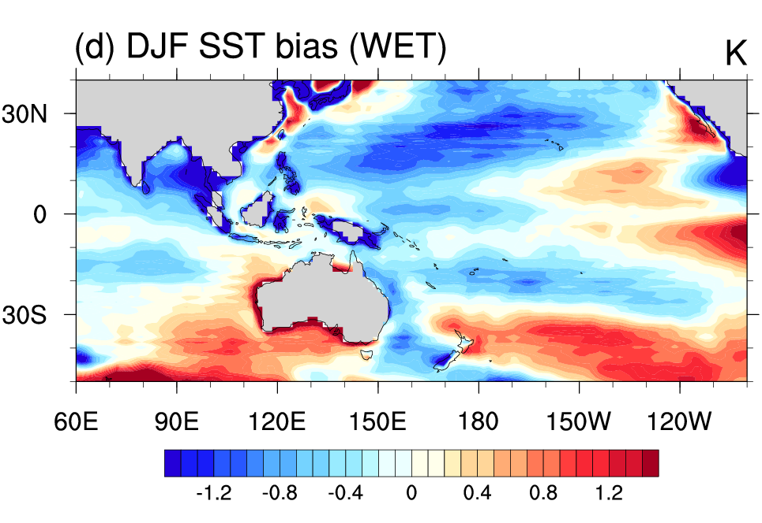
Sea surface temperature biases
DJF sea surface temperature (K) in CMIP5 models compared with HadISST observations (1980-2005)

Slide 8
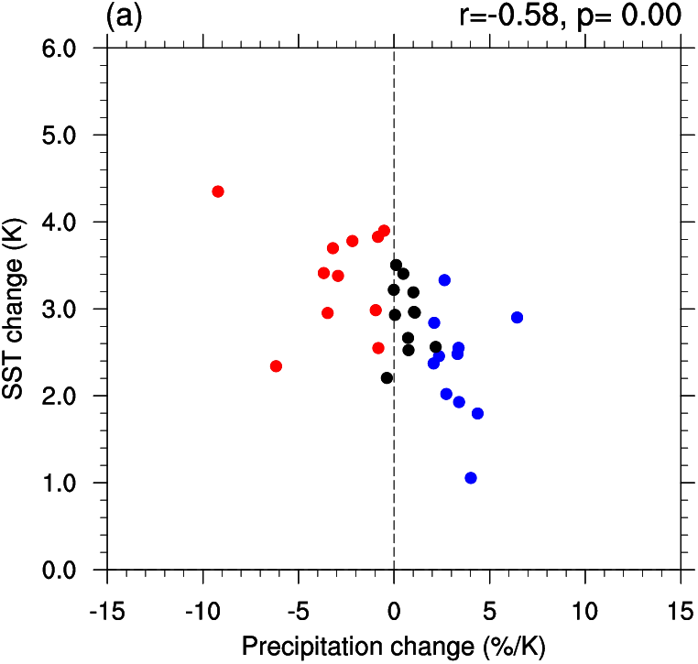
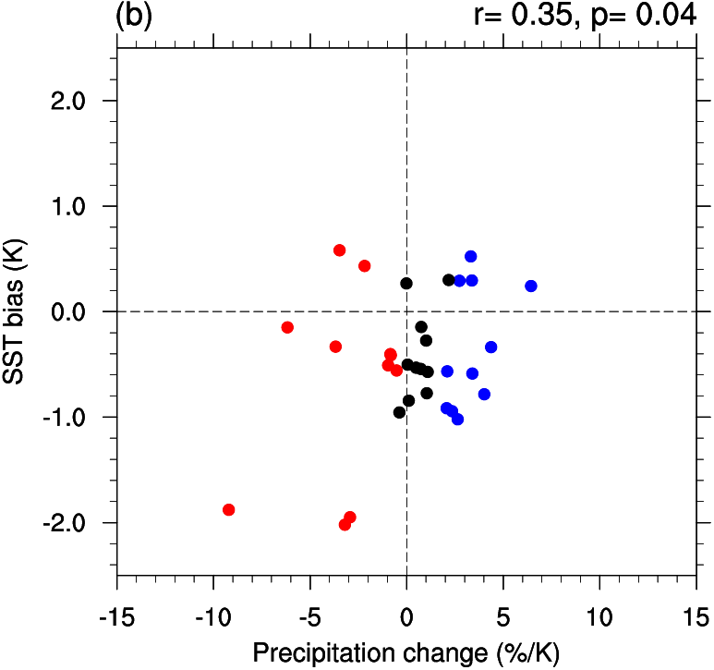
Rainfall versus SST change, SST bias?
Warmer in western Eq. Pac.
WEP SST change (K)
WEP SST bias (K)
Drier
Wetter
Australian summer monsoon rainfall change is negatively correlated with the amount of SST warming in the Western Equatorial Pacific (WEP)
Monsoon rainfall change is weakly correlated with the model SST bias in this region, so models with a larger cold bias tend to project larger decreases in monsoon rainfall (three outliers: CSIRO, MIROC-ESM models)

Slide 9
Conclusions #1:
A wetter or drier Australian monsoon?
Australian monsoon rainfall changes are strongly correlated with SST warming in the western equatorial Pacific
The large model spread in monsoon projections is mainly due to the different dynamical shifts in rainfall due to the different spatial patterns of SST warming
Models that simulate decreases in future monsoon rainfall may be less reliable due to the influence of SST biases on the SST warming pattern and rainfall response
[Brown, J.R, A. F. Moise, R. Colman, and H. Zhang (2016), Will a warmer world mean a wetter or drier Australian monsoon? Journal of Climate, 29, 4577-4596.]

Slide 10
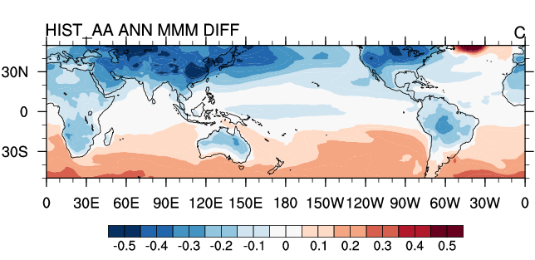
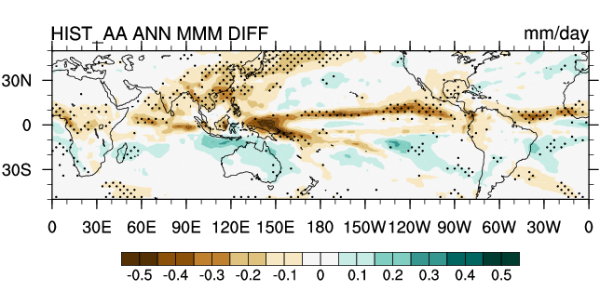
Sensitivity to aerosol forcing?
Historical AA only simulations: MMM change in annual temperature and rainfall (1975-2005 minus 1900-1930)
Anthropogenic aerosol forcing leads to greater cooling in NH and hence reduced NH tropical precipitation, increased SH tropical precipitation
Future aerosol reductions may lead to increased Asian monsoon rainfall and decreased Australian monsoon rainfall due to hemispheric asymmetry in warming (e.g. Rotstayn et al. 2013; 2015; Friedman et al. 2013; Levy et al. 2013)
(TS anomaly from tropical mean)
Notes:
Projections for North Australia region from CMIP5 models under RCP8.5, RCP4.5 and RCP2.6 scenarios:
Wide model spread for all scenarios (largest for high emissions)
Under RCP4.5, fewer models simulate wetter than drier conditions by 2090
Does rainfall change scale linearly with warming? What about aerosols?

Slide 11
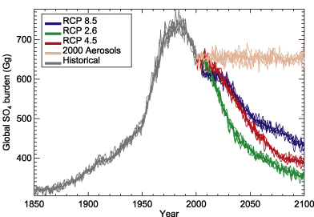
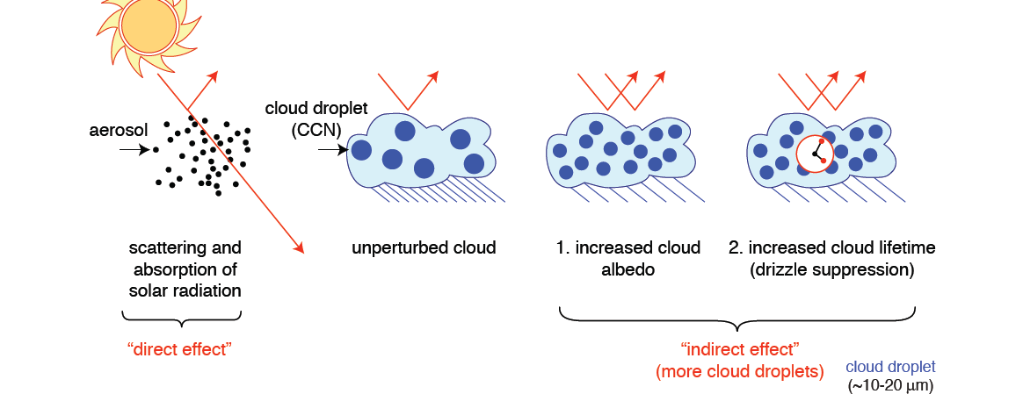
Aerosol effects in CMIP5 models
Recent studies suggest that the indirect effect is responsible for the majority of the precipitation response to aerosol forcing (e.g. Chung and Soden 2017)
Only a subset of CMIP5 models include both direct and indirect aerosol effects. Following Rotstayn et al. (2015), we divide CMIP5 models into "HiForce" (indirect + direct) and "LoForce” (direct only)
We use LoForce and HiForce groups as a proxy for runs with and without aerosol forcing
Are Australian monsoon projections different for HiForce and LoForce groups of models?
Notes:
Rotstayn et al. (2015) divide CMIP5 models into "HiForc" and "LoForc" based on whether they represent indirect aerosol effects (changes to cloud properties). HiForc have much larger response to aerosol forcing.
As we do not have projections with and without anthropogenic aerosols, we instead use LoForc and HiForc groups as a proxy for runs with and without aerosol forcing
Are Australian monsoon projections different for HiForc and LoForc models?

Slide 12
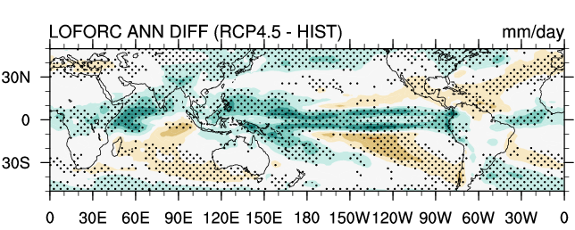
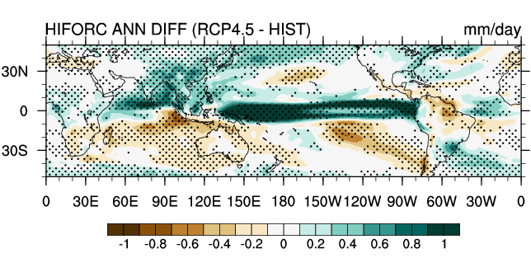
Pattern of precipitation change
"LoForce" and "HiForce" rainfall difference: RCP4.5 minus HIST
LoForce simulates wetter Australian and Asian monsoons (GHG signal)
Rainfall changes in HiForce models show hemispheric asymmetry: rainfall increases in Northern Hemisphere and decreases in Southern Hemisphere in response to aerosol decline
HiForce simulates drier Australian monsoon and wetter Asian monsoon (aerosol decline + GHG)

Slide 13
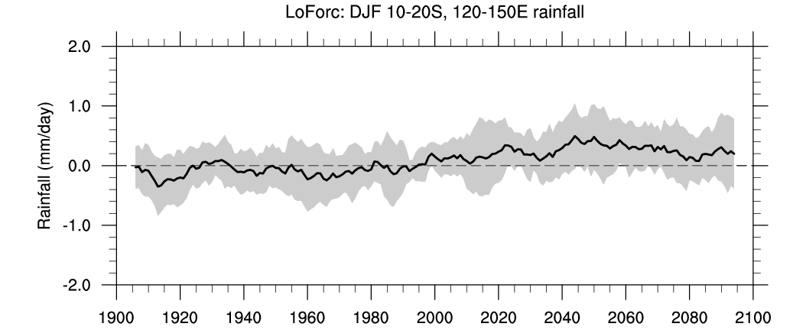
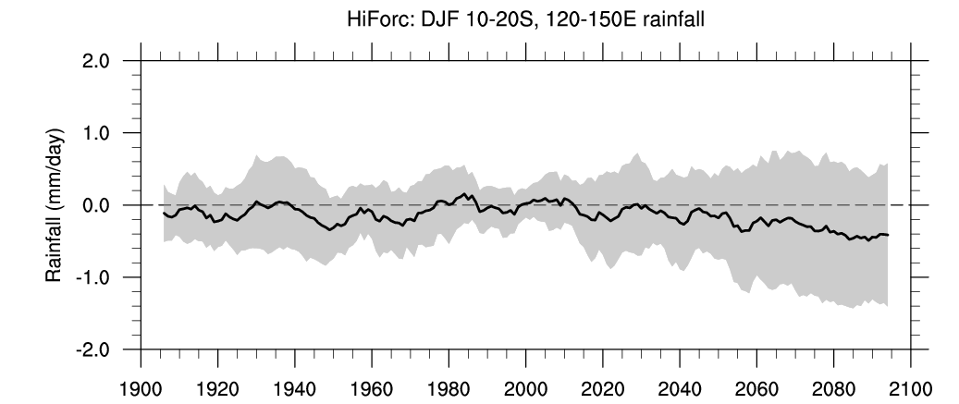
Australian monsoon rainfall
"LoForce" and "HiForce" Australian monsoon domain DJF rainfall
HISTORICAL (1900-2005) + RCP4.5 (2006-2100) simulations
LoForce
"LoForce" includes only direct aerosol effects
Models show weak increase in Australian monsoon rainfall from beginning of 21st century
LoForce models have rainfall increase in response to GHG warming while the HiForce models have decrease in response to aerosols offset by GHG warming increase
"HiForce" includes indirect aerosol effects
Models show decrease in Australian monsoon rainfall in 21st century
HiForce
(11-year running mean, anomaly relative to 1986-2005 climatology, range is ± one std deviation)
Notes:
LoForc and HiForc models for RCP4.5:
"LoForc" models show weak increase in Australian monsoon rainfall in 21st century
"HiForc" models show decrease in Australian monsoon rainfall in 21st century

Slide 14
Conclusions #2:
Sensitivity to aerosol forcing?
Models with indirect aerosol effects ("HiForce models") show a large inter-hemispheric asymmetry in temperature and precipitation trends in future simulations (due to aerosol decrease)
Models with indirect effects are more likely to project a drier Australian monsoon, especially under lower emission RCPs
Models that simulate large increases in future monsoon rainfall may be less reliable due to lack of aerosol indirect effects
[Brown, J.R, R. Colman, A. F. Moise, Sensitivity of future Australian monsoon rainfall to emissions scenario, in preparation. ]

Slide 15
A more robust monsoon projection
Dividing the CMIP ensemble into groups with common characteristics can provide insights beyond traditional MMM and model range
Our results indicate less confidence in models with drying (due to western Pacific SST biases) and models with large wetting (due to lack of indirect aerosols) => no change or small increase most likely
Model disagreement is due to:
  Model biases in present day tropical SSTs
  Patterns of change in tropical SSTs
  How aerosols are represented (HiForce vs. LoForce)
  Other factors – convection scheme etc.
The next generation of CMIP6 models may narrow this uncertainty – but it's not guaranteed!
Notes:
Dividing the CMIP ensemble into groups with common characteristics can provide insights beyond traditional MMM and model range
Our results indicate less confidence in models with drying (due to western Pacific SST biases) and models with large wetting (due to lack of indirect aerosols) => no change or small increase most likely
Model disagreement is due to:
Model biases in present day tropical SSTs
Patterns of change in tropical SSTs
How aerosols are represented (HiForce vs. LoForce)
Other factors – convection scheme etc.
The next generation of CMIP6 models may narrow this uncertainty – but it's not guaranteed!

Slide 16
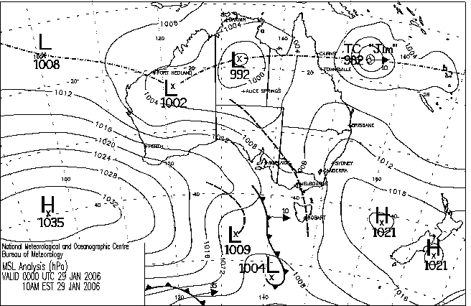
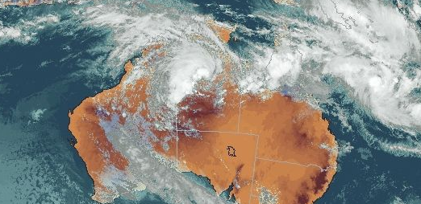
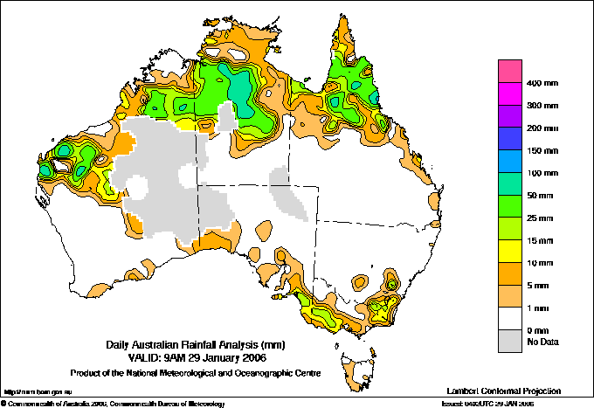
Questions?
Dr Josephine R. Brown
Climate Research Section, Bureau of Meteorology
Email: josephine.brown@bom.gov.au
Phone: 03 9669 4175
Notes:
Questions?

