Slide 1






The weather@home regional climate modelling project for Australia and New Zealand
Mitchell Black & David Karoly

Slide 2
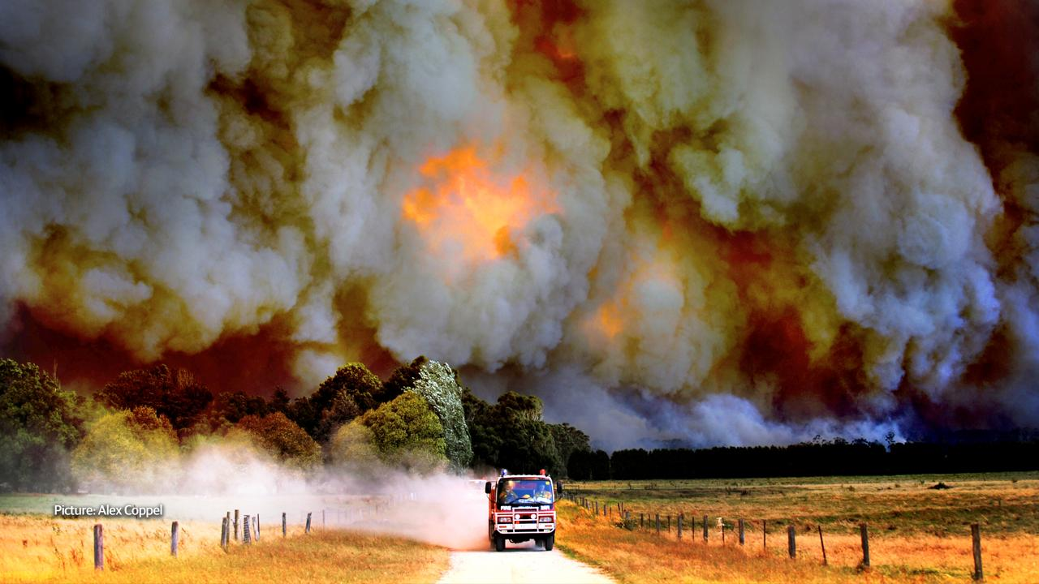

Slide 3



23 May 2016
Climate Change Might Be Causing Massive Canadian Wildfires
26 October 2013
Australian bushfires fan global warming debate
1 November 2013
Blazing row over fires and climate change

Slide 4
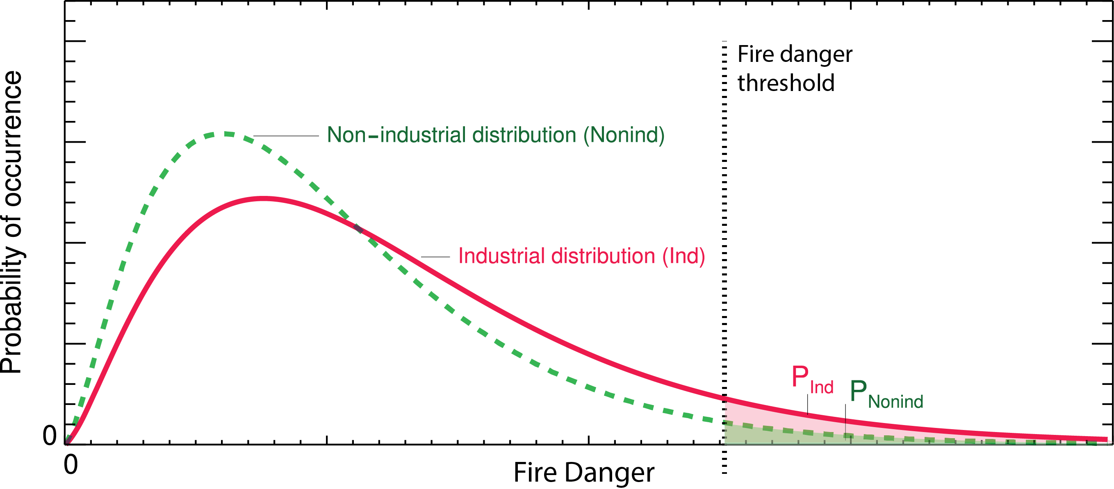
Pr (industrial climate)
Pr (non-industrial climate)
Risk Ratio =
Notes:
'Risk' – misleading as is not a function of vulnerability and exposure. 'Likelihood' ratio.

Slide 5
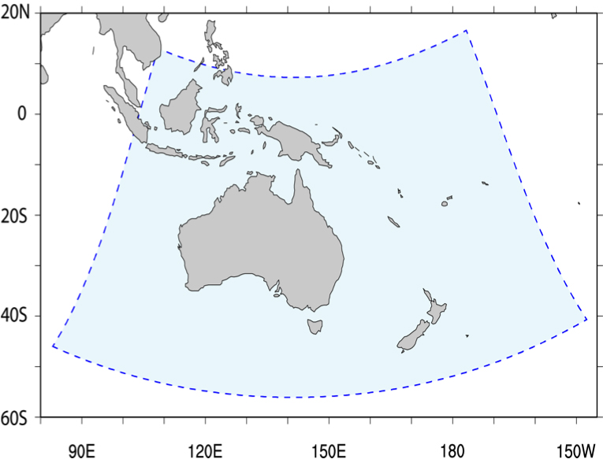
Weather@Home Australia-New Zealand
Global climate model:
HadAM3P (1.875°x 1.25°, 19 levels)
Nested regional climate model:
HadRM3P (0.44°x 0.44°, 19 levels)
AMIP-style simulations, daily fields
Perturbed initial conditions
Notes:
Need: model resolution and ensemble size

Slide 6
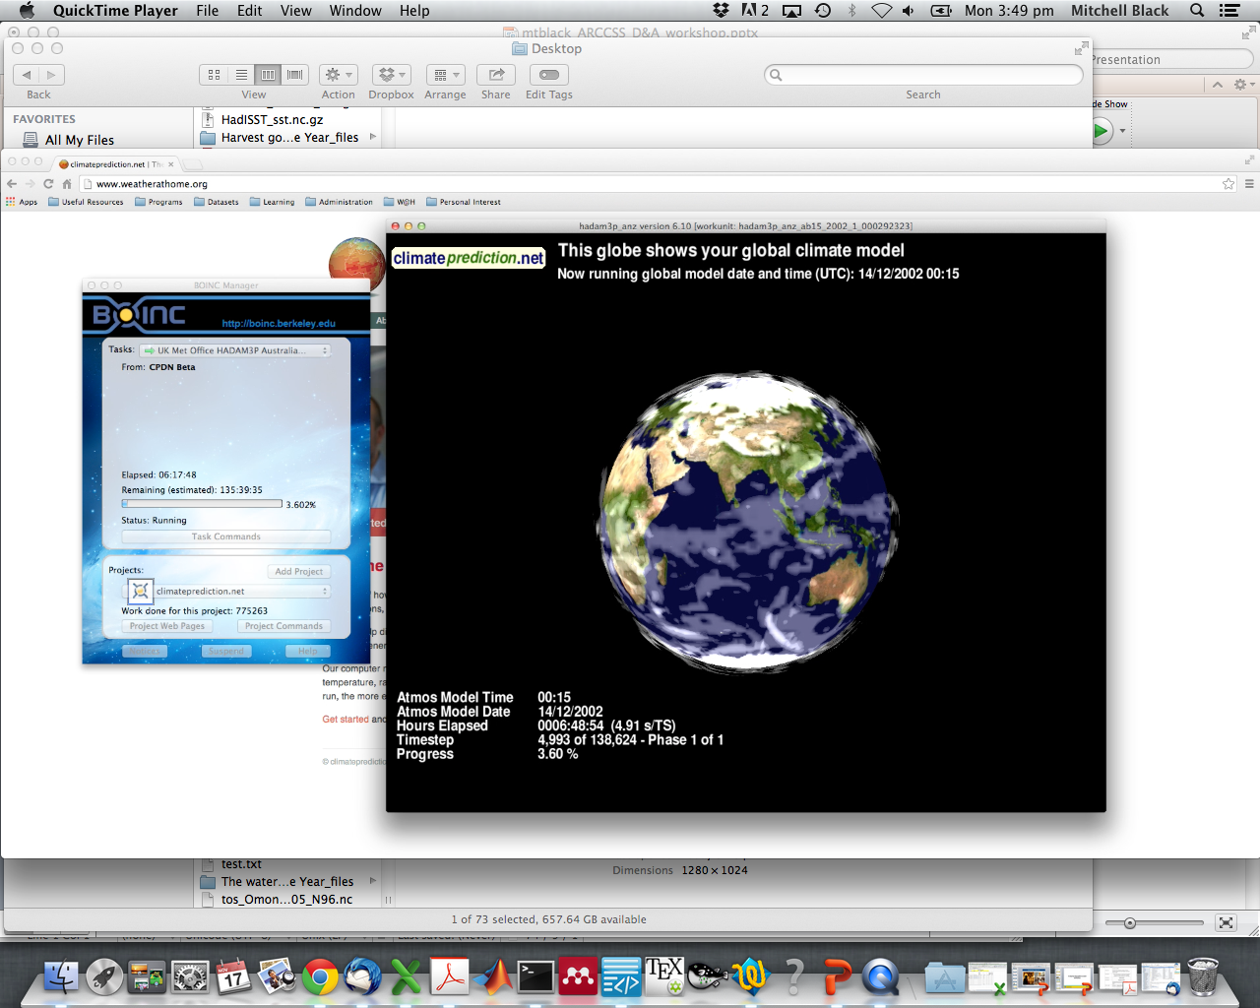

Slide 7







completed >250,000 simulations

Slide 8
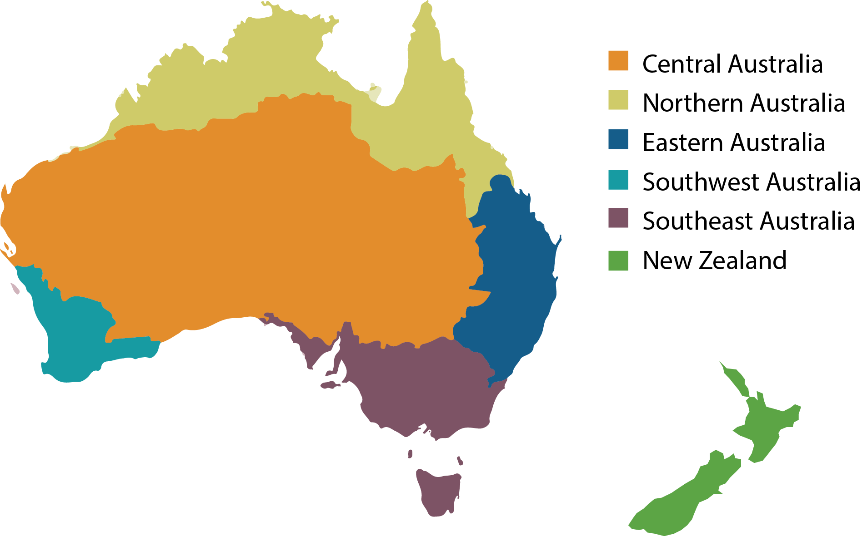
Weather@Home Australia-New Zealand
Model evaluation
The combination of large ensemble size and model resolution allows a range of extreme events to be examined with well-constrained estimates of sampling uncertainty.
The model resolves many climate features important for Australia including the influence of ENSO on driving natural climate variability.
See model description and evaluation paper: Geoscientific Model Development

Slide 9

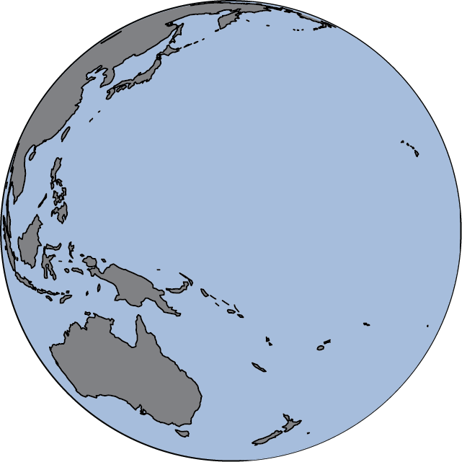


Observed daily SST fields (OSTIA)
Present-day (industrial) levels of greenhouse gasses, ozone and aerosols
'Industrial' scenario
The world as it is
Natural forcing factors
(e.g., changes in volcanic aerosols and solar irradiance)

Slide 10
- ˚C
Observed daily SST fields are cooled to remove estimates of anthropogenic warming
Pre-industrial (1850) levels of greenhouse gasses, ozone and aerosols
'Pre-industrial' scenario
The world without human emissions
Natural forcing factors
(e.g., changes in volcanic aerosols and solar irradiance)

Slide 11
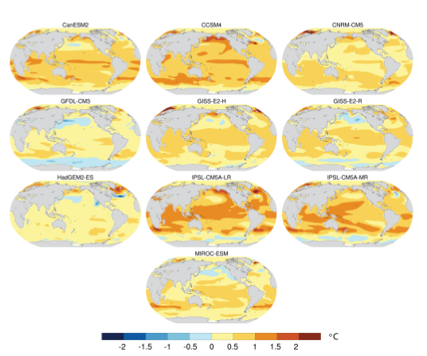
- ˚C
Observed daily SST fields are cooled to remove estimates of anthropogenic warming
Pre-industrial (1850) levels of greenhouse gasses, ozone and aerosols
Natural forcing factors
(e.g., changes in volcanic aerosols and solar irradiance)
'Pre-industrial' scenario(s)
The world without human emissions

Slide 12
- ˚C
Observed daily SST fields are cooled to remove estimates of anthropogenic warming
Pre-industrial (1850) levels of greenhouse gasses, ozone and aerosols
Natural forcing factors
(e.g., changes in volcanic aerosols and solar irradiance)
'Pre-industrial' scenario(s)
The world without human emissions

Slide 13
- ˚C
Observed daily SST fields are cooled to remove estimates of anthropogenic warming
Pre-industrial (1850) levels of greenhouse gasses, ozone and aerosols
Natural forcing factors
(e.g., changes in volcanic aerosols and solar irradiance)
'Pre-industrial' scenario(s)
The world without human emissions

Slide 14
2008/2009
'Industrial' scenario
The world as it is
2008/2009
'Pre-industrial' scenario
The world without human emissions

Slide 15
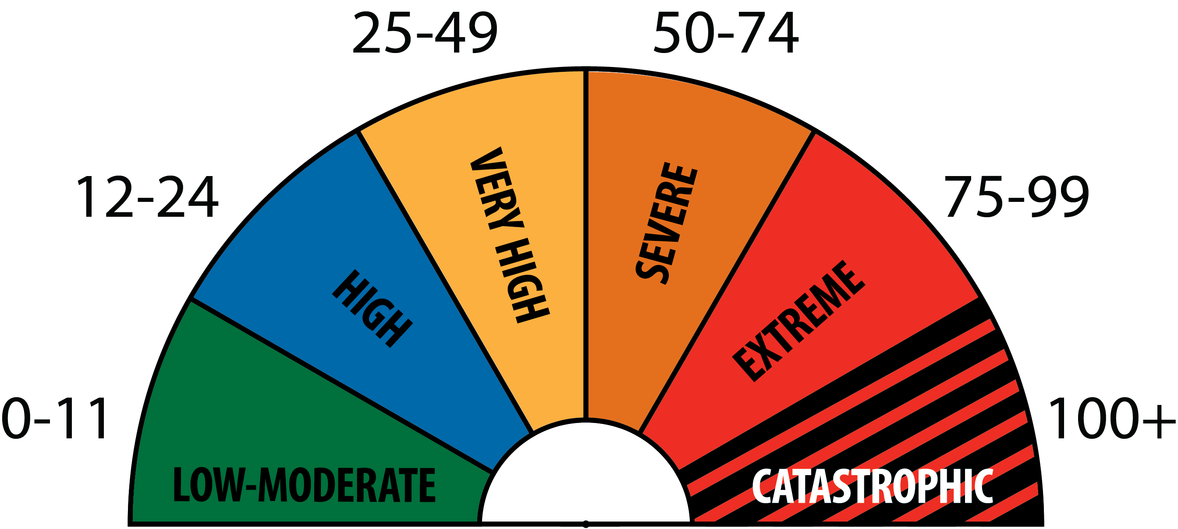
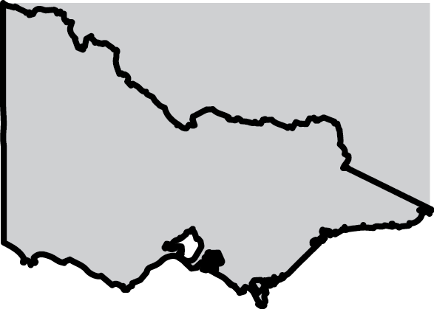
2008/2009
'Industrial' scenario
The world as it is
2008/2009
'Pre-industrial' scenario
The world without human emissions
Daily Forest Fire Danger Index calculated over southeast Australia
FFDI = ƒ(T, RH, Wind, DF)

Slide 16
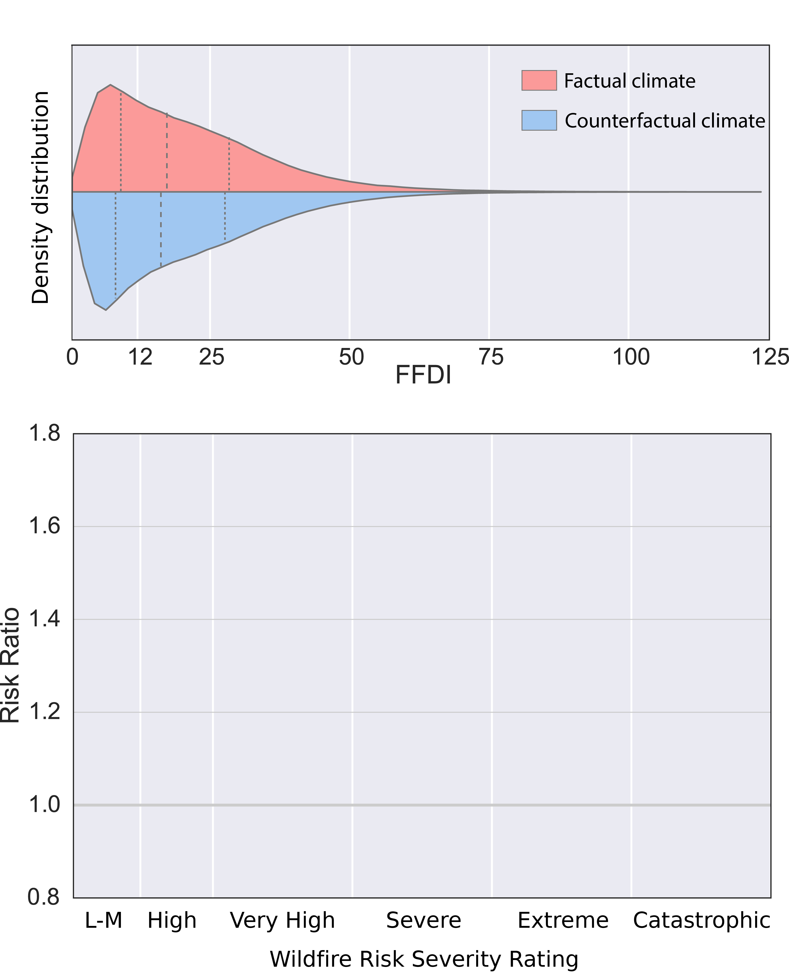
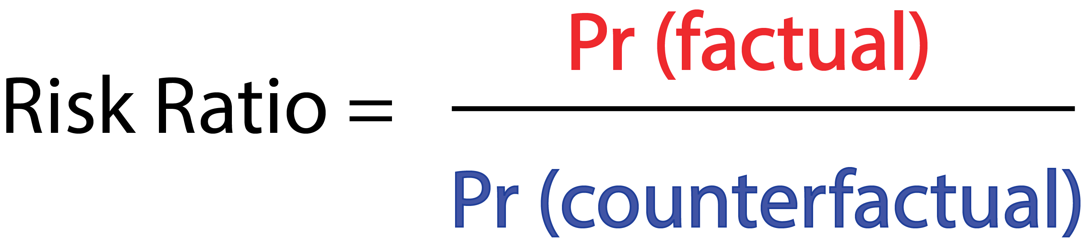
Sept. 2008 – Feb. 2009

Slide 17
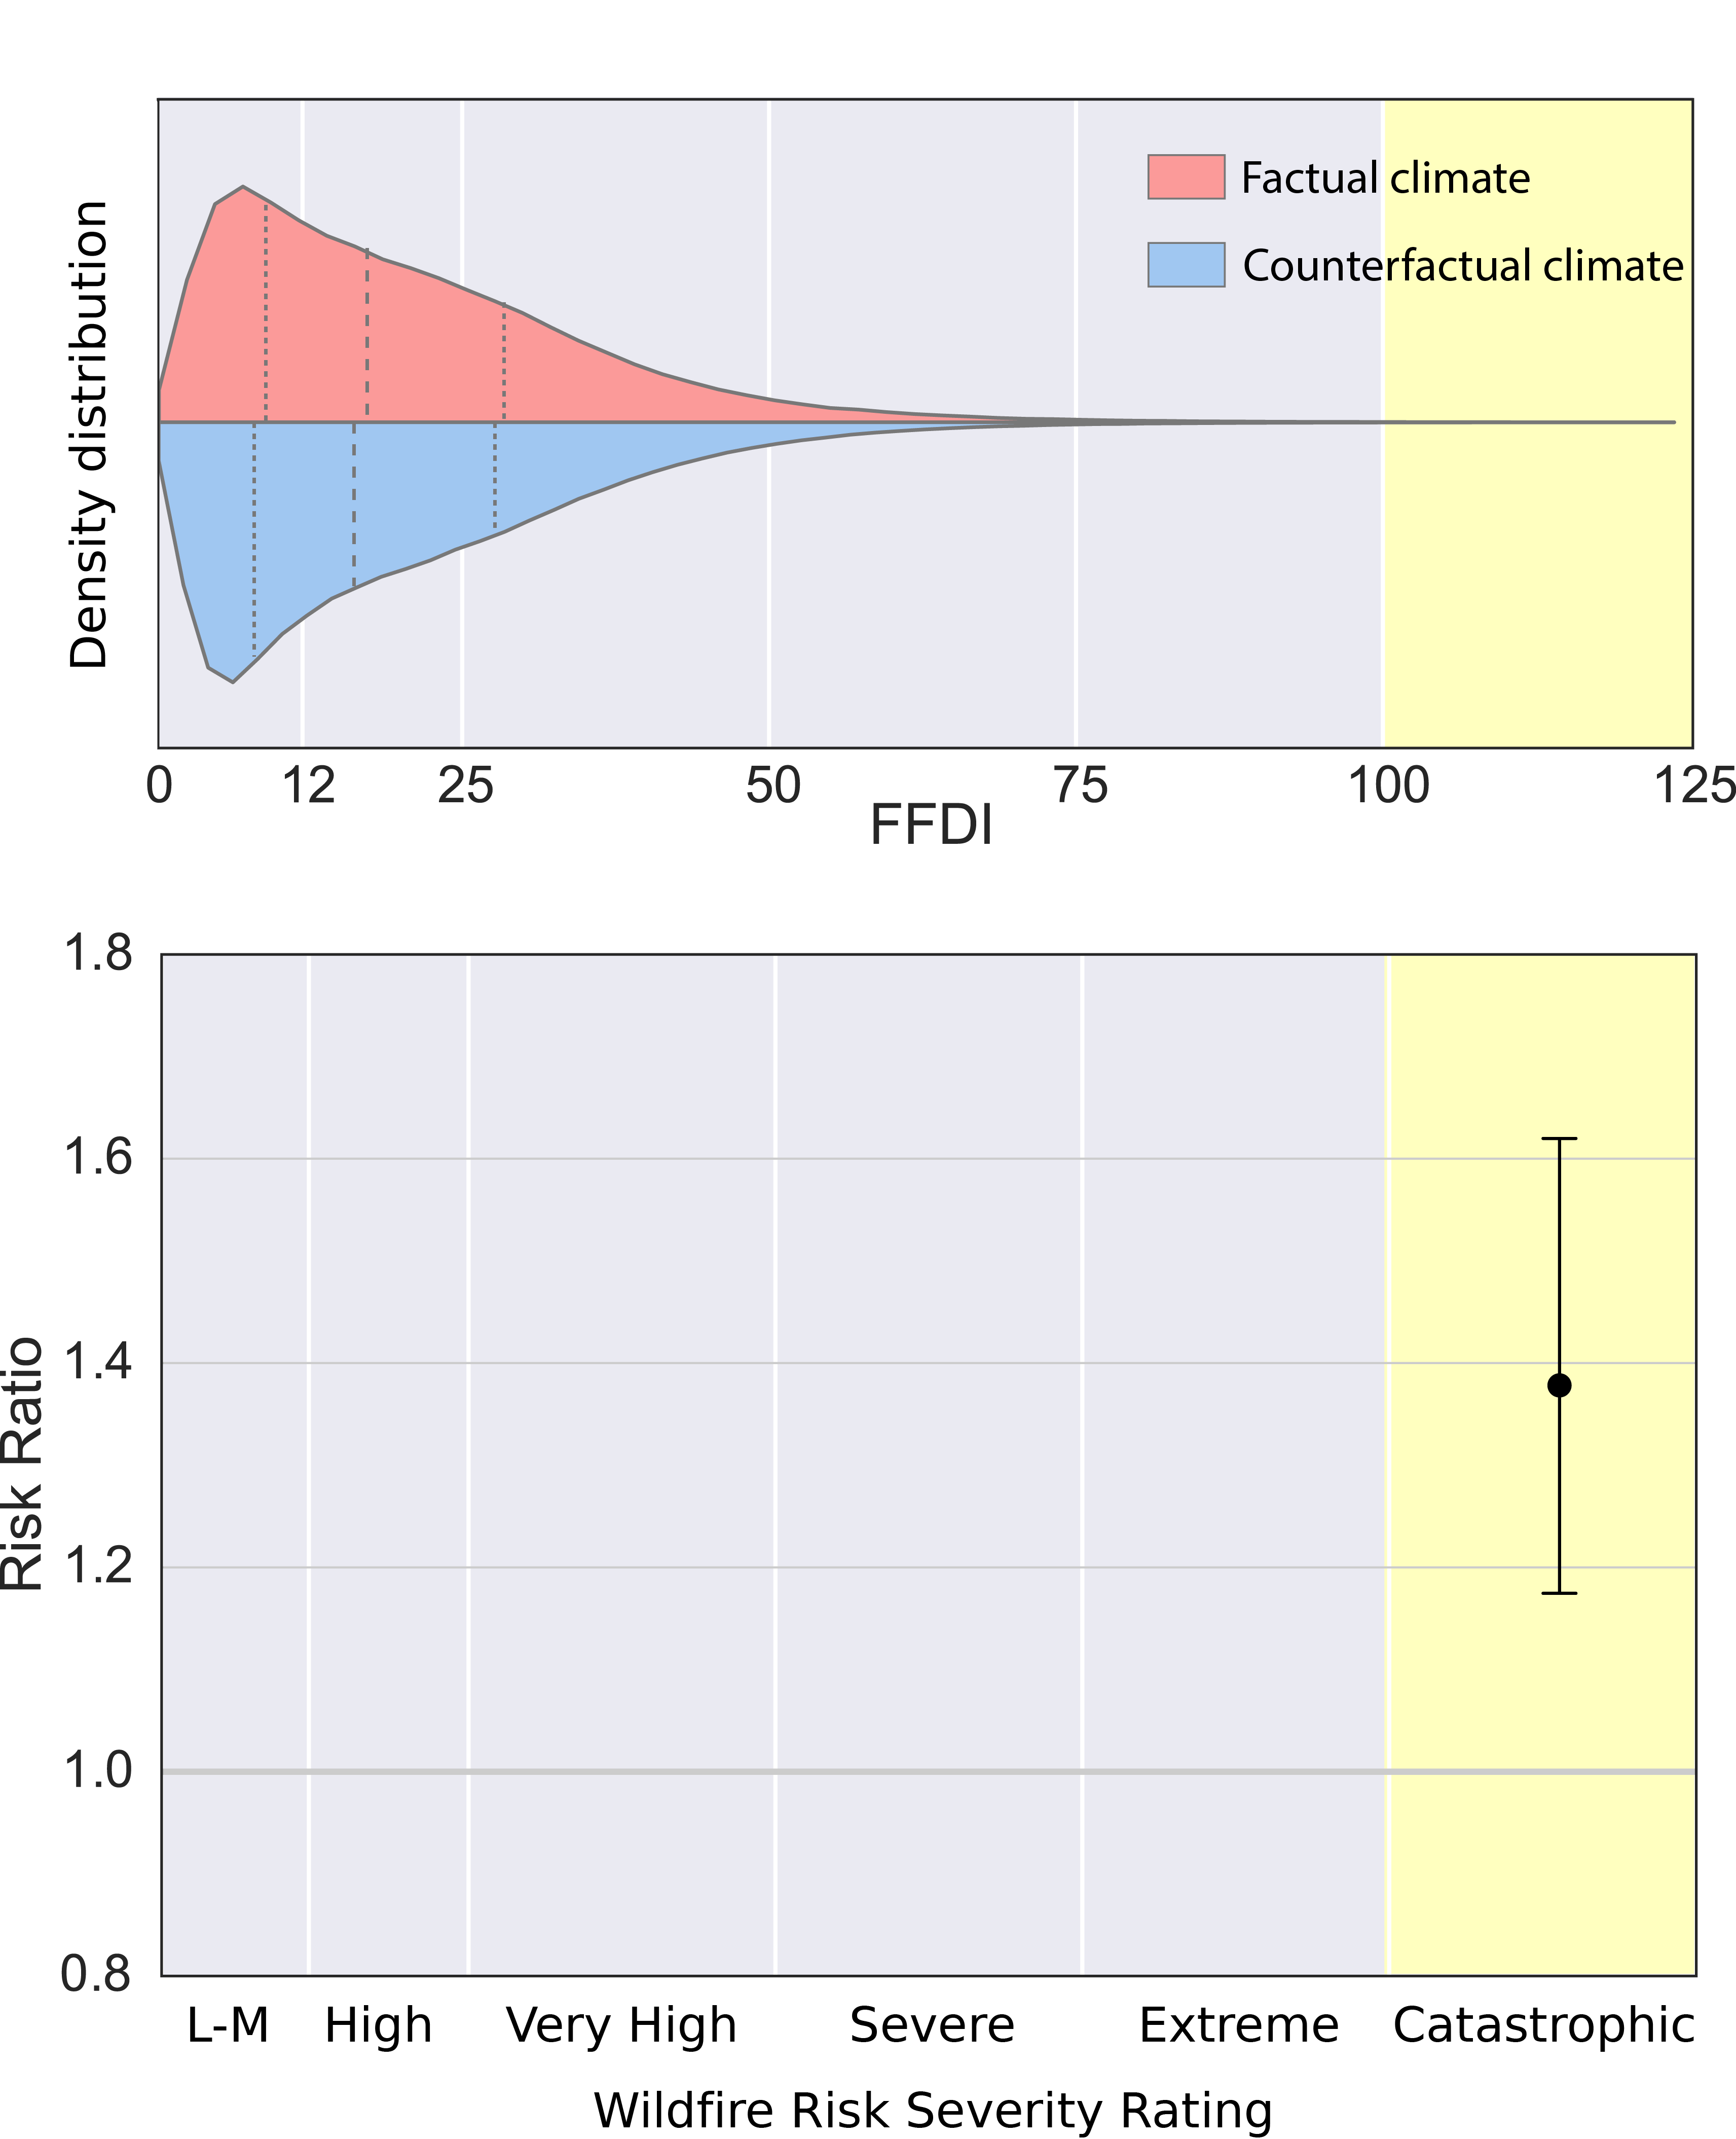
Sept. 2008 – Feb. 2009
There was at least a 17% increase in catastrophic fire weather days due to anthropogenic climate change.
+38%
+17%

Slide 18
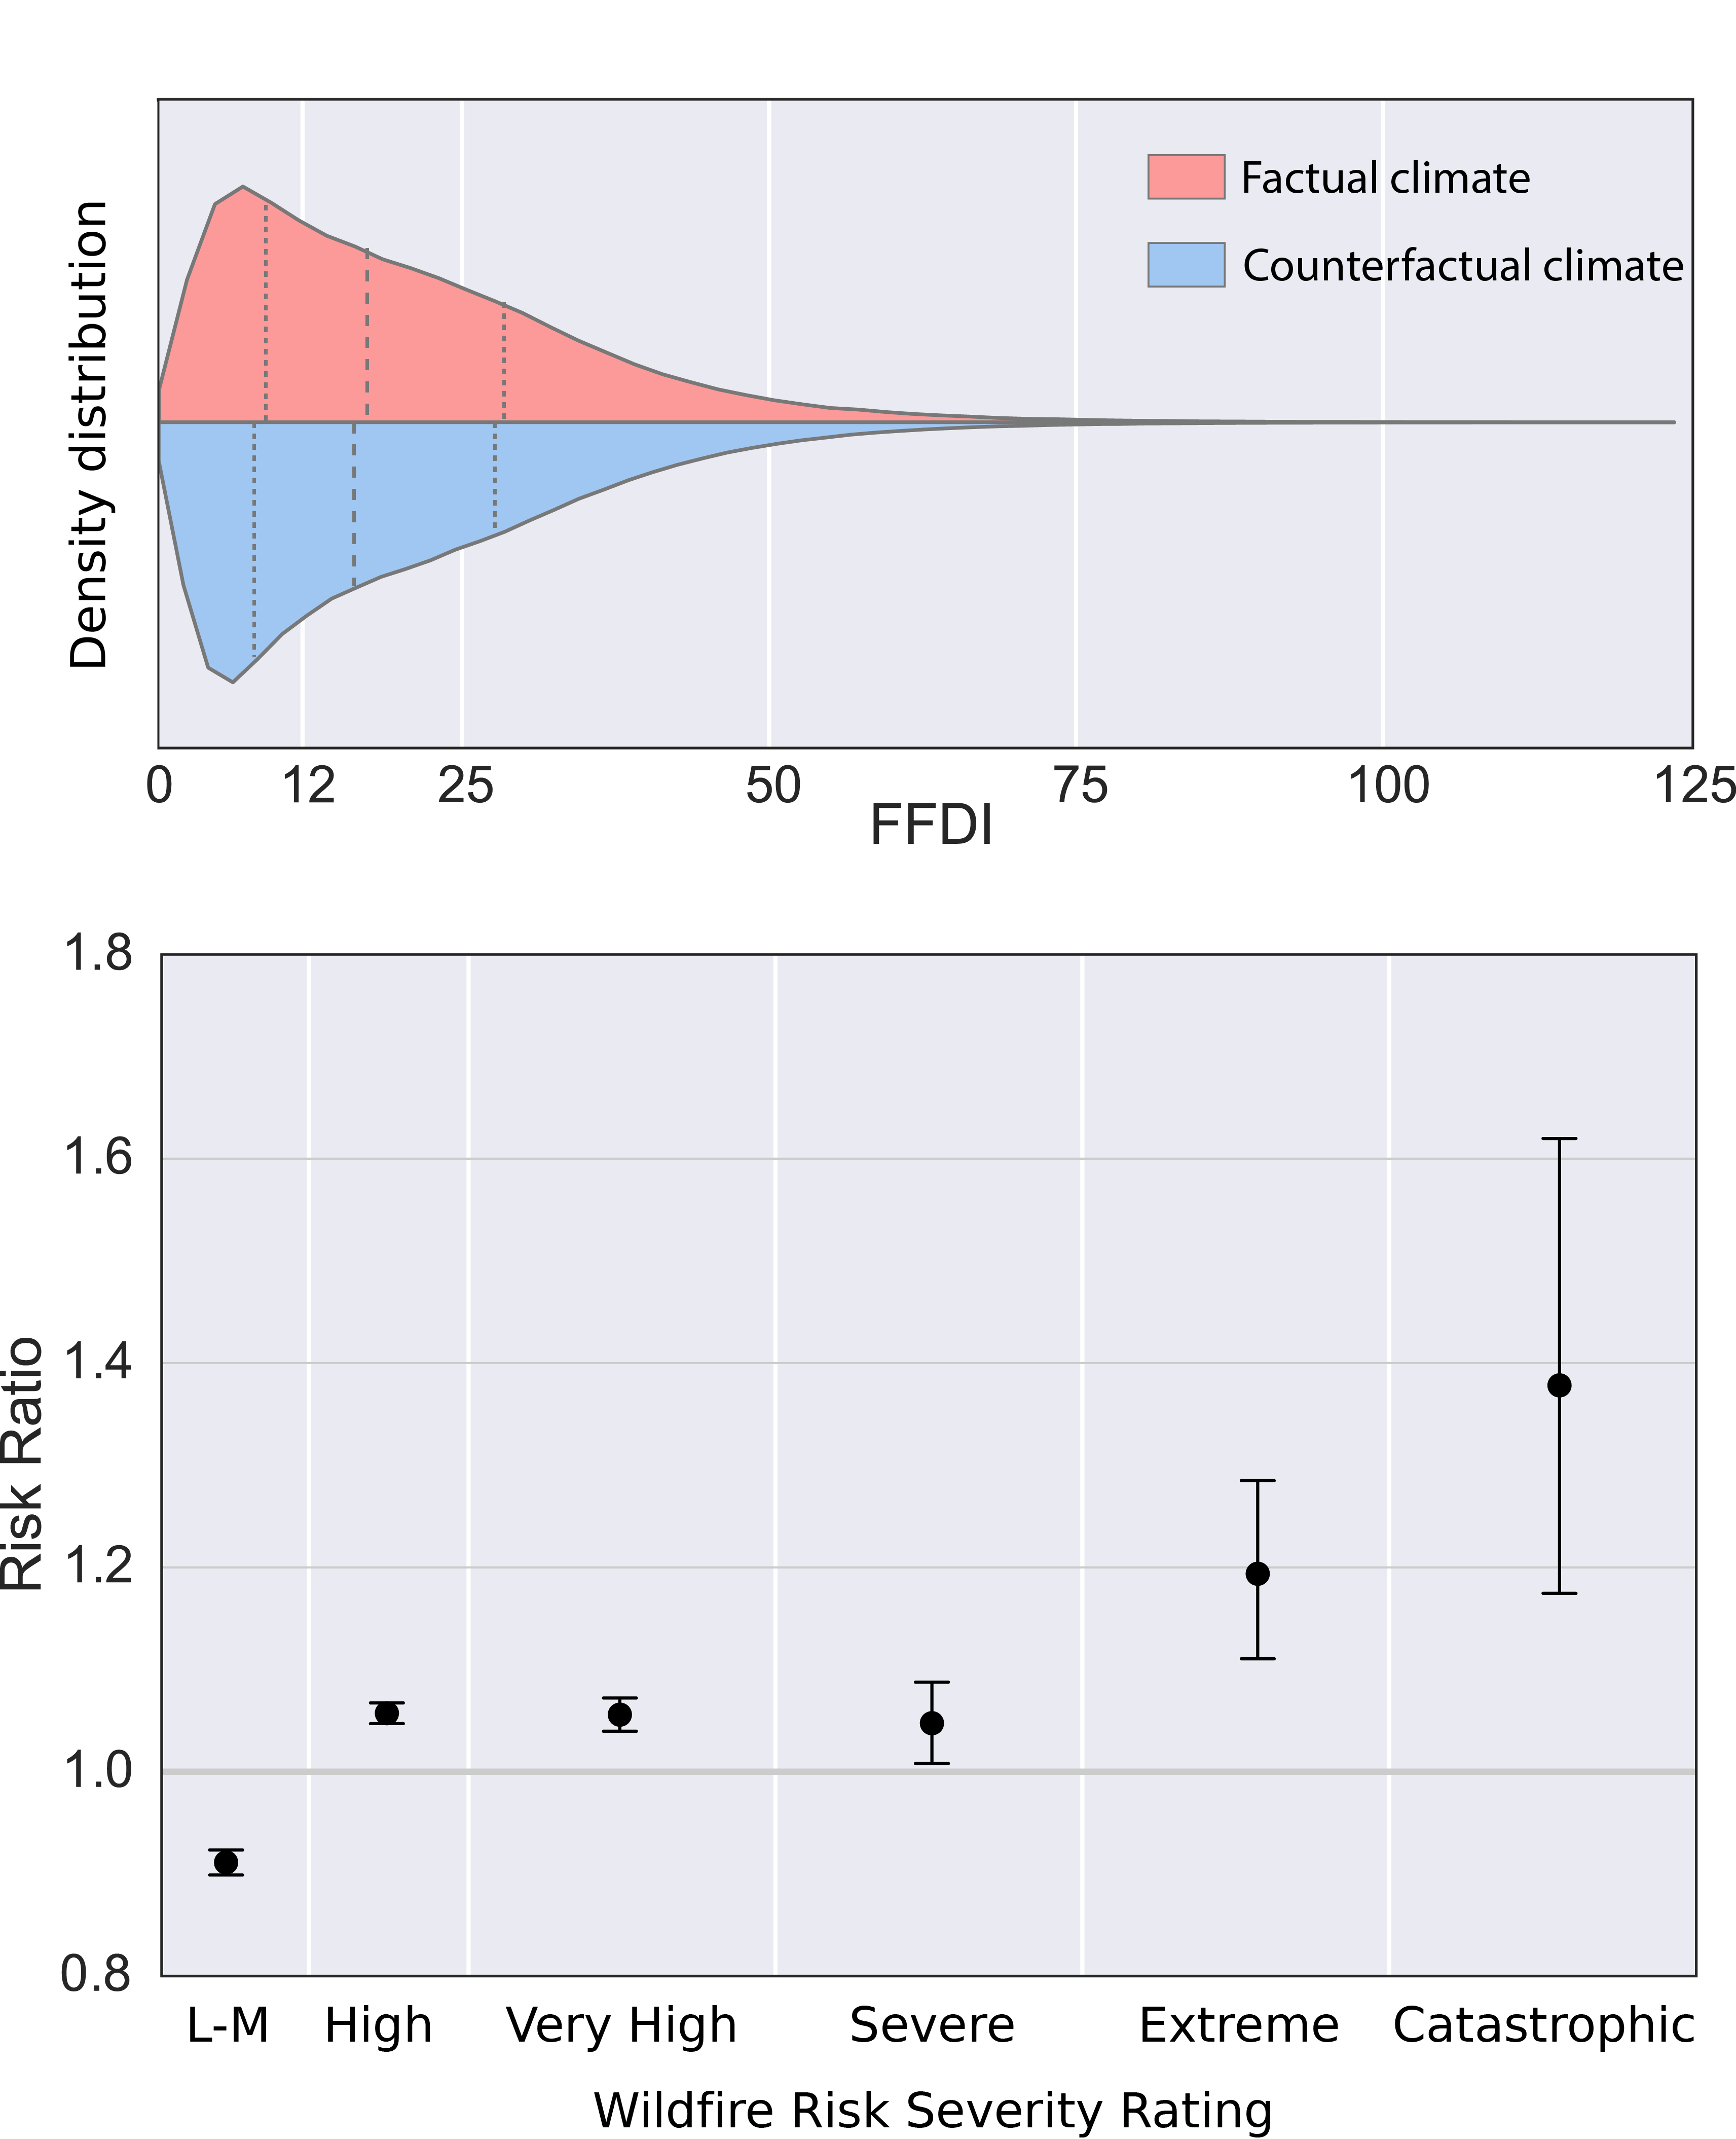
Sept. 2008 – Feb. 2009
+17%
+11%
-8%
+5%
+4%
+1%

Slide 19
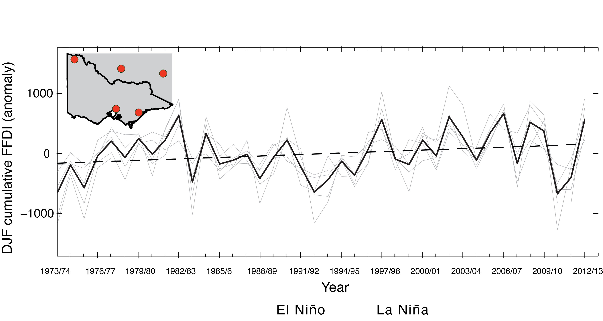
Adapted from Clarke et al. (2012)

Slide 20
Case study: SE Aus. fire weather
La Niña
El Niño
‘Industrial’ world
The world as it is
‘Pre-industrial’ world
Counterfactual world without human emissions

Slide 21
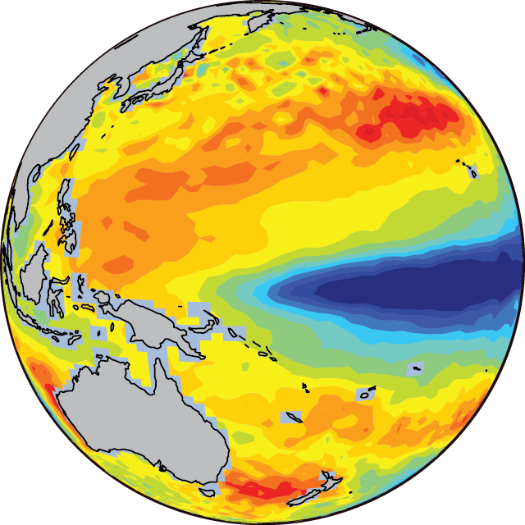
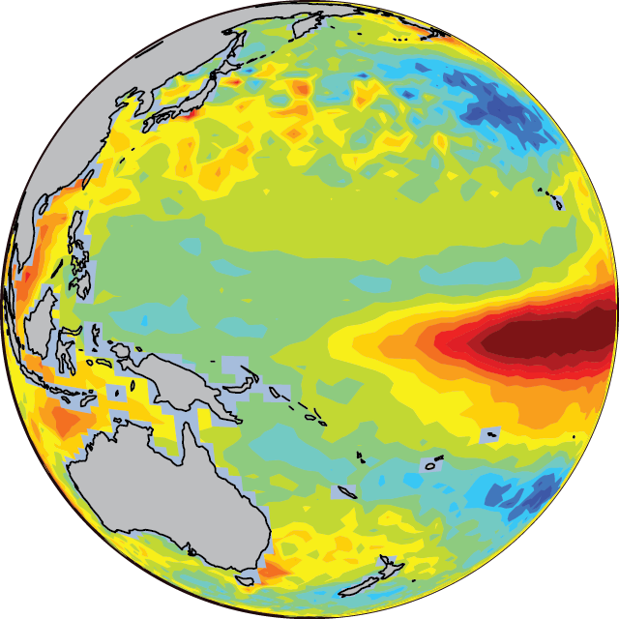
Case study: SE Aus. fire weather
La Niña
El Niño
‘Industrial’ world
The world as it is
‘Pre-industrial’ world
Counterfactual world without human emissions

Slide 22
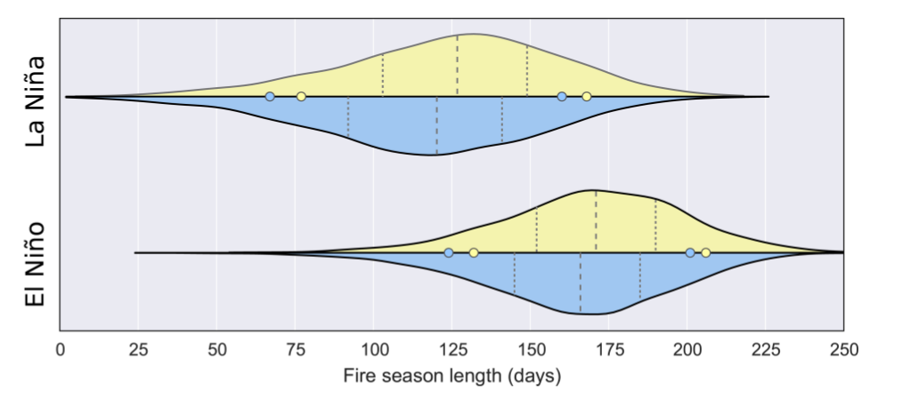
Case study: SE Aus. fire weather
Industrial climate Pre-industrial climate
On average, anthropogenic climate change lengthens the fire season by 8 days.
On average, a change in ENSO phase from La Niña to El Niño conditions lengthens the fire season by 47 days.

Slide 23
Conclusions
We have developed a citizen science climate modelling project capable of simulating extreme weather events over Australia
The Weather@Home Australia-New Zealand project was launched in 2014 and has been extremely successful.
f
This dataset has been widely used in attribution studies and is freely available to the research community
A number of studies have been completed for a range of extreme weather events, including heat waves, atmospheric blocking, rainfall and fire weather.
Black et al. (2016). The weather@home regional climate modelling project for Australia and New Zealand, Geoscientific Model Development, 9, 3161-3175.

