Slide 1


Model dependence in multi-model ensembles
Gab Abramowitz
UNSW Sydney /
ARC Centre of Excellence for Climate Extremes
Notes:
Procedural / technical talk

Slide 2
Structure
Context – what is model dependence?
Epistemic vs aleatory uncertainty
Why weighting / sub-selecting for dependence and/or performance is a calibration exercise
Towards holistic, rather than application-specific calibration

Slide 3
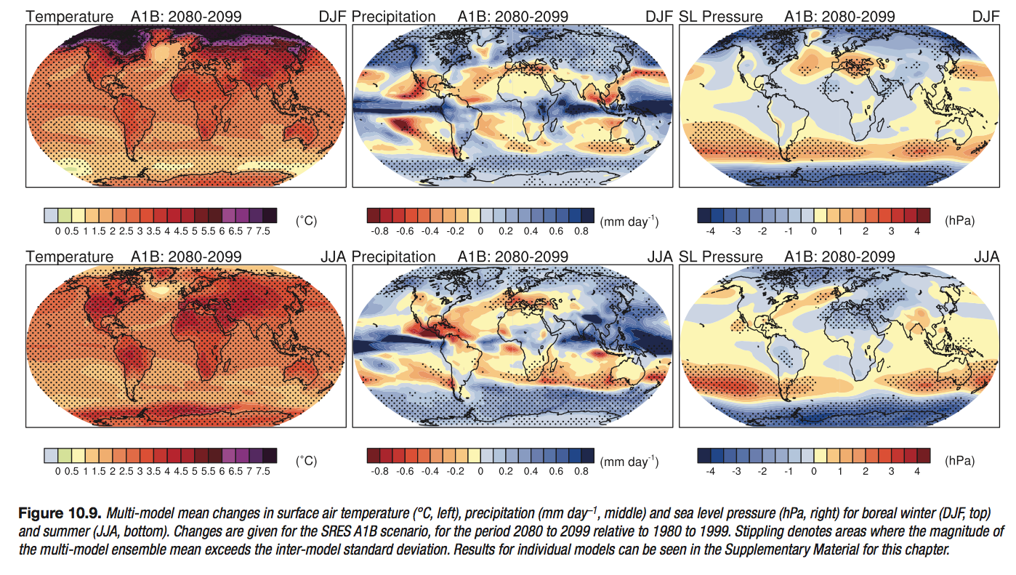
Framing dependence
Is agreement a sign of robustness?
Notes:
Can see individual model simulations

Slide 4
Framing dependence: propagating uncertainty
How can we consider uncertainty associated with the space of all possible models?
Model parameters
(time-independent)
spatially explicit surface properties
physical constants
parameters for empirically approximated processes
Model inputs
(time-varying)
carbon emission scenarios
solar radiation changes
human land use changes
Output /
prediction
MODEL
State of system in the past
Atmosphere, ocean, soil temperature
concentrations, stores e.g. CO₂ in air
momentum, vegetation distribution

Slide 5
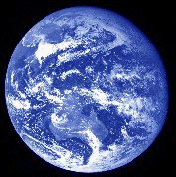
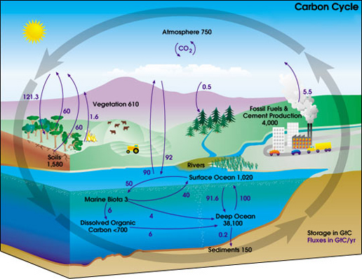

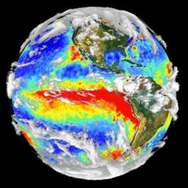
Framing dependence: choices in model development
PERCEPTUAL MODEL – identify features of the system
CONCEPTUAL MODEL – identify relationships between features/processes in the perceptual model
MATHEMATICAL/SYMBOLIC MODEL – identify equations that describe the conceptual model
NUMERICAL MODEL – codification of equation solutions, spatial and temporal aggregation choices; implementation on a computer system.

Slide 6
Framing dependence: propagating uncertainty
How can we consider uncertainty associated with the space of all possible models?
Model parameters
(time-independent)
spatially explicit surface properties
physical constants
parameters for empirically approximated processes
Model inputs
(time-varying)
carbon emission scenarios
solar radiation changes
human land use changes
Output /
prediction
MODEL
State of system in the past
Atmosphere, ocean, soil temperature
concentrations, stores e.g. CO₂ in air
momentum, vegetation distribution

Slide 7
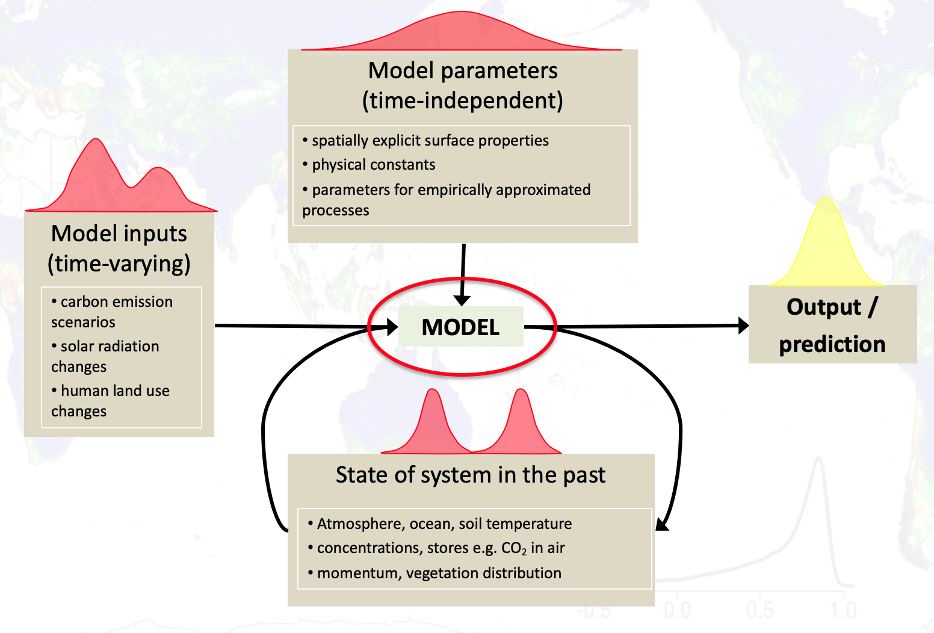
Framing dependence
How can we consider uncertainty associated with the space of all possible models?
Dependence and convergence:
  We want agreement where there is observational constraint, and diversity where there isn’t
dim(model) > dim(obs) : fundamental issue of confirmation holism
dim(climate) >> dim(model) > dim(obs) : models are gross simplifications
Two approaches to this problem
  What does the complete model space look like (spanning)
  How do we best account for dependence with the ensembles we already have (duplication)

Slide 8
Framing dependence
Modelling groups share literature, data sets, parametrisations, even model code – do different climate models constitute independent estimates of a prediction problem?
Each RCP projection in CMIP5 has a different set of contributions – are we really just comparing differences between RCPs?
There are many ways to define dependence
  ‘a priori’ approach: Different research group => independence? Model structure/shared parametrisation (evolutionary cladistics)
  ‘a posteriori’: effect of dependence on ensemble performance (Linnaean taxonomy) – more like what we care about
  Hilltop estimation analogy of mean estimate
x
x
independence
performance
Notes:
Based on error covariance

Slide 9
Structure
Context – what is model dependence?
Epistemic vs aleatory uncertainty
Why weighting / sub-selecting for dependence and/or performance is a calibration exercise
Towards holistic, rather than application-specific calibration

Slide 10
Dividing multi-model ensemble spread in two: epistemic and aleatory uncertainty
Epistemic: uncertainty in our ability to model the system, a property of us, that we might hope to transcend as we learn more
  Potentially predictable, uncertainty that could possibly be resolved
  Ensemble spread that can be attributed to differences in models
Aleatory: either:
  Uncertainty in the system itself (i.e. perfect measurement), or
  Uncertainty in the system itself, given the amount of information we have (e.g. observations of initial conditions states, at a particular spatial and temporal resolution)
  Distinction between the two is theoretical, practically it makes no difference
  “internal variability”, any evaluation that involves time series, or shorter term averages
  Ensemble spread that is irreducible, fundamentally unpredictable
We can consider dependence in estimates of either of these

Slide 11
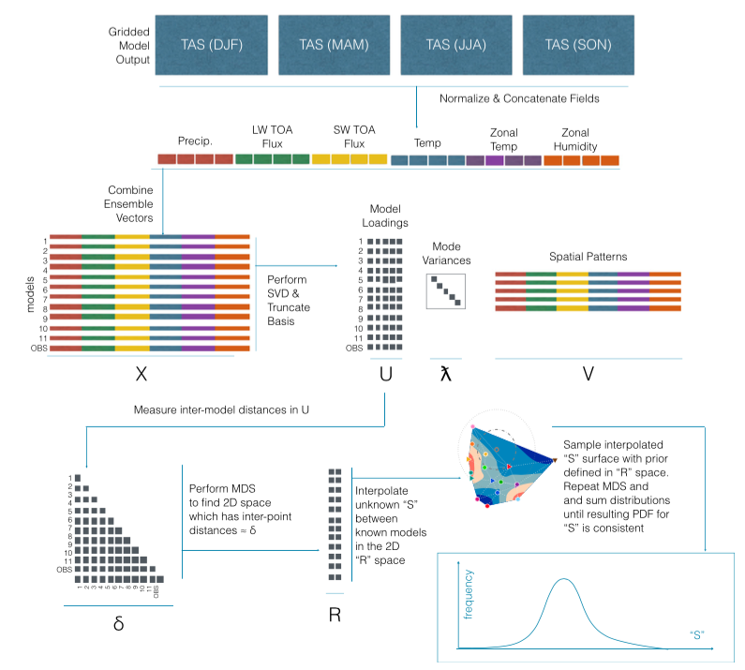
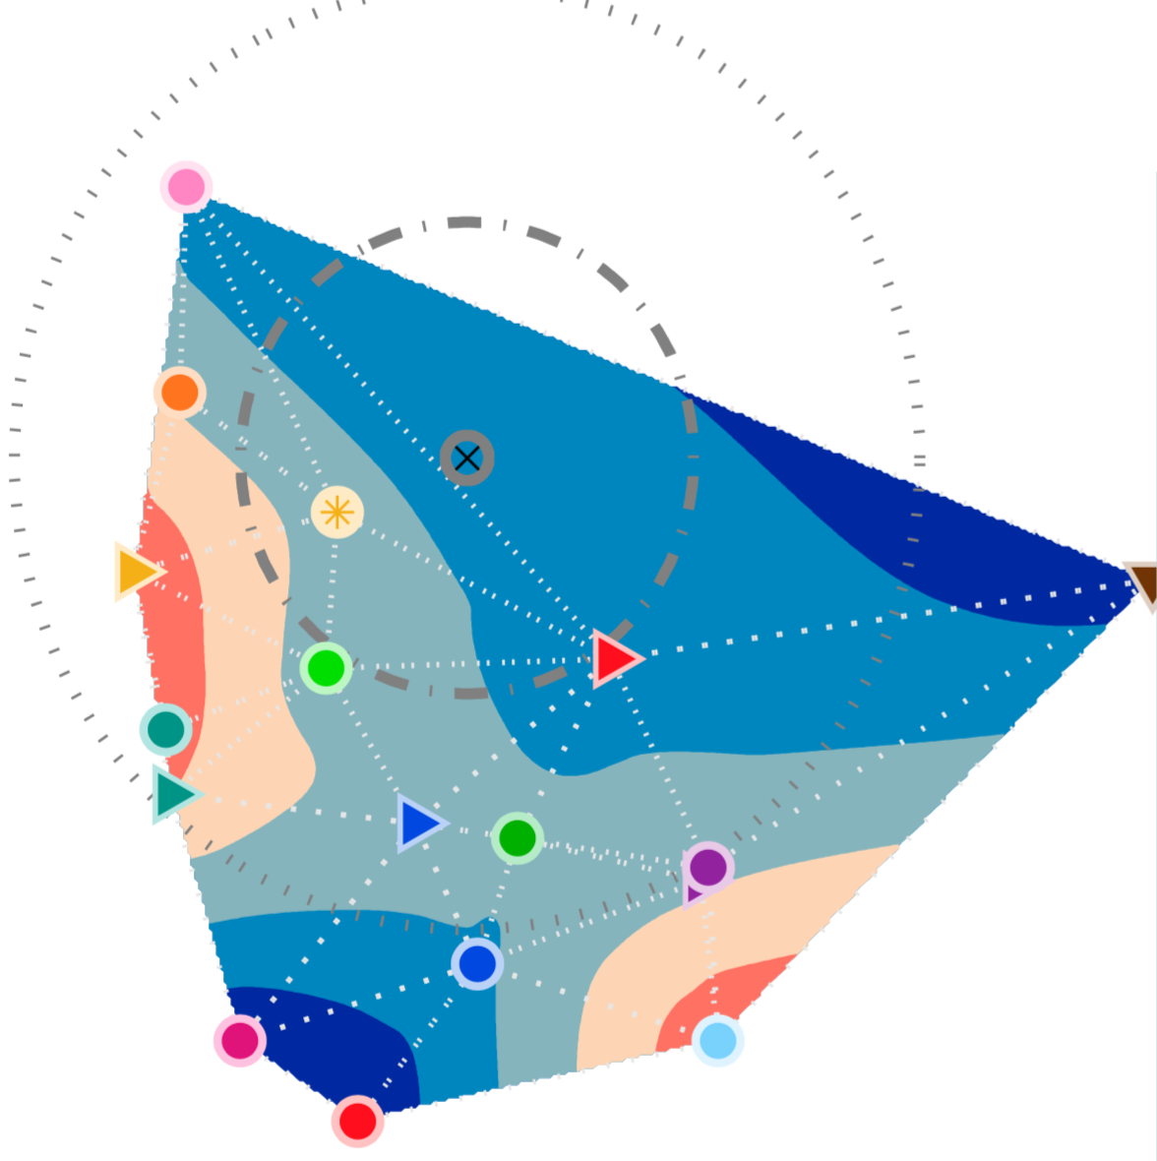

Dividing multi-model ensemble spread in two: epistemic and aleatory uncertainty
Sanderson et al (2015a,2015b) dealt with epistemic uncertainty:
dependence in climatology biases (assumes no aleatory uncertainty)
integrative metric (variables grouped together)
Model distances projected to 2D space
Weights intended to discount effect of model clustering

Slide 12
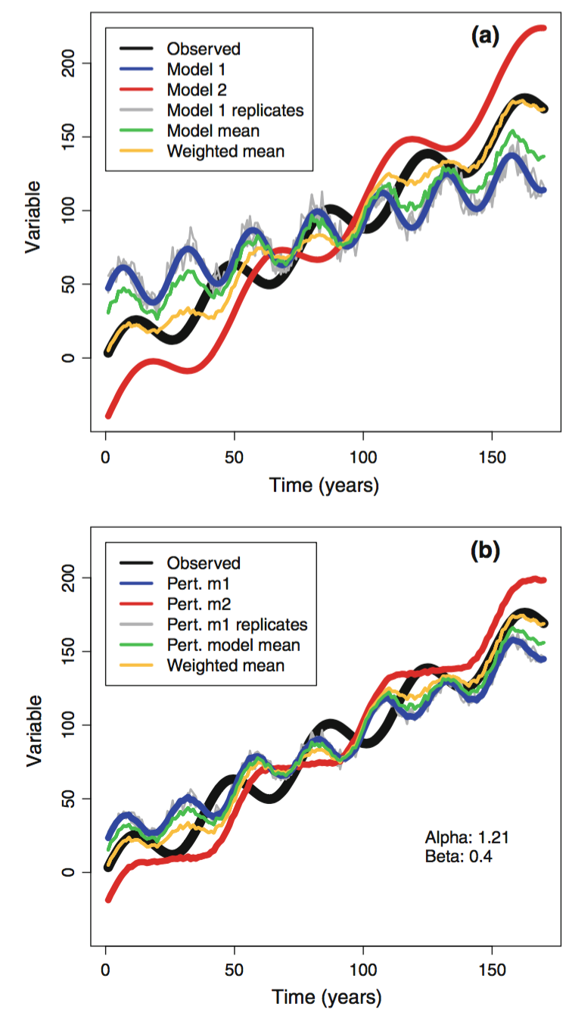
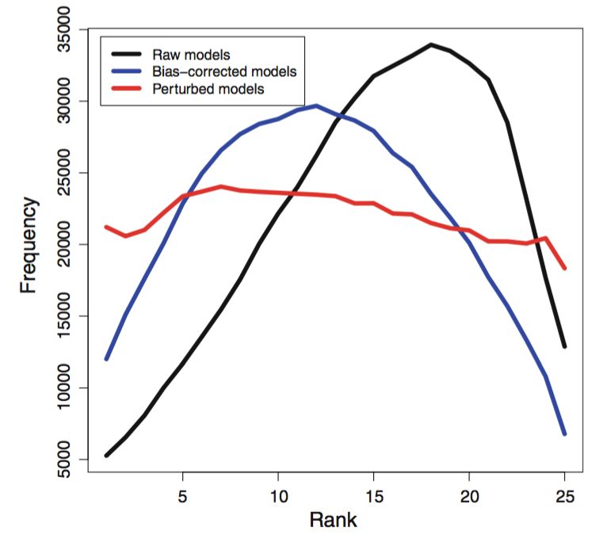
Dividing multi-model ensemble spread in two: epistemic and aleatory uncertainty
Bishop & Abramowitz (2013) / Abramowitz & Bishop (2015) primarily dealt with aleatory uncertainty
Attempted to calibrate ensemble to represent irreducible system uncertainty only
Estimate forced climate signal and statistical properties of internal variability (without using I/C ensembles)
Rescale CMIP ensemble about the forced climate signal estimate to replicate this internal variability estimate

Slide 13
Structure
Context – what is model dependence?
Epistemic vs aleatory uncertainty
Why weighting / sub-selecting for dependence and/or performance is a calibration exercise
Towards holistic, rather than application-specific calibration

Slide 14
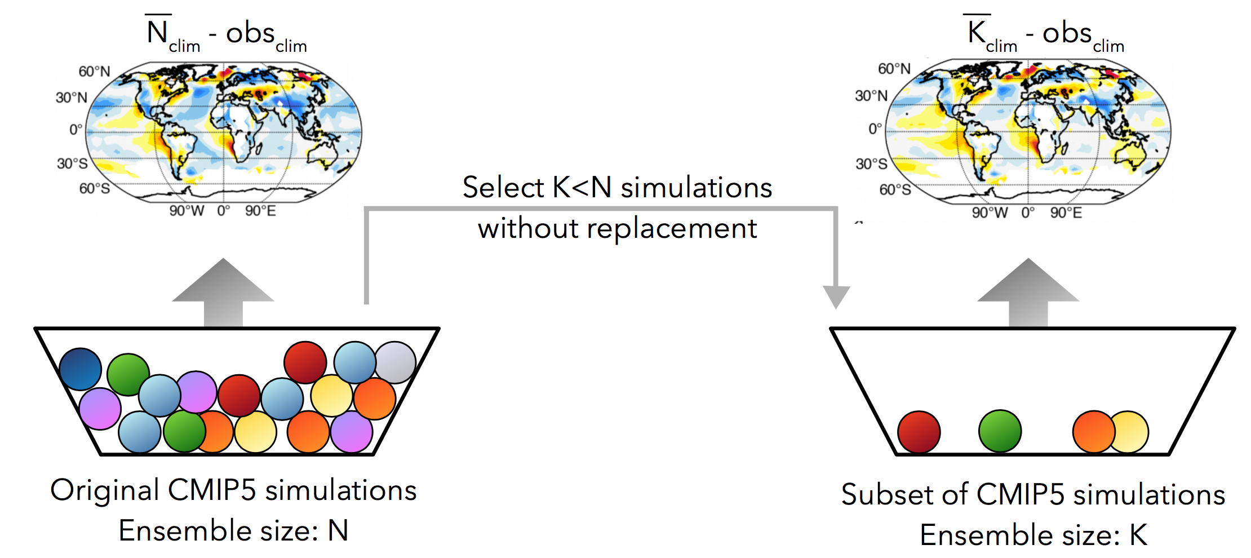
Ensemble sub-sampling to account for dependence
Three ensemble sub sampling approaches:
Random sampling of K simulations from a pool of N (100 times)
Choose the best performing K simulations (in terms of climatology)
Choose the K simulations whose mean has minimum RMSE in climatology against obs – account for dependence in regional biases

Slide 15
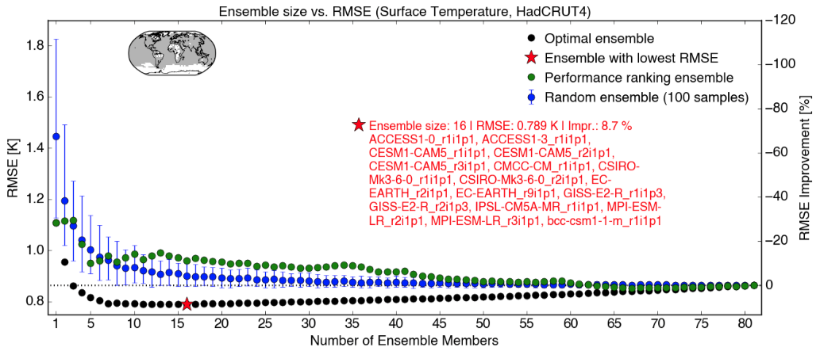
Ensemble size vs RMSE
Choosing the optimal ensemble is non-trivial – choosing K=40 (of N=81) means there are 212,392,290,424,395,860,814,420 possible ensembles
Herger et al, 2018a
Choosing the best performing models does not imply the best performing ensemble mean – dependence degrades the mean

Slide 16
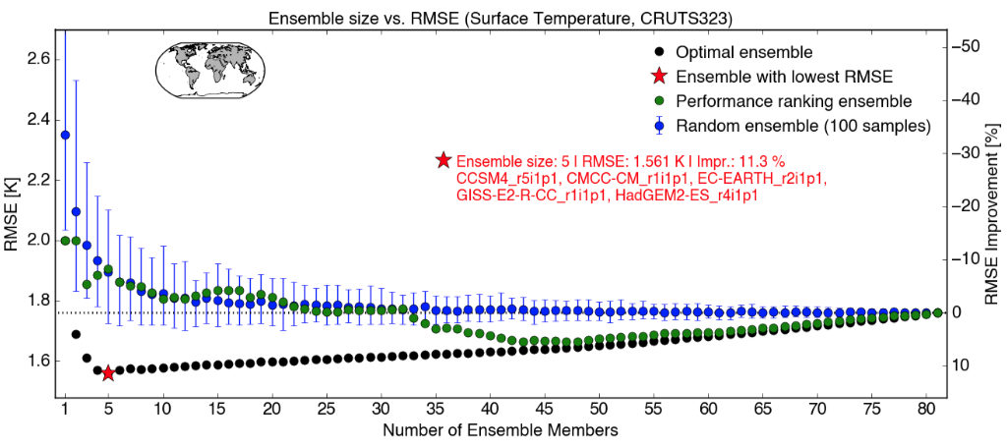
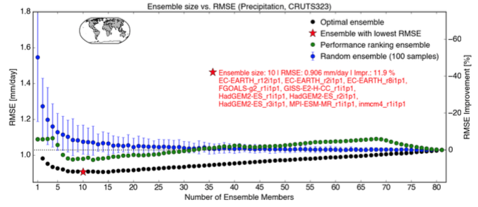
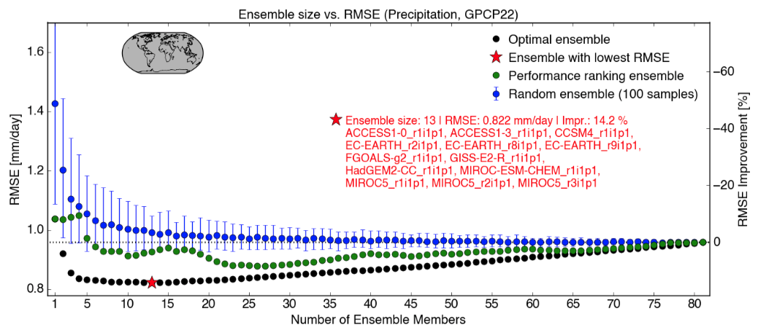
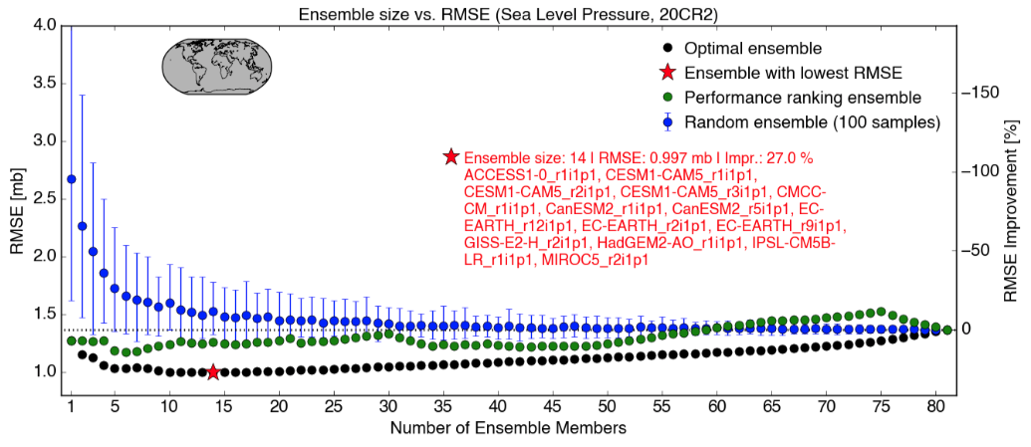
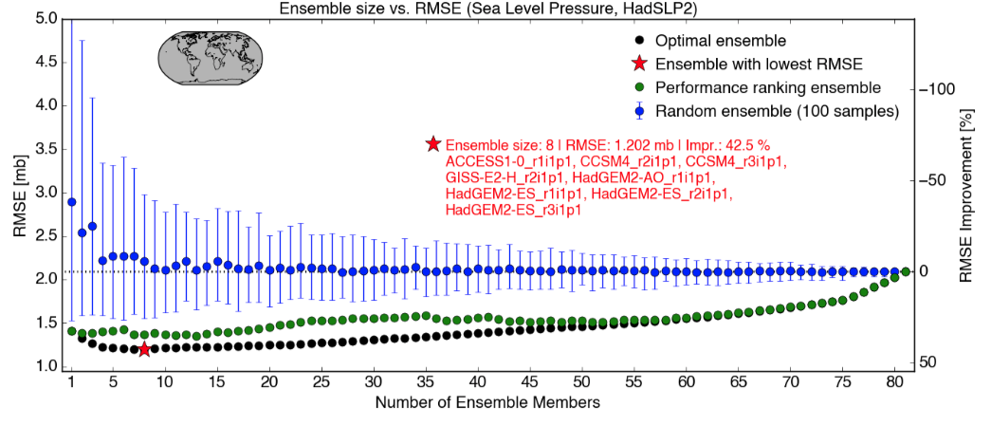
Results differ across variables and obs products
Herger et al, 2018a

Slide 17
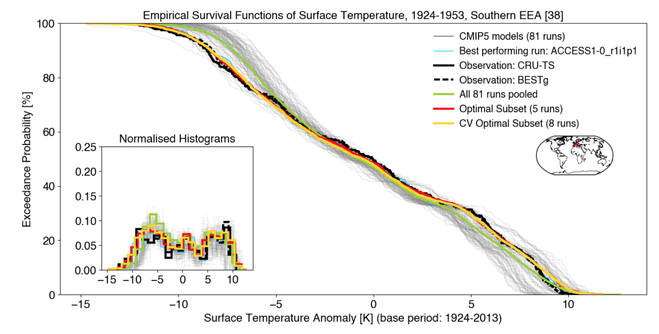
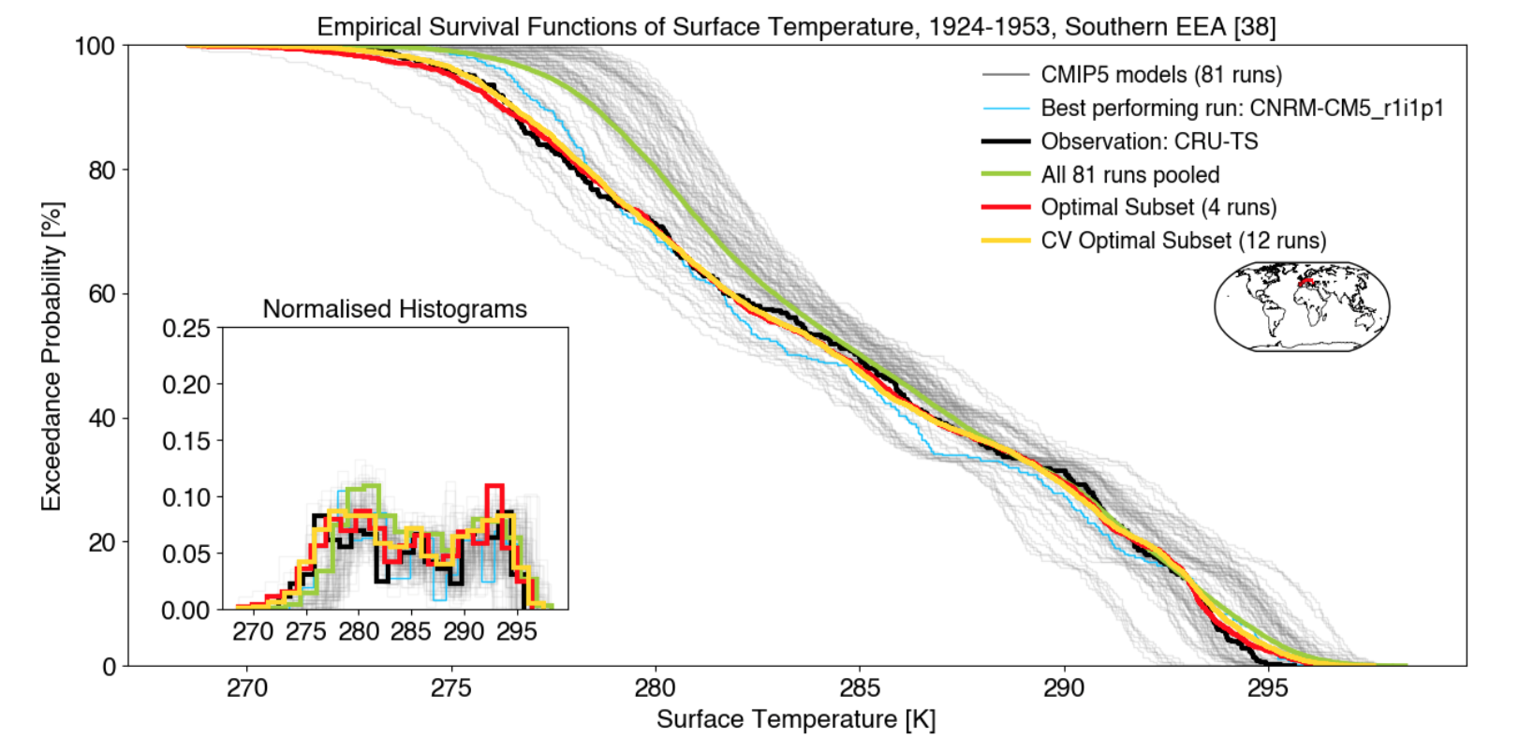
Results differ across different metrics and regions
This optimisation approach can be applied to a range of definitions of dependence by adjusting the cost function used in the optimisation
Select ensemble subset that minimises K-S test
With or without prior bias correction
Results vary markedly by region
Herger et al, 2018b

Slide 18
Structure
Context – what is model dependence?
Epistemic vs aleatory uncertainty
Why weighting / sub-selecting for dependence and/or performance is a calibration exercise
Towards holistic, rather than application-specific calibration

Slide 19
Should calibration be application-specific or holistic?
Optimal weights / ensemble selection are specific to time period, climatology vs time varying, time step size, resolution, region, metric, variable, data set
  i.e. specific to each application
In most cases, this calibration process is robust when tested out of sample
  Cal/val on different time periods, model-as-truth / perfect model experiments
  Dependence exists and can be accounted for
Is application-specific calibration satisfactory?
Status quo - should we just use the whole ensemble? Isn’t an entirely uncalibrated ensemble underutilising the information we have?
How would we implement universal/holistic calibration for model dependence for a given ensemble?

Slide 20
Towards holistic calibration - is a single integrated cost function the best solution?
E.g. should we find weights, or choose sub-ensemble that optimises:
mean(ta_{obs1}) & cor(ta_{obs1}) & sd(ta_{obs1}) & Kstest(ta_{obs1}) &
mean(ta_{obs2}) & cor(ta_{obs2}) & sd(ta_{obs2}) & Kstest(ta_{obs2}) &
mean(pr_{obs1}) & cor(pr_{obs1}) & sd(pr_{obs1}) & Kstest(pr_{obs1}) &
mean(pr_{obs2}) & cor(pr_{obs2}) & sd(pr_{obs2}) & Kstest(pr_{obs2}) &
….... (with normalising weights)....
Weights non-commensurable variables & metrics against each other

Slide 21
Towards holistic calibration - is a single integrated cost function the best solution?
**Does not fairly represent the uncertainty involved**
All of CMIP
Spread of monthly precip optimal ensemble
Spread of KS-test precip distribution optimal ensemble,
Obs 2
Spread of RMSE pressure daily time series optimal ensemble
Spread of KS-test precip distribution optimal ensemble,
Obs 1
Spread of integrated cost function optimal ensemble
Spread of 99% temperature extremes optimal ensemble

Slide 22
Towards holistic calibration – why an integrative cost function is a bad idea
All of CMIP
Spread of monthly precip optimal ensemble
Spread of KS-test precip distribution optimal ensemble,
Obs 2
Spread of RMSE pressure daily time series optimal ensemble
Spread of KS-test precip distribution optimal ensemble,
Obs 1
Spread of integrated cost function optimal ensemble
Spread of 99% temperature extremes optimal ensemble

Slide 23
Towards holistic calibration – why an integrative cost function seems like a bad idea
The discrepancy between solutions that are optimal for different variables, metrics, obs products etc, is meaningful!
If our ensemble (say CMIP) were perfectly calibrated, each of these optimisations would give the same result – the optimal ensemble
Conservation of crap : dim(world) >> dim(model) > dim(obs)
The inability of our ensemble to deliver this is an indication of its inability to cover the degrees of freedom needed to simultaneously answer the problems that were interested in
We could attempt to measure the discrepancy

Slide 24
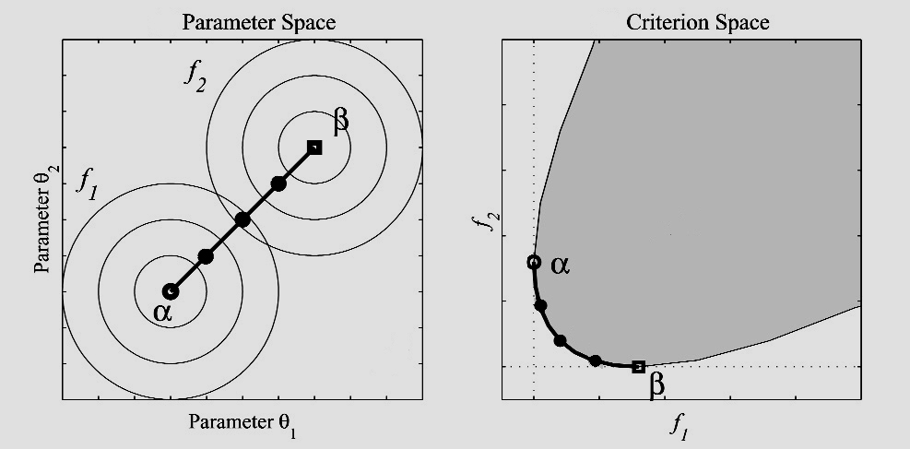
Towards holistic calibration – a better idea
A Pareto set – an ensemble of ensembles – seems a better approach?
Ensemble sub-selection
or weight space

Slide 25
Towards holistic calibration – why an integrative cost function is a bad idea
All of CMIP
Spread of monthly precip optimal ensemble
Spread of KS-test precip distribution optimal ensemble,
Obs 2
Spread of RMSE pressure daily time series optimal ensemble
Spread of KS-test precip distribution optimal ensemble,
Obs 1
Spread of Pareto set
Spread of integrated cost function optimal ensemble
Spread of 99% temperature extremes optimal ensemble

Slide 26
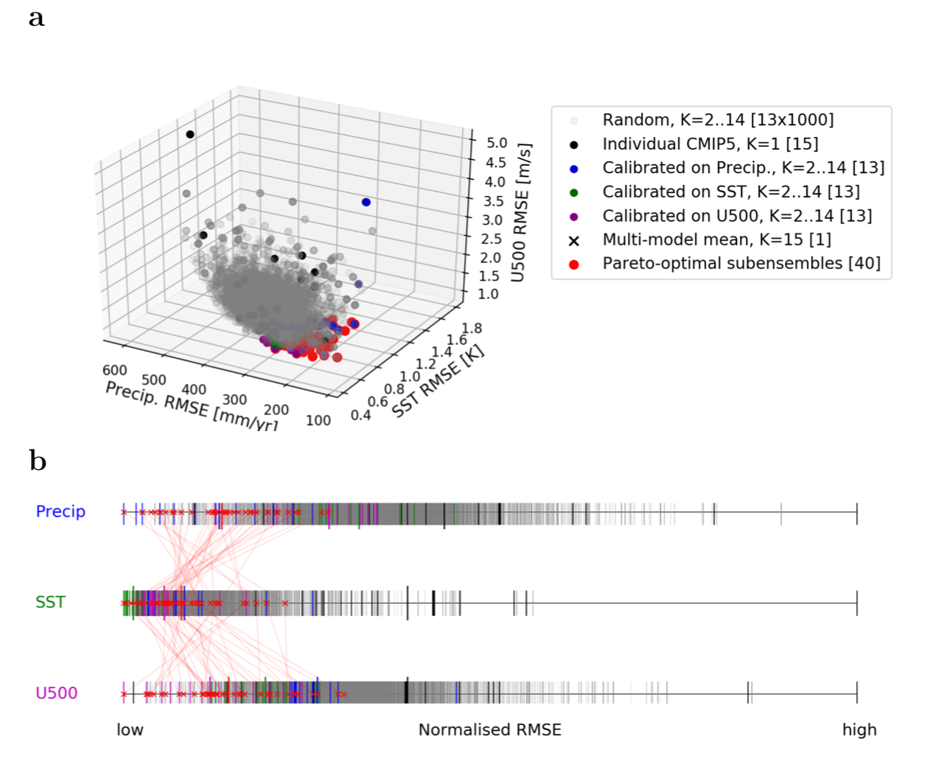
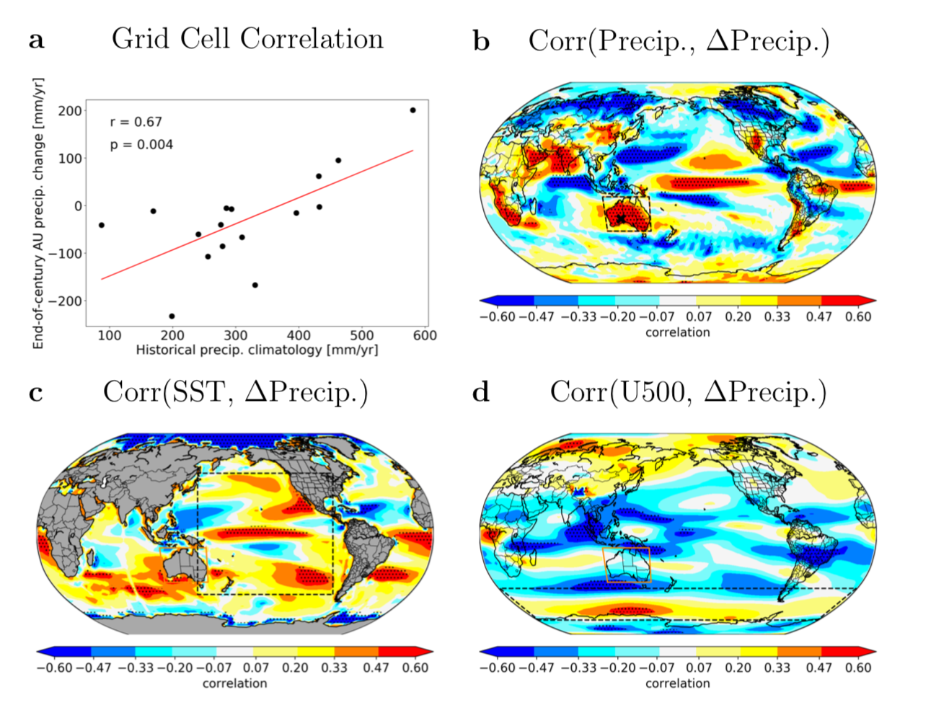
Towards holistic calibration – Pareto optimality
Herger, N, G Abramowitz, S Sherwood, R Knutti, O Angelil, S Sisson (2018c) Constraining future precipitation change over Australia using Pareto-optimal estimates, in review, Climate Dynamics.

Slide 27
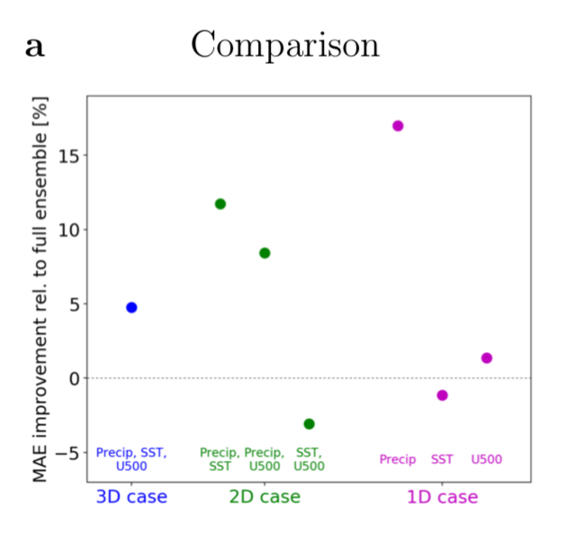
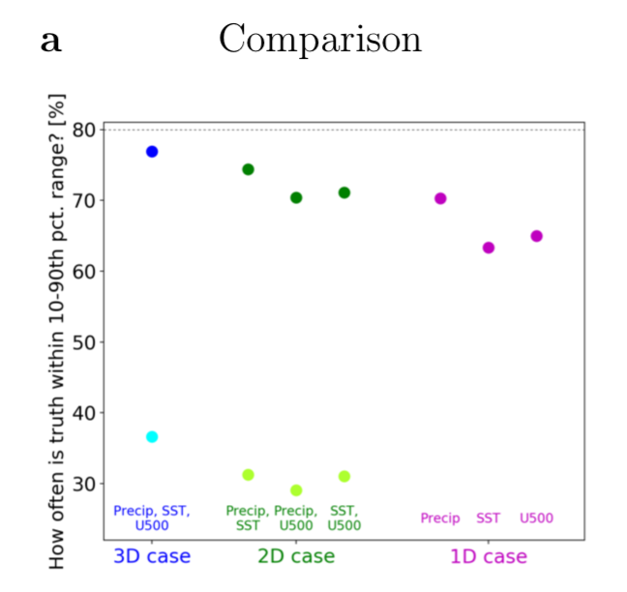
Towards holistic calibration – Pareto optimality
Herger, N, G Abramowitz, S Sherwood, R Knutti, O Angelil, S Sisson (2018c) Constraining future precipitation change over Australia using Pareto-optimal estimates, in review, Climate Dynamics.

Slide 28
Conclusions
Dependence matters
  Choosing the best performing models (or weighting for performance) can be counter-productive if dependence is not considered
Weighting or sub-selecting ensemble members for independence / performance is essentially a calibration exercise
If we are interested in a best estimate of a single projection property / quantity then calibrating for it likely to improve estimates
  Several techniques are available, each appropriate for different applications
  Needs to be tested out of sample, in a way commensurate with the application
  BUT uncertainty estimates suffer
If we want/need a holistic accounting for model dependence with more meaningful uncertainty estimates, an ensemble of ensembles (Pareto set) is likely a more defensible approach than combining cost functions

Slide 29
References
Review paper:
Abramowitz, G., Herger, N., Gutmann, E., Hammerling, D., Knutti, R., Leduc, M., Lorenz, R., Pincus, R., and Schmidt, G. A.: Model dependence in multi-model climate ensembles: weighting, sub-selection and out-of-sample testing, Earth System Dynamics Discussions, https://doi.org/10.5194/esd-2018-51, in review, 2018.
Abramowitz, G. and Bishop, C. H. (2015) Climate model dependence and the ensemble dependence transformation of CMIP projections’, J. Climate, vol. 28, pp. 2332 - 2348, http://dx.doi.org/10.1175/JCLI-D-14-00364.1
Bishop, C. H. and Abramowitz, G. (2013) Climate model dependence and the replicate Earth paradigm, Clim. Dyn., 41(3-4), 885–900, doi:10.1007/s00382-012-1610-y.
Herger, N., Abramowitz, G., Knutti, R., Angélil, O., Lehmann, K., and Sanderson, B. M. (2018a) Selecting a climate model subset to optimise key ensemble properties, Earth Syst. Dynam., 9, 135-151, https://doi.org/10.5194/esd-9-135-2018.
Herger, N., Angélil, O., Abramowitz, G., Donat, M., Stone, D., & Lehmann, K. (2018b). Calibrating climate model ensembles for assessing extremes in a changing climate. Journal of Geophysical Research: Atmospheres, 123, 5988–6004. https://doi.org/10.1029/2018JD028549
Herger, N., Abramowitz, G., Sherwood, S., Knutti, R., Angélil, O., Sisson, S. (2018c). Constraining future precipitation change over Australia using Pareto-optimal estimates, Climate Dynamics, in review.
Lenhard, J. and E. Winsberg (2010), Holism, entrenchment, and the future of climate model pluralism, Studies in History and Philosophy of Modern Physics, 41, 253–262.
Sanderson, B. M., Knutti, R., and Caldwell, P. (2015a) Addressing interdependency in a multimodel ensemble by interpolation of model properties, J. Climate, 28, 5150–5170, doi:10.1175/JCLI-D-14-00361.1.
Sanderson, B. M., Knutti, R., and Caldwell, P. (2015b) A representative democracy to reduce interdependency in a multimodel ensemble, J. Climate, 28(13), 5171–5194, doi:10.1175/JCLI-D-14-00362.1.

