Slide 1
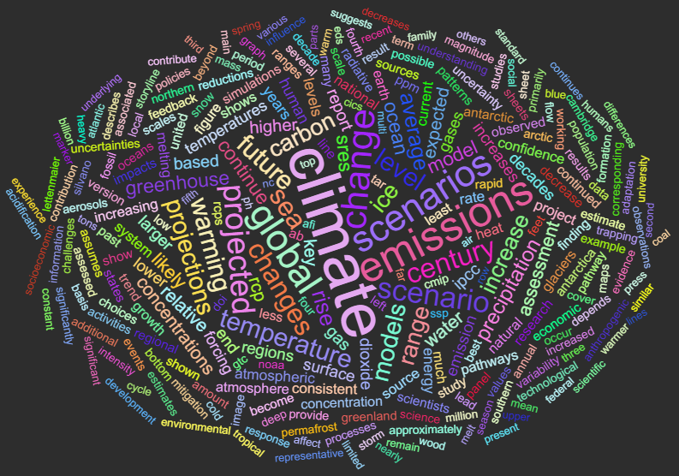
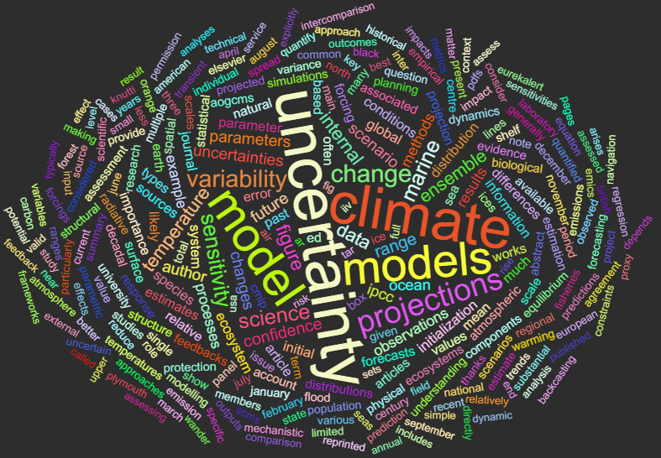
Objective method for building a reduced ensemble for climate change projections
Dr Aurel Moise¹, Dr Clementine Dalelane²
¹Bureau of Meteorology Research Section, Melbourne, Australia
²Deutscher Wetterdienst (DWD), Germany
Bureau Annual Workshop – November 2018

Slide 2
Overview
Ensembles of climate projections
Concept of probability in climate projections
Redundancy in ensembles of opportunity
Adjustment of redundancy → reduced ensemble
Ensemble reduction - procedure
Examples: regional projections Germany

Slide 3
Ensembles of climate projections
Ensembles of climate projections
Climate projections are uncertain
  Future GHG emissions, modelling errors, natural variation
Multi model ensembles of climate projections to assess climate change and its impacts
A lot of models! confine to essential information
Statistical ensemble measures are physically inconsistent not apt for impact modelling
What is the essential information of an ensemble?
Distribution within the ensemble = Probability of climate change?

Slide 4
Concept of probability in climate projections
“Probability” in climate projections?
Distribution of climate model output is biased by arbitrary selection of models
→ not informative about climate change
  Ensembles of opportunity
  Production of projections depends on economic, technical ect. factors
  Scientific criteria for ensemble composition are of secondary importance
Climate projections are not associated to probability
(for example, see Parker 2013)
Quantification of uncertainty not (yet) possible
Clusters within the ensemble are not essential information

Slide 5
Redundancy in ensembles of opportunity
Redundancy in ensembles of opportunity
Clusters are generated by similarities between models (Knutti et al. 2013)
Common code, components, parametrization, forcing, observation data sets for calibration
    Similar climate change signals, similar errors!
Ensembles of opportunity are highly redundant → Overconfidence (apparent robustness), little gain of information, more work
A redundancy-adjusted ensemble shows the spread of changes, which are plausible from today’s knowledge → essential information

Slide 6
Adjustment of redundancy → reduced ensemble
Selection of dissimilar projections, i.e. small ensemble with large spread of climate signals → little loss of information, increased robustness, less work
Sanderson et al. (2015): Independent Ensemble Quality Score (IEQS)
    Selection of projections with high independence and low bias
Following: C. Dalelane, B. Früh, C. Steger, and A. Walter (2018) A pragmatic approach to build a reduced regional climate projection ensemble for Germany using the EURO-CORDEX 8.5 ensemble, J Appl Met and Climat, 57(3), 477-491.
Analysis is underway to apply this to Australia using NRM regions and CMIP5 models

Slide 7
Ensemble reduction - procedure
Ensemble reduction
Multivariate procedure (mean temperature, total precipitation, extremes and persistence indices, mean wind speed) in regional and monthly differentiation on 3 time slices=1440 Variables → Principal component analysis
Independent Ensemble Quality Score (IEQS) –
  uniqueness score for every projection=sum of pairwise distances to all other projections (large distances → high uniqueness → high score)
  quality score=distance to observations (large distance → low quality → low score)
  IEQS for the whole ensemble=sum of product scores
Procedure: stepwise exclusion of projections with smallest contributions to IEQS
Result: maximum IEQS ensemble
Notes:
QUALITY score: This weighting is meant to give less weight to climate projections with high errors, and consecutively these climate projections are first excluded from the ensemble.
UNIQUENESS score: The distance between two climate projections in the space of principal components is a measure of interdependence.
IEQS is then combination of both

Slide 8
Example 1

Slide 9
Example 1: regional projections Germany
15 projections from Euro-CORDEX EUR-11 ensemble (plus a bit more):
From varying combinations of 7 GCMs and 5 RCMs
Arbitrary, unbalanced selection, interdependent → Ensemble of opportunity
Reduction to sub-ensemble with 7 projections → little loss in spread compared to full ensemble

Slide 10
Example 1 : regional projections Germany
IEQS for decreasing number of ensemble members
Ensemble spread of SURFACE AIR TEMPERATURE climate change signal per season (rows) depending on the number of climate projections (columns) for future period 2071–2100

Slide 11
Example 1 : regional projections Germany
Aggregated explained variance of the PCs of the matrix of changes between the periods 1971–2000 and 2071–2100
Ensemble spread of PRECIPITATION climate change signal per season (rows) depending on the number of climate projections (columns) for future period 2071–2100

Slide 12
Example 1: regional projections Germany
Remaining spread per variable (%) from only 7 climate projections, and two future periods, aggregated over the whole area and all seasons
 | 2021 - 2050 | 2071 – 2100
Mean temperature | 96.7% | 99.3%
Total precipitation | 86.5% | 93.2%
R95pTOT – extreme rainfall | 89.0% | 96.0%
HUSS - spec humidity | 89.9% | 98.3%
RSDS – surface radiation | 98.2% | 99.0%
TOTAL | 91.0% | 97.0%

Slide 13
Example 1: regional projections Germany
Dependencies on procedure for the reduction to 7 climate projections:
Varying spatial aggregation
Varying input variables
Varying periods included
Varying number of PC's considered

Slide 14
Example 1: regional projections Germany
Weighting vs not-weighting (purple against blue bars)
Comparing spread in change with MSE against OBS (solid against dashed)

Slide 15
Example 2

Slide 16
Example 2: regional projections Germany
43 projections from Euro-CORDEX and ReKliEs-De
Varying combinations of 8 GCMs and 8 RCMs (dynamical and statistical)
Arbitrary, unbalanced selection, interdependent → Ensemble of opportunity
Reduction to sub-ensemble with 9 projections → little loss in spread compared to full ensemble

Slide 17
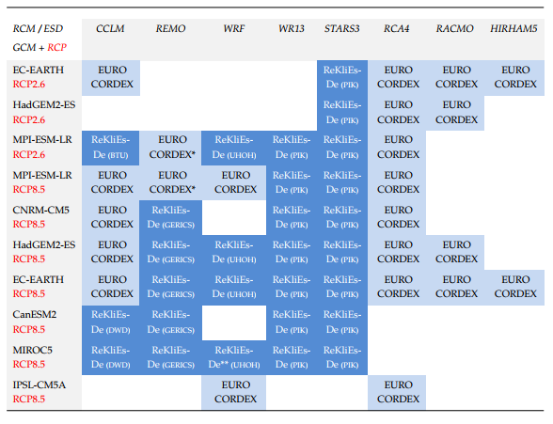
ReKliEs-De = Regional Climate Projections Ensemble for Germany
Under the European initiative EURO-CORDEX (Coordinated Downscaling experiment for Europe) several of these global simulations have been regionalized using (dynamic) regional climate models.
These simulations were augmented by further simulations done under ReKliEs-De (some Europe wide, some only for Germany)

Slide 18
Example 2: regional projections Germany
43 projections from Euro-CORDEX and ReKliEs-De
Varying combinations of 8 GCMs and 8 RCMs (dynamical and statistical)
Arbitrary, unbalanced selection, interdependent → Ensemble of opportunity
Reduction to sub-ensemble with 9 projections → little loss in spread compared to full ensemble
 | 2021 - 2050 | 2071 – 2100
Mean temperature | 87.8% | 92.2%
Total precipitation | 80.5% | 85.7%
Extreme precip index | 75.5% | 89.3%
Precip persistence index | 81.4% | 82.3%
Mean wind speed | 80.2% | 82.0%
TOTAL | 81.1% | 86.3%

Slide 19
Example: regional projections Germany
Reduced ensemble for Germany
spread 2071-2100
9 out of 43 projections
Spread of reduced compared to full ensemble in regional and seasonal
temperature precipitation extremes persistence wind

Slide 20
Spread scatterplots DJF
Reduced ensemble for
Germany
WINTER (DJF) mean climate change signals for Germany: reduced compared to full ensemble
Spread in both extreme and moderate climate change signals well covered
wind speed persistence extreme precipitation
temperature precipitation extreme persistence

Slide 21
Summary
Service for Users of regional climate change projections
Data for impact modelling (RCP8.5, RCP4.5, RCP2.6)
Spread of full ensemble covered by small number of projections
No quality ranking, no quantification of uncertainty
Ongoing/planned work:
Testing of scheme for Australia using existing climate change projections for Australia (CMIP5)
Compare reduced ensemble with CCiA work
Extension to CMIP6

Slide 22

Thank you
Any questions?

Slide 23
Extra Slides – Spread scatterplots JJA
Reduced ensemble for
Germany
SUMMER (JJA) mean climate change signals for Germany: reduced compared to full ensemble
Spread in both extreme and moderate climate change signals well covered
wind speed persistence extreme precipitation
temperature precipitation extreme persistence

Slide 24
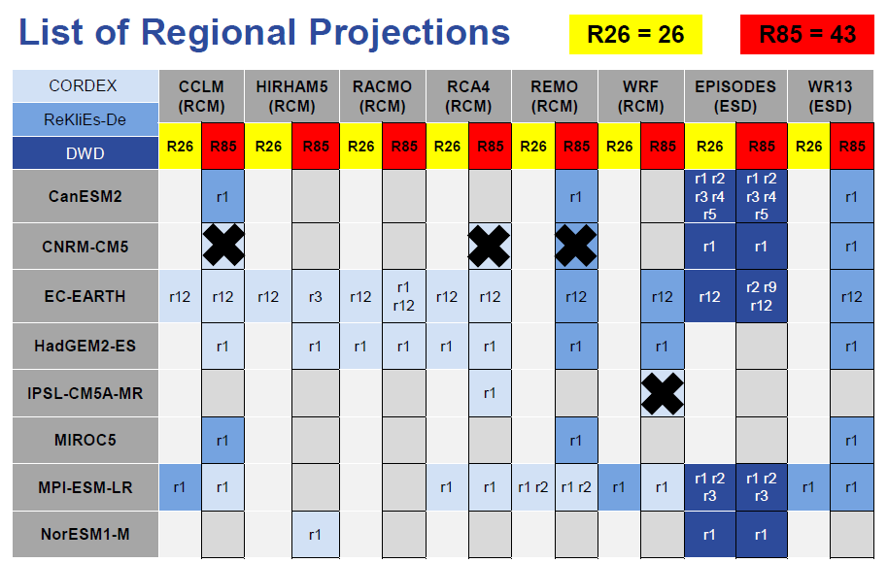
Extra slides – GCM-RCM matrix

