Slide 1
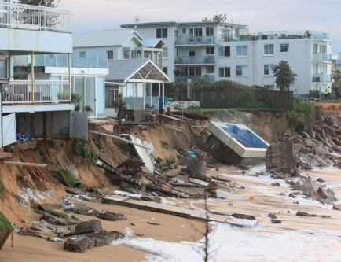
Climate hazards and extreme weather projections for Australia
Andrew Dowdy
Climate Research, Bureau of Meteorology

Slide 2
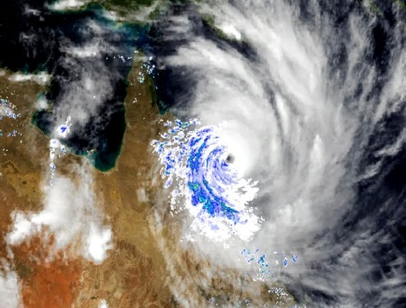
The problem
Natural disasters in Australia are commonly associated with weather and ocean hazards.
Many impacts of climate change will be experienced through changes in these hazards.
However, significant knowledge gaps exist around the influence of climate change on natural hazards in Australia.

Slide 3
Recent review and synthesis of latest research
Hazard types | General climate change influences
Temperature: extreme heat/cold, heat wave | More frequent and intense extreme heat events and heat waves, with the converse for extreme cold events
Extreme rainfall, flood, snow and drought | Likely to have more extreme rain events, larger uncertainties for flood risks, less snow cover and potential increases in drought risks
Unstable atmosphere: thunderstorm, hail, lightning, dust storm | Potential increases in some thunderstorm hazards (particularly sub-daily rainfall extremes), larger uncertainties for tornados, wind extremes, hail, lightning, dust storms.
Storm surge and coastal inundation | Sea levels will continue to rise, increasing storm surge and inundation risk
Cyclones | Fewer but potentially more intense cyclones in some regions of Australasia
Bushfires and fire weather | More dangerous bushfire conditions in some regions, as well as seasonal changes
Compound or coincident events | Large knowledge gaps, but growing interest in the importance of these events

Slide 4
Recent review and synthesis of latest research
Hazard types | General climate change influences
Temperature: extreme heat/cold, heat wave | More frequent and intense extreme heat events and heat waves, with the converse for extreme cold events
Extreme rainfall, flood, snow and drought | Likely to have more extreme rain events, larger uncertainties for flood risks, less snow cover and potential increases in drought risks
Unstable atmosphere: thunderstorm, hail, lightning, dust storm | Potential increases in some thunderstorm hazards (particularly sub-daily rainfall extremes), larger uncertainties for tornados, wind extremes, hail, lightning, dust storms.
Storm surge and coastal inundation | Sea levels will continue to rise, increasing storm surge and inundation risk
Cyclones | Fewer but potentially more intense cyclones in some regions of Australasia
Bushfires and fire weather | More dangerous bushfire conditions in some regions, as well as seasonal changes
Compound or coincident events | Large knowledge gaps, but growing interest in the importance of these events
User interest in climate hazards is projected to increase (high confidence)

Slide 5
Climate hazards information provided to stakeholders:
Emergency management authorities (including AFAC and state fire agencies) now have best available information on climate risk, understanding that past practices may not always be applicable.
State governments (including SA, WA, QLD, VIC and NSW) and federal (e.g., Senate inquiry into Climate Change and National Security).
Insurance, banking and finance, as well as energy sector groups.
Other researchers and model developers.
Informing broader reviews produced on climate hazards:
State of the Climate 2018 report.
Scientific foundation for AFAC Discussion Paper (approved by AFAC Council in May) enabling changes in practises for EM sector throughout Australasia, enhancing climate adaptation and resilience.
Knowledge gaps are communicated.

Slide 6
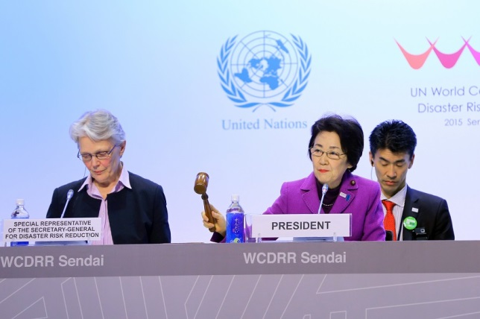
What solutions are needed?
Clear need for robust science‐based decision making in relation to the influence of climate change on natural hazards.
Given the existing knowledge gaps, effective risk reduction requires improved knowledge of future climate risks.
Evolving needs, evolving capabilities, evolving solutions.

Slide 7
Review and synthesis approach
Rainfall analyses for northeast NSW:
implied increase (blue), decrease (red) or little change (black), as well as increased uncertainty (purple) in direction of change.
Reference:
Dowdy et al. 2015, AMOJ.

Slide 8
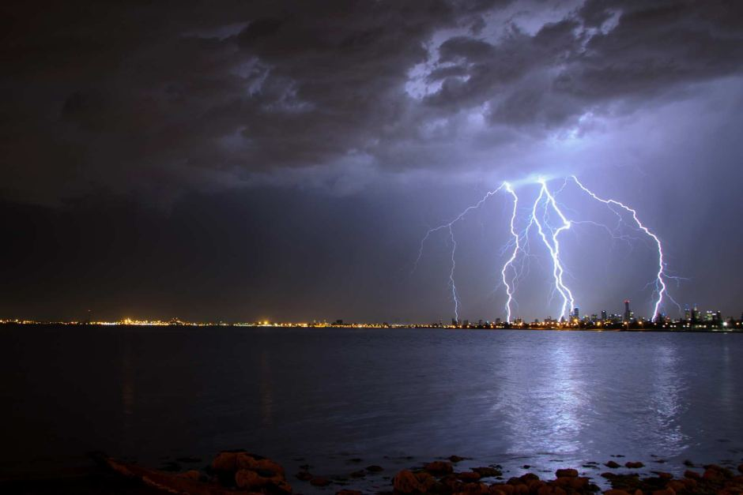
BARPA
Relatively limited range of downscaling methods for Australia, with UM-based approach complementary to existing methods.
‘Test of concept’ stage completed for BARPA (like ‘BARRA’ but with a P for projections rather than R for reanalysis), based on CCSM4.
Second stage of development underway.
Future work planned from July 2019 for AEMO ‘Finkel’ project.
Longer-term view towards other applications (DRR, finance sector, NRM, …), within CORDEX Australasia, based on HighResMIP.

Slide 9

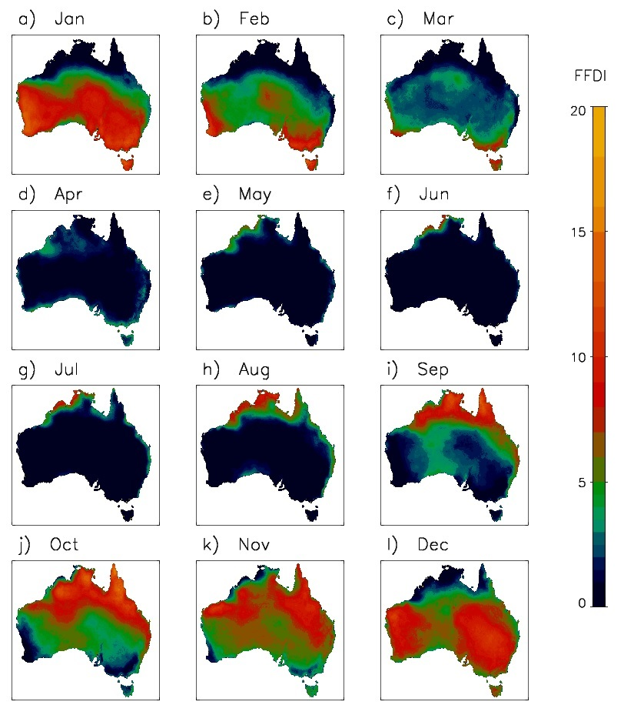
Modelling of future extremes
Currently examining FFDI and C-Haines from GCMs and downscaling (WRF and CCAM).
Assessed against observations-based FFDI dataset for current climate.
Next step is examining extremes in future climate simulations.
Downscaled projections of fire weather extremes completed by June 2019.
Model assessment tool: Mean number of days per month that the AWAP-based FFDI is above 90th percentile (1950-2016).

Slide 10
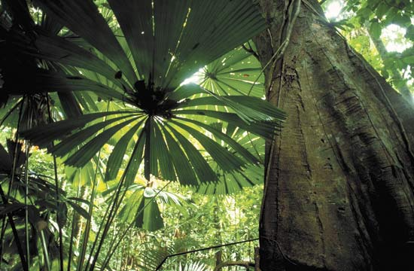
Conclusions
Projections of extremes have been improving, due to increased modelling capability and physical understanding.
User needs and expectations are rapidly increasing.
Projections methods for extremes need to continue evolving to provide solutions to emerging needs.
Communication/coordination between different research and user groups is essential for improved outcomes.

Slide 11
Thank You
Dr Andrew J. Dowdy
Senior Research Scientist
Climate Research Section, Bureau of Meteorology
p: +613 9669 4722
e: andrew.dowdy@bom.gov.au

