Slide 1
Ensemble selection for hydrological projections – preliminary steps
Pandora Hope, Chantal Donnelly, Louise Wilson, Justin Peter, Elisabeth Vogel, Wendy Sharples Bureau of Meteorology
Rainfall
Temperature
Wind
Radiation

Slide 2
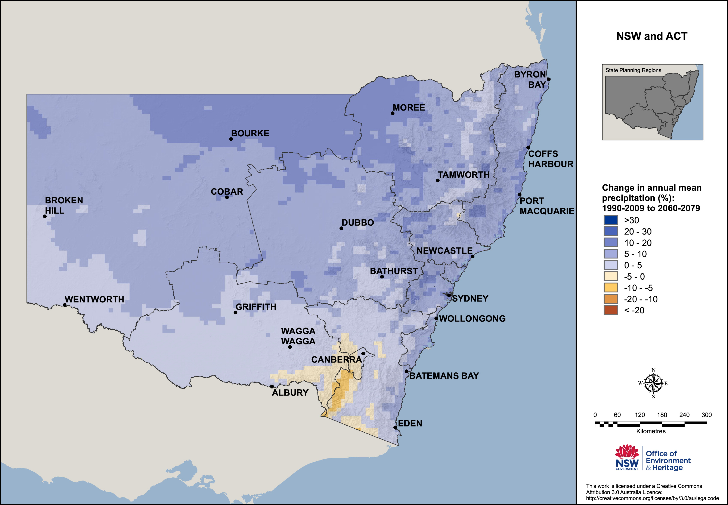
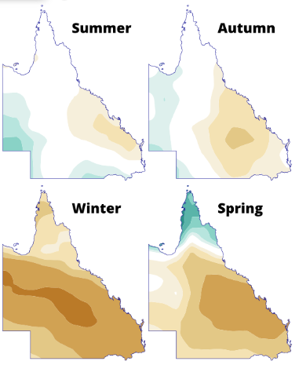
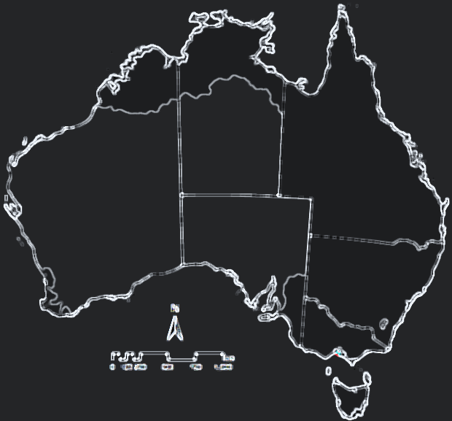
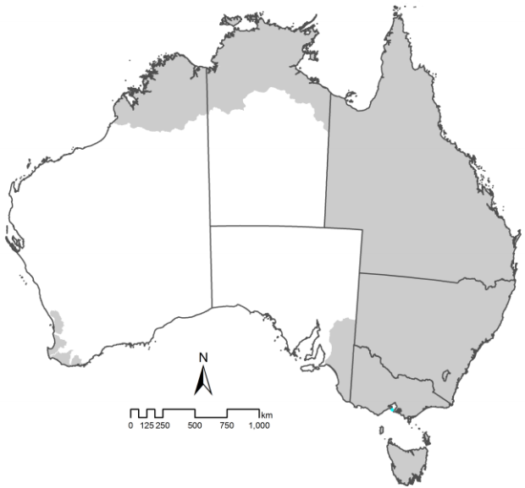
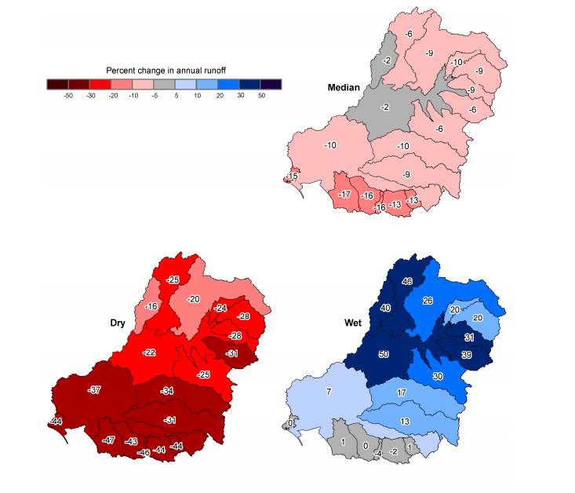
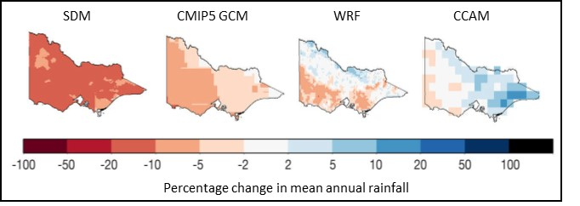
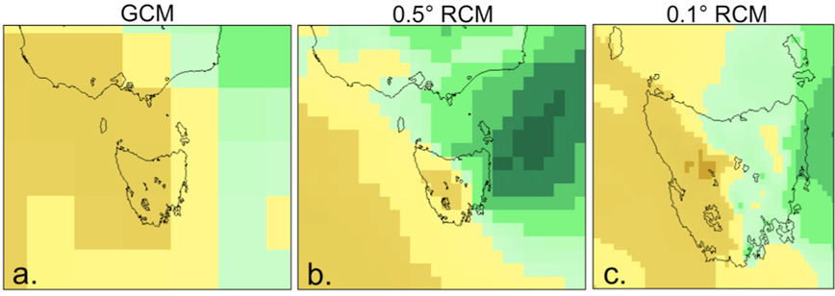
Hydrological Projections: the national picture
Commonwealth Scientific and Industrial Research Organisation (CSIRO) Sustainable Yields Projects

Slide 3
National Hydrological Projections
Ensemble of climate forcing from GCMs
Multiple bias-correction + downscaling approaches
Continental in scale (# of Hydrological Models)
Complementary to existing hydrological projections landscape

Slide 4
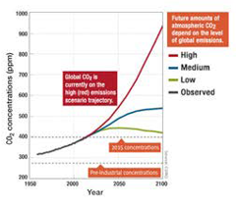

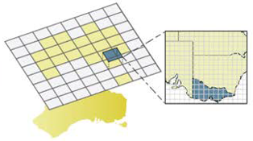
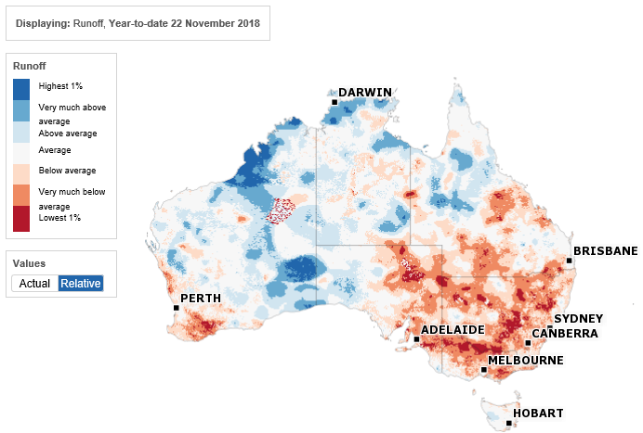
Confidence in projections: characterising uncertainty
Future GHG Concentrations
Changes in Global Climate
Changes in Regional Climate
Changes in Regional Hydrology
Representative Concentration Pathways
Global Climate Modelling
Regional climate modelling or statistical downscaling
Bias-Correction
Hydrological Modelling
1
3
5
5
=75 members
Notes:
This diagram illustrates the modelling chain described in the previous slide, required to produce a set of hydrological projections
In order to properly sample the UNCERTAINTY in the climate systems response to changes in GHG concentrations, we must utilise an ensemble of GCMs.
And in order to use the output from GCMs – which have spatial scales in the order of 100 – 200km^2 per grid cell, we must downscale to the resolution of our hydrological model. In this case, 5km.
Depending on study location, or variable of interest, regional downscaling/ bias-corr or hyd modelling can be as uncertain as GCM – need to consider uncertainty in each component
The cascading set of lines below the schematic, represents the increase in the size of the overall ensemble, each time a new emissions scenario, or bias-correction and downscaling methodology is implemented
You can see that we quickly end up with a very large ensemble, which is good because it means we are characterising more of the uncertainty, which is an essential step for informing confidence in our projections

Slide 5
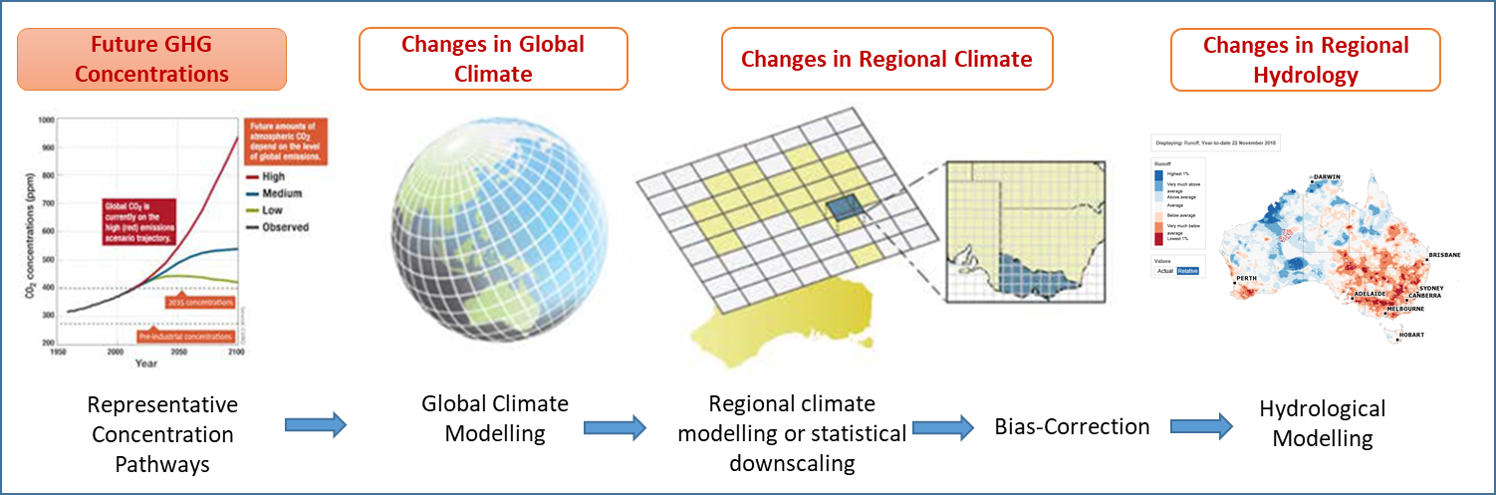
Sample future emissions uncertainty

Slide 6

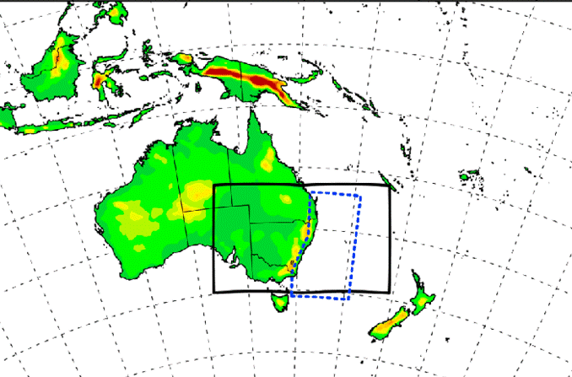
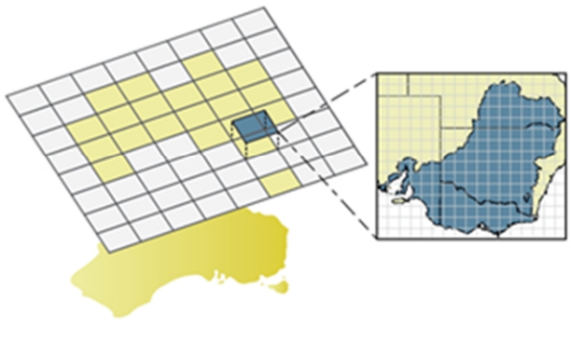
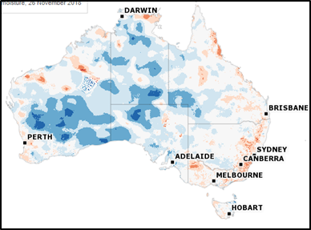
Large to local scales
General Circulation Models
GCMs are the tool we use to gain insight into plausible future climates
GCMs output at spatial scales which are much larger than the scales of interest to users
Interactions at local scales are key, and so want to capture relationships between large and local scale features whilst retaining information about climate change from the GCM
Impact models are parametrised which means they are sensitive to bias from their host
Necessary to bias-correct GCM-inputs prior to downscaling
Regional Circulation Models
Bias-Correction & Scaling
Impact Models

Slide 7
Sample response uncertainty: ensemble of GCMs

Slide 8
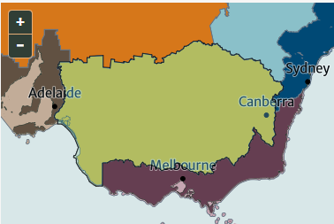
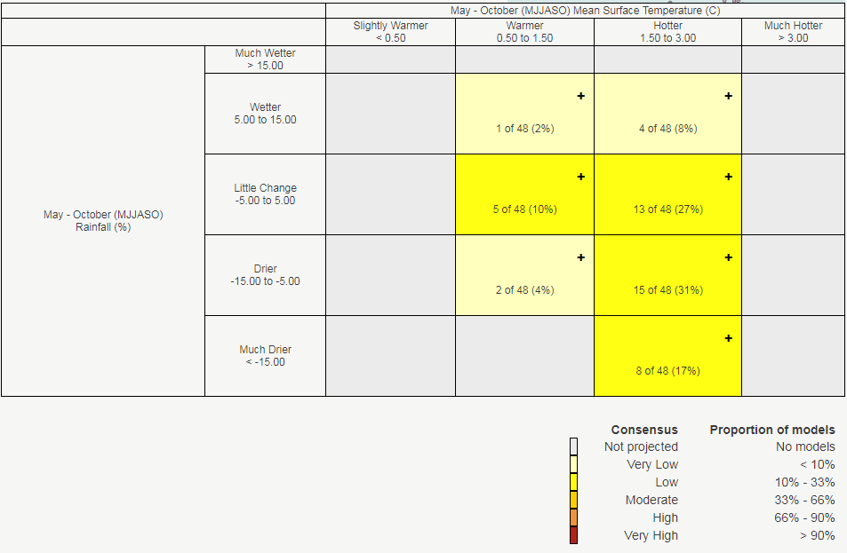
Global Climate Model Selection
CMIP5 has data from over 40 models available.
For impact studies, rather than using the full suite of models, often 3 or 4 models are selected.
The aim is that these models encapsulate the 'range' of projections
This can be identified using tools on climatechangeinaustralia.gov.au
Warmer and little change: MIROC5
Hotter and drier: ACCESS1.0
Hotter and much drier: ACCESS1.3

Slide 9
Global Climate Model (GCM) selection
Choose Models Based Upon:
the range of climate they simulate (hotter, less warm; wetter, drier).
their ability to capture important process (e.g. aerosols), have lower biases (e.g. ENSO), capture weather features of importance to Australia (e.g. blocking), and the seasonal cycle for a specific region.
Pragmatic choices:
which ones have been downscaled
which ones have the relevant data fields available
which ones have been used in other hydro projections?

Slide 10
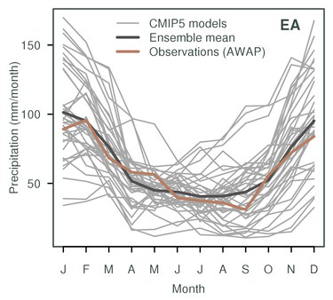
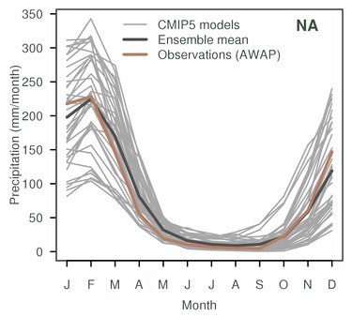
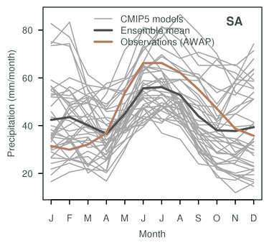
GCM selection based upon model's ability to simulate features of Australia's climate – including seasonal cycle
Projections for NRM (climatechangeinaustralia) defined a subset of 8 GCMs which was felt to adequately sample the full range of projections for the Australian region:
ACCESS1-0, CESM1-CAM5, CNRM-CM5, GFDL-ESM2M, HadGEM2-CC, CanESM2, MIROC5, NorESM1-M
Climate Change In Australia Technical Report, 2015
Notes:
Seasonal cycle of rainfall

Slide 11
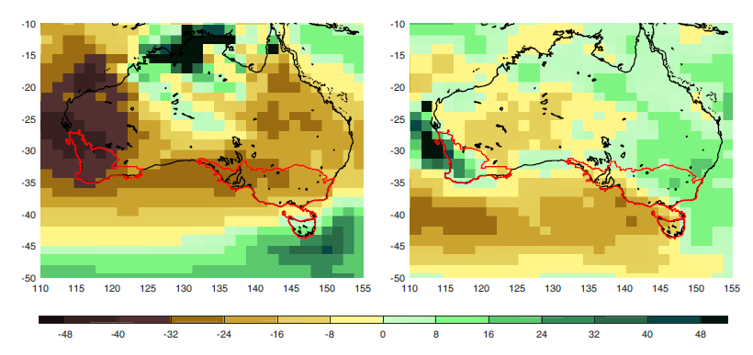
Capture weather features well
July
January
For Instance
ACCESS1.0, ACCESS1.3 BCC_CSM1.1, NorESM1-M, CMCC-CM, CNRM-CM5 GFDL-ESM2G, GFDL-ESM2M, CNRM-CM5, GFDL-ESM2G, CMCC-CM
BCC_CSM1.1(m) (blocking poor), CMCC-CMS (storm tracks poor) HadGEM2-CC (blocking poor) INM-CM4.0 (jets poor), IPSL-CM5A-MR (storm tracks poor) MPI-ESM-LR (storm tracks poor) MRI-CGCM3 (blocking poor)
Grose et al. 2017

Slide 12
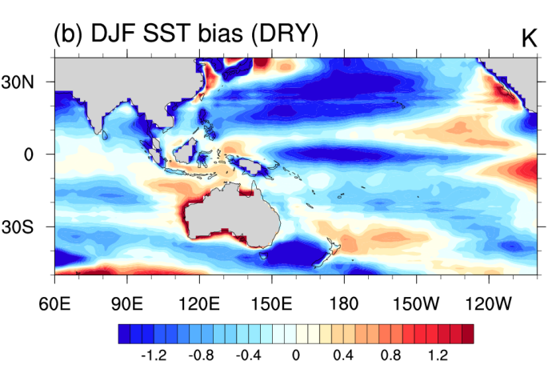
Climate models that include a representation of the indirect aerosol effect and cloud lifetime and also capture the processes that influence southern Australian rainfall well, along with a reasonable representation of ENSO are: ACCESS1.0, ACCESS1.3, NorESM1-M, MRI-CGCM3
'Cold tongue' bias of ENSO
Brown et al. 2016

Slide 13
Model Selection: ACCESS1.0, ACCESS1.3, MRI-CGCM3, NorESM1-M
CCIA: ACCESS1-0, CESM1-CAM5, CNRM-CM5, GFDL-ESM2M, HadGEM2-CC, CanESM2, MIROC5, NorESM1-M
Choice: ACCESS1.0, NorESM1-M

Slide 14
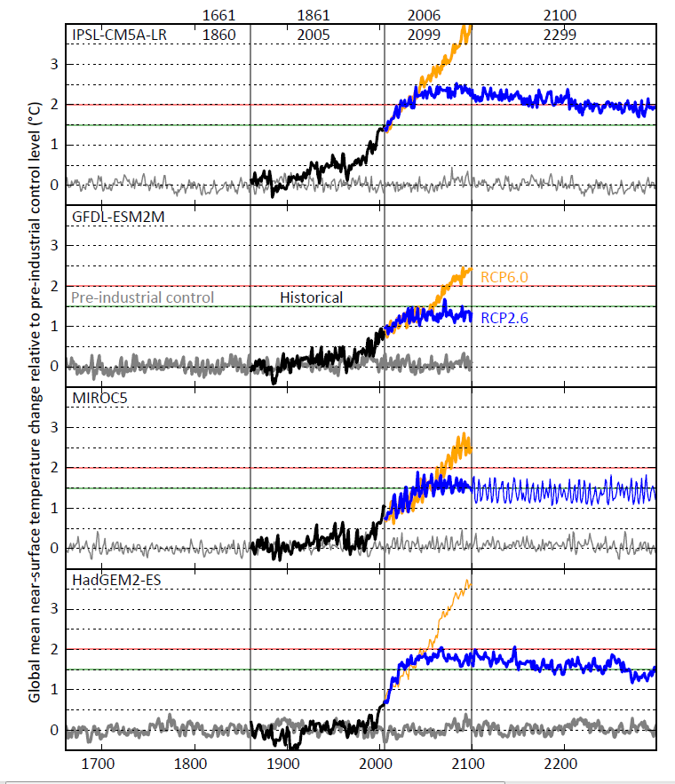
Inter-Sectoral Impact Model Intercomparison Project (ISI-MIP)
IPSL-CM5A-LR GFDL-ESM2M MIROC5 HadGEM2-ES
RCP2.6, RCP6.0
NorESM1-M was good, but did not have near-surface winds available.
1861 to 2005
Frieler et al. 2017

Slide 15
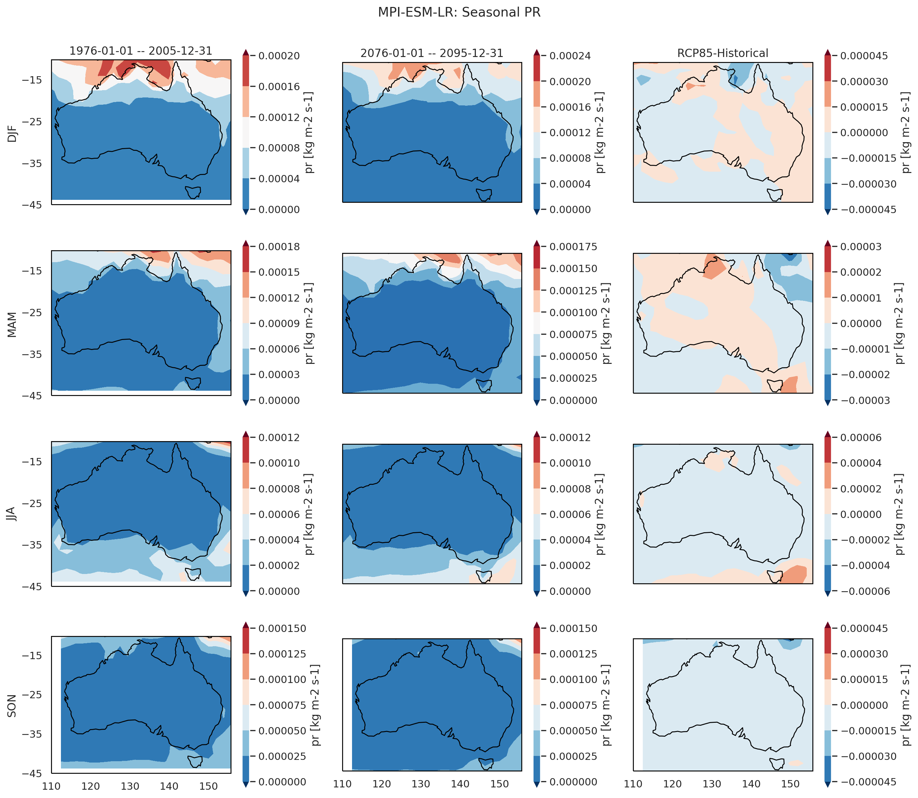
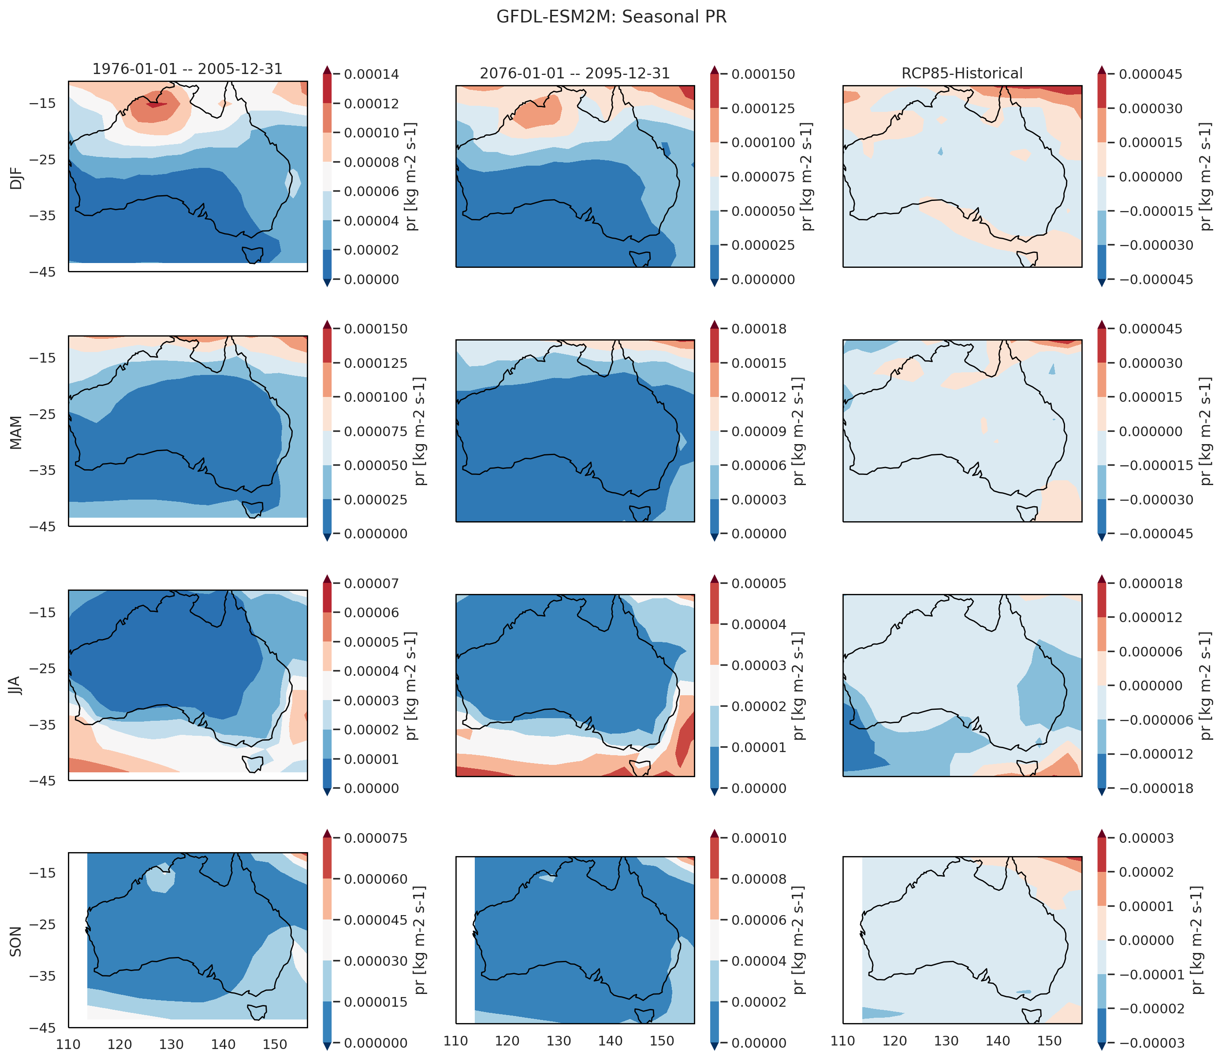
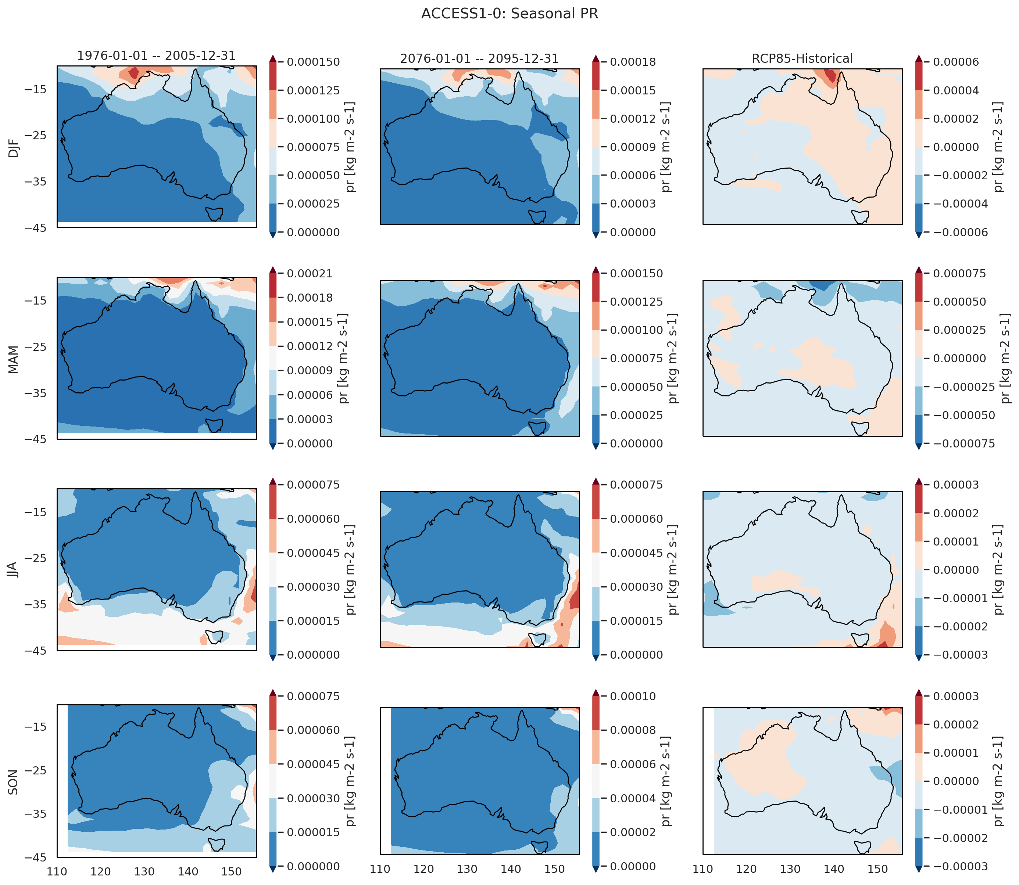
MPI-ESM-LR
ACCESS1.0
GFDL-ESM2M
DJF
MAM
JJA
SON

Slide 16
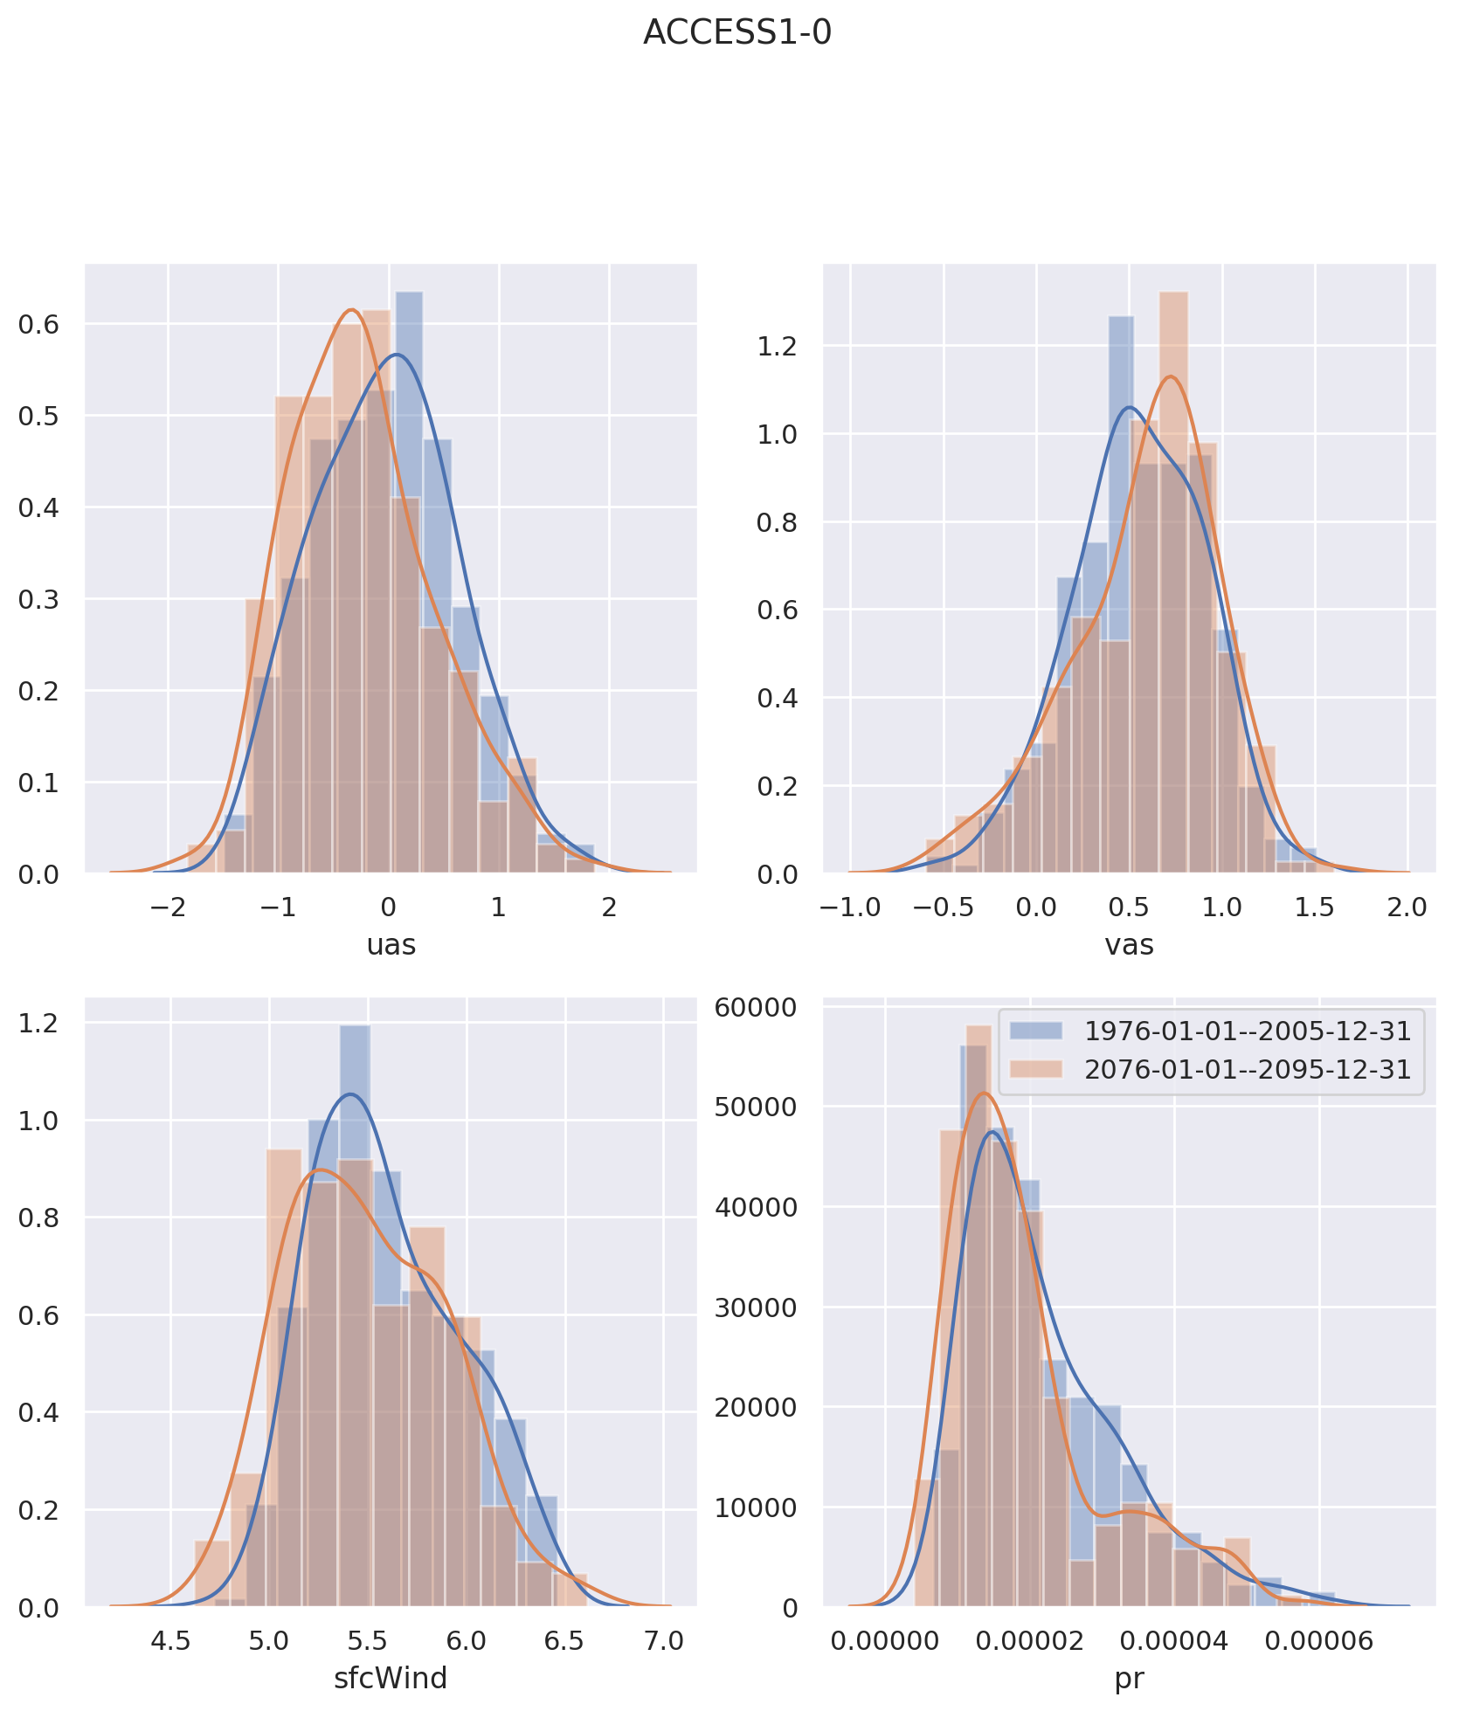
Which variables change the most?
Rainfall
Temperature
Wind
Radiation
ACCESS1.0
Uwnd
Vwnd
Wind Speed
Precip

Slide 17

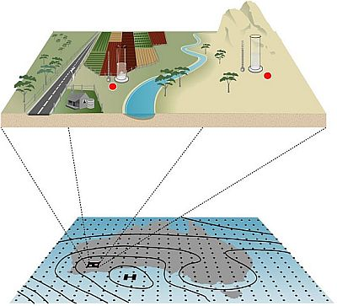
Need to bias-correct and downscale GCM output before input into hydrological model.
Use a suite of approaches:
Empirical methods
Statistical methods
Dynamical models
Sample response uncertainty: ensemble of GCMs

Slide 18
 | Description | Caveats | Examples
Change factor / scaling | Computationally inexpensive Conceptually simple Transfer function can be as simple as a delta change, or quantile based | Cannot add new information Cannot account for systematic changes or changes to feedback processes Assumes time invariant biases | Chiew method (MODSIM, 2017)

Slide 19
 | Description | Caveats | Examples
Change factor / scaling | Computationally inexpensive Conceptually simple Transfer function can be as simple as a delta change, or quantile based | Cannot add new information Cannot account for systematic changes or changes to feedback processes Assumes time invariant biases | Chiew method (MODSIM, 2017)
Statistical | Based on relationship between large scale circulation and observations Relatively inexpensive (compared to dynamical downscaling) | Can add some new information by way of increased skill (relationships from large to local scale) Not internally consistent Assumes time invariant relationships | BoM-SDM (Timbal, 2009) NHMM (Potter, 2018) MRNBC (Johnson & Sharma) GLIMCLIM (Frost, 2011) ISIMIP2b (Frieler, 2017)

Slide 20
 | Description | Caveats | Examples
Change factor / scaling | Computationally inexpensive Conceptually simple Transfer function can be as simple as a delta change, or quantile based | Cannot add new information Cannot account for systematic changes or changes to feedback processes Assumes time invariant biases | Chiew method (MODSIM, 2017)
Statistical | Based on relationship between large scale circulation and observations Relatively inexpensive (compared to dynamical downscaling) | Can add some new information by way of increased skill (relationships from large to local scale) Not internally consistent Assumes time invariant relationships | BoM-SDM (Timbal, 2009) NHMM (Potter, 2018) MRNBC (Johnson & Sharma) GLIMCLIM (Frost, 2011) ISIMIP2b (Frieler, 2017)
Dynamical | Resolves physical processes using GCM output as boundary conditions Better in areas with significant land surface processes | Computationally expensive Can add new information, especially in regions of complex topography and along coastlines | WRF (CMIP5 CORDEX runs) CCAM (CMIP5)

Slide 21
Which GCMs have Downscaled Result Available??
Statistical:
BoM Statistical Downscale Method: 22 models.
ISI-MIP IPSL-CM5A-LR GFDL-ESM2M MIROC5 HadGEM2-ES
Dynamical:
CCAM: ACCESS1.0, CCSM4, CNRM-CM5, GFDL-CM3, MPI-ESM-LR, NorESM1-M
WRF, NARCliM new: ACCESS1.3; To come: ACCESS1.0, CanESM2,
COSMO: EC-EARTH, MPI-ESM-LR

Slide 22
Comparison of downscaled results with observations
From CORDEX Giovanni Di Virgilio (in press, Giovanni@unsw.edu.au)

Slide 23
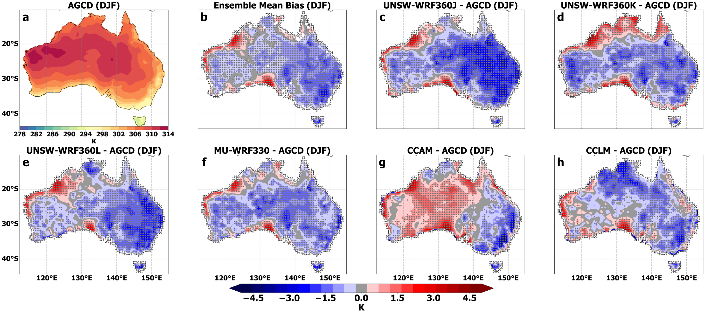
Downscaled anomaly
Observed Tmax DJF
Fig. 4 Summer (DJF) maximum temperature bias with respect to AGCD observations with stippling as per Fig. 3

Slide 24
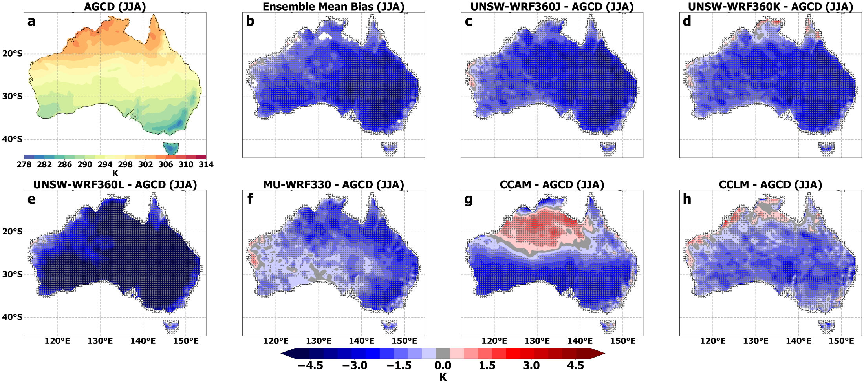
Downscaled anomaly
Observed Tmax JJA
Fig. 5 Winter (JJA) maximum temperature bias with respect to AGCD observations with stippling as per Fig. 3

Slide 25
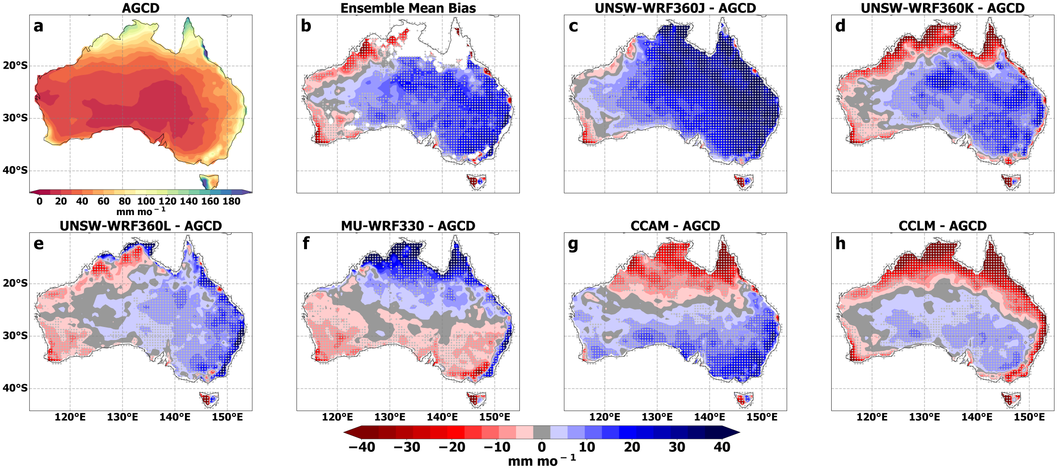
Downscaled anomaly
Observed Precip Annual
Fig. 12 Annual mean precipitation bias of the RCMs with stippling as per Fig. 3

Slide 26
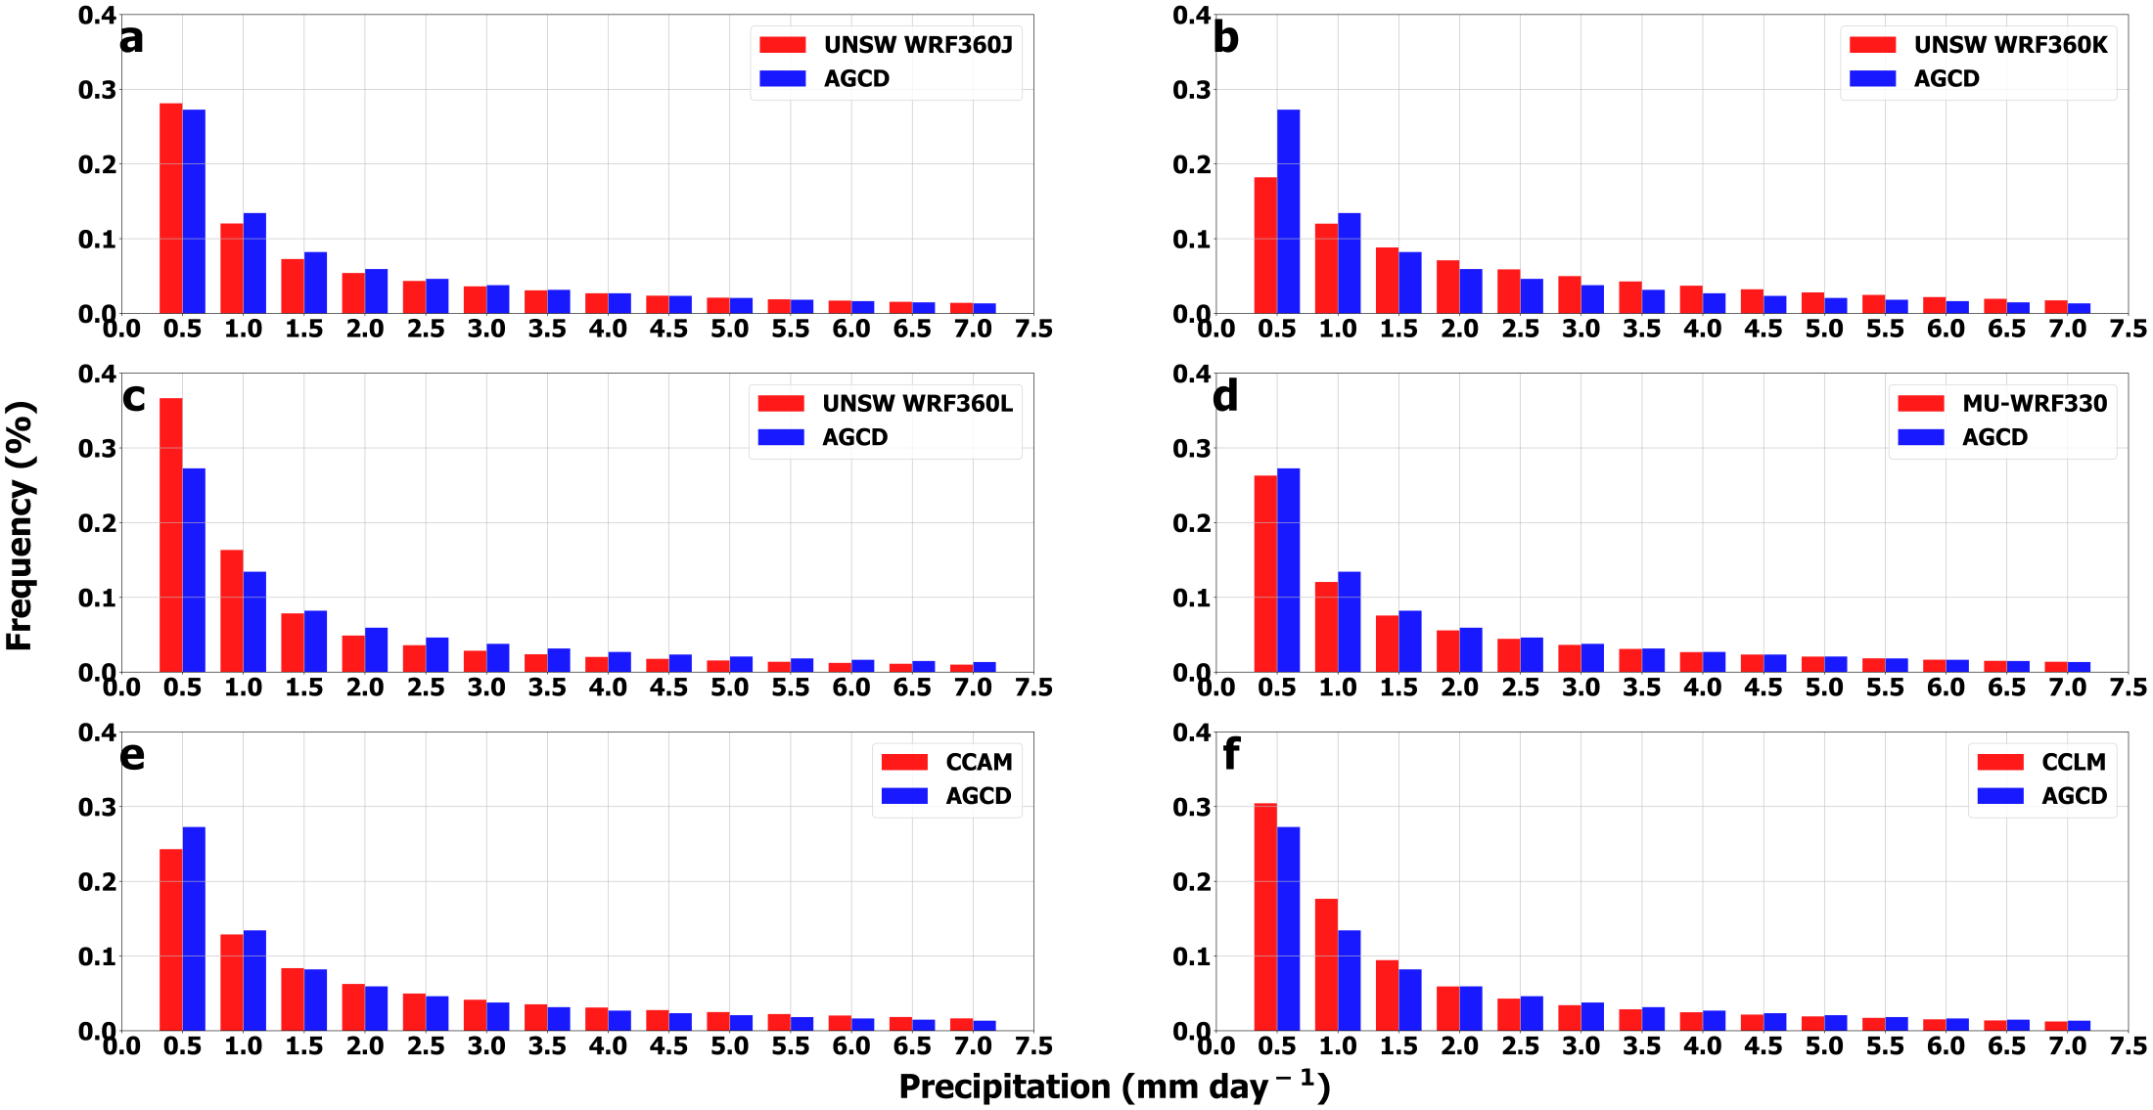
Fig. 11 Probability density functions of mean daily precipitation across Australia

Slide 27
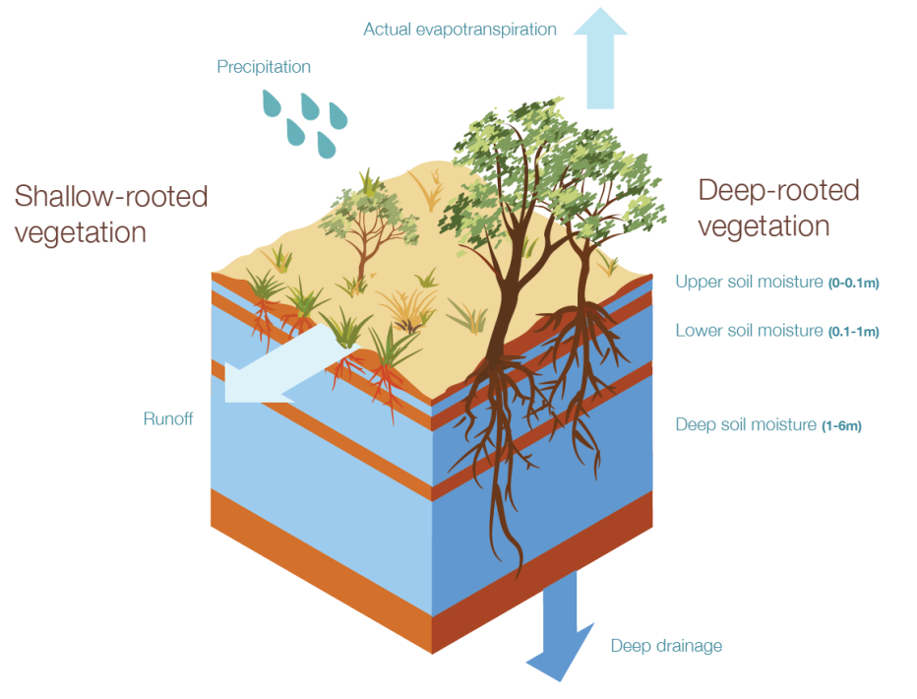
AWRA-L
Sample response uncertainty: ensemble of GCMs
Bias-corrected and downscaled inputs

Slide 28
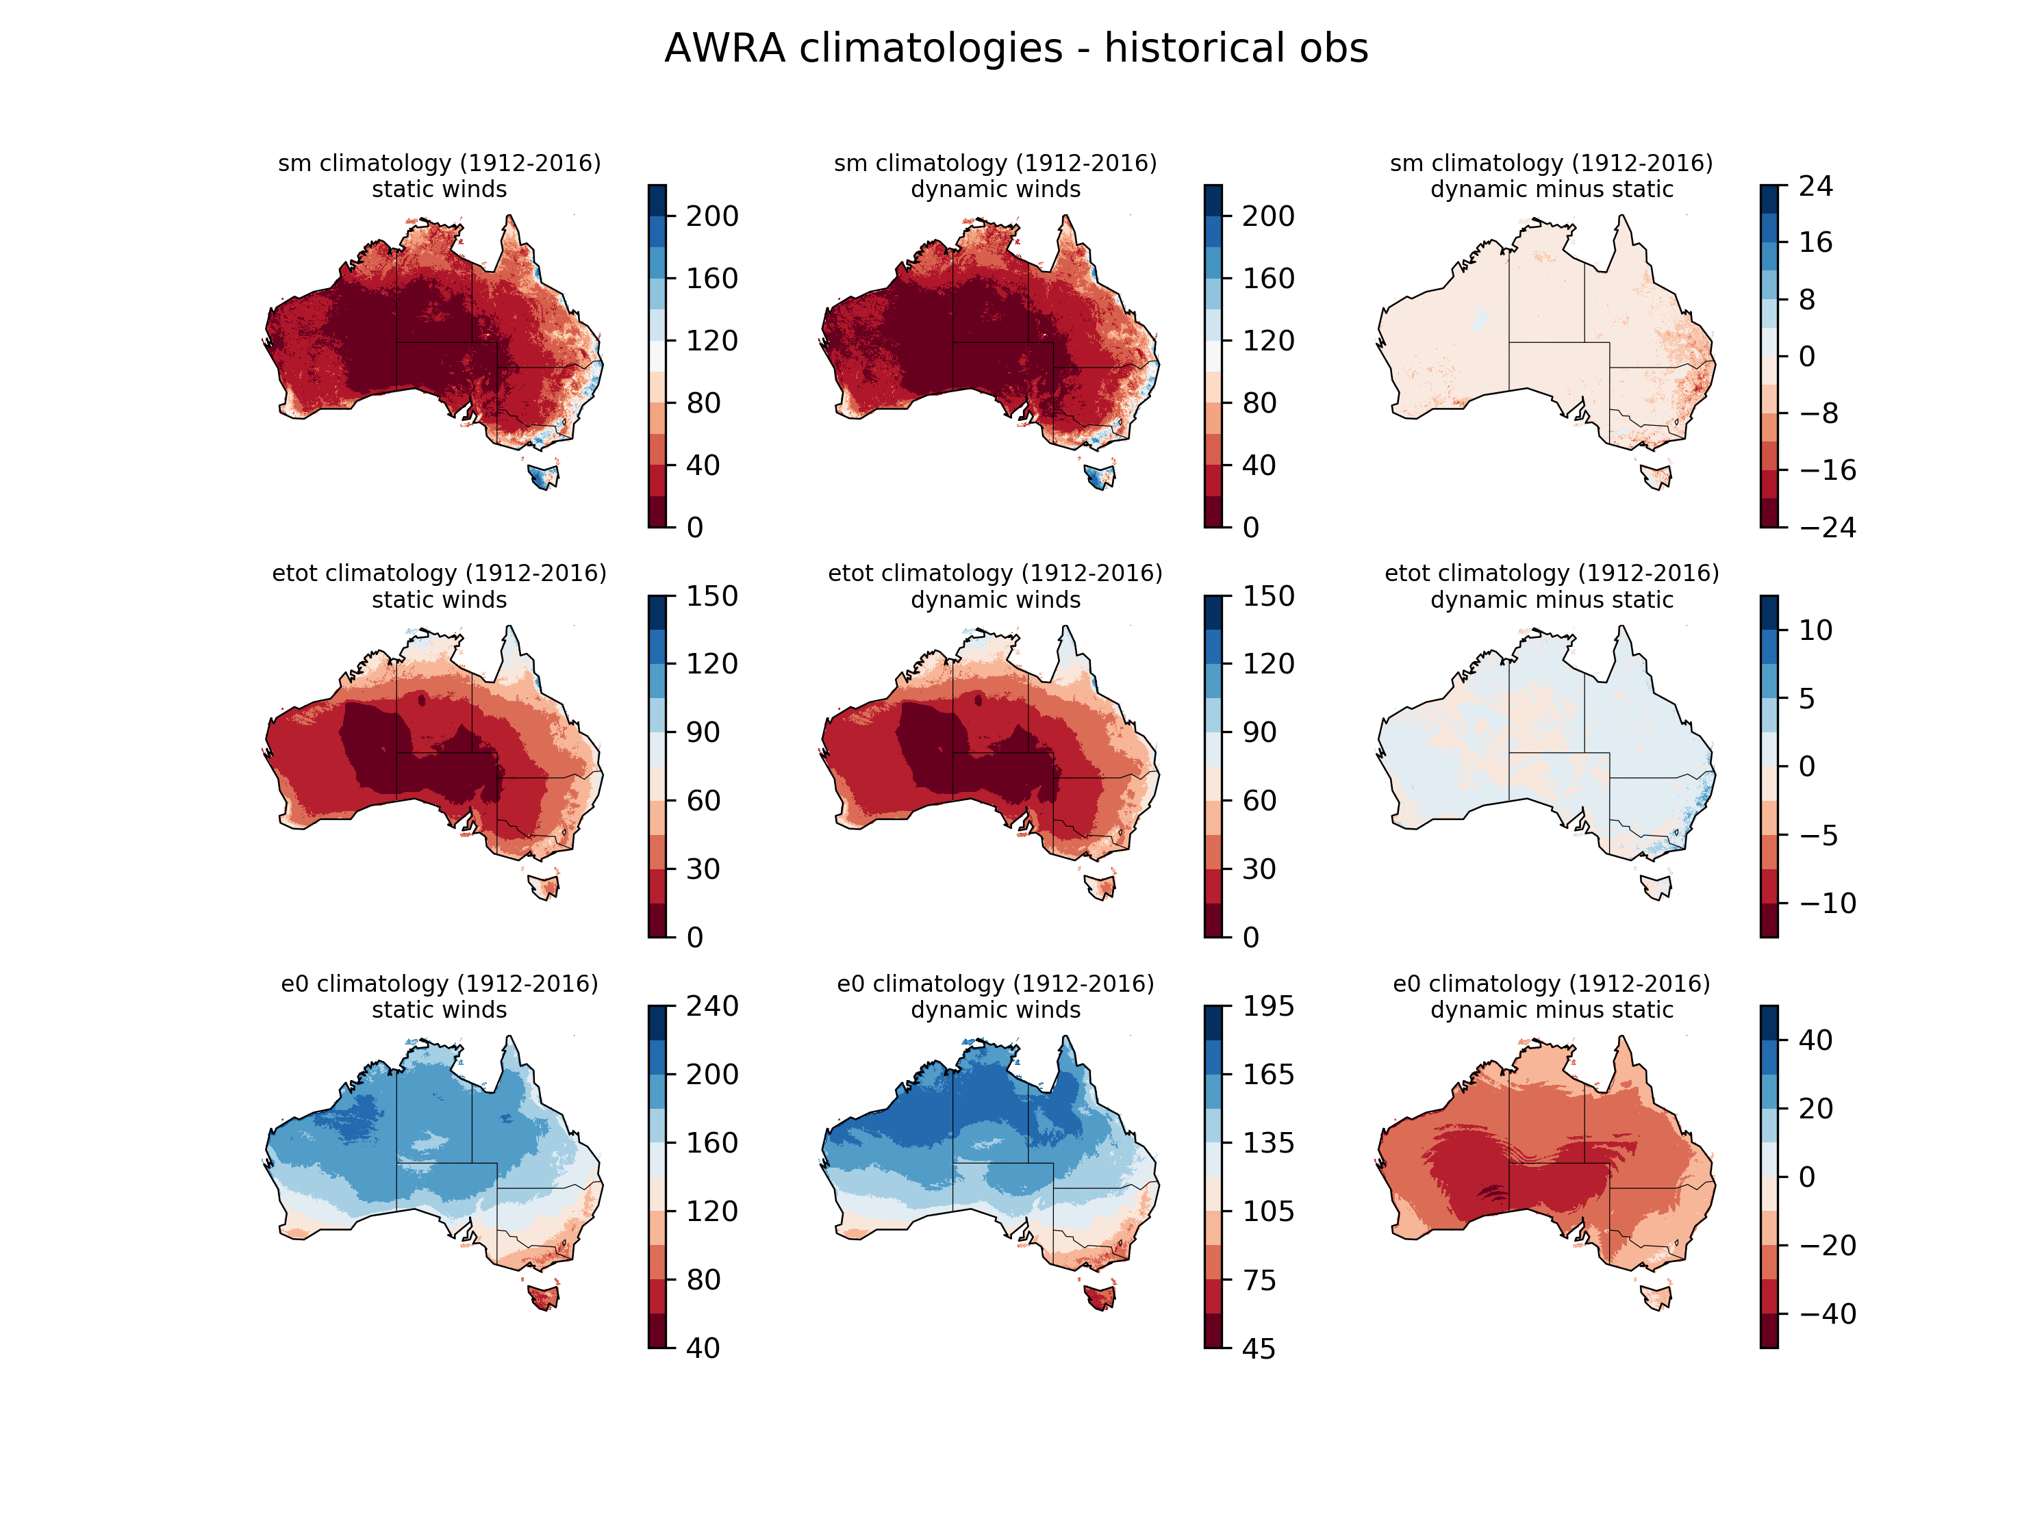

Slide 29
Conclusion – which GCMs to do hydrological projections from?
We now have an understanding of the strengths and weaknesses of models, when we include them.

Slide 30
National Hydrological Projections
Pandora Hope
Pandora.Hope@bom.gov.au
03 9669 4774
Louise Wilson, Chantal Donnelly
Thank you
Ensemble of climate forcing from GCMs
Multiple bias-correction + downscaling approaches
Continental in scale (# of Hydrological Models)
Complementary to existing hydrological projections landscape

Slide 31
Thank you
Pandora Hope
Pandora.Hope@bom.gov.au
03 9669 4774

