Slide 1
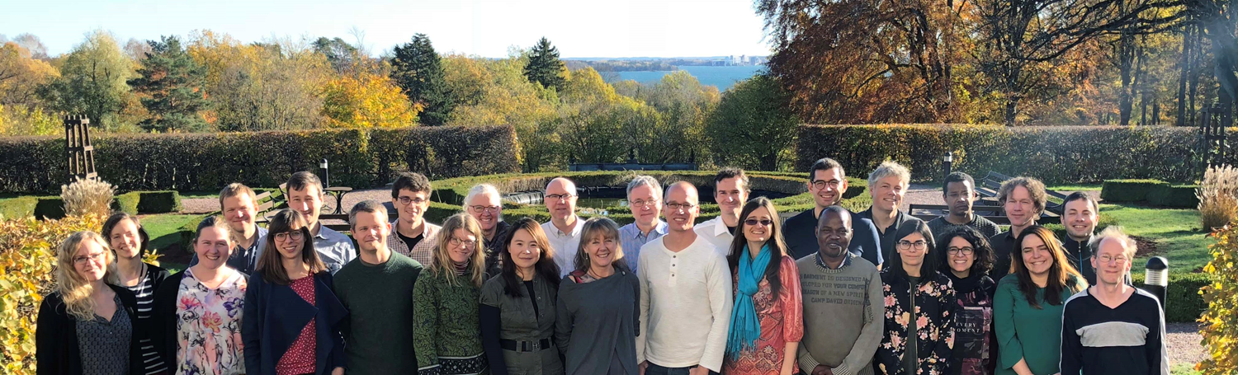
Climate & Water Projections – experiences from using ensemble methods in climate and water services
Berit Arheimer, Head of Hydrological Research, SMHI
Hydrological Research unit, SMHI

Slide 2
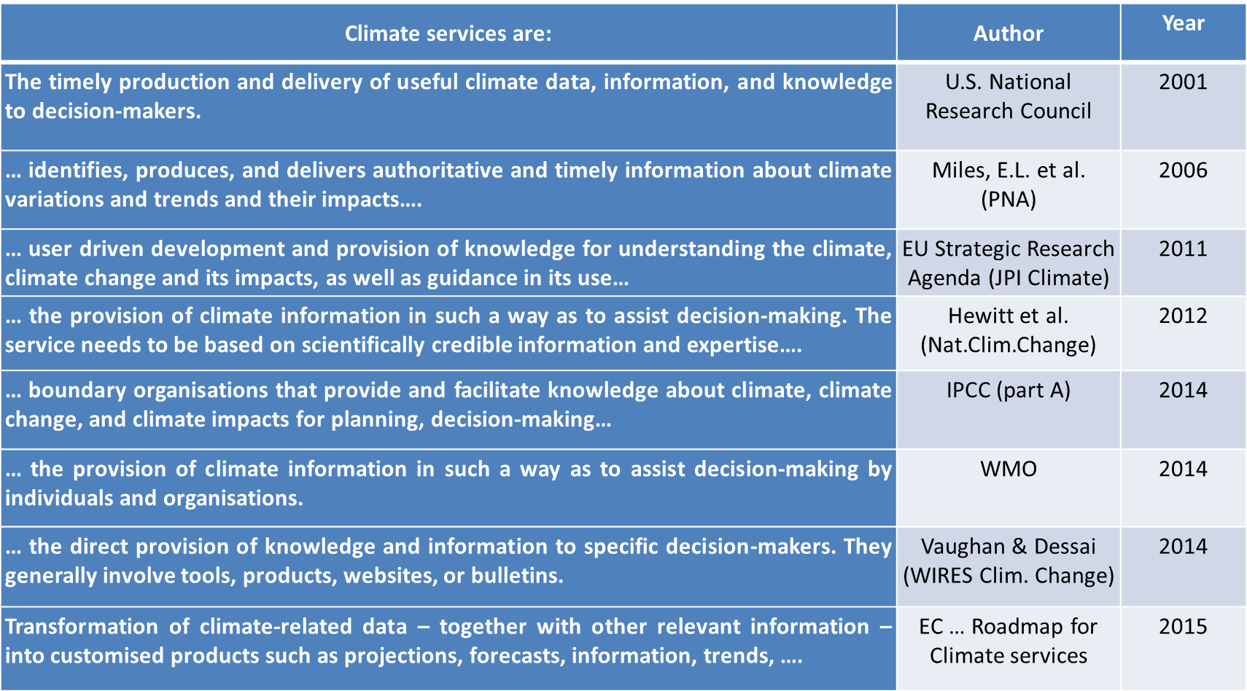
What is a climate service?

Slide 3
Current evolution of climate services
(Weichselgartner and Arheimer,
Manuscript, 2018)

Slide 4
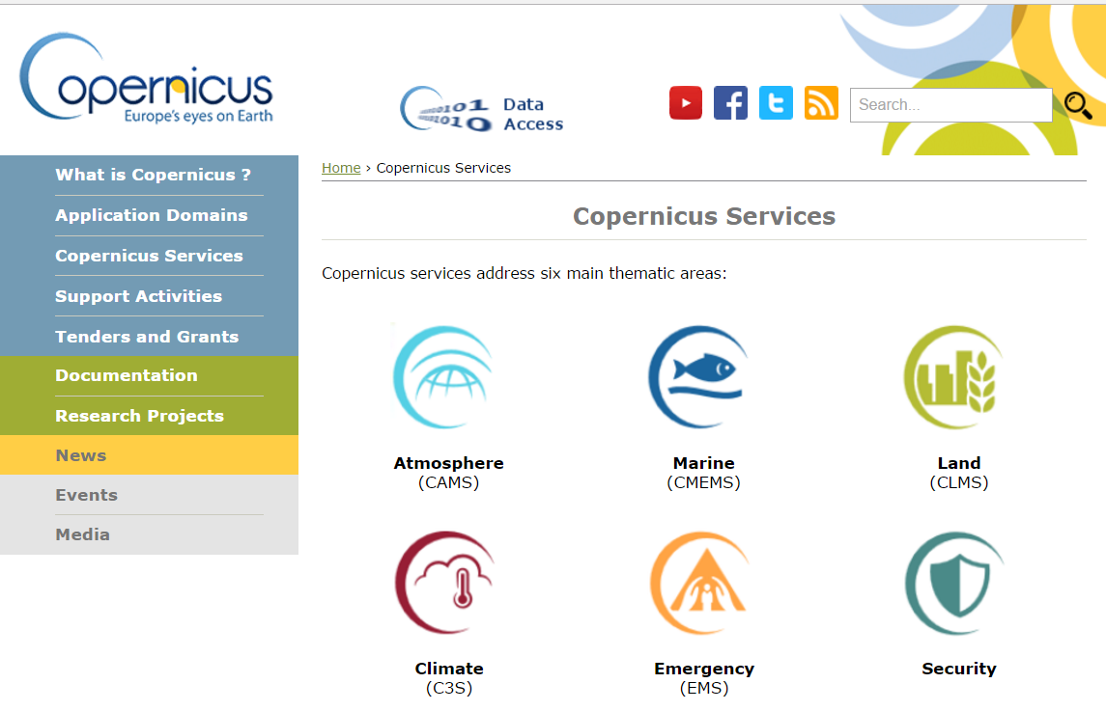
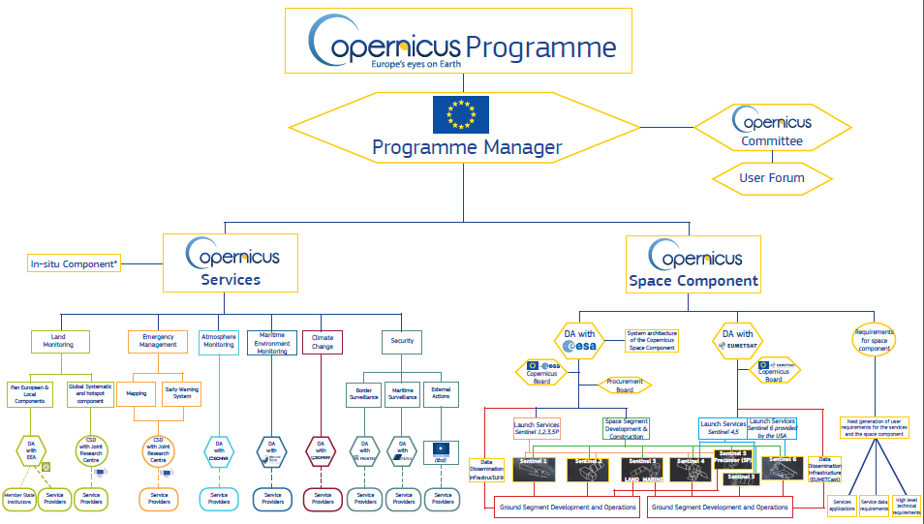
Space and Data initiative in Europe

Slide 5
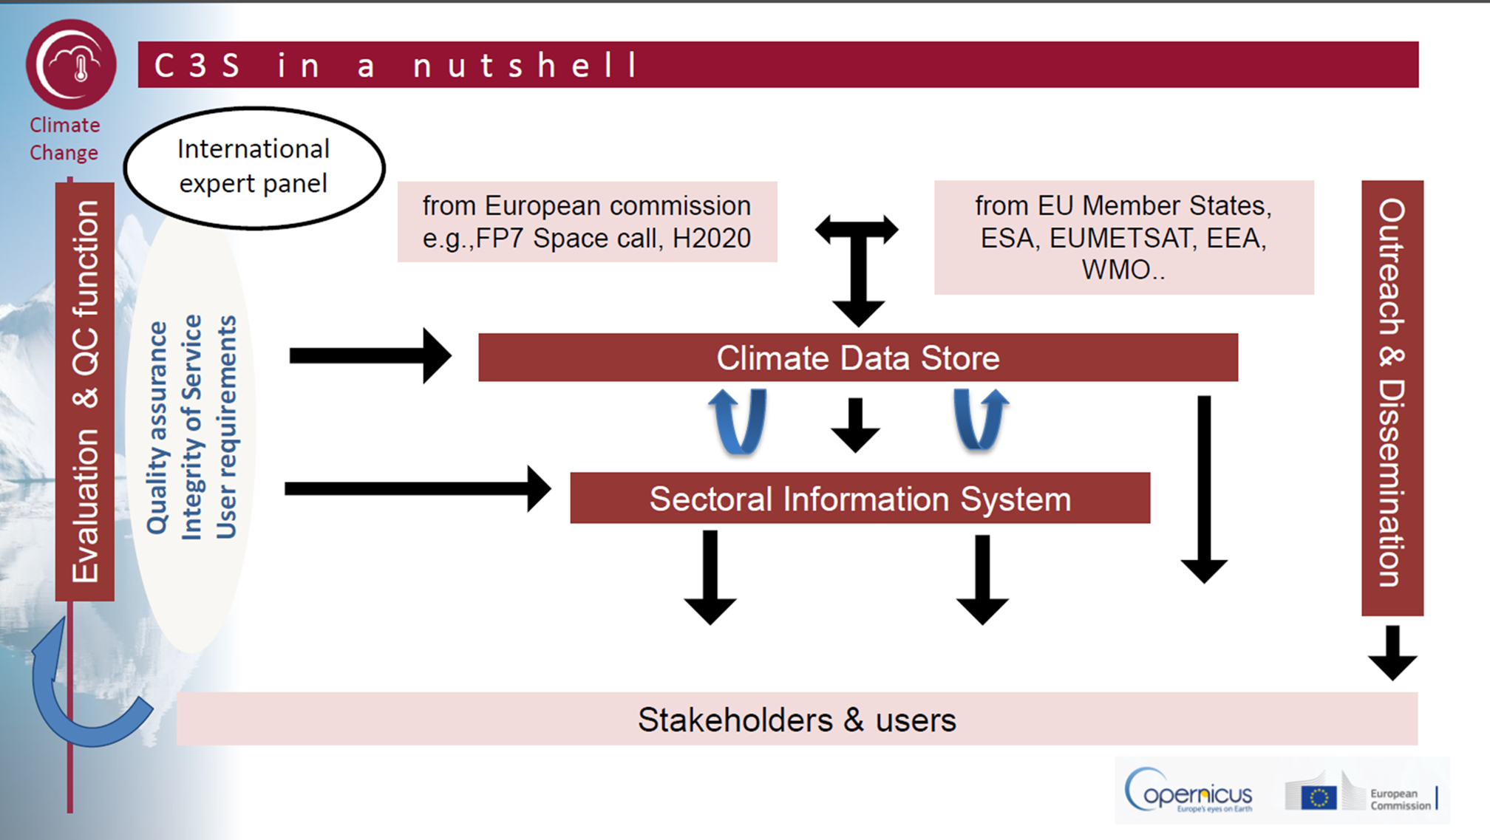
Copernicus Climate Change Service (C3S)

Slide 6
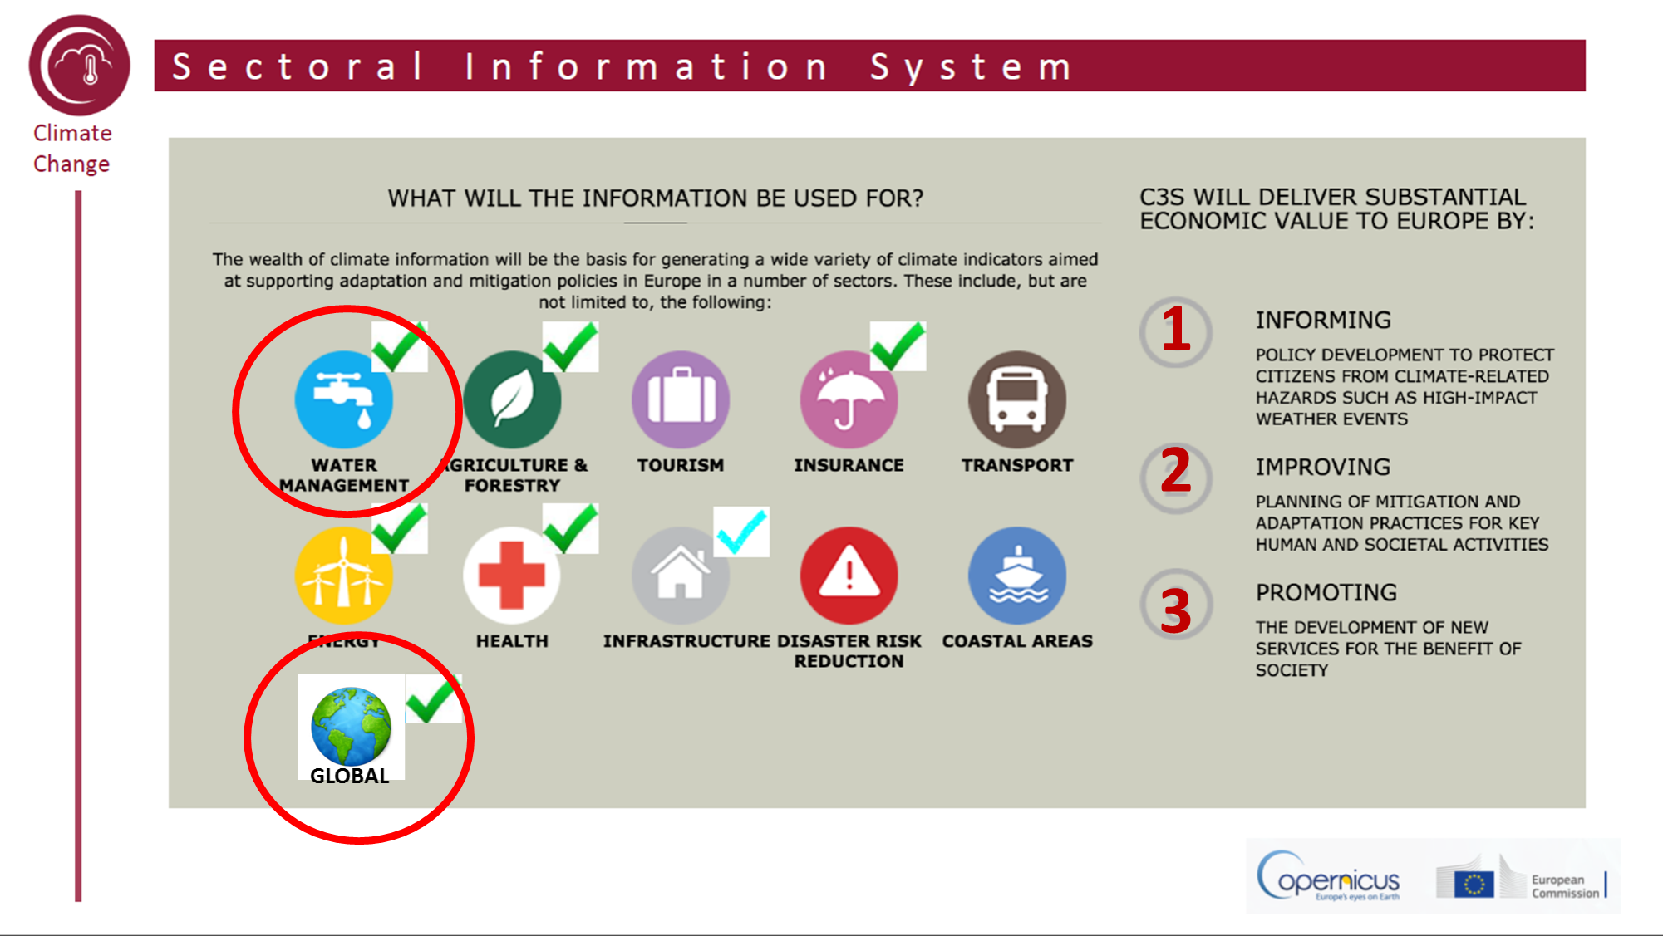
Data and proof-of-concepts for sectors

Slide 7
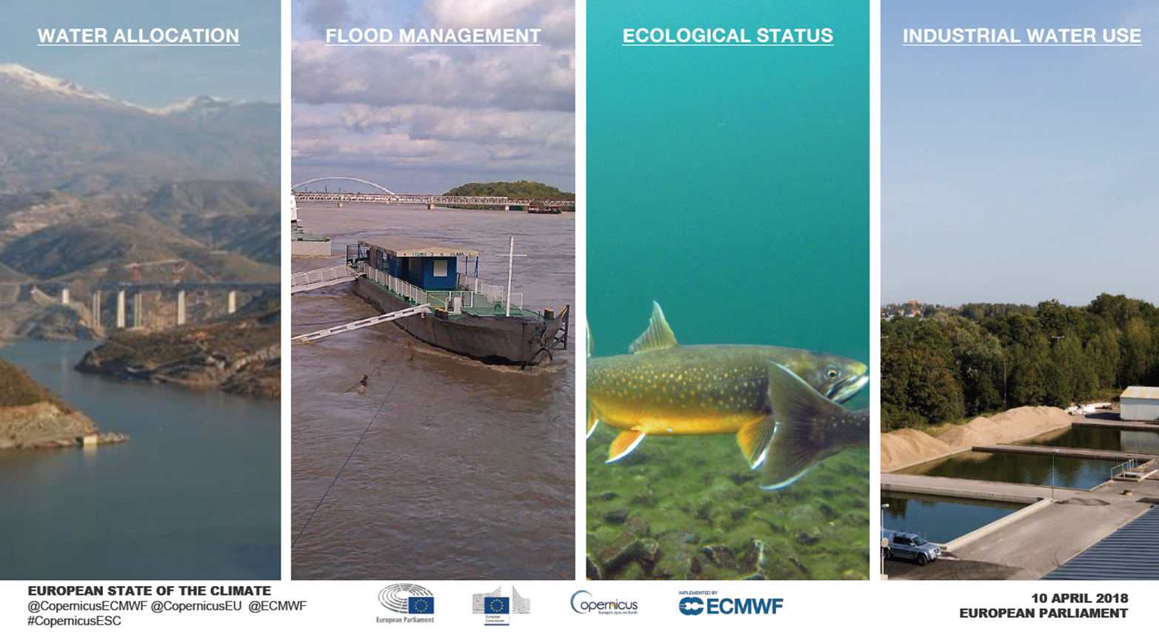
User communities in the water sector

Slide 8
Producers & Users in Climate Services
C
L
I
E
N
T
K
N
O
W
L
E
D
G
E
P
U
R
V
E
Y
O
R
GAP
P
R
O
V
I
D
E
R
(Weichselgartner and Arheimer,
Manuscript, 2018)

Slide 9
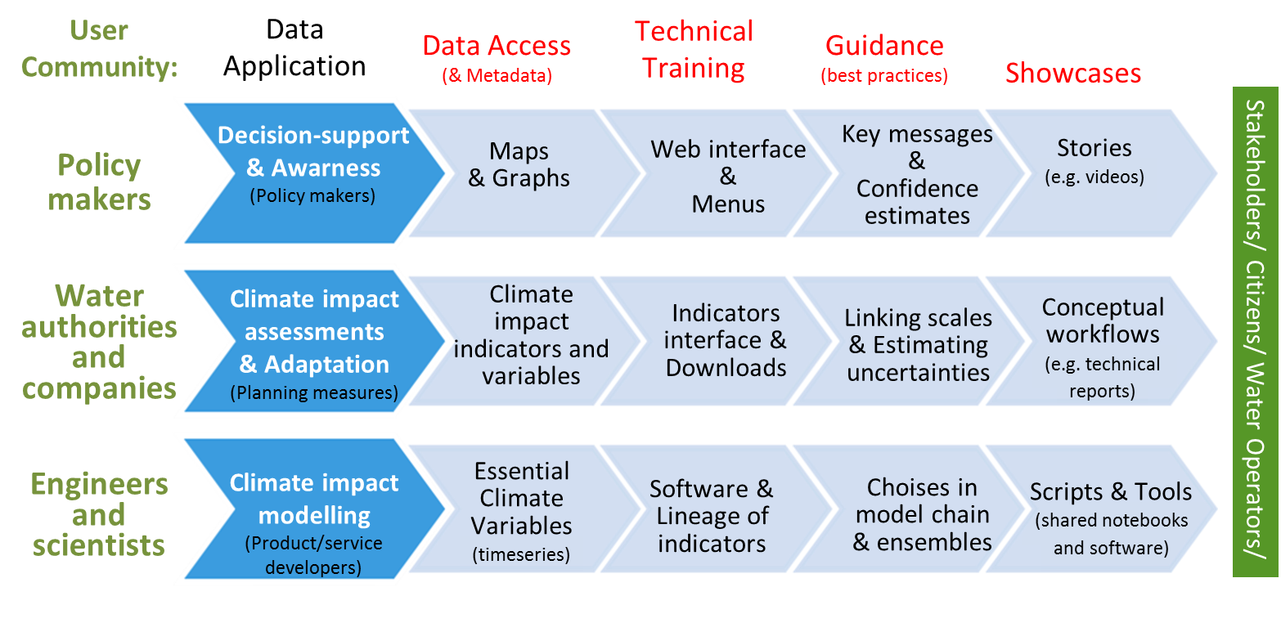
Components of climate services

Slide 10
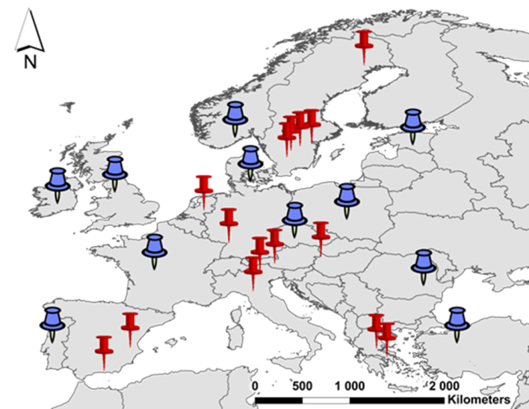
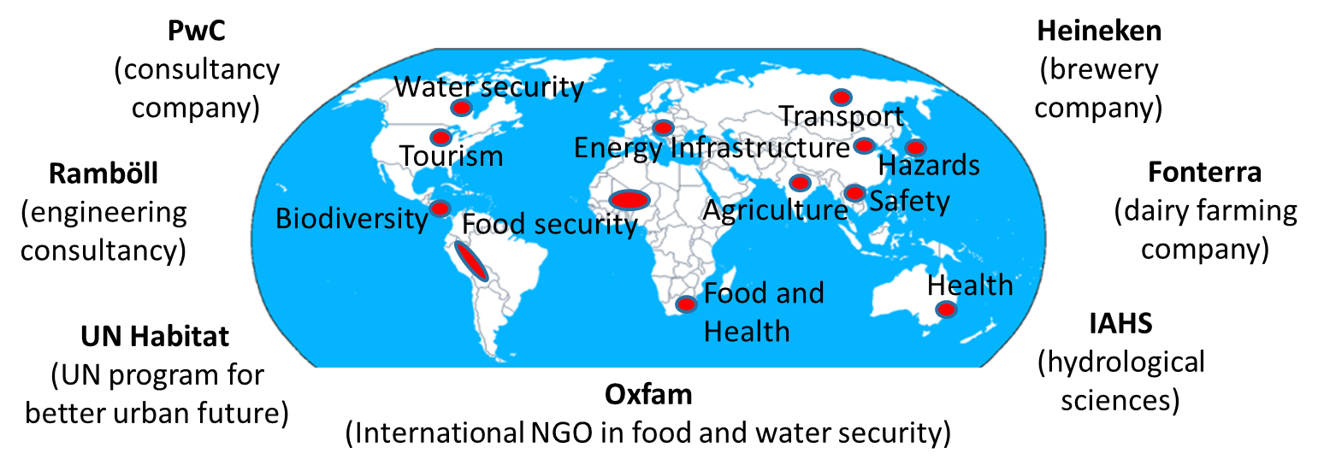
C3S: Co-design with user communities
In Europe:
Globally:

Slide 11
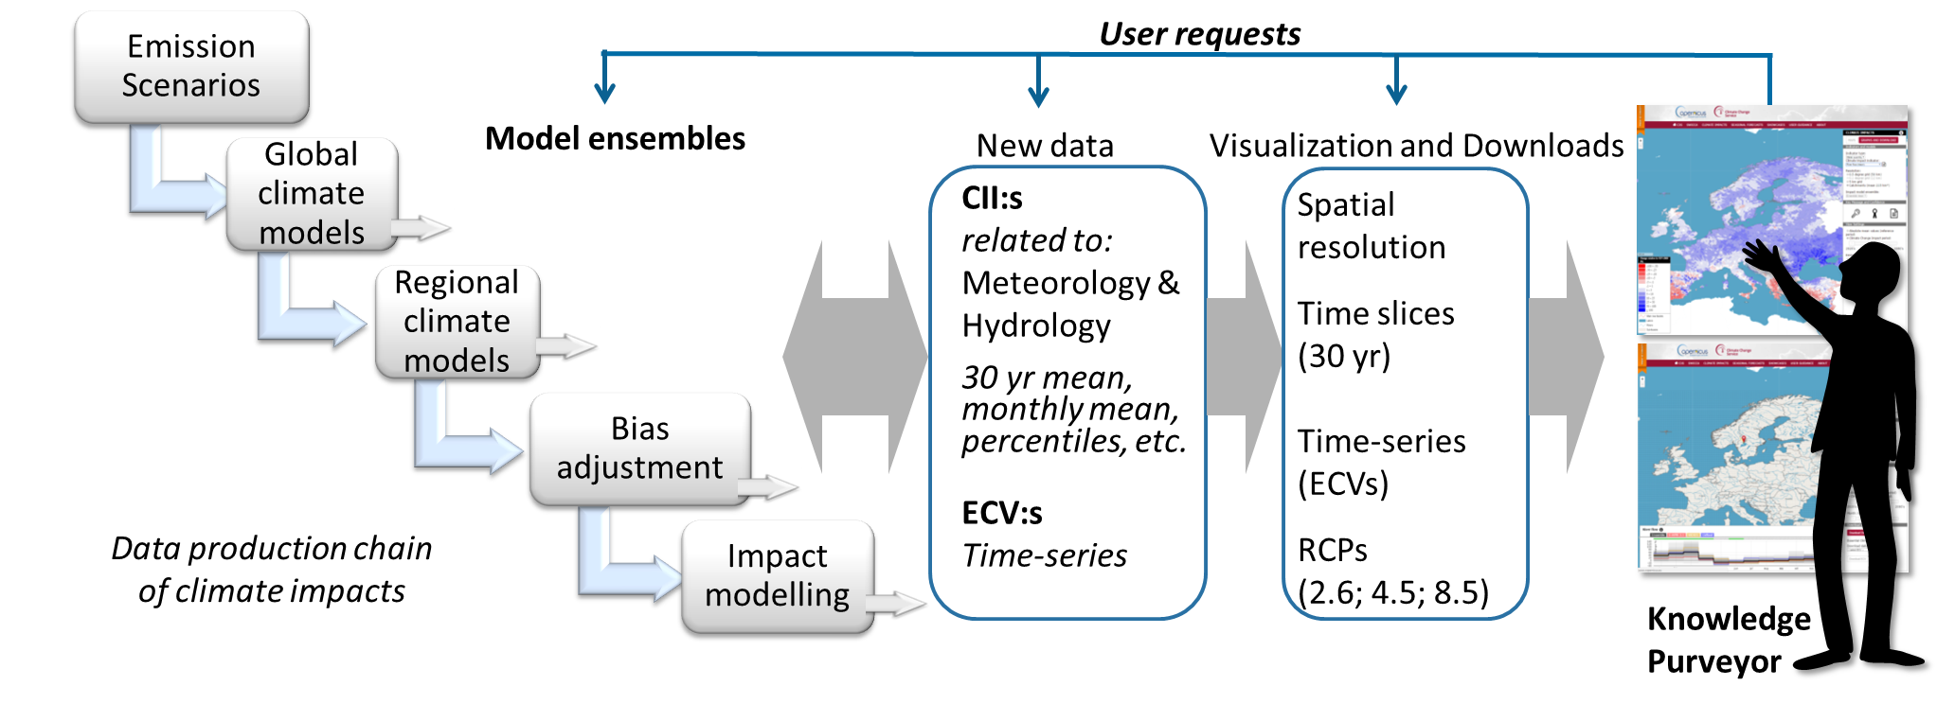
Data production chain in climate services

Slide 12
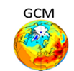




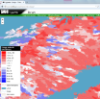



Choices to be made in a climate service
General Circulation Models
Regional Climate Models
Ensemble choice
Ensemble choice
?
Ensemble choice
Bias-adjustment & Scaling
Ensemble
choice
Who?
Indicator choice
What? Where?
How?
Impact Models
Knowledge
Purveyors
Water
Manager
Climate Service

Slide 13



Two types of climate services
the general and web-based
the tailor made in dialogue with a specific user.
Could the two categories be interlinked, by ‘Knowledge Purveyors’?
GENERAL
TAILORED

Slide 14
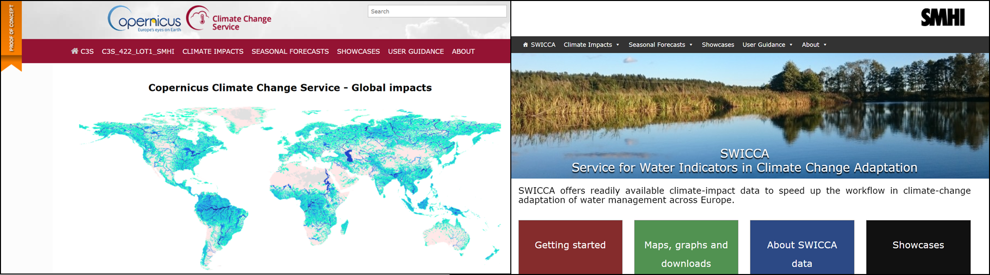
Proofs-of-Concepts with temporary web sites
http://climateservice-global.eu/
http://swicca.eu/

Slide 15
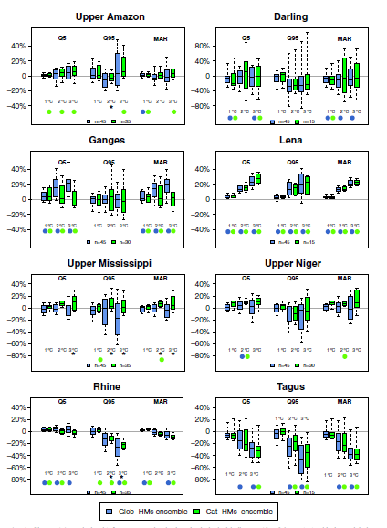
The value of ensembles? (pros and cons)
Shows the uncertainty due to model assumptions
Treat all models as equally probable
Easy and political correct
Does not show the full uncertainty
Some models may be less trustworthy and pollute the ensemble
Time-consuming for running impact modelling
Ensembles of Global vs Catchment models
(Gosling et al., 2016; Climatic Change)

Slide 16
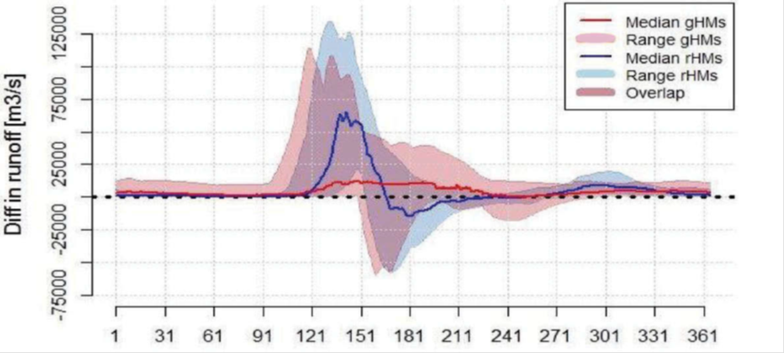
How to use the model ensemble?
Robustness estimates using full ensemble – some examples
Choosing model members from an ensemble – statistics or qualitative
Tailored approaches – site and user specific
(Krysanova et al., 2018, Hydro. Science Journal)

Slide 17
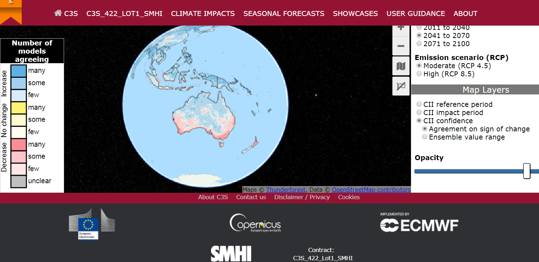
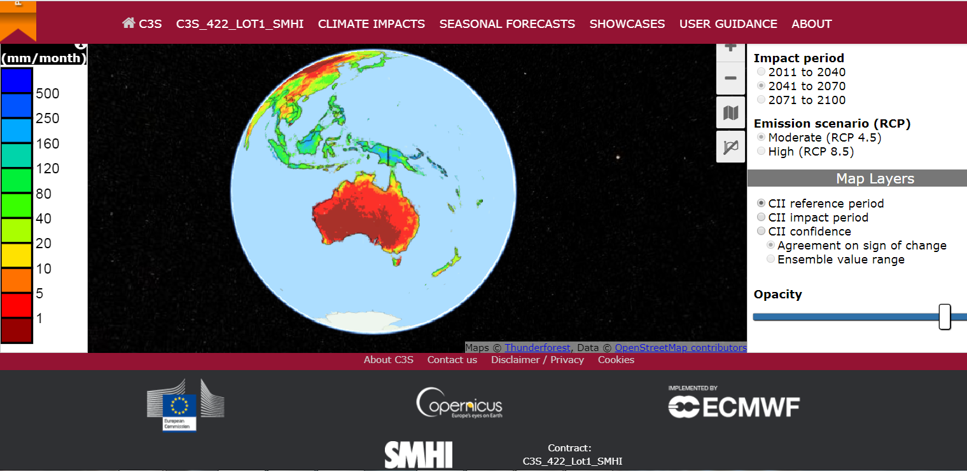
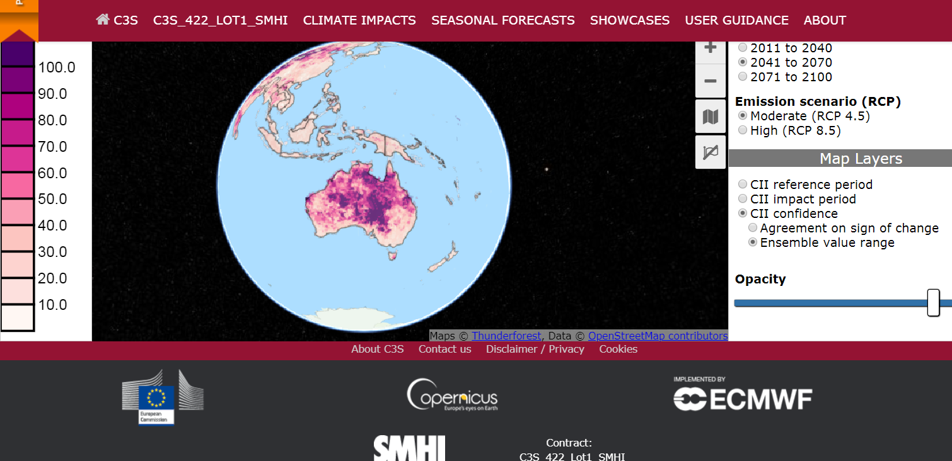
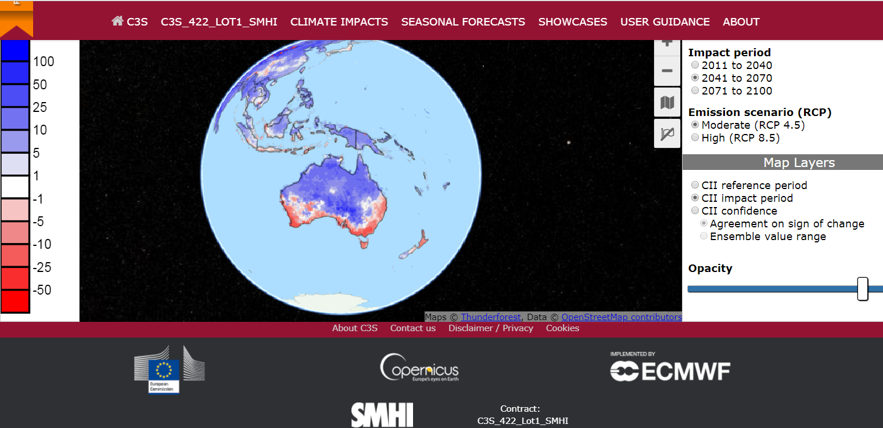
How to use the model ensemble?
Robustness estimates using full ensemble – some examples for water runoff:
http://climateservice-global.eu/climate-impacts/

Slide 18
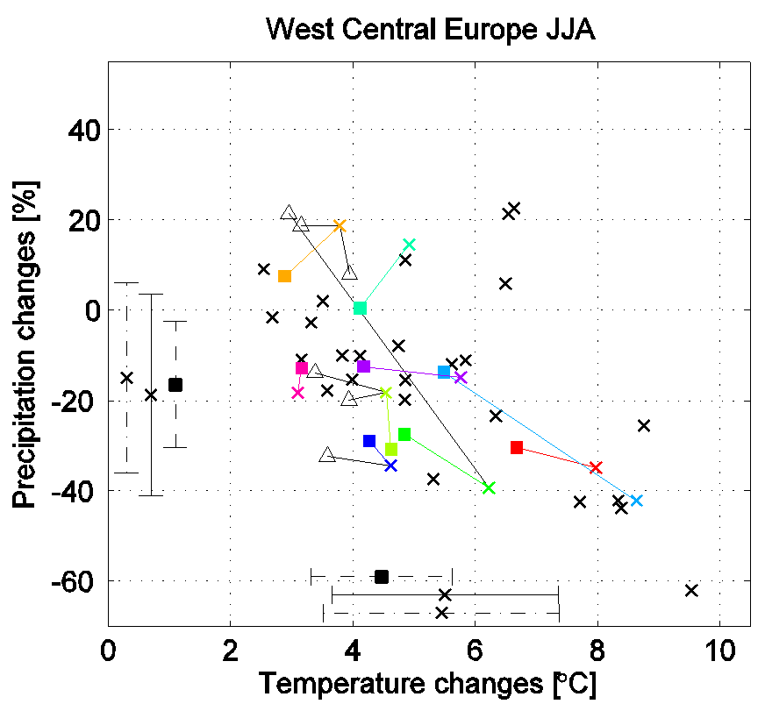
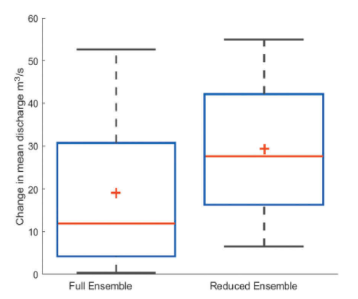
How to use the model ensemble?
Choosing model members from an ensemble – statistics or qualitative
Keeping ensemble spread?
Removing poorly performing members?
Water flow in Kalix River at 2°C warming
(Krysanova et al., 2018,
Hydro. Science Journal)

Slide 19
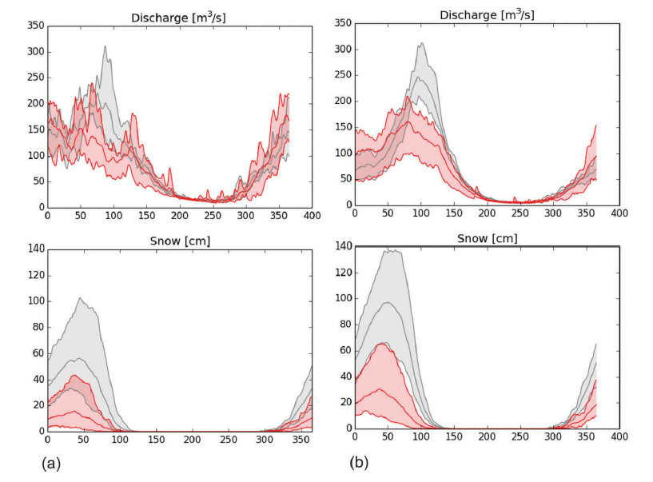
How to use the model ensemble?
Tailored approaches – site and user specific
Continental scale
Locally calibrated
(Krysanova et al., 2018, Hydro. Science Journal)

Slide 20



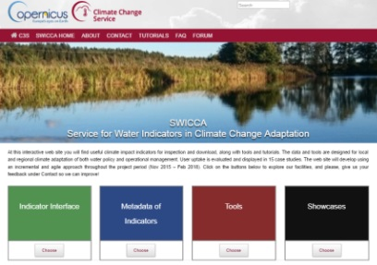





User guidance and feedback on (ensemble) choices
http://aquaclew.eu/
WEB INTERFACE
DATA & INFO
IMPACT
BIAS ADJ.
CLIMATE
FUTURE
Visualisation & Downloads
Variables,Indicators, Resolution,Confidence
Hydro. Models
Observations
GCMs & RCMs
RCPs
USERS

Slide 21
Concluding remark from user experience
Climate science is difficult with large uncertainties (requesting ensemble approaches) therefore there is a need of an intermediate expert - the ‘Knowledge purveyors”, i.e. consultant engineers.
Know-how in tailoring data is essential for a wide uptake of climate services. The large-scale data need to be further adjusted to observations and merged with local data sources.
Climate impact indicators are appreciated for quick assessments – yet they must be followed by key-messages, meta-data and fact sheets to be digested. Users also need to be ensured about service sustainability, data consistency, and robustness of results.

Slide 22
Thank you for your attention!
Hydrological Research unit, SMHI

Slide 23
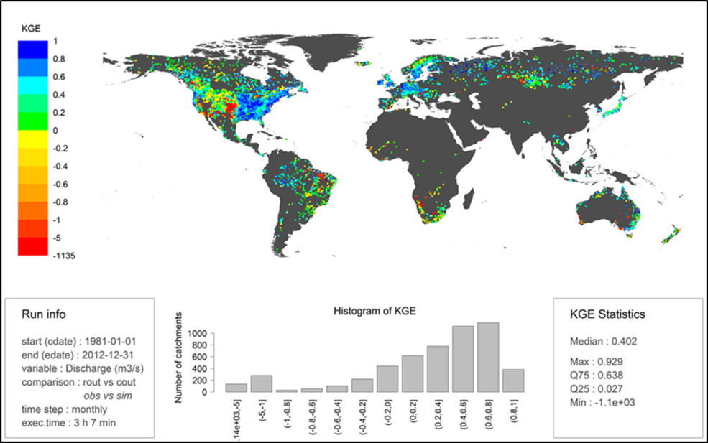
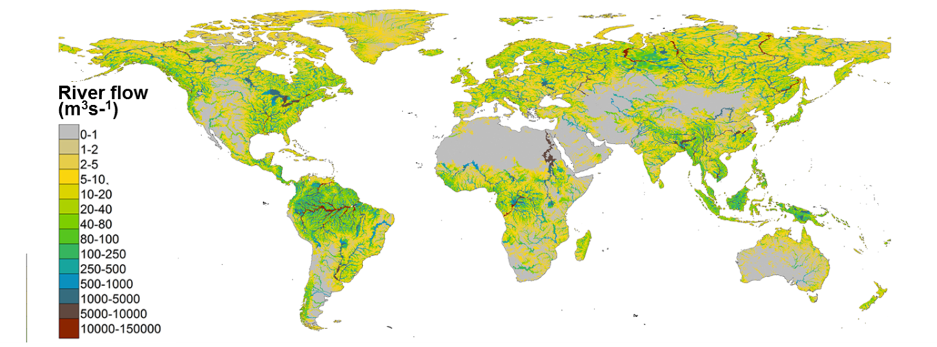
C3S_422_Lot1_SMHI: global service
CIIs & ECVs from 19 GCMs
Seasonal forecasts (precip., temp., River flow)
The World-Wide HYPE (WWH) model
WWH:
Catchment model (130 000 subbasins; 1000 km²)
Daily time-step
Input data from some 20 open global data sources
Representative gauges with Step-wise calibration
Evaluated against 5400 time-series
(Arheimer et al., manuscript, 2018)

Slide 24


