Slide 1
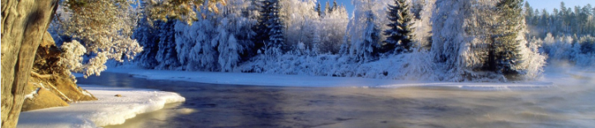
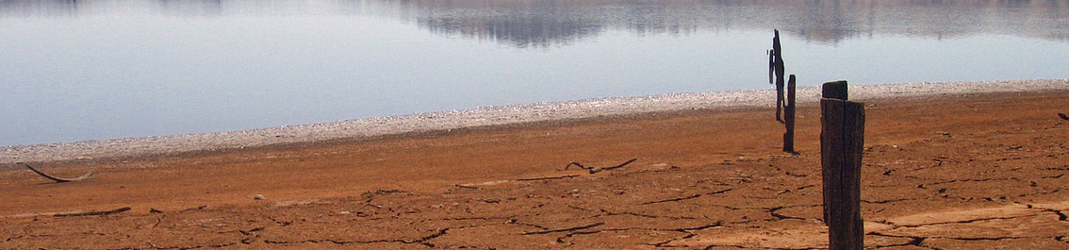
Using the EUROCORDEX ensemble to examine the impacts of 1.5, 2 and 3 °C global warming on European hydrology
Chantal Donnelly, Wouter Greuell, Jafet Andersson, Dieter Gerten, Giovanna Pisacane, Philippe Roudier, Fulco Ludwig and the teams at SMHI, WUR, PIC, ENEA and AFD.

Slide 2

Research Questions
UNFCC 2015 (COP Paris) "….hold the increase in the global mean temperature (GMT) to well below 2°C above pre-industrial levels and to pursue efforts to limit the temperature increase to 1.5°C……”
What are the impacts of a +1.5, +2 and +3°C increase in GMT and the associated changes in precipitation and other climate variables on freshwater flows in Europe?
Can we distinguish the differences in the impacts of climate change on water at +1.5, +2 and +3°C increase in GMT? Is our science good enough yet?

Slide 3
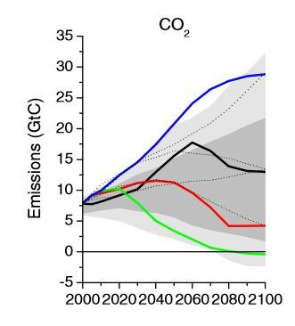
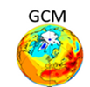


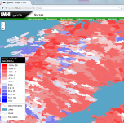

Hydrological Climate Impact Modelling
RCP
Representative Concentration Pathways
General Circulation Models
Regional Climate Models
Bias-Correction & Scaling
Impact Models
Water Indicators for Customers
Or statistical downscaling
Landuse, management changes
CMIP5
EuroCordex
IMPACT2C

Slide 4
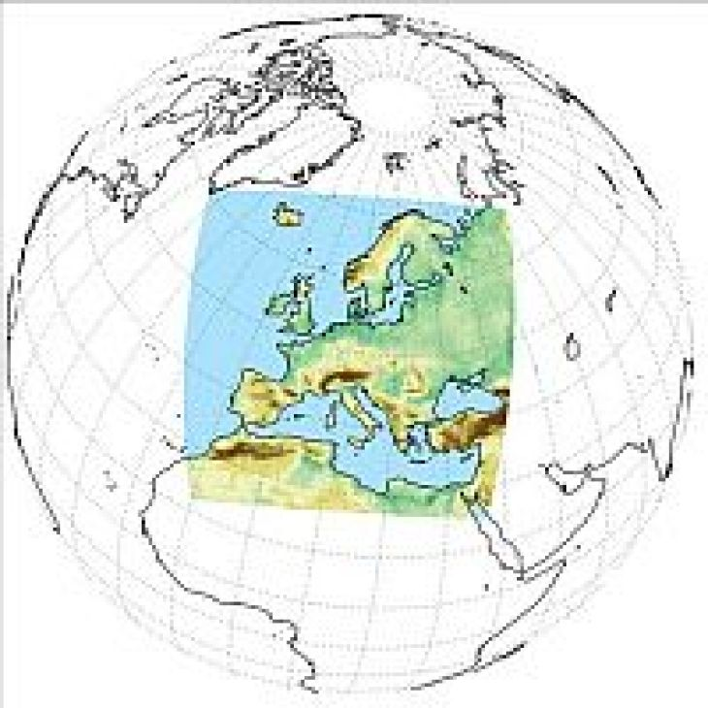
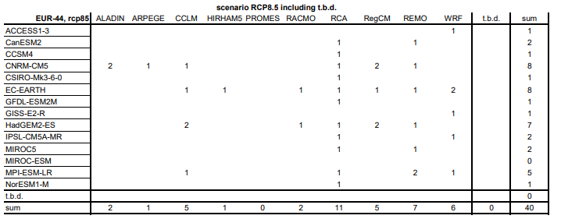
EURO-CORDEX
Coordinated Regional Downscaling Experiment (CORDEX)
Internationally coordinated framework to produce improved regional CC projections for all land regions worldwide
32 European institutions contributing (2018)
0.44º runs: 88 runs finished/published
** Uncertainty from the regional downscaling is significant and for some variables/locations is as significant as GCM uncertainty (e.g. Kjellstrom et al 2013)

Slide 5
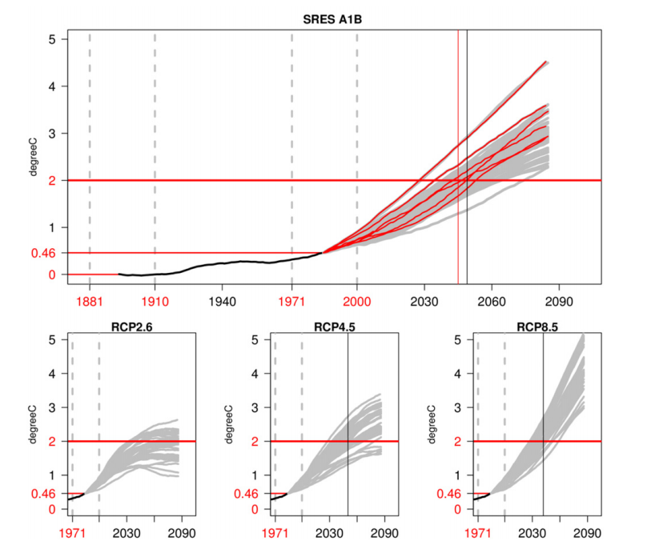
How do we quantify a 1.5, 2 or 3 C climate?
Looking for + 1.5/2/3 C from pre-industrial
Very few climate models have been run to stabilise at +1.5 C, 2 C, 3C, insufficient ensembles.
Large CMIP5 and Euro-Cordex ensembles
-> Define a 30 year period centred around the year the GCM reaches the warming threshold
i.e. scenarios that pass the target warming level are used as snapshots in time representing these levels of warming.
Vautard et al. 2014, Env Res. Lett. 9.

Slide 6
What do we have available to do this?
RCPs 2.6, 4.5 and 8.5,
Subset of 11 GCM/RCM combinations chosen using cluster analysis
5 GCMs, 4 RCMs
Bias-correction (quantile mapping)
5 European/Global hydrological models (VIC, EHYPE, LISFLOOD, LPJML, WBM)

Slide 7
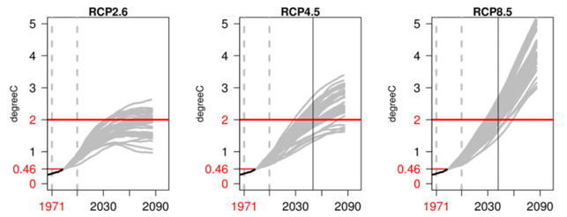
How do we quantify a 1.5, 2 or 3 C climate?
Which RCPs should we use?
RCP 2.6 and 4.5: Too few models reach +3 C prior to 2100
RCP 8.5: Models reaching +1.5 C early, initial state uncert. very high
For +1.5 C: Only the RCP 2.6 and RCP 4.5 runs are used – Low RCPs (35 ensemble members)
For 3 C: Only the RCP 8.5 runs are used – High RCP (20 ensemble members)
For 2 C: Twice, Low RCPs, High RCPs -> Experiment to evaluate the methodology
RCP | Driving GCM | RCM | +1.5°C period | +2°C period | +3°C period
2.6 | MPI-ESM-LR | CSC-Remo | 2035-2064 | 2071-2100 | na
2.6 | EC-EARTH | SMHI-RCA4 | 2028-2057 | 2071-2100 | na
4.5 | MPI-ESM-LR | CSC-Remo | 2020-2049 | 2050-2079 | na
4.5 | EC-EARTH | SMHI-RCA4 | 2019-2048 | 2042-2071 | na
4.5 | EC-EARTH | KNMI-RACMO22E | 2018-2047 | 2042-2071 | na
4.5 | Had-GEM-ES | SMHI-RCA4 | 2007-2036 | 2023-2053 | 2055-2084
4.5 | IPSL-CM5A-MR | IPSL-WRF331F | 2009-2038 | 2028-2057 | 2053-2082
8.5 | MPI-ESM-LR | CSC-Remo | 2014-2043 | 2030-2059 | 2053-2082
8.5 | EC-EARTH | SMHI-RCA4 | 2012-2041 | 2027-2056 | 2052-2081
8.5 | EC-EARTH | KNMI-RACMO22E | 2012-2041 | 2028-2057 | 2052-2081
8.5 | Had-GEM-ES | SMHI-RCA4 | 2004-2033 | 2016-2045 | 2037-2066
Low RCPs
High RCP

Slide 8

What do users want to know about future Water?
Precipitation: Mean annual precipitation
Evapotranspiration: Mean annual evapotranspiration
Runoff: Mean annual runoff (indicative of available water resources, e.g. for agriculture, water supply, navigation, hydropower etc.).
High runoff: Mean annual maximum runoff (indicative of recurring high flows/flood potential)
Low runoff: Mean annual low runoff (mean of annual 10th percentile runoff, indicative of streamflow drought, e.g. for agriculture, water supply, navigation etc. )
6. Snowpack: Mean annual snow water equivalent (SWE) maximum (indicative of snow storage for hydropower production and tourism)

Slide 9
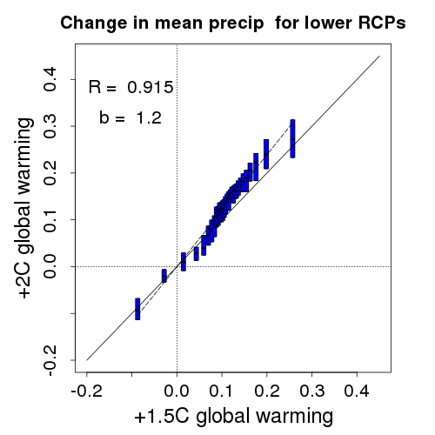
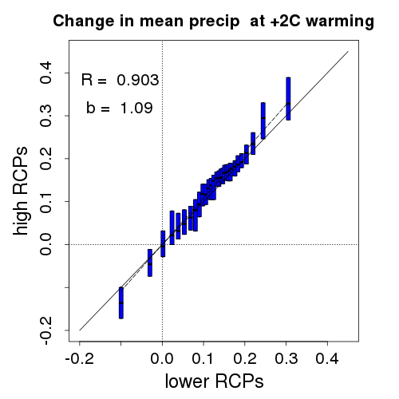
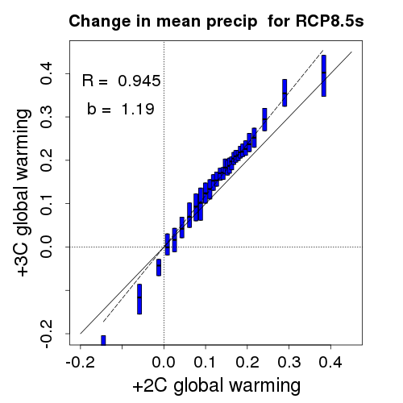
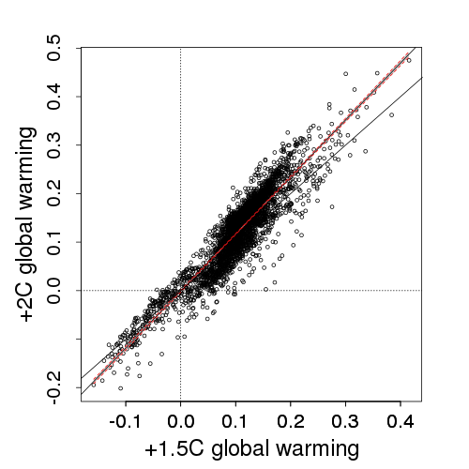
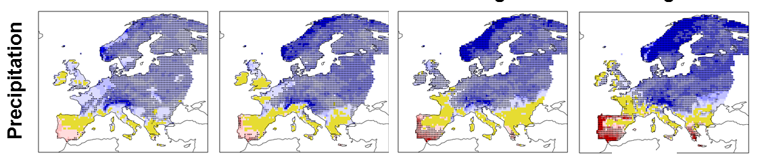
Results - Precipitation
Notes:
30 equal bins, interquartile range in each bin
Dots are the mean change in each grid cell for each GCM/RCM/HM combination

Slide 10
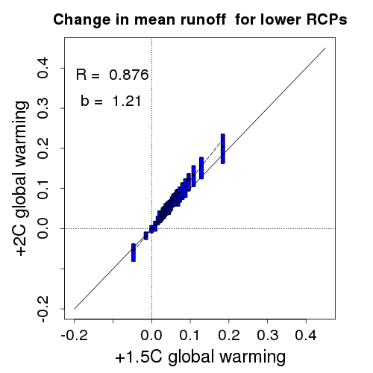
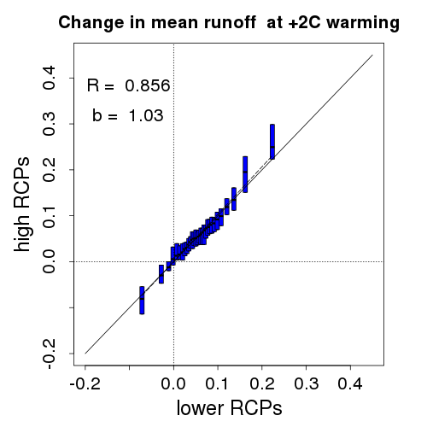
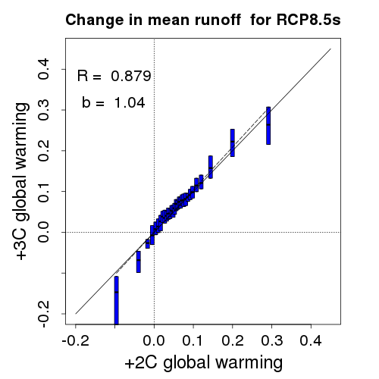
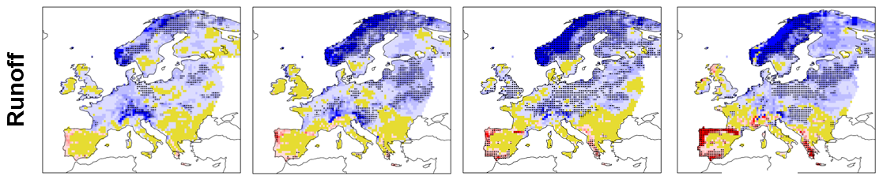
Results - Runoff

Slide 11
Key results for Europe
Robust increases in total annual P in most of central, western and northern Europe
Negligible or uncertain changes in P in central western and southern Europe and UK, even at the 3° level
Some decreases in P projected around the Iberian coast becoming larger and more widespread with increasing warming.
Robust increases in R only smaller regions, parts of Sweden and Norway, north-eastern Europe, Austria, the northwest Balkans and Hungary (varying between warming levels)
Negligible changes in R: large parts of France, UK, Spain, Greece and the Balkans = uncertain because individual models can give large positive or negative changes. Runoff changes in these regions should therefore be considered uncertain.
Clear difference between the changes to runoff in the 1.5 °C and 3°C scenarios, particularly with more widespread and intense decreases in runoff seen in the already water stressed regions of southern Europe

Slide 12
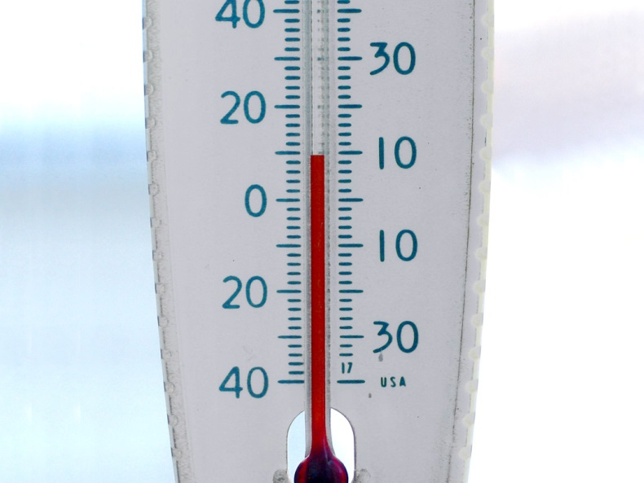
Some Interesting Discussion Points
The method used to define warming levels is ok, until better data becomes available.
Yes, there were differences between 2C impacts calculated using lower and high RCPs, but these differences were less than the differences between 1.5 and 2 C and between 2 and 3 C.
The higher 2C RCP had stronger impacts – Why?
Possibly due to inertia effect of ocean - longer to heat up in the lower emissions ensemble
Temperature difference between ocean and land would be higher for RCP8.5, possibly causing stronger impacts?

Slide 13
Final Key Messages
There is a considerable difference between the impacts on runoff at 1.5 and 2.0 degrees indicating even a small increase in global warming has an impact of the European water resources
Impacts are more widespread and intense at 3 C compared to 2 or 1.5C
Worst decreases in runoff are for 3C in southern Europe – water supply risks
See both positive and negative impacts: e.g. Increases in northern runoff – hydropower gains

Slide 15
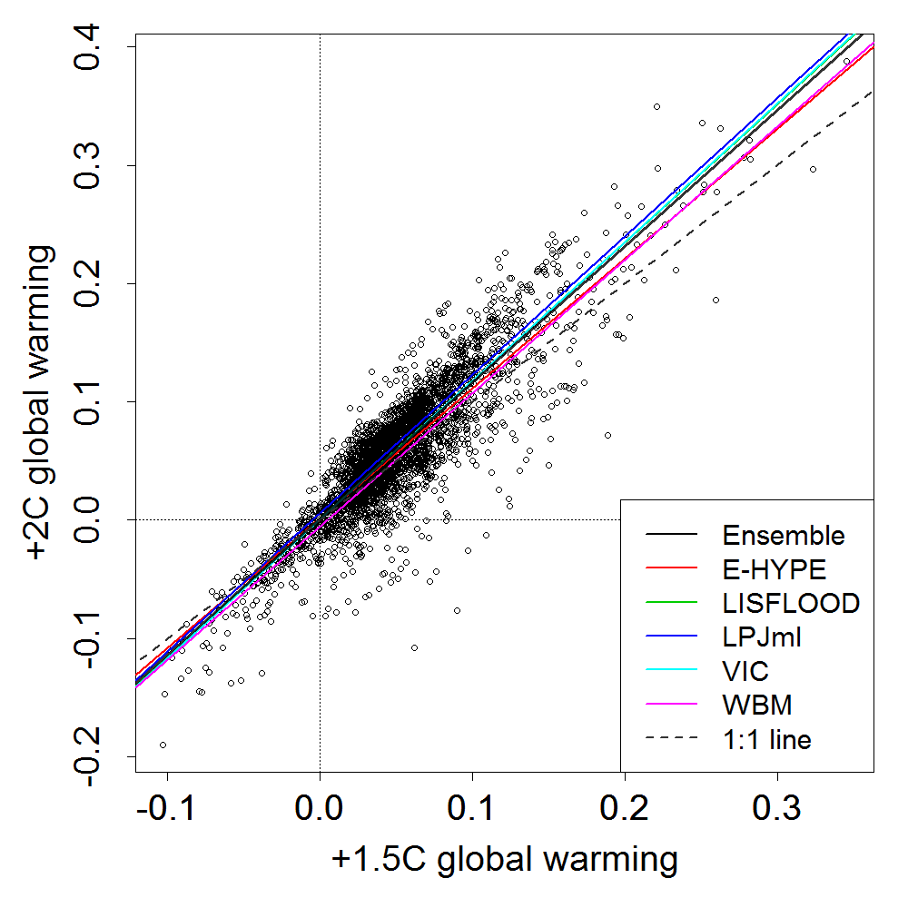
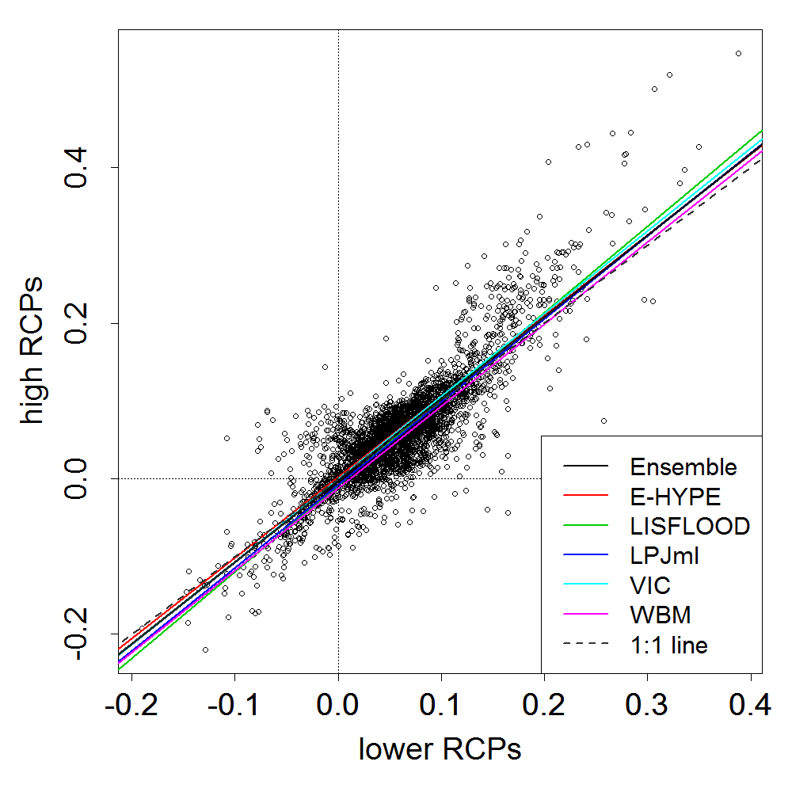
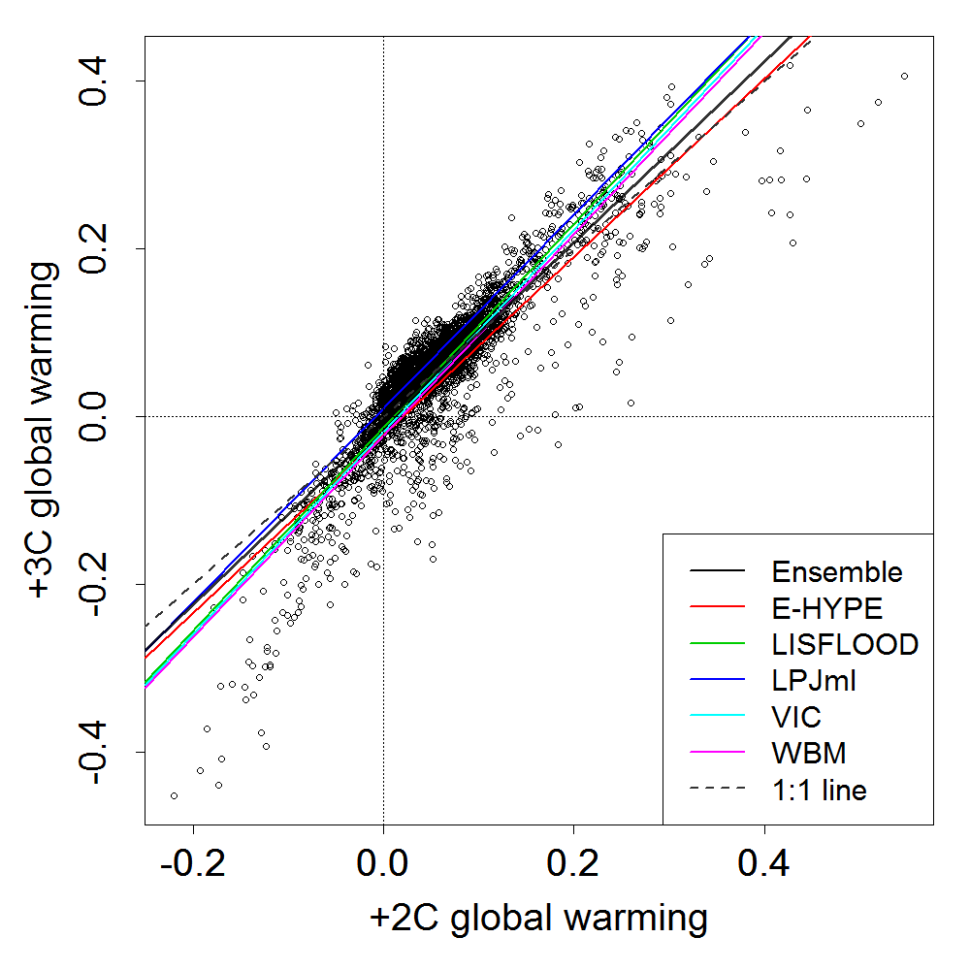
Hydrological Model Uncertainty
Notes:
Fig. 2 Comparison of HM sensitivity to warming plotted for different levels of warming (left and right column) and for different RCPs (middle column) for +2°C. The coloured lines are a linear fit (least squares) for each HM to the CM ensemble mean changes at each grid point. The points are the HM and CM ensemble mean changes in runoff.

Slide 16
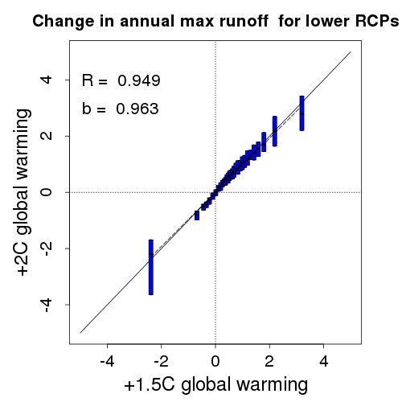
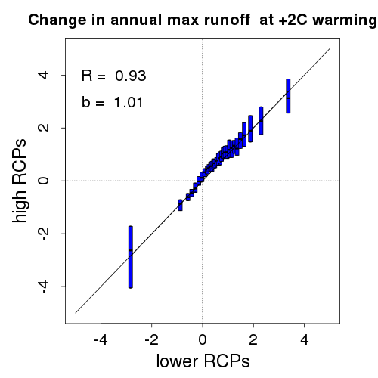
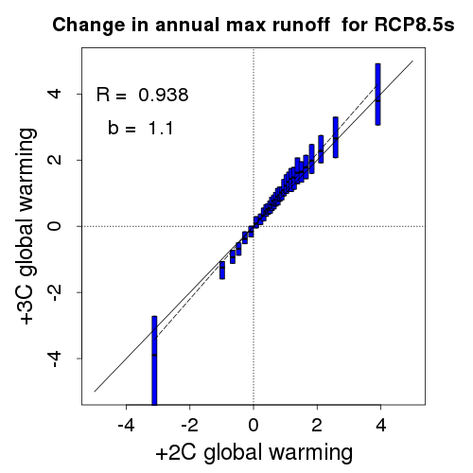
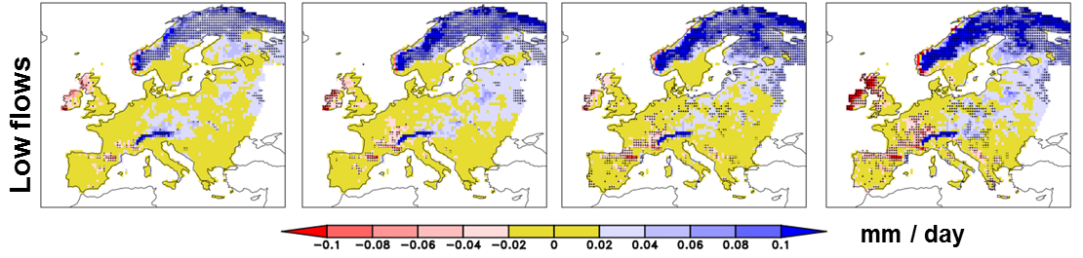
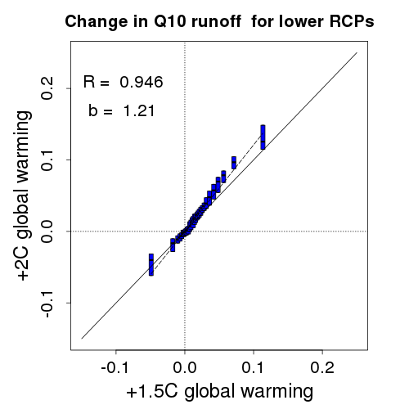
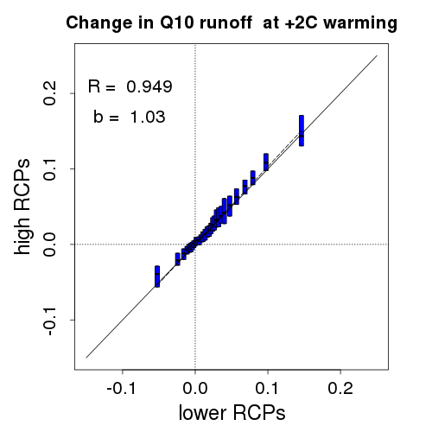
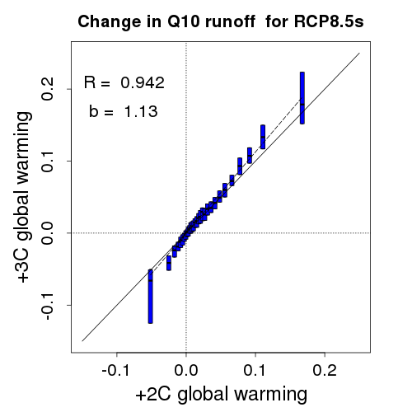
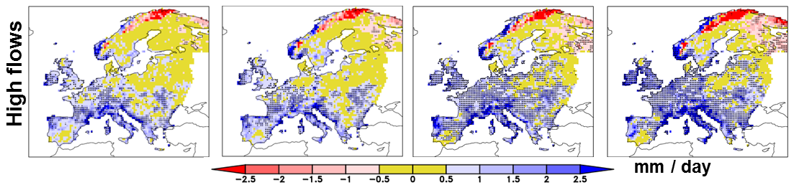
Results – Low and High flows

