Slide 1
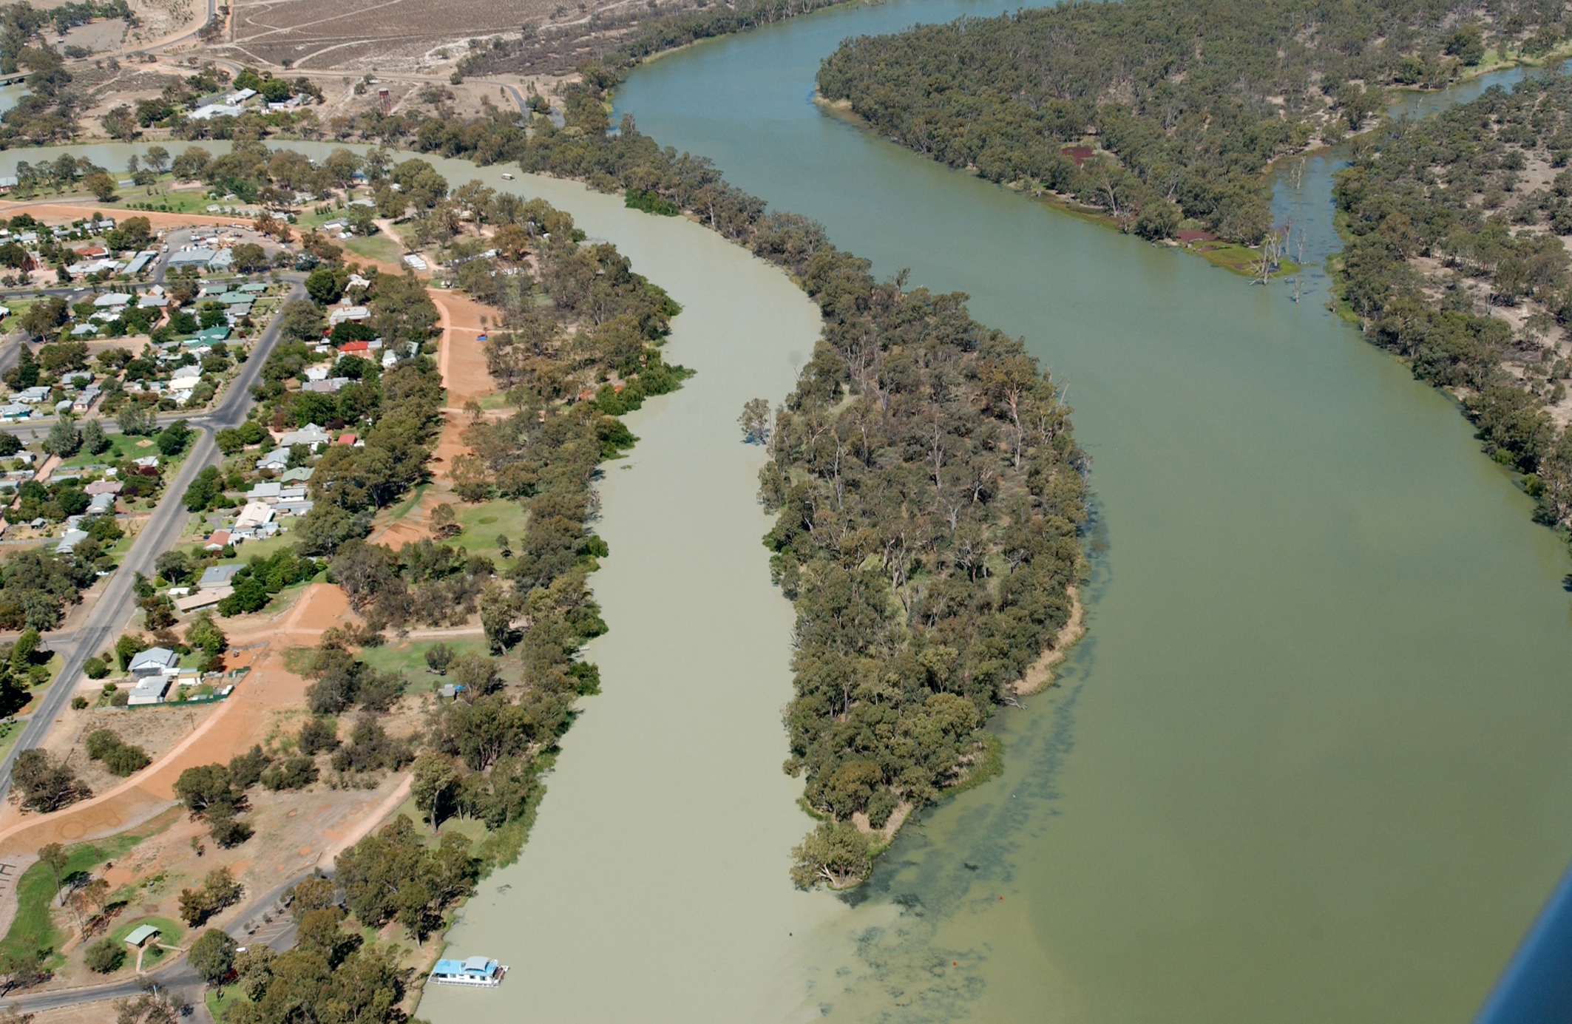
Predicting water futures: cascading ensemble of uncertainties
Francis Chiew
CSIRO LAND AND WATER
Bureau of Meteorology R&D Workshop 2018
Melbourne, 26–30 November 2018

Slide 2
Predicting water futures: Modelling components and sources of uncertainties
Greenhouse gas emission scenarios.
Time horizons.
Uncertainty in future rainfall (and climate) projections
Interpreting and communicating multiple climate projection data sources.
Extrapolating models to a future that is different from the past.
Climate inputs for hydrological simulations.

Slide 3
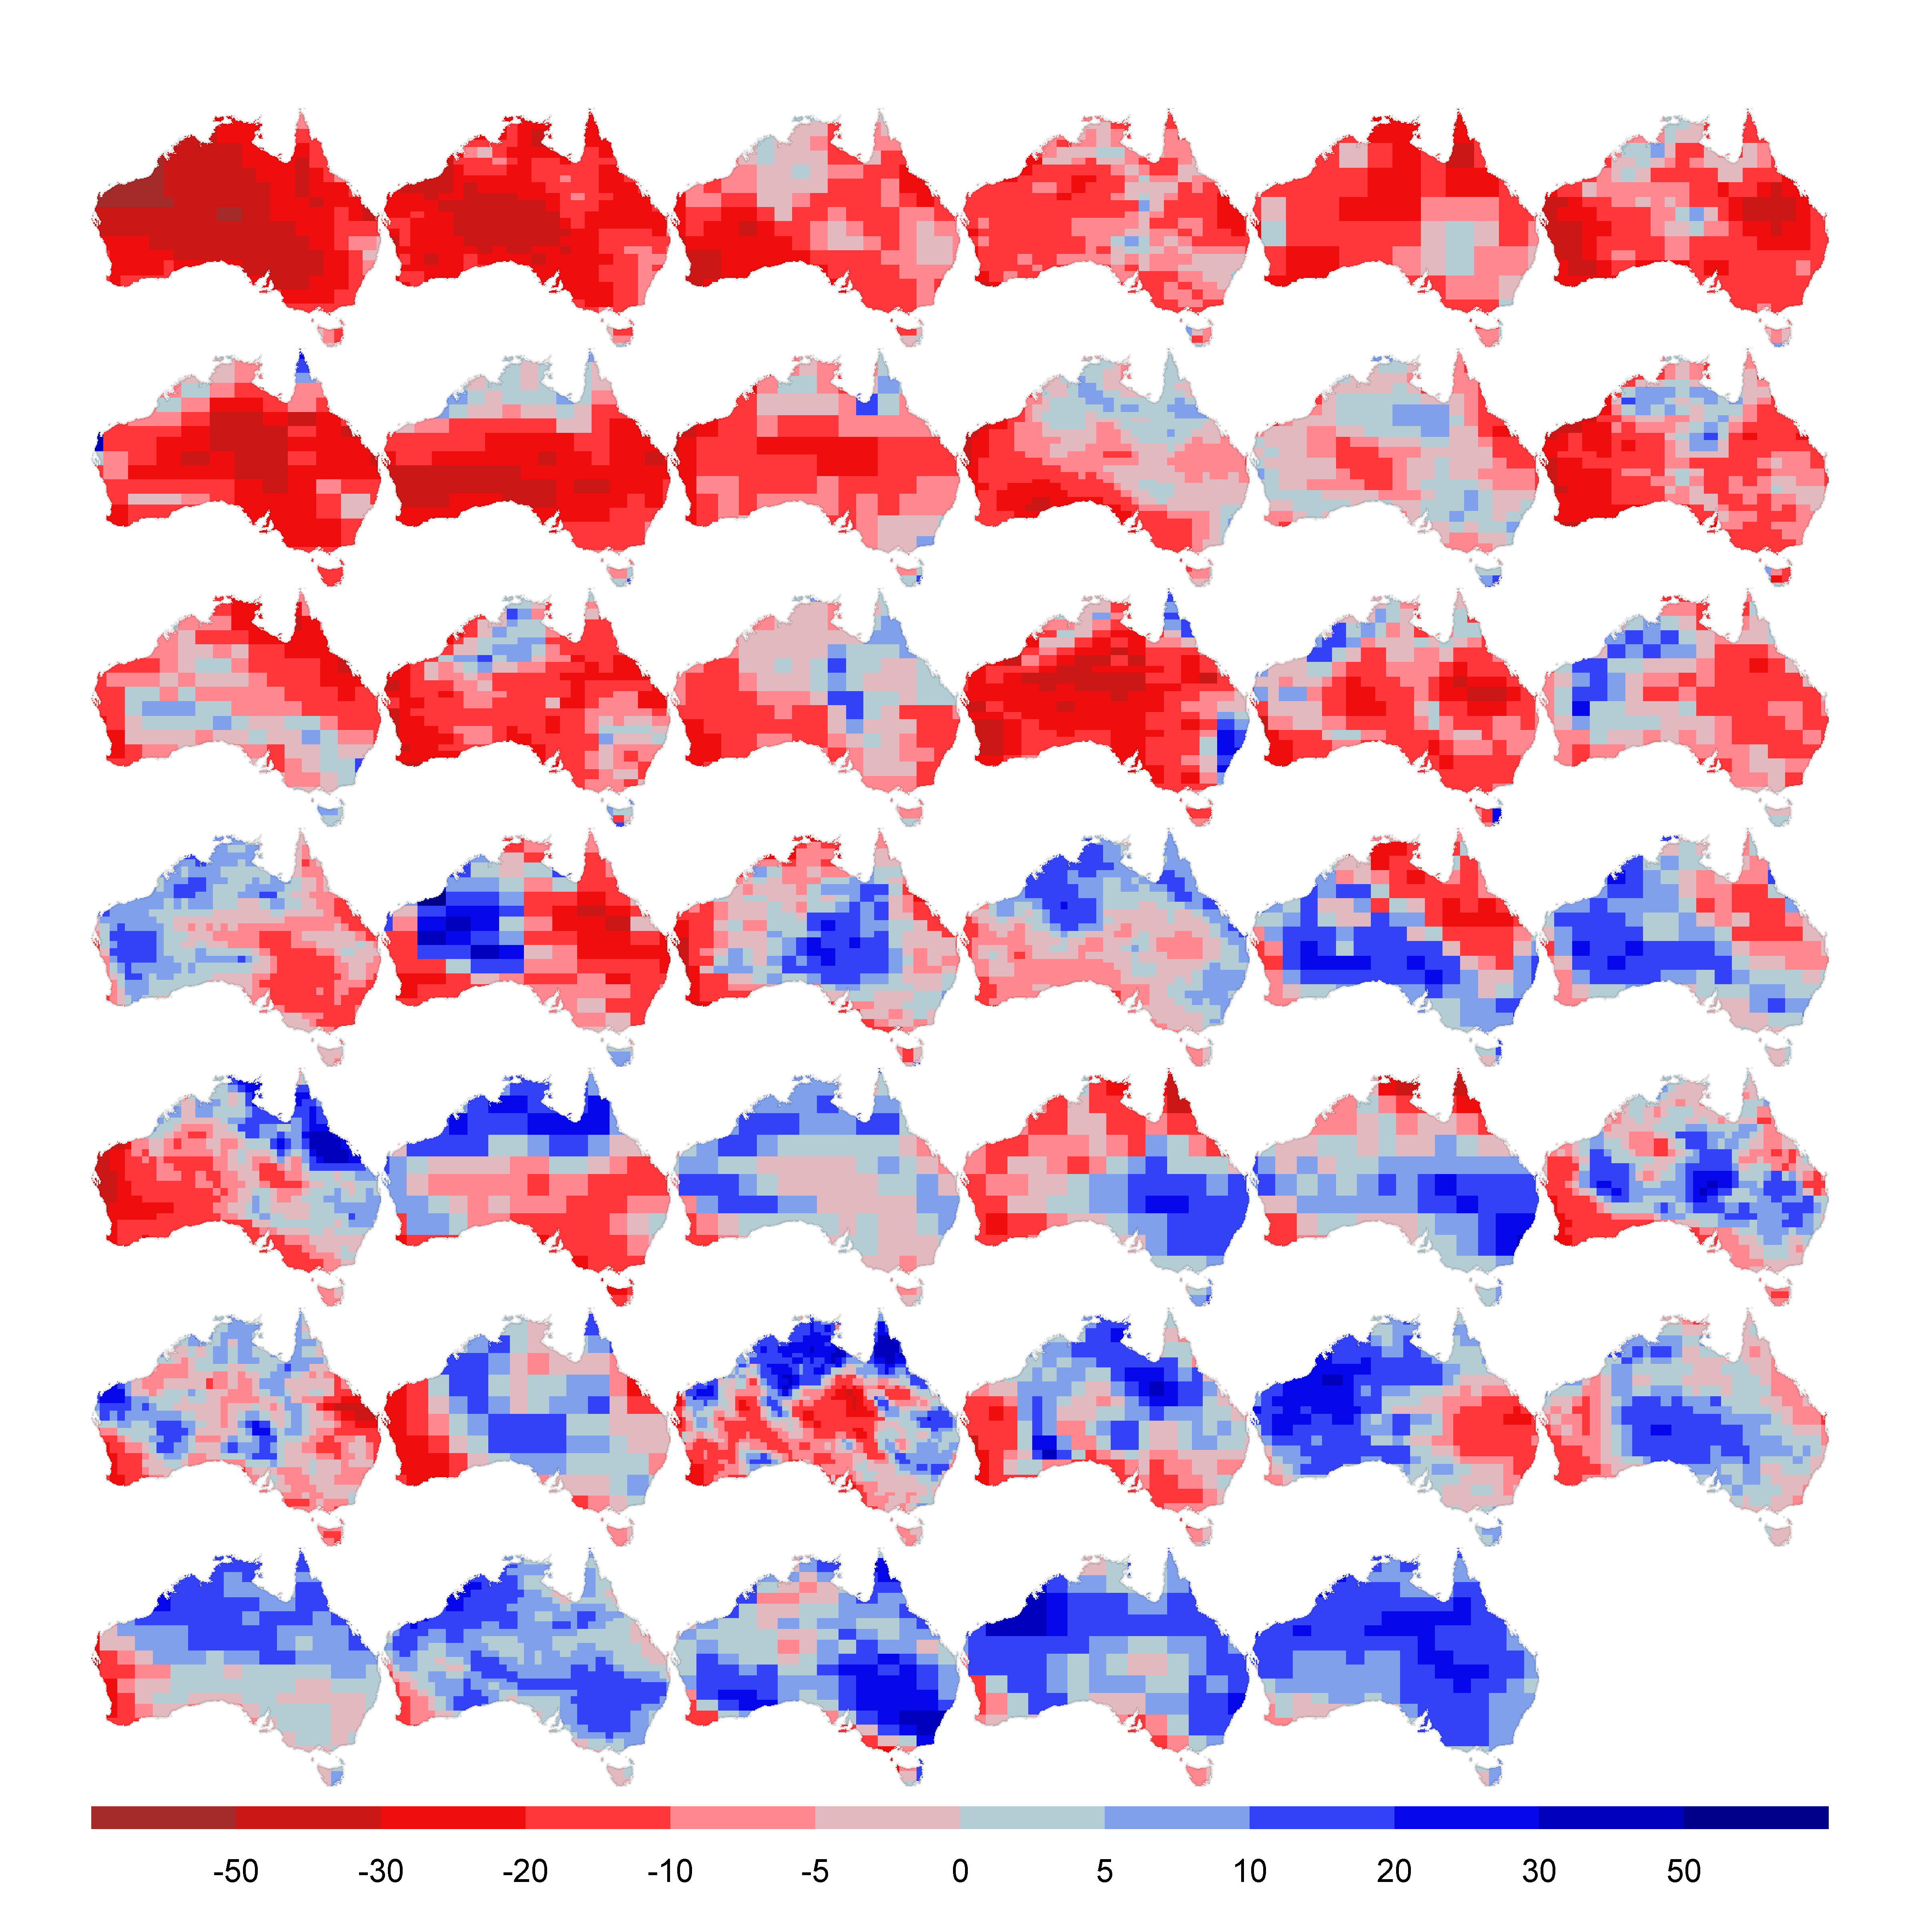
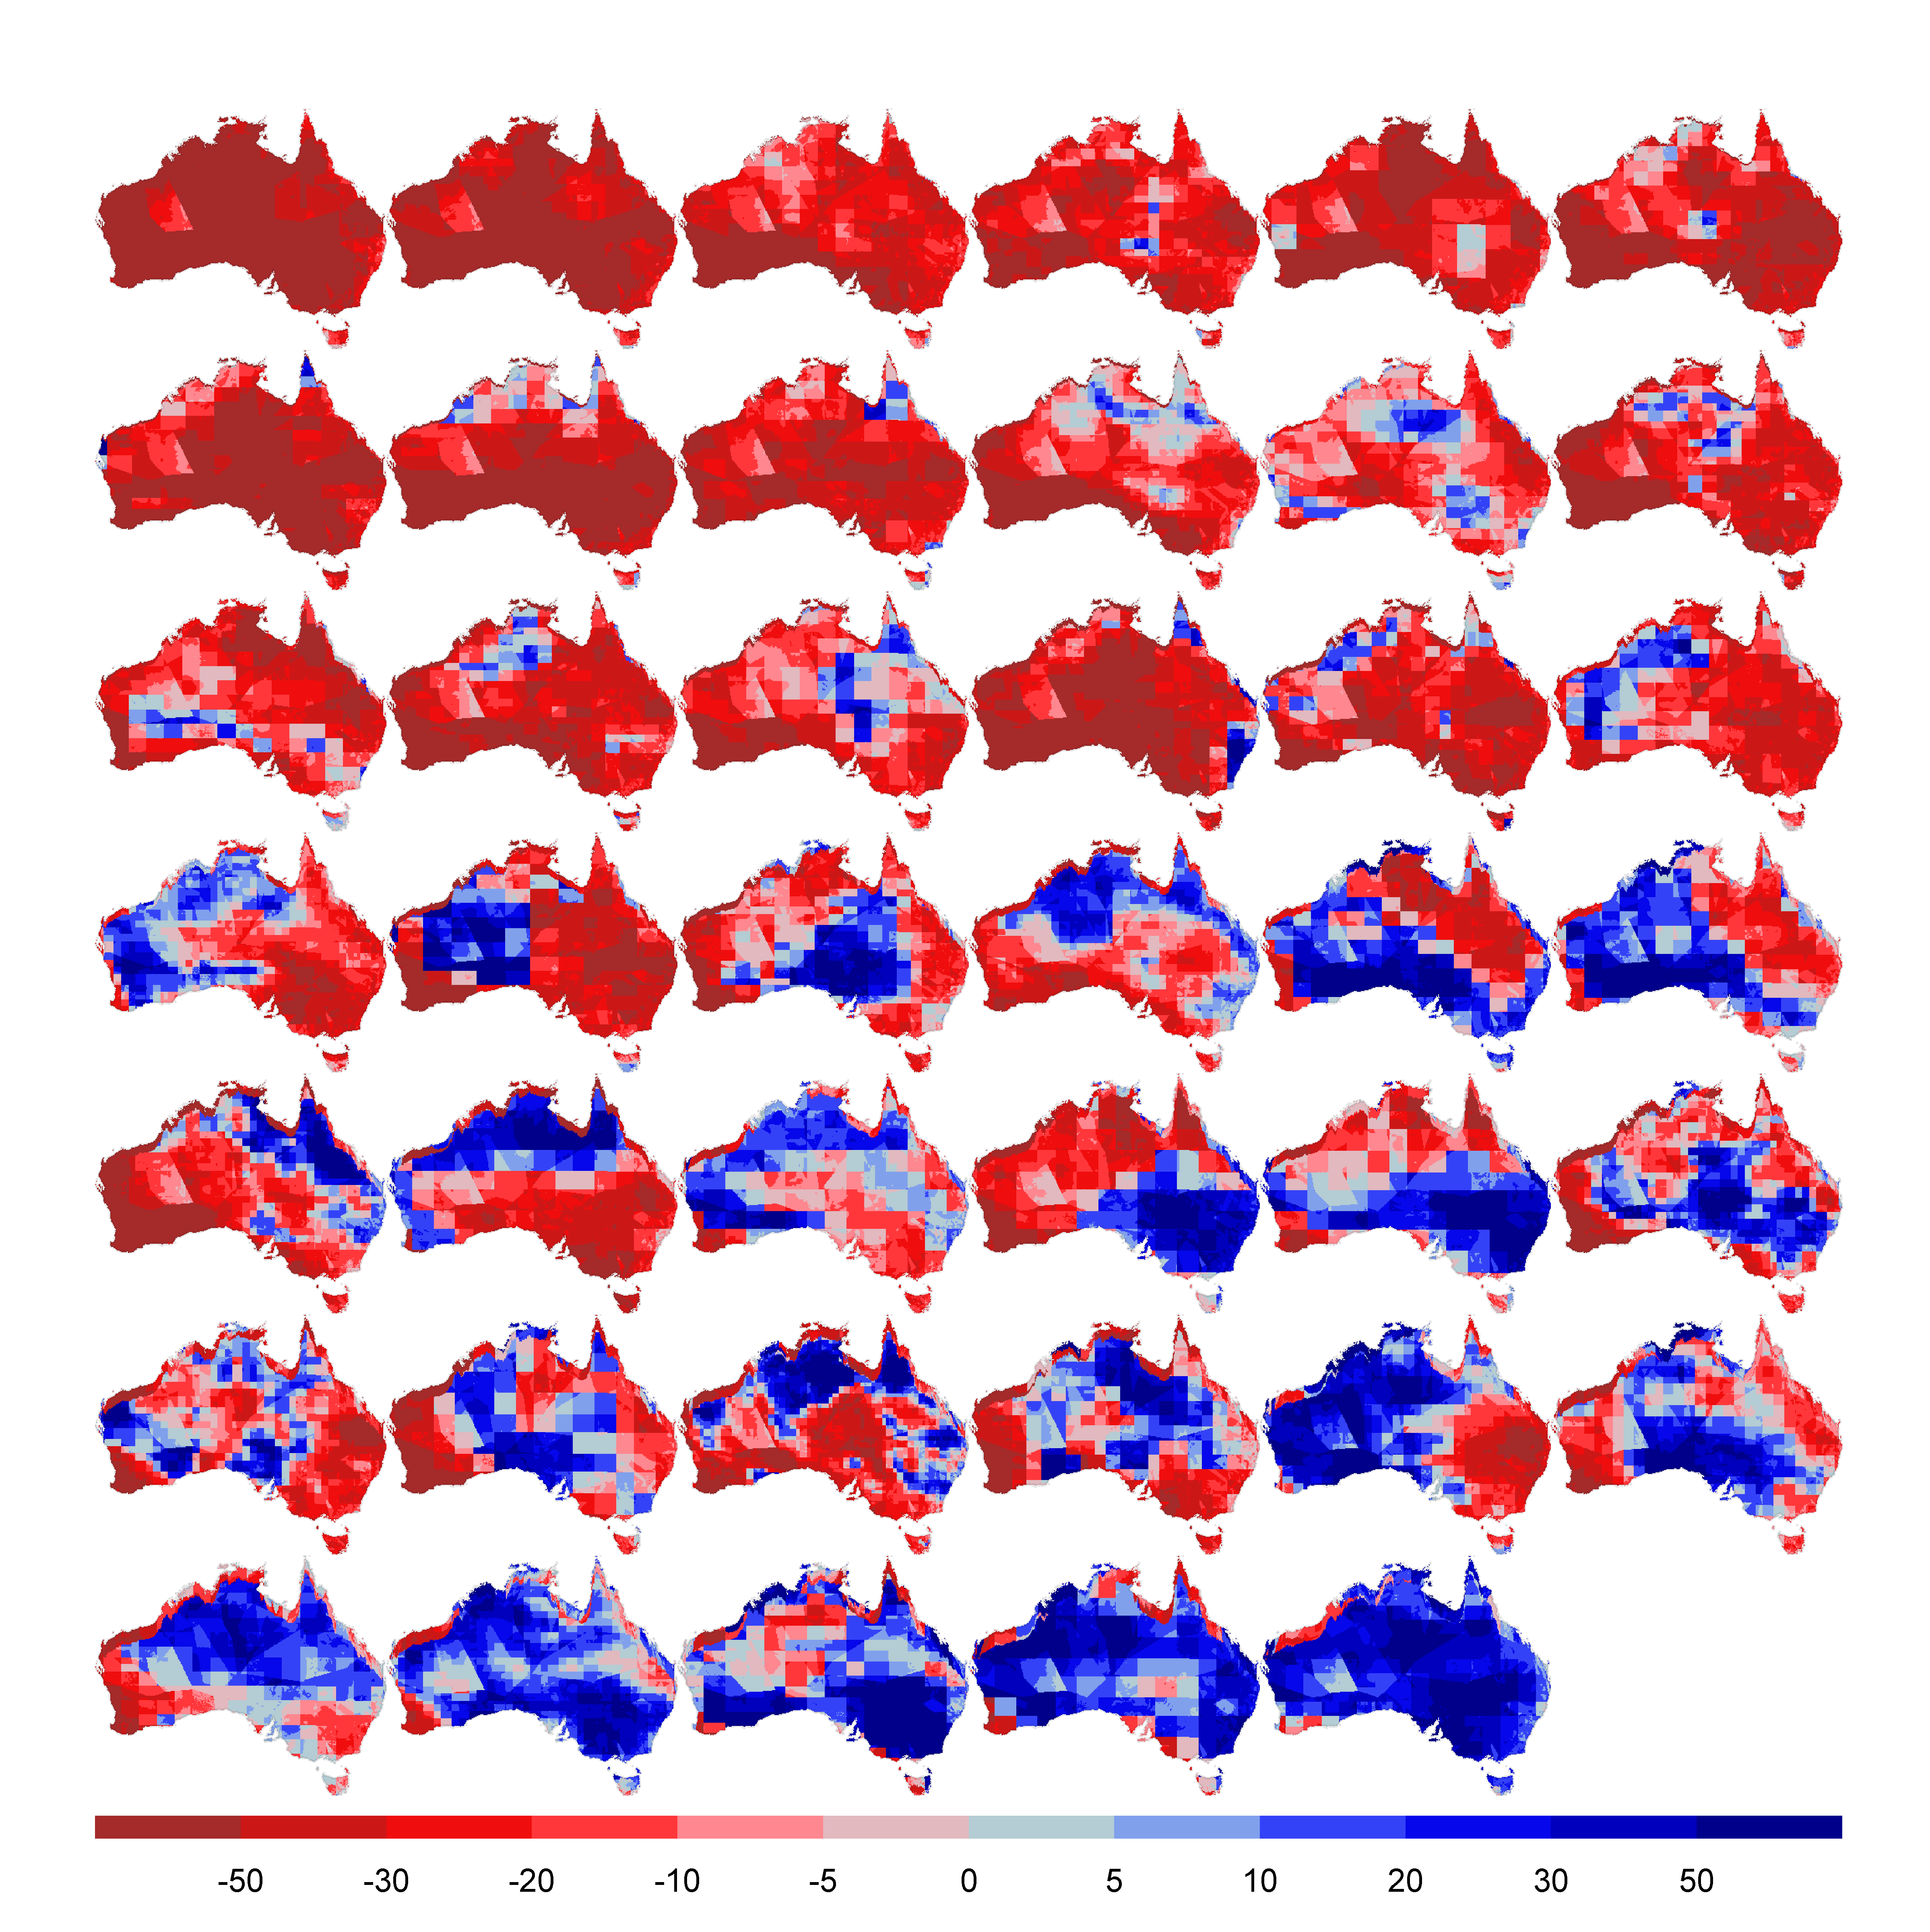
Large uncertainty in future rainfall projections
….. amplified in the runoff
Projections from 41 CMIP5 (IPCC AR5) GCMs
Percentage change in future RAINFALL
(RCP8.5, 2046–2075)
Percentage change in future RUNOFF
(RCP8.5, 2046–2075)

Slide 4
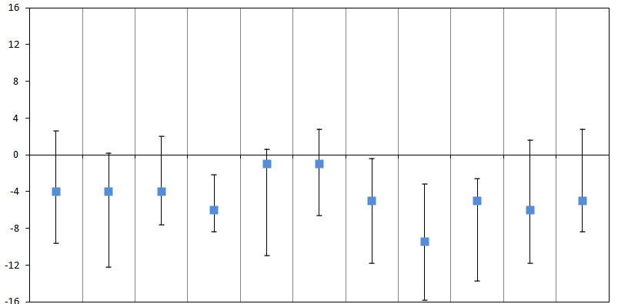
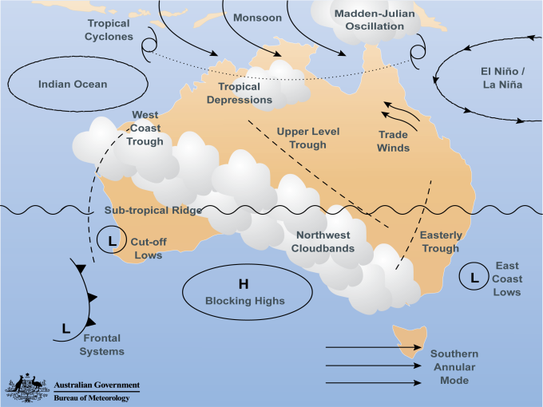
Reducing uncertainty by using only the better GCMs?
Percentage change in future mean annual rainfall
Range of projections from ‘best five’ GCMs
[10th percentile, median and 90th percentile]
IOD
ENSO
STR
SAM
All GCMs
Rainfall
Temp
MSLP
ENSO
IOD
SAM
P vs ENSO
P vs IOD
P vs SAM
P vs STR
[NRM projections technical report, 2015]
[Chiew et al., JHydrol, 2009]
[Smith & Chandler, ClimChg, 2009]
[Kirono et al., MODSIM, 2011]

Slide 5
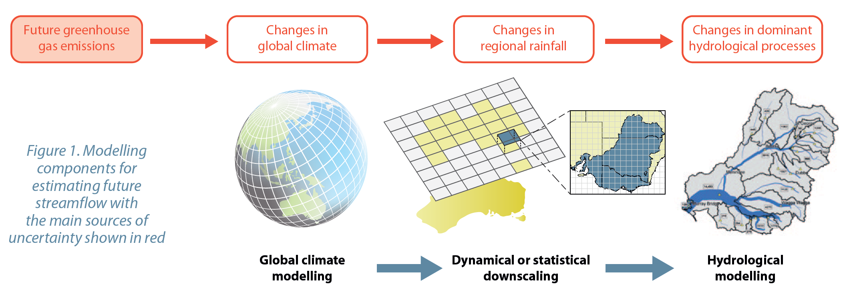
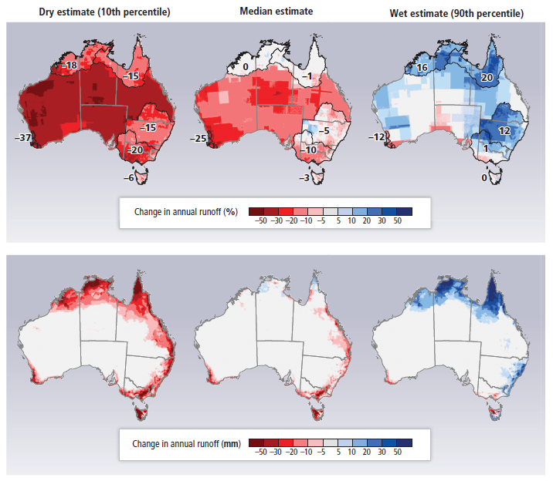
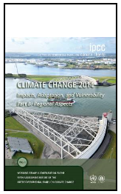

Climate change impact on future runoff
Change in mean annual runoff for 1ºC warming
[Chiew et al., MODSIM, 2017]
[Chiew et al., WRR, 2009]
[Petheram et al., JHydrometeorol, 2012]
[Post et al., JHydrol, 2012]
[Teng et al., JHydrometeorol, 2012]
[Chiew and Prosser, CSIRO Water Book, 2011]

Slide 6
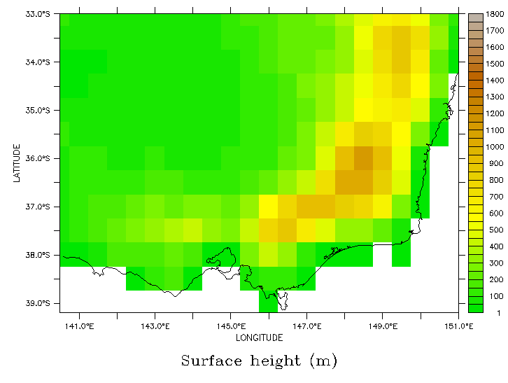
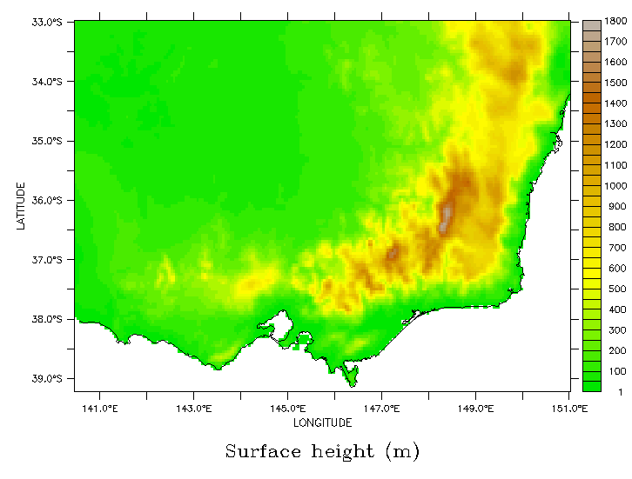
Dynamic downscaling
50 km resolution
5 km resolution

Slide 7
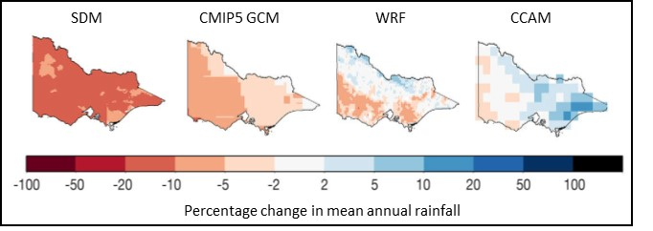
Downscaling?
[Potter et al., 2017]
[Hope et al., VicCI Synthesis Report, 2017]
[Ekstrom et al., Climate Services, 2016]
[Grose et al., AMOS, 2015]

Slide 8
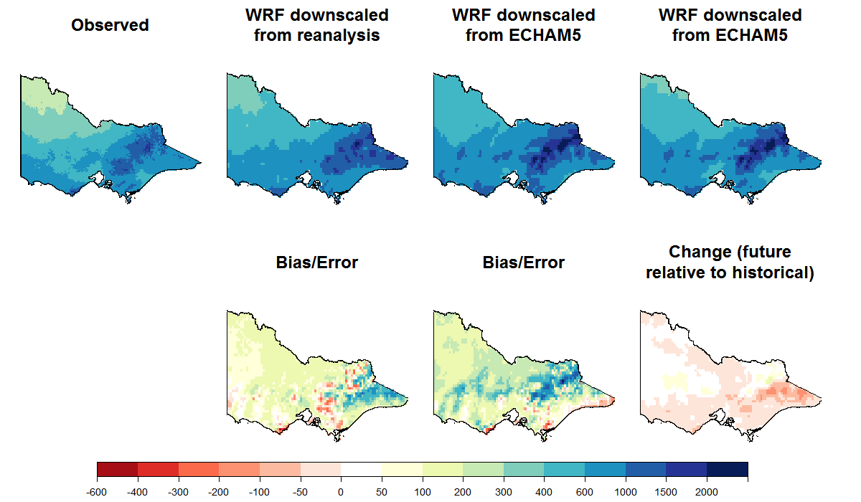
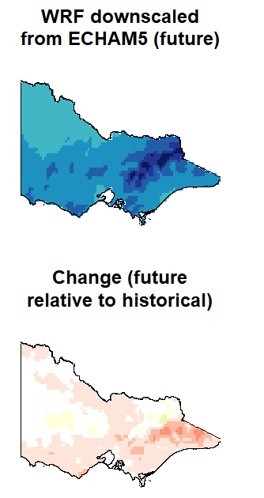
Significant bias in downscaled rainfall
Historical simulation (1990–2009)
Future (2060–2079)
[Potter et al., 2018]
Mean annual rainfall (mm)

Slide 9
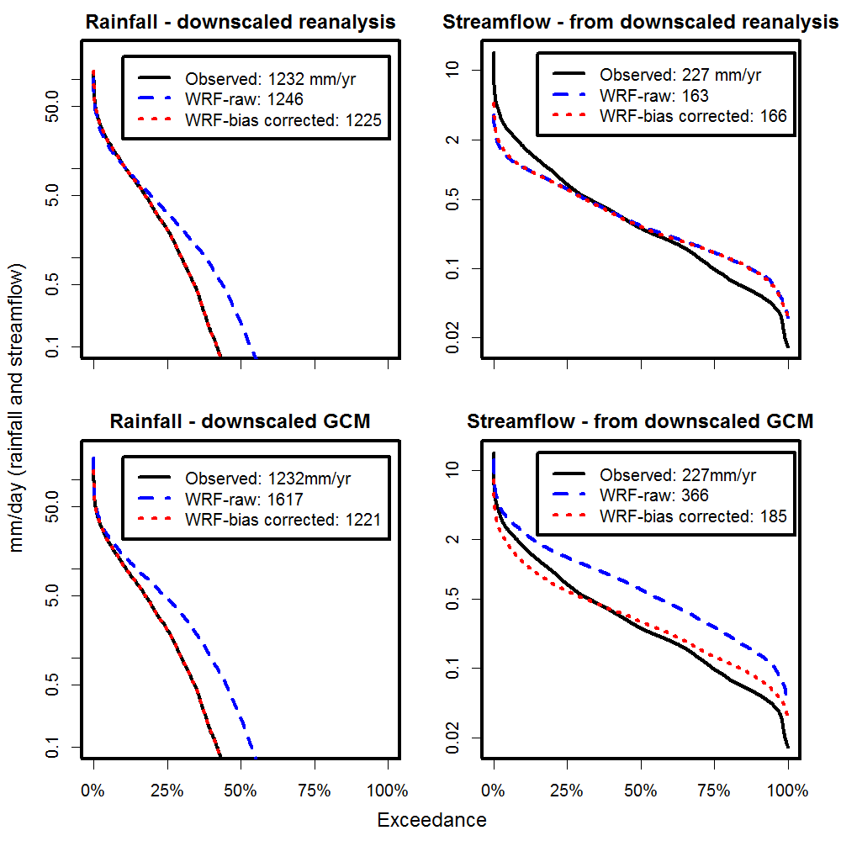
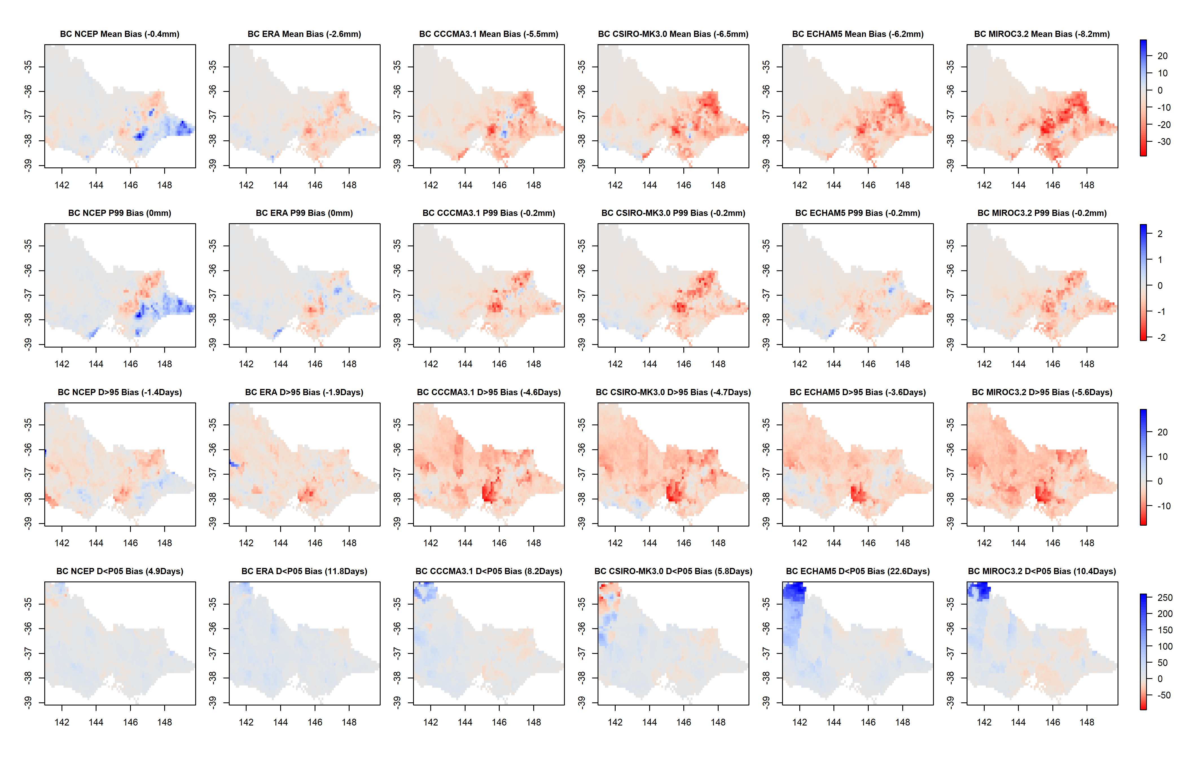
Downscaled rainfall inputs underestimate runoff
Downscaled daily rainfall
Mean annual Q
Days > Q₉₅
Modelled daily runoff
[Potter et al., 2018]
[Charles et al., 2018]
Q₉₉
Days < Q₅
Exceedance

Slide 10
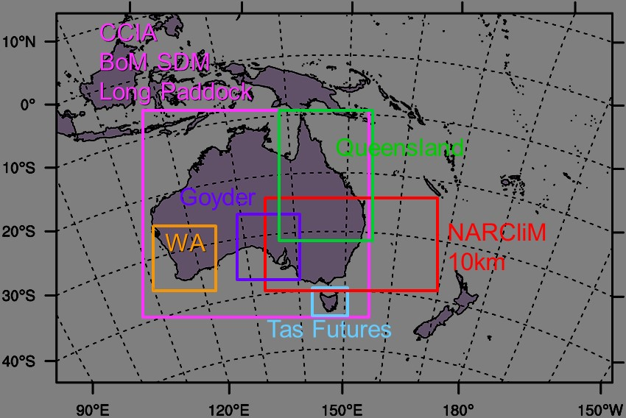
Climate projection data products used in Australia
CCAM

Slide 11
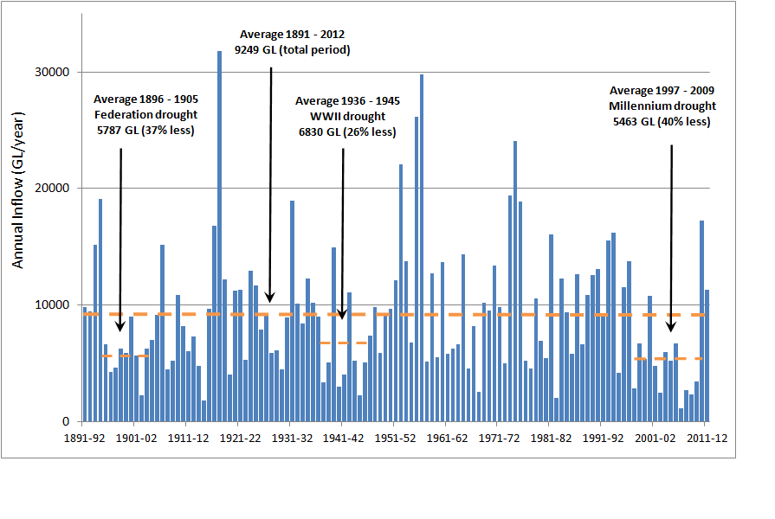
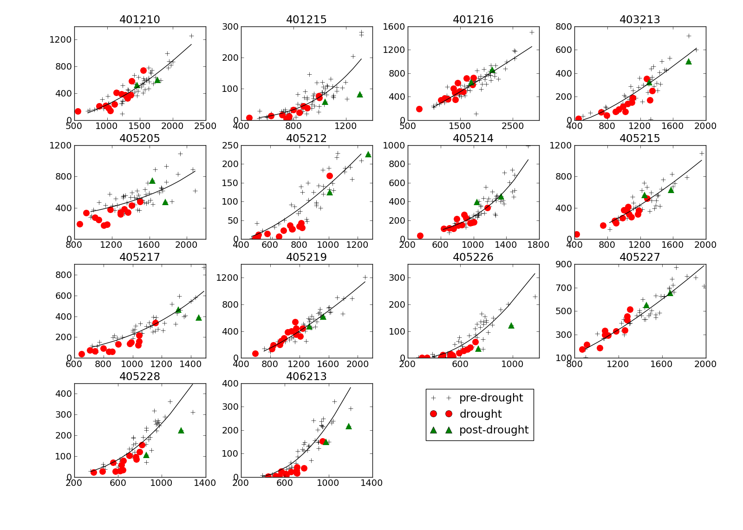
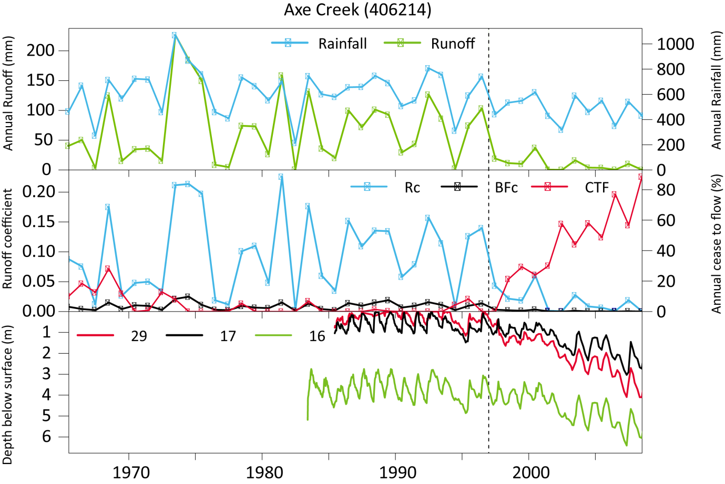
Hydrologic nonstationarity
Millennium drought (1997–2009)
Changing rainfall-runoff relationship
Change in dominant processes
Annual runoff
Annual rainfall
[Potter & Chiew, WRR, 2011]
[Potter et al., JHydrol, 2010]
[Chiew et al., SERRA, 2014]
[Saft et al., WRR, 2015]
[Saft et al., GRL, 2016]

Slide 12

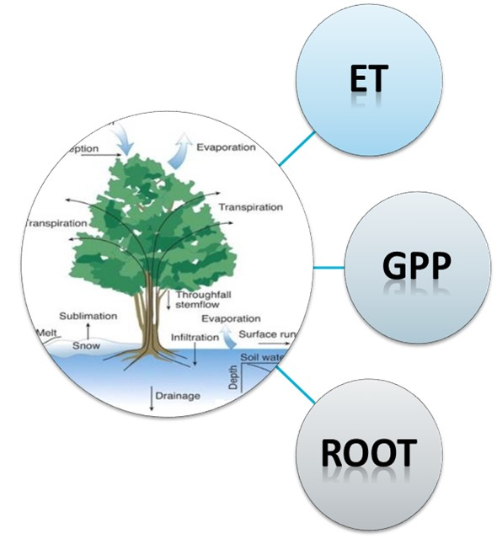

Extrapolating hydrological models
to predict a changing future
Changing rainfall-runoff relationship
Challenges
Different rainfall-runoff relationships and dominant processes under different hydrologic regimes.
Extrapolating to a future under warmer conditions and higher CO₂ environment not seen in the past.
Modelling solutions
Build the ‘perfect’ landscape hydrological or land surface model.
Improve conceptualisations of dominant processes in long dry spells, and simple coupling of carbon and water cycle.
Pragmatic fit-for-purpose calibration and parameterisation approaches.
Carbon-water coupling under enhanced CO₂
[Vaze et al., JHydrol, 2011]
[Chiew et al., SERRA, 2014]
[Chiew et al., PIAHS, 2015]
[Fowler et al., WRR, 2016, 2018]

Slide 13
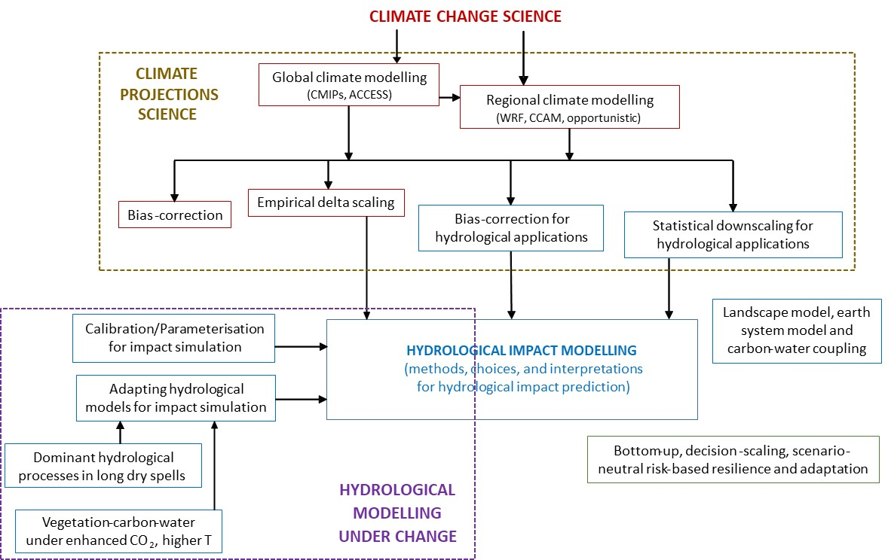
Delivering projections of water metrics

Slide 14

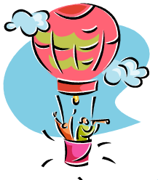
Planning and adaptation informed by science
Decision makers in water and related sectors
Communication and partnerships
Climate and water projection science

Slide 15
Thank you
CSIRO LAND AND WATER
Francis Chiew CSIRO Science Leader Research Group Leader (Water Resources Assessment and Prediction)
t +61 2 62465717
m +61 439987877
e francis.chiew@csiro.au
w http://www.csiro.au/people/Francis.Chiew.html
CSIRO LAND AND WATER

