Slide 1


Ensemble methods in downscaling projections
Jason Evans
Jason.evans@unsw.edu.au
Notes:
1

Slide 2

Regional Climate Modelling
GCM climate projection ensemble
Collection of RCMs
Regional climate projection ensemble
Chosen GCM simulations
Chosen RCMs
Notes:
2

Slide 3
What are the desired properties of a climate projection ensemble?
Historical simulated climate is centred on observed climate
Ensemble spread reflects internal (inter-annual) variability of the real climate
Climatic extremes are captured
Future projections span overall uncertainty in climate sensitivity (embodied in future temperature and precipitation changes)
To use the minimum resources required

Slide 4
Some Past Regional Climate Projections projects
Prudence (2001-2004; Europe)
1 GCM x 9 RCMs (50km)
Convenience
RMIP (2003-2013; Asia)
1 GCM x 5 RCMs (50km)
Convenience
Ensembles (2004-2009; Europe)
6 GCM x 10 RCM (25km)
Convenience/unordered sparse matrix
NARCCAP (2006-2010; North America)
4 GCM x 6 RCM (50km)
Structured sparse matrix
Tas Futures (2006-2010; Tasmania)
6 GCM x 1 RCM (14km)
Performance / convenience
NARCliM (2011-2014; SE Australia)
4 GCM x 3 RCM (10km)
Performance / independence / span GCM climate sensitivity

Slide 5
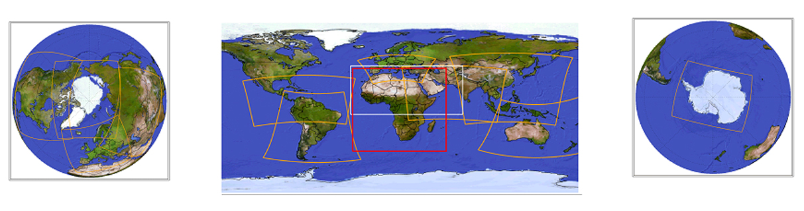
CORDEX domains

Slide 6
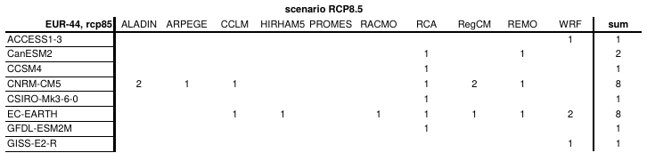
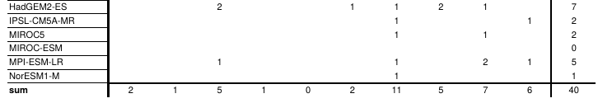
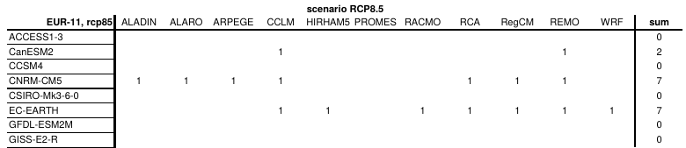
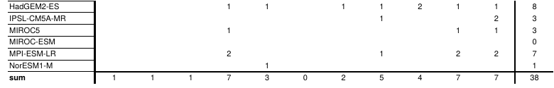
Euro-CORDEX
14 GCMs & 10 RCMs
RCP8.5 is 40/38 member ensemble: RCP4.5 is 33/25: RCP2.6 is 16/16
Resolution is 50km/12km
Convenience / sparse matrix
50km
12km
https://euro-cordex.net/index.php.en

Slide 7
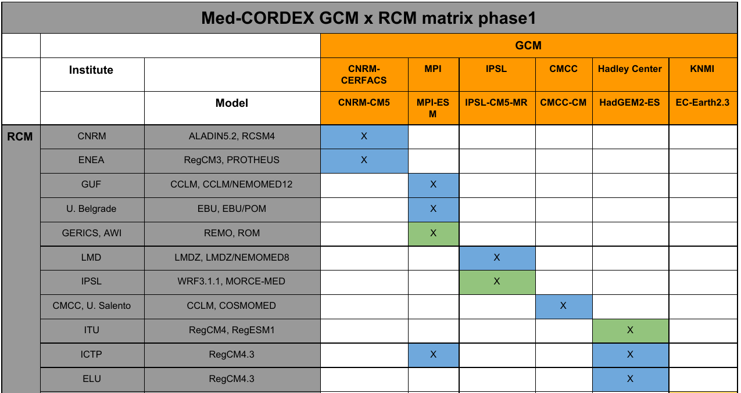
Med-CORDEX
Uses coupled regional ocean model
6 GCMs and 10 RCMs
RCP8.5 has
11 member
ensemble
50km resolution
Convenience / ordered matrix
https://www.medcordex.eu/index.php/

Slide 8
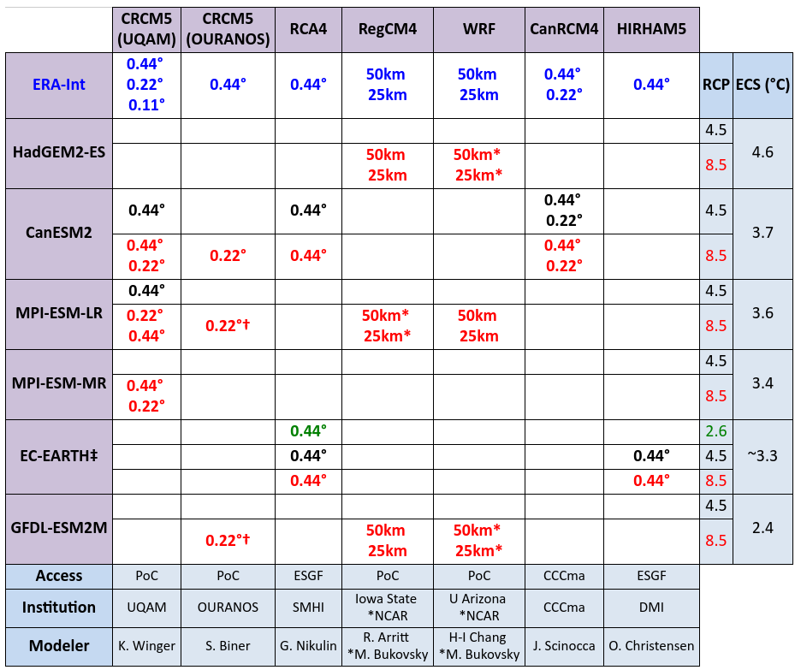
North America CORDEX
6 GCMs & 7 RCMs
RCP8.5 is 14 member ensemble: RCP4.5 is 6 member ensemble
Resolutions: 50km & 25km
Convenience / GCMs span range of climate sensitivity / structured sparse matrix
https://na-cordex.org/

Slide 9
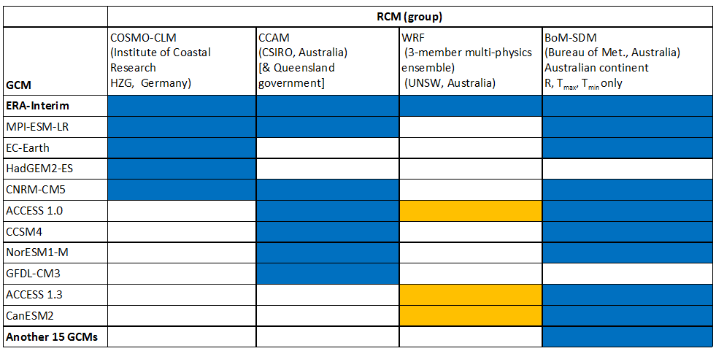
CORDEX-AustralAsia
10 GCMs & 5 RCMs + SDM
RCP8.5 is 19 member ensemble; RCP4.5 is 12 member ensemble
Resolution is 50km
Convenience

Slide 10
How do we select a subset with the desired properties of a climate projection ensemble?
Historical simulated climate is centred on observed climate
Ensemble spread reflects internal (inter-annual) variability of the real climate
Climatic extremes are captured
Future projections span overall uncertainty in climate sensitivity (embodied in future temperature and precipitation changes)
Consider bias and interdependence
Appropriate performance metrics
Evans, J. P., Ji, F., Abramowitz, G., & Ekström, M. (2013). Optimally choosing small ensemble members to produce robust climate simulations. Environmental Research Letters, 8(4), 044050. https://doi.org/10.1088/1748-9326/8/4/044050
Herger, N., Abramowitz, G., Knutti, R., Angélil, O., Lehmann, K., & Sanderson, B. M. (2018). Selecting a climate model subset to optimise key ensemble properties. Earth Syst. Dynam., 9(1), 135–151. https://doi.org/10.5194/esd-9-135-2018

Slide 11
How do we select a subset with the desired properties of a climate projection ensemble?
Historical simulated climate is centred on observed climate
Ensemble spread reflects internal (inter-annual) variability of the real climate
Climatic extremes are captured
Future projections span overall uncertainty in climate sensitivity (embodied in future temperature and precipitation changes)
Consider bias and interdependence
Appropriate performance metrics
Consider GCM spread
McSweeney, C. F., Jones, R. G., & Booth, B. B. B. (2012). Selecting Ensemble Members to Provide Regional Climate Change Information. Journal of Climate, 25(20), 7100–7121. https://doi.org/10.1175/JCLI-D-11-00526.1
Whetton, P., Hennessy, K., Clarke, J., McInnes, K., & Kent, D. (2012). Use of Representative Climate Futures in impact and adaptation assessment. Climatic Change, 115(3–4), 433–442. https://doi.org/10.1007/s10584-012-0471-z

Slide 12
How do we select a subset with the desired properties of a climate projection ensemble?
To use the minimum resources required
That is, want to identify an ensemble sub-set that retains as much information as possible from the full ensemble, and satisfies previously stated conditions.
Related to model interdependence.
Herger, N., Abramowitz, G., Knutti, R., Angélil, O., Lehmann, K., & Sanderson, B. M. (2018). Selecting a climate model subset to optimise key ensemble properties. Earth Syst. Dynam., 9(1), 135–151. https://doi.org/10.5194/esd-9-135-2018
Sanderson, B. M., Knutti, R., & Caldwell, P. (2015). Addressing Interdependency in a Multimodel Ensemble by Interpolation of Model Properties. Journal of Climate, 28(13), 5150–5170. https://doi.org/10.1175/JCLI-D-14-00361.1

Slide 13
Proposed Regional projection ensemble creation process
GCM climate projection ensemble
Collection of RCMs
Regional climate projection ensemble
Chosen GCM simulations
Chosen RCMs

Slide 14
Proposed Regional projection ensemble creation process
GCM climate projection ensemble
Collection of RCMs
Regional climate projection ensemble
Eliminate poor performers
Consider model interdependence
Span climate sensitivity range
Chosen RCMs

Slide 15
Proposed Regional projection ensemble creation process
GCM climate projection ensemble
Collection of RCMs
Regional climate projection ensemble
Eliminate poor performers
Consider model interdependence
Span climate sensitivity range
Eliminate poor performers
Model interdependence

Slide 16
Proposed Regional projection ensemble creation process
GCM climate projection ensemble
Collection of RCMs
Use a structured sparse matrix
Eliminate poor performers
Consider model interdependence
Span climate sensitivity range
Eliminate poor performers
Model interdependence

Slide 17
Thank you for your attention
Ensemble methods in downscaling projections
Jason Evans
Jason.evans@unsw.edu.au
Notes:
17

