Slide 1
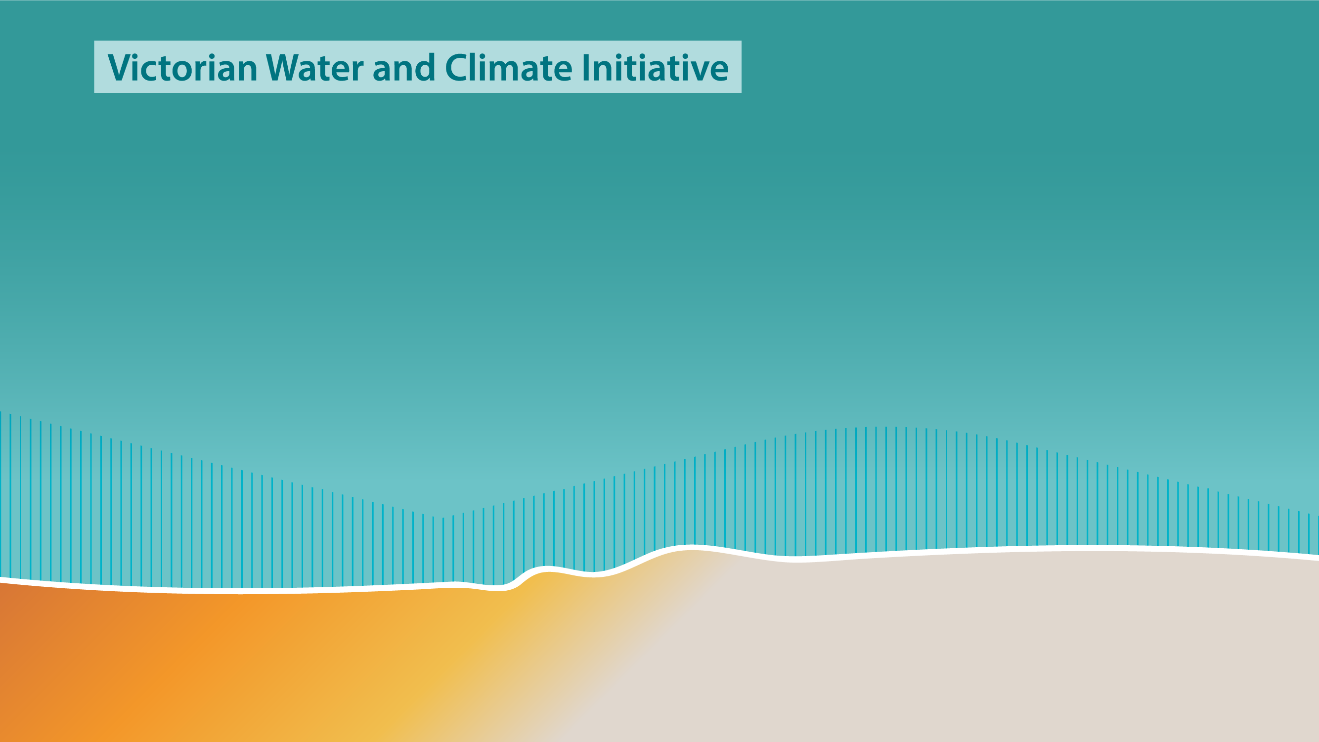
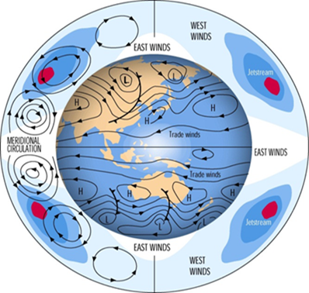
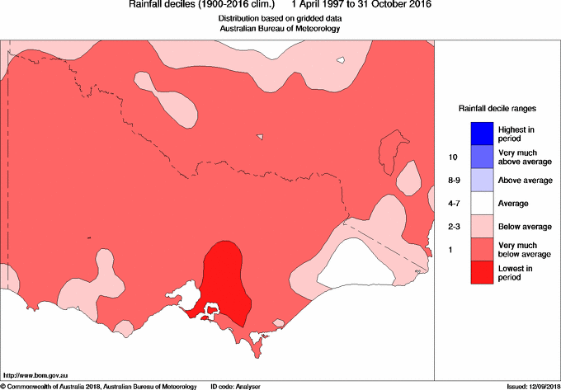


Using Ensemble in Deriving Baselines for Victorian Water Assessment
Surendra Rauniyar and Scott Power
Bureau of Meteorology
BoM R&D Annual Workshop, 29Th November 2018
Notes:
Recent Studies have shown that the baseline climate is changing as the assumption of a stationary climate has been challenged by the recent persistently dry conditions over Victoria.
Similarly, research undertaken during SEACI and VicCI pointed out that baseline selection poses a significant source of uncertainty in defining the exact magnitude of the projected changes in Victoria’s climate.
These concerns lead to questions about how best to characterise the baseline climate for Victoria.

Slide 2
Outline
Introduction
What is baseline and what are the limitations of current baselines
Objectives
Data & Methods
Descriptions of Climate Models & Forcing Applied
Preliminary results:
How unusual is the observed recent drying in Victoria
Do models project drying during the future
Do models simulate drying during the past
Did increase in greenhouse gases cause the drying
Summary & Future Plans
Notes:
Here is the outline of today's talk.

Slide 3
Baseline
Baseline is a period which has been chosen to best represent the current climate of a region and serves two main purposes:
it is used as a reference against which recent observations are compared and
it can be used as a benchmark to evaluate the looming changes in climate for planning and management processes
Key requirements for a baseline are:
it should be of sufficient duration to encompass the range of natural climate variability, but, given that the climate is likely to be changing due to anthropogenically-driven climate change,
the baseline should also be of short enough duration so as to represent the current state of the climate, and minimise the chance of any climate shifts within the baseline period.
Notes:
If the climate is stationary and has no trends, then it would only be a matter of sampling a long enough period (e.g. full historical record) to determine the baseline climate with an assumption that the same will continue in the future.
However, it is not the case and hence ..

Slide 4
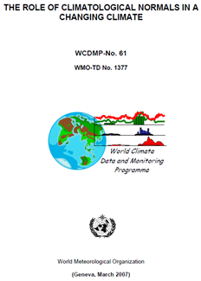
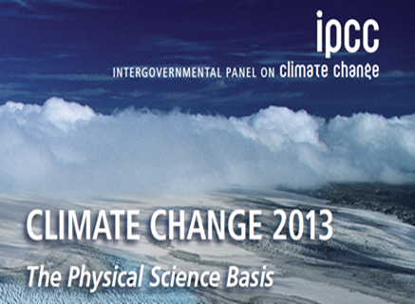
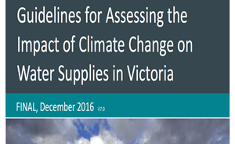
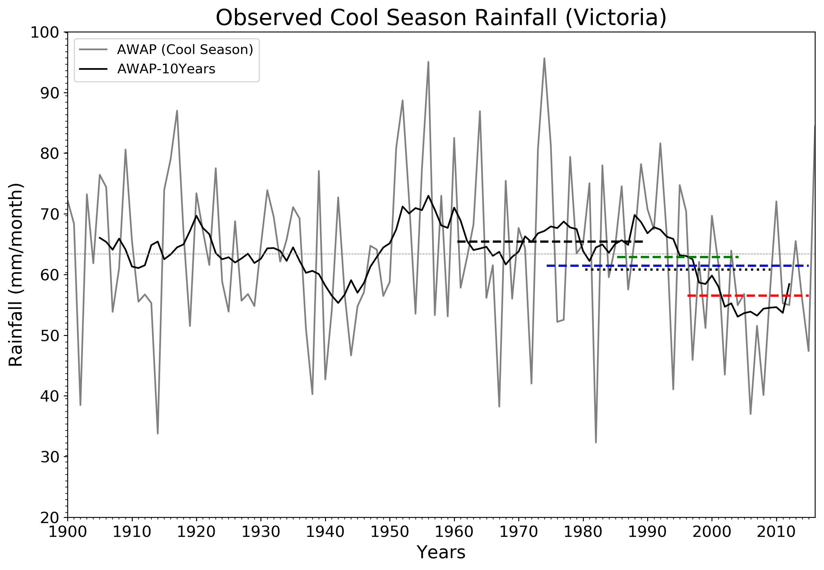
Current Baselines
WMO recommends using a period of at least 30 years and updating every decades (e.g. 1961 – 1990, 1981 – 2010) as a baseline to compute the climatological standard normals
IPCC, CSIRO & BoM have used the 1986 – 2005 period as a baseline for the assessment of climate change
DELWP currently recommends period from 1975-current as a baseline for water assessment
Some agencies use the start of Millennium Drought to current (1997- current) as a baseline.
horizontal dashed and dotted lines represent the different baselines
Notes:
WMO/IPCC/CSIRO/BoM: It is not robust under conditions of rapid changes in climate or of sustained trends.
If tracking climate change, then it makes sense to use a fixed baseline and reference all change to that climatology (generally covering a period of good observations, or alternatively a 'pre-industrial' period).
DELWP: Victorian rainfall trends include a known influence from climate change, thus this recent period could be representative of the best baseline to use.
However, the projected rainfall reductions for 2030 across the region are smaller than the observed declines over the last decades.
Similarly using post 1997 alone will omit important aspects of the climate variability experienced previously during 1900 – 1996.
One way of reconciling these issues is to use scaling factors based on deciles SF1= D1*(post 1997)/D1(pre 1997)
This would only be optimal if the deviations in the Scaling Factors from 1 are due to permanent climate change.
However, some of the deviations are likely due to natural climate variability.

Slide 5
Objectives:
Provide advice on baseline choices
Better understand the relative contribution of anthropogenic forcing and natural variability to Victorian rainfall
Provide improved estimates of Victorian rainfall statistics for the coming decade
Notes:
Hence the question arises,
do the recent decades represent a true baseline, and a good estimate of the climate going forward, or are they unusually dry?
Is any historical period truly representative of the current state of the climate or the expected climatic conditions over the coming decade?
What we know that the climate at any point of time is a function of natural climate variability and a human-forced signal

Slide 6
Method
We are examining observed rainfall changes (AWAP, 5 km data)
We are also examining Victorian rainfall in numerous climate model simulations under a variety of different forcing scenarios for the past:
In some simulations the forcing applied to climate models includes increases in greenhouse gases (arising from human activity)
In other simulations it does not
Comparing 1 and 2 allows us to estimate the impact of greenhouse gases on Victorian rainfall

Slide 7
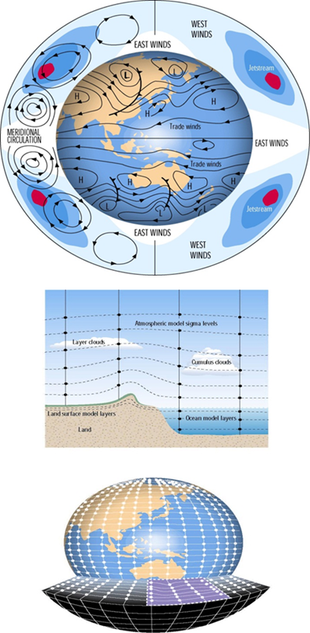
Climate Models & Forcing Applied
We are using more climate model simulations than have ever been used before to study Victorian rainfall:
Over 40 climate models
Over 350,000 years of model simulation
Forcing applied:
Preindustrial conditions (not used previously in VicCI or SEACI)
Historical conditions (GHG, NAT, ALL – forcings) for 1900-2005
Three scenarios for the early 21st century:
RCP2.6 (lower emissions)
RCP4.5 (high emissions)
RCP8.5 (very high emissions)
Notes:
Climate models provide simulations of climate for the past, present and the future
Climate models are imperfect.
Estimates of the future are therefore often estimated using a fusion of both observational data and climate model projections

Slide 8
Questions addressed today:
How unusual is the observed recent drying in Victoria?
Do models project drying during the future?
2017-2036?
2081-2100?
How large is the simulated drying relative to the variability?
Do models simulate drying during the past:
1900-1999?
1997-2016?
Did increases in greenhouse gases cause the drying?

Slide 9
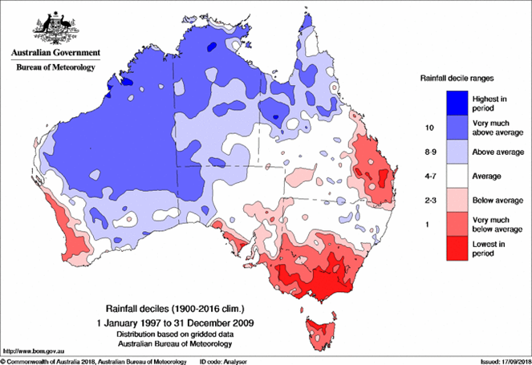
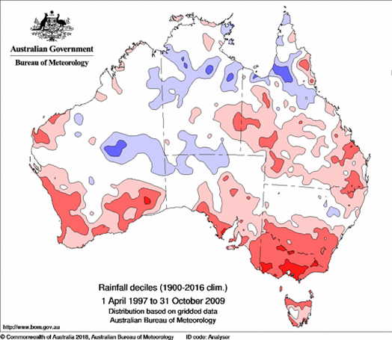
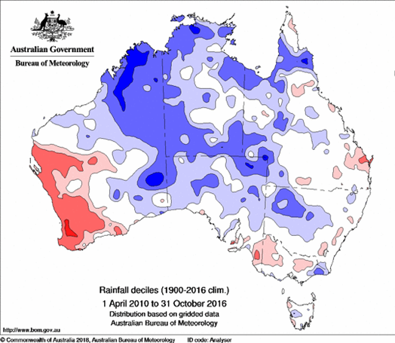
Characteristics of recent drying: Rainfall Deciles Maps Compared to Long-term Climatology
Millennium Drought (1997 – 2009)
Apr 1997 – Oct 2009 (MD)
Apr 2010 – Oct 2016
Driest 13-year period since reliable climate records have been kept
Differs from previous droughts in:
its extent, year-to-year rainfall variability and seasonality of the rainfall decline
occurred during a period of rising temperature, degree of magnification of the response in streamflow is unusual
Persisted even after cessation of the Millennium Drought in 2010/11 and 2011/12 (Spring & Summer)
Notes:
Key points: The MD differs from any previous droughts in many aspects that we know from the great research done during the SEACI and VicCI
Historical records have shown that the Victorian rainfall exhibits a great deal of variability.
In the past, Victoria has observed many wet and dry episodes and
More recently, it has experienced a Mega Drought, known as the Millennium Drought.
Research undertaken during SEACI & VicCI found that the characteristics of MD has been very different in terms of historical context.
Lasted longer than any previous period of rainfall deficiency
No individual wet years
Tends to be confined to southern Australia, rather than extending over most of the continent
Main decrease in rainfall in autumn, while previous drought tended to have a decrease in the winter-spring period.
Occurred during a period of rising temperature
Degree of magnification of the response in streamflow relative to rainfall in the recent drought is unusual

Slide 10
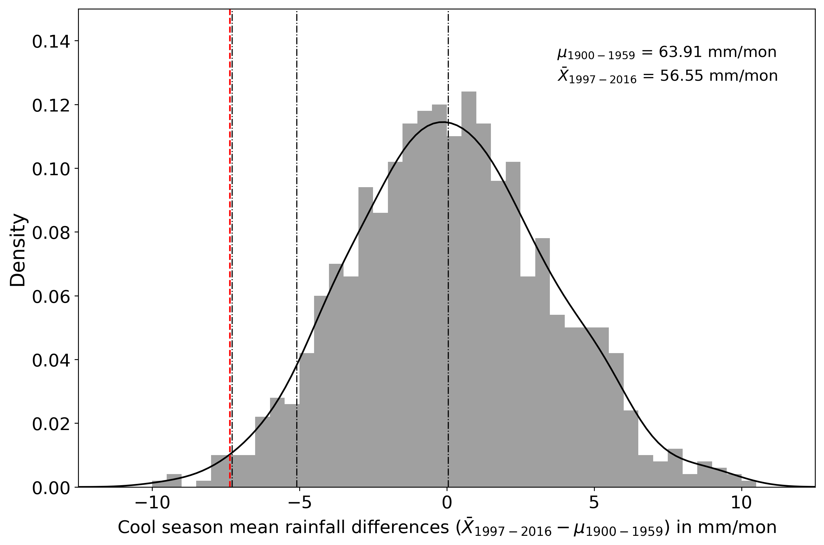
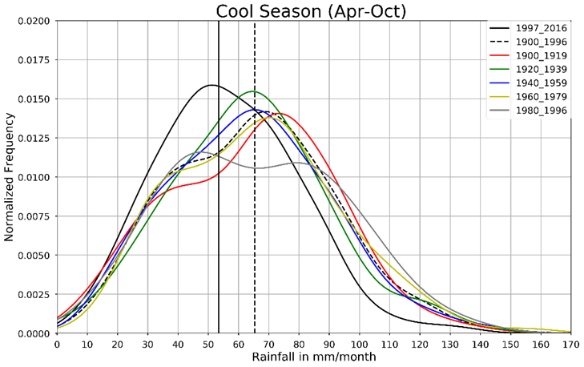
How unusual is cool season rainfall decline during 1997-2016?
Preliminary Result
Multi-decadal Variability (AWAP, 5km)
Obs 1% 5% 50%
PDF of rainfall anomalies for the recent 20 years period wrt to earlier 60 years by chance obtained by bootstrapping
But we don't know for sure how much is due to the natural variability or due to the human activity
Notes:
To analyse how unusual is the recent decline, we applied a sophisticated statistical methods called bootstrapping.
Now we are going to look how unusual is the recent rainfall decline
The distribution of anomalies of rainfall for the recent 20 years period wrt to earlier 60 years by chance is shown as PDF.
It is extremely unlikely to obtain the observed change by chance only, hence is very unusual. But we don't know for sure how much is due to the natural variability or due to the climate change
This result suggests that the latest part of the rainfall record may be statistically different from the entire instrumental record and implies that the climate baseline may have shifted
This change in rainfall is due to :
External forcing including GHGs plus
Internal variability.

Slide 11
Questions addressed today:
How unusual is the observed recent drying in Victoria?
Do models project drying during the future?
2017-2036?
2081-2100?
How large is the simulated drying relative to the variability?
Do models simulate drying during the past:
1900-1999?
1997-2016?
Did increases in greenhouse gases cause the drying?

Slide 12
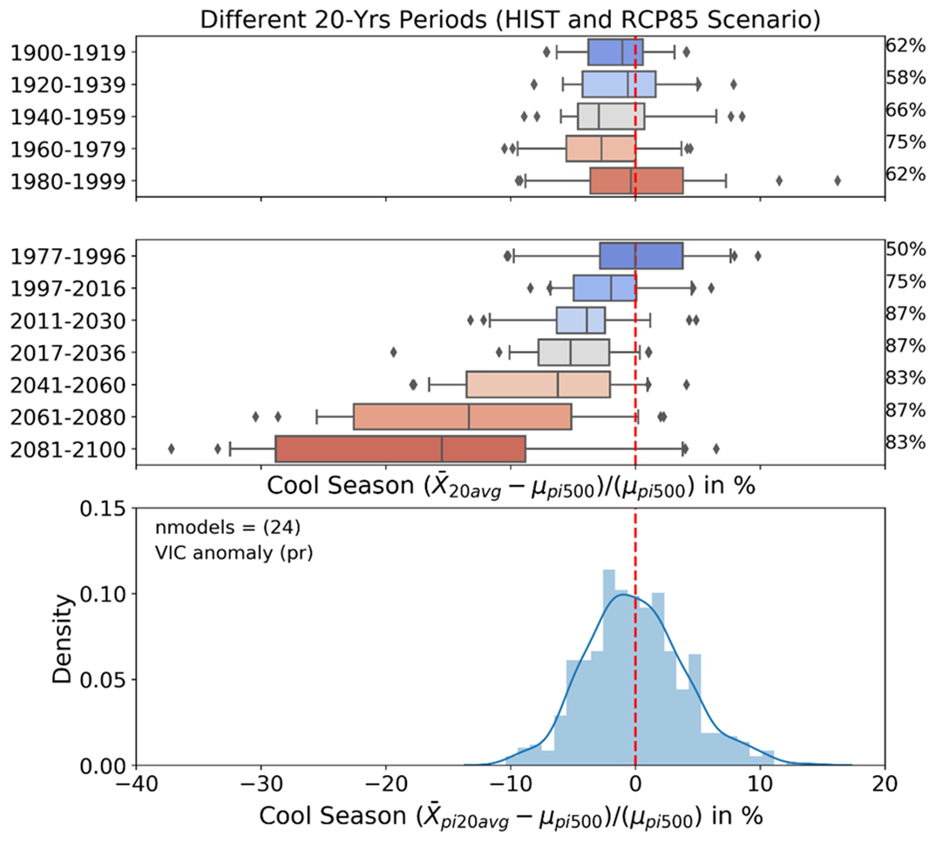
Past, Present & Future Decadal Rainfall Changes
Preliminary Results
Distribution of changes
(24 models X 25 20-yr periods)
Changes that can arise from internal climate variability alone
Notes:
rainfall anomalies in %.
The light-blue bars represent the distribution of changes between the 24 pre-industrial periods.
The light-blue bars therefore represent changes that can arise from internal climate variability alone.
The boxplots represent the changes for 20-years average rainfall relative to 500 years average of pre-industrial values.
The whiskers indicate the 5th and the 95th percentiles, the boxplot the 25th and 75th percentiles, and the median is indicated by the vertical line in the boxes.
All changes are relative to 25 different pre-industrial periods.
Multi-Model Median shows the rainfall decline is
XX % of standard deviation of piControl Variability
100*yrly_df_sel_20Yrs.median()/np.std(pi_yrly_norm)
1977-1996: -0.477309
1997-2016: -50.029255
2011-2030: -99.202293
2017-2036: -132.782525
2041-2060: -158.647129
2061-2080: -339.643667
2081-2100:-394.887549

Slide 13
Questions addressed today:
How unusual is the observed recent drying in Victoria?
Do models project drying during the future?
2017-2036?
2081-2100?
How large is the simulated drying relative to the variability?
Do models simulate drying during the past:
1900-1999?
1997-2016?
Did increases in greenhouse gases cause the drying?

Slide 14
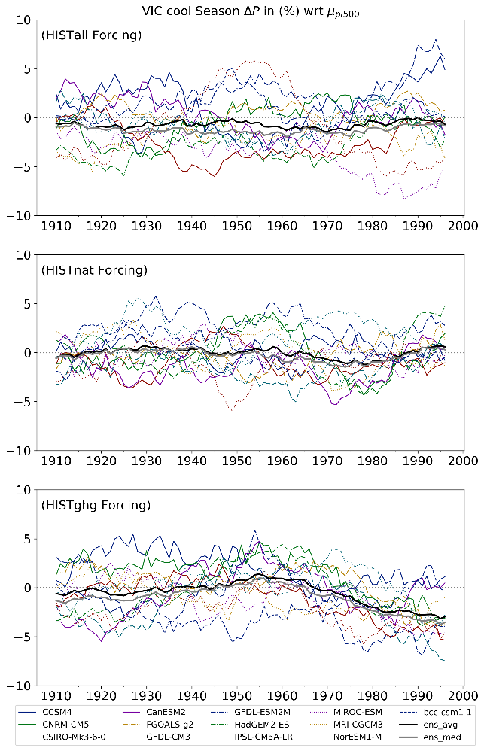
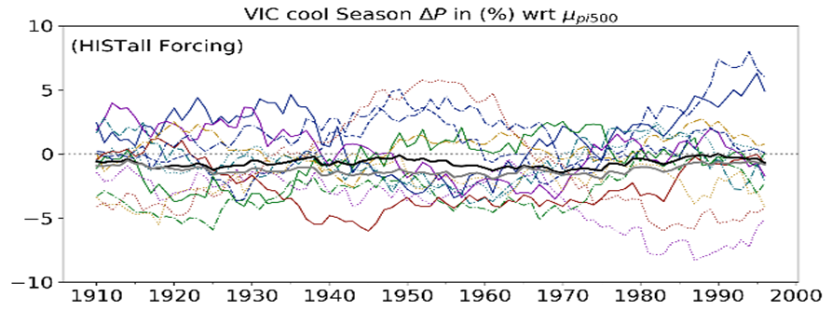
How much of the drying is due to human activity in the models?
Preliminary Results
Notes:
84% of models show a decline in response to greenhouse gases increases
But this is partially, but not totally, offset by net effect of natural forcing, internal variability and other human-forcing factors
Drying is approximately 50% of standard deviation of variability

Slide 15
Summary of preliminary results
1997-2016
Observed drying is highly unusual relative to variability exhibited since 1900 (statistical significance=1%)
75% of models show rainfall decline during this period
84% of models show a decline in response to greenhouse gases increases
But this is partially, but not totally, offset by net effect of natural forcing, internal variability and other human-forcing factors
Drying is approximately 50% of standard deviation of variability
2081-2100
Rainfall is projected to decline over coming century
Drying is approximately 400% of standard deviation of variability
2017-2036
Decline in rainfall over next two decades, relative to preindustrial conditions, is very clear

Slide 16
Plans
Further clarify extent to which humans have affected VIC rainfall
Assess climate model simulations
Consider sub-regions e.g. southern VIC
Begin to examine pros and cons of different baseline choices
Can we improve the scaling method?
make use of projected changes in climate models, as well as historical data, to obtain scaling factors based on climate model projections for e.g., 2019-2025.
apply these new scaling factors to the observed data.
assess the performance of the new approach
Notes:
Rainfall in e.g. 2020 is a function of natural climate variability and a human-forced signal (from e.g. greenhouse gas increases)
We can't accurately predict the rainfall in 2020, but we do know something about the statistics of what rainfall might occur in 2020
We can approximate the statistics of rainfall in 2020 by the statistics of rainfall over e.g., 1900-2017
However, anthropogenic climate change has lowered rainfall in Victoria, and so the early historical record gives an overoptimistic sense of how much rainfall we might get in 2020
What historical period or baseline would provide a more appropriate representation of the range of possibilities for Victoria rainfall in 2020?
We could try using a recent record only, e.g. 1997-2017, because it includes the impact of climate change on Victorian rainfall
But using 1997-2017 alone will omit important aspects of the climate variability experienced previously during 1910-1996
One way of reconciling these issues is to use scaling factors:
Calculate decile rainfall amounts for years 1997-2017 say: D1*, D2*, …, D10*
Then calculate decile rainfall amounts for 1900-1996: D1, D2, …, D10
Then find the scaling factors SF1, …, SF10 for each decile, where SF1=D1*/D1 etc.
The standard method is optimal if the deviations in the Scaling Factors from 1.0 are due to permanent climate change. However, some of the deviations are likely due to natural climate variability. We know, for example, that the best estimate of conditions in 2020 for example, is not 1997-2017, because climate in 2020 will have further changed since this period. It would be better if we used a multi-decadal period centred on 2020.
It is impossible to create a distribution centered on 2020 using observations, because observations for years 2019 and beyond do not yet exist. However, they do exist in climate models out to 2100 and beyond, under different scenarios for future greenhouse gas concentrations. This gives us the potential to assess the scaling method described above, to see how well it captures a more accurate representation of the rainfall distribution for 2020, e.g. a 20-year period centred on 2020.
To find out we will:
make use of projected changes in climate models, as well as historical data, to obtain scaling factors based on climate model projections for e.g., 2019-2025.
apply these new scaling factors to the observed data.
assess the performance of the new approach.

Slide 17
Thanks for listening
surendra.rauniyar@bom.gov.au
scott.power@bom.gov.au
Bureau of Meteorology GPO Box 1289 Melbourne VIC 3001 Level 9, 700 Collins Street, Docklands VIC 3008

Slide 18

Baseline in Literature
$${\overline{T}}_{i, k}=\frac{1}{k}\sum_{j=1}^{k}{T_{i−j}}$$
Optimal Climate Normals (Huang et al. 1996, Wilks 1996) :
Their results indicate that annually updated climate normals averaged over shorter periods (For USA: 10-yr for Temperature. and 15-yr for Rainfall) are better than the WMO specified 30-yr normal, in terms of skill in seasonal temperature prediction in the upcoming year.
Least Square Fits:
Least squares linear trend fits to the period since the mid-1970s are viable alternatives to OCN
Hing-Fits:
They exploit longer records to stabilize estimates of modern trends in local and regional climates; therefore, they not only outperform straight-line fits but even OCN for underlying trends as small as 0.3 standard deviation of the climate noise per decade.
Fig1. from Wilks 2013
Notes:
A variety of earlier studies addressing this issue, some dating back to the first half of the century
These studies found that the WMO-recommended 30-yr normals, even updated every 10 yr, are no longer generally useful for the design, planning, and decision-making purposes for which they were intended
They not only have little relevance to the future climate, but are more and more often unrepresentative of the current climate. This is a direct result of rapid changes in the global climate over approximately the last 30 yr that most climate scientists agree will continue well into the future.

