Slide 1

Impact of global warming on ENSO-driven rainfall variability in the pacific
François Delage
Christine Chung
Scott Power

Slide 2
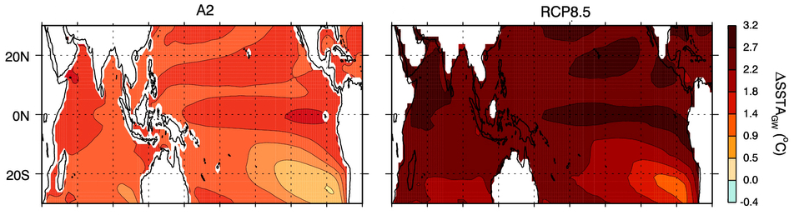
Projections of warming in CMIP3 and CMIP5
CMIP models provide best estimates of projected future warming
Tropical Pacific warming pattern is consistent – how will this impact interannual climate variability?
Notes:
This talk is part 1 and describes a series of projects spanning the last 5 yrs, using CGCMS and AGCMS to project the impact of global warming on ENSO & ENSO-driven rainfall across the Pacific. This talk will summarise the work over the last few years leading up to the latest projections which will be presented by Scott immediately after.
What are CMIP models? Warming patterns are consistent amongst models – how does this impact enso.

Slide 3
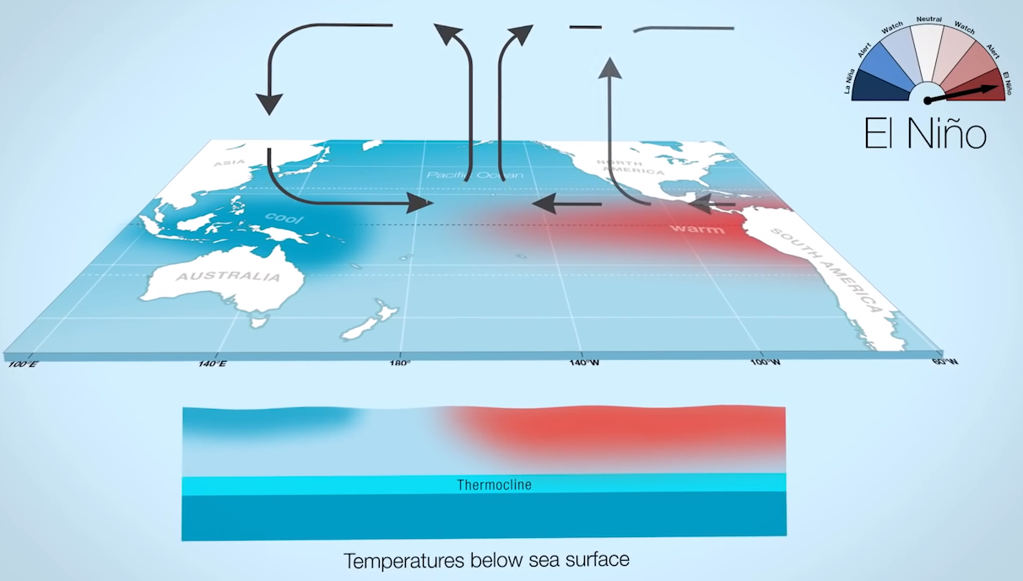
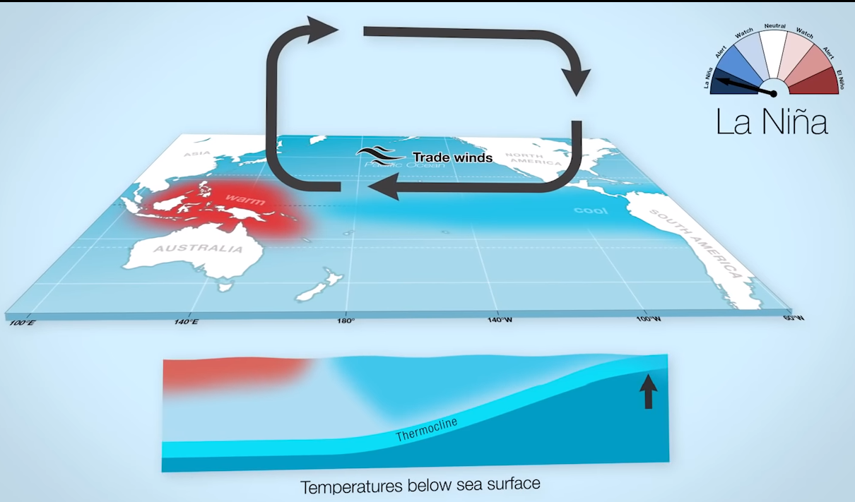
ENSO and Tropical Pacific Variability
El Nino
La Nina
ENSO-driven SST variability drives temperature and rainfall changes globally
How does this change under global warming?
Notes:
ENSO drives tropical Pac variability – changes in SST drive rainfall changes which have huge global impacts
These are screenshots from the video on BOM's ENSO website

Slide 4
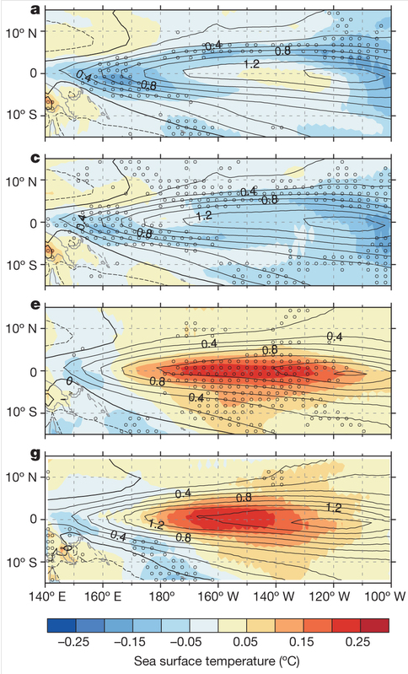
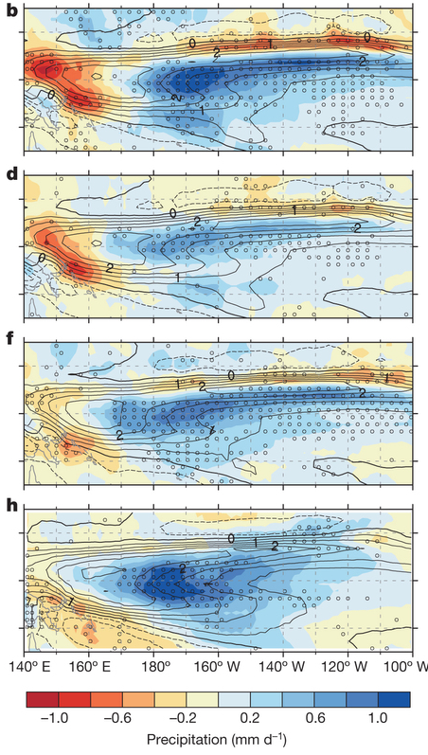
Projections of SST and rainfall change
RCP8.5
RCP4.5
1%CO2
A2
Power et al (2013), Nature
SST
Rainfall
Notes:
SST projections uncertain – but rainfall projections robust

Slide 5
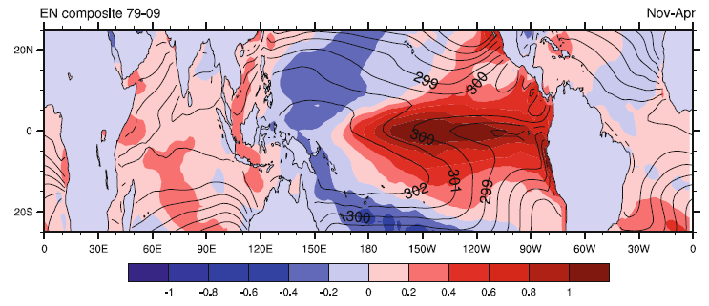
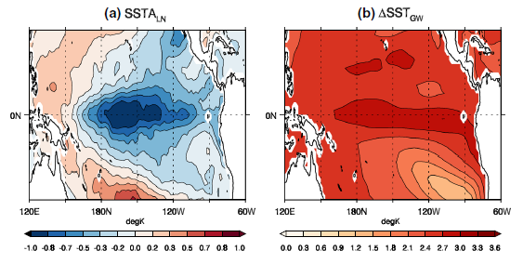
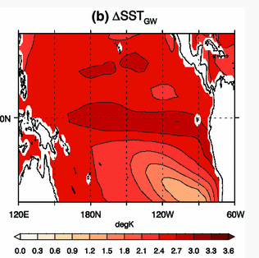
ACCESS AGCM experiments
How does rainfall during weak/medium/strong EN/LN years change during global warming ?
1 to 4 x
EN SST anomaly
1 to 4 x
LN SST anomaly
+
= ??
Chung et al (2014), Clim Dyn
Chung & Power (2014), Clim Dyn

Slide 6
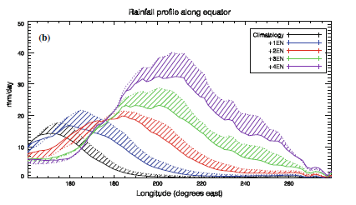
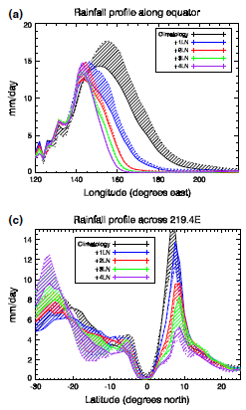
ACCESS experiments
Non-linear rainfall changes along the equator
EN:
Eastward shift of max rainfall profile
Non-linear increase in rainfall amount
Non-linearity enhanced by GW
LN:
Westward shift of max rainfall profile
Non-linear decrease in rainfall amount
Non-linearity reduced by GW
Notes:
Shifts/increases in EN much larger than LN
NL enhanced by GW during EN years because GW and EN SST anomalies are similar
NL reduced by GW during LN years because GW and LN SST anomalies cancel out a bit
Note these are highly idealised sims – 4xEN and 4xLN not 'realistic' – what happens with realistic SSTs

Slide 7
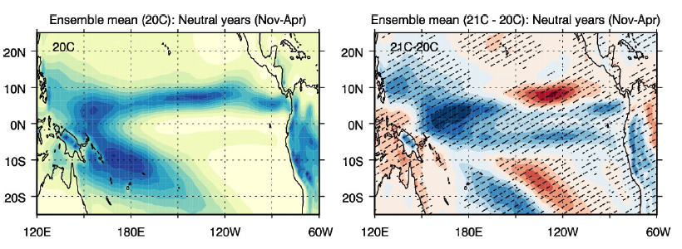
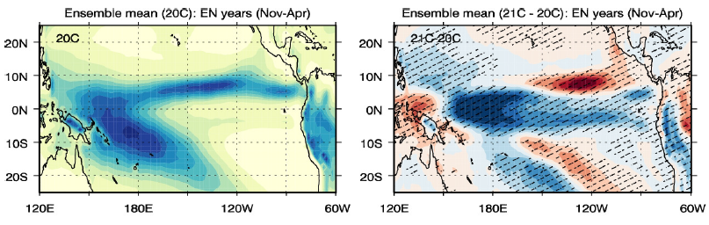
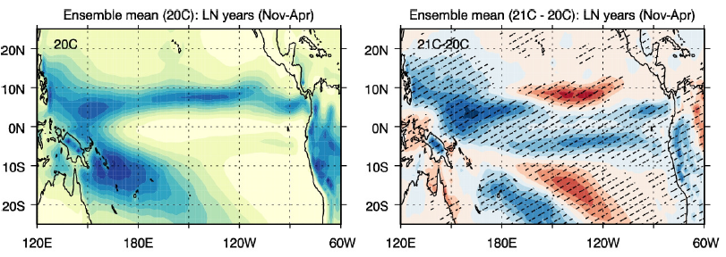
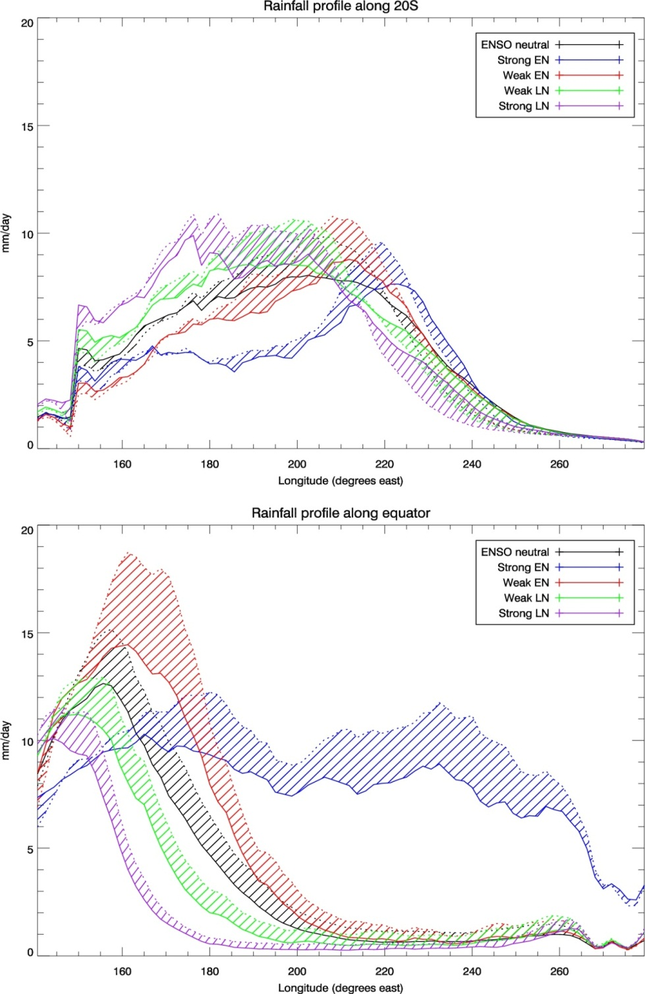
Time-varying SSTs
Neutral
All EN
All LN
Chung & Power (2016) J Clim
Notes:
Using observed SSTs, and adding GW pattern, we get projections of rainfall change under GW
Note AGCM runs lack the coupled air-sea interactions but their strength is that they don’t suffer from the biases that the coupled models have

Slide 8
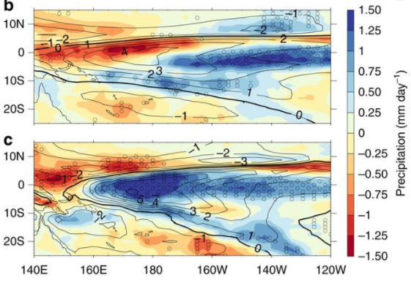
Rainfall changes: AGCM vs CMIP models?
EN rainfall changes
under GW:
CMIP5 MMEM
AGCM
Despite differences between AGCM & CGCMs,
good agreement in projections of rainfall change in Tropical Pacific
Power et al (2017) Nature Comms
Notes:
Note AGCM runs lack the coupled air-sea interactions but their strength is that they don’t suffer from the biases that the coupled models have
Despite these differences, there is good agreement in projections of rainfall change

Slide 9
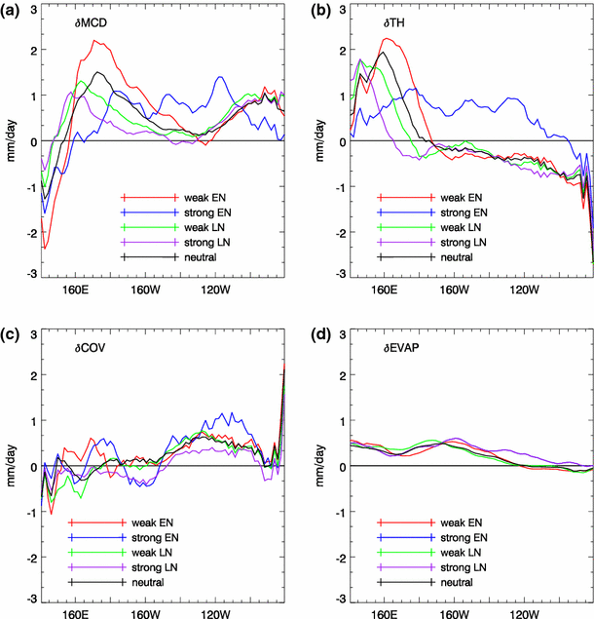
Moisture budget analysis
Rainfall changes decomposed into:
Dynamic
Covariant
Thermodynamic
Evap
Notes:
Decomposing precip changes along equator shows that changes in dynamic (changes in winds/circulation) and thermodynamic (change in amount of moisture in atmosphere) are the two main contributors. But the spatial distribution depends on ENSO strength
- Western Pac – largest positive changes in MCD & TH for weak EN/LN
Eastern Pac – Positive changes for MCD for weak EN/LN, negative changes for TH
For strong EN events (82/83, 97/98), changes occur more in the central Pac

Slide 10
Summary
Projections of future changes on ENSO-driven SST changes are uncertain, however projected ENSO-driven rainfall changes are robust
Both coupled models and SST-forced models agree on the pattern of rainfall change in the tropical Pacific
When strong EN(LN) SST anomalies are imposed on an AGCM,
  Rainfall shifts eastwards(westwards) and increases(decreases) nonlinearly
With a GW SST pattern imposed,
  Rainfall along the equator increases, especially over the western Pacific
  EN/LN intensified over west & central Pacific
  Non-linearity in EN(LN) years is enhanced(reduced)

Slide 11
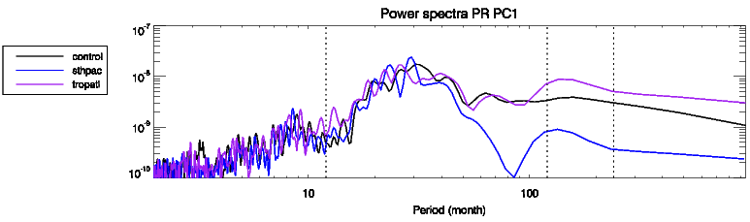
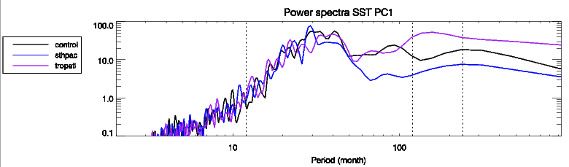
Future work
How does suppressing the variability in remote ocean basins affect tropical Pacific variability (ENSO & IPO) ?
"Clamp" (set to climatology) temperature and salinity in various regions (e.g. South Pacific, tropical Atlantic, etc)
Notes:
Preliminary results – clamping South Pacific (blue) and Tropical Atlantic (purple) does not significantly impact tropical Pacific variability on interannual timescales
On ~8-20 year timescales, there is a reduction in precipitation and SST variability when the South Pacific is clamped, and an increase in variability when the Tropical Atlantic is clamped

Slide 12
Thank you
François Delage
francois.delage@bom.gov.au
Christine Chung
christine.chung@bom.gov.au

Slide 13
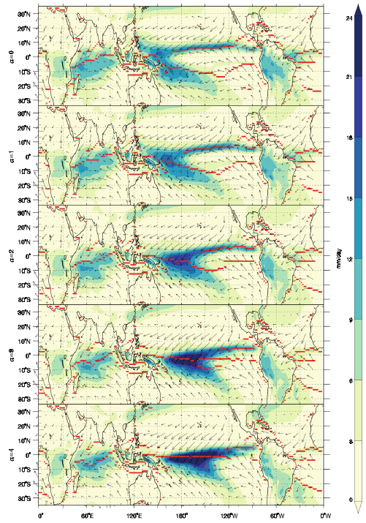
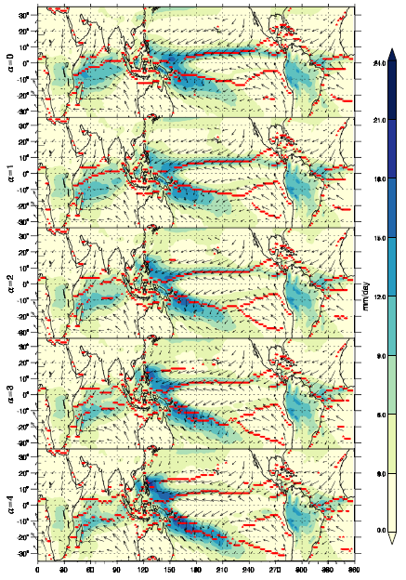
ACCESS experiments
EN LN

