Slide 1
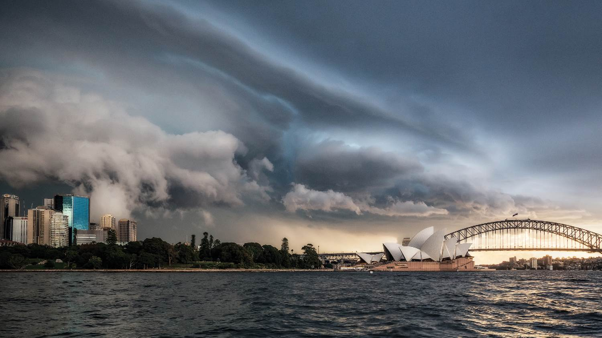
Impact of global warming on ENSO precipitation teleconnections
Scott Power, François Delage, Christine Chung
Bureau of Meteorology
R&D Workshop
November 2018
Notes:
Image: Shelf Cloud over Sydney on 26 April 2015 by Daniel Tran

Slide 2
Outline
Projected changes in El Niño-driven precipitation variability in the Pacific
Implications for regions around the world
i.e., “teleconnections”
Implications for Australia
Has ENSO already changed?

Slide 3
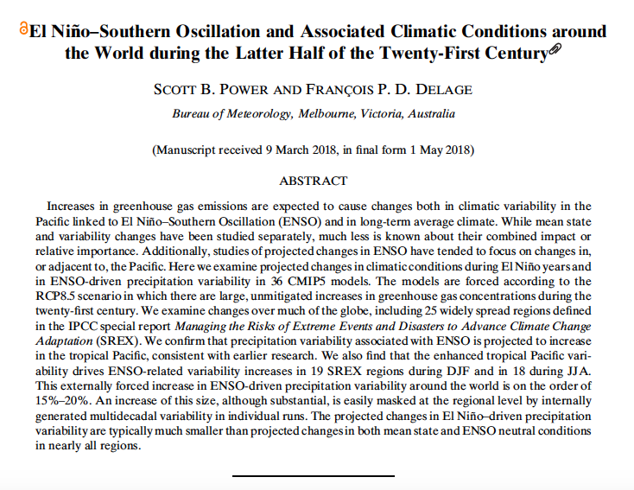
D

Slide 4
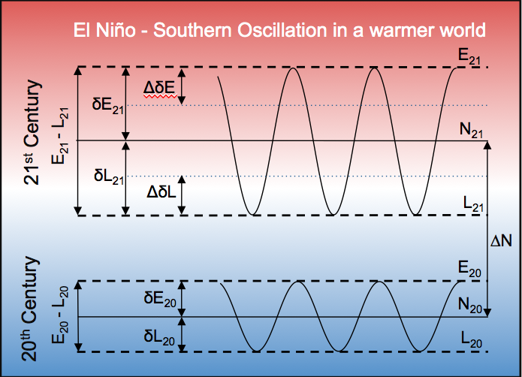

Slide 6

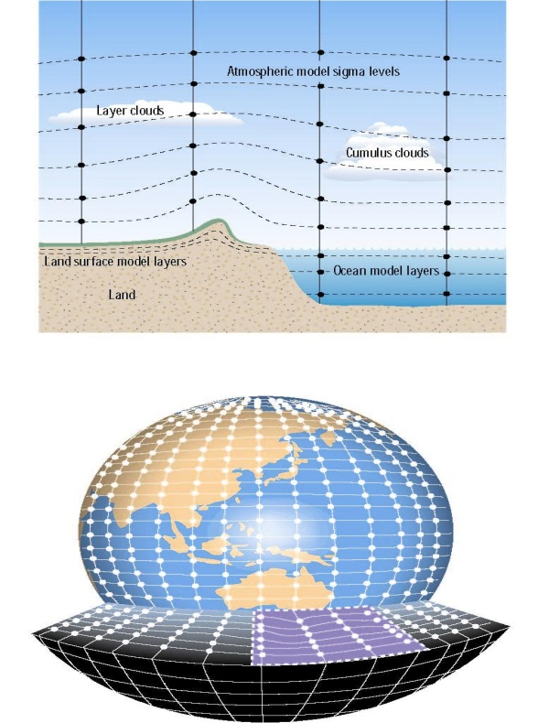
What happens to ENSO-driven precipitation variability in climate models, in response to business-as-usual increases in greenhouse gases?

Slide 7
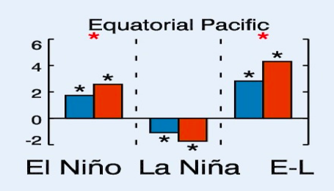
Global warming intensifies ENSO-driven precipitation variability in the Pacific
Results from CMIP5 models
Late 20th C
Late 21st C
RCP8.5

Slide 8
As variability in the equatorial Pacific is the engine for ENSO-driven variability around the world, this raises an important question:
Does this drive an increase in the intensity of ENSO-driven precipitation variability beyond the Pacific, around the world?
In other words,
do ENSO precipitation “teleconnections” intensify?

Slide 9
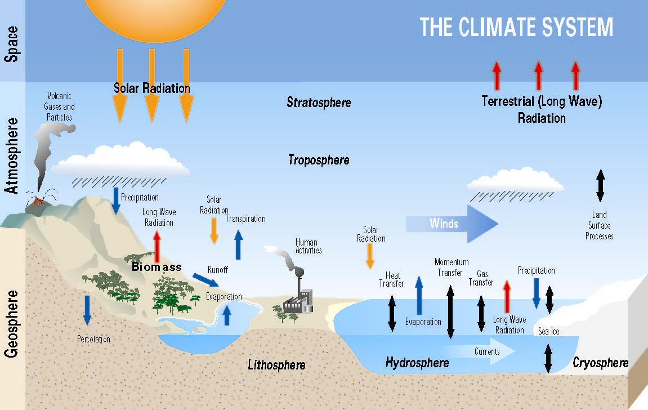
How well do climate models simulate ENSO teleconnections?

Slide 10
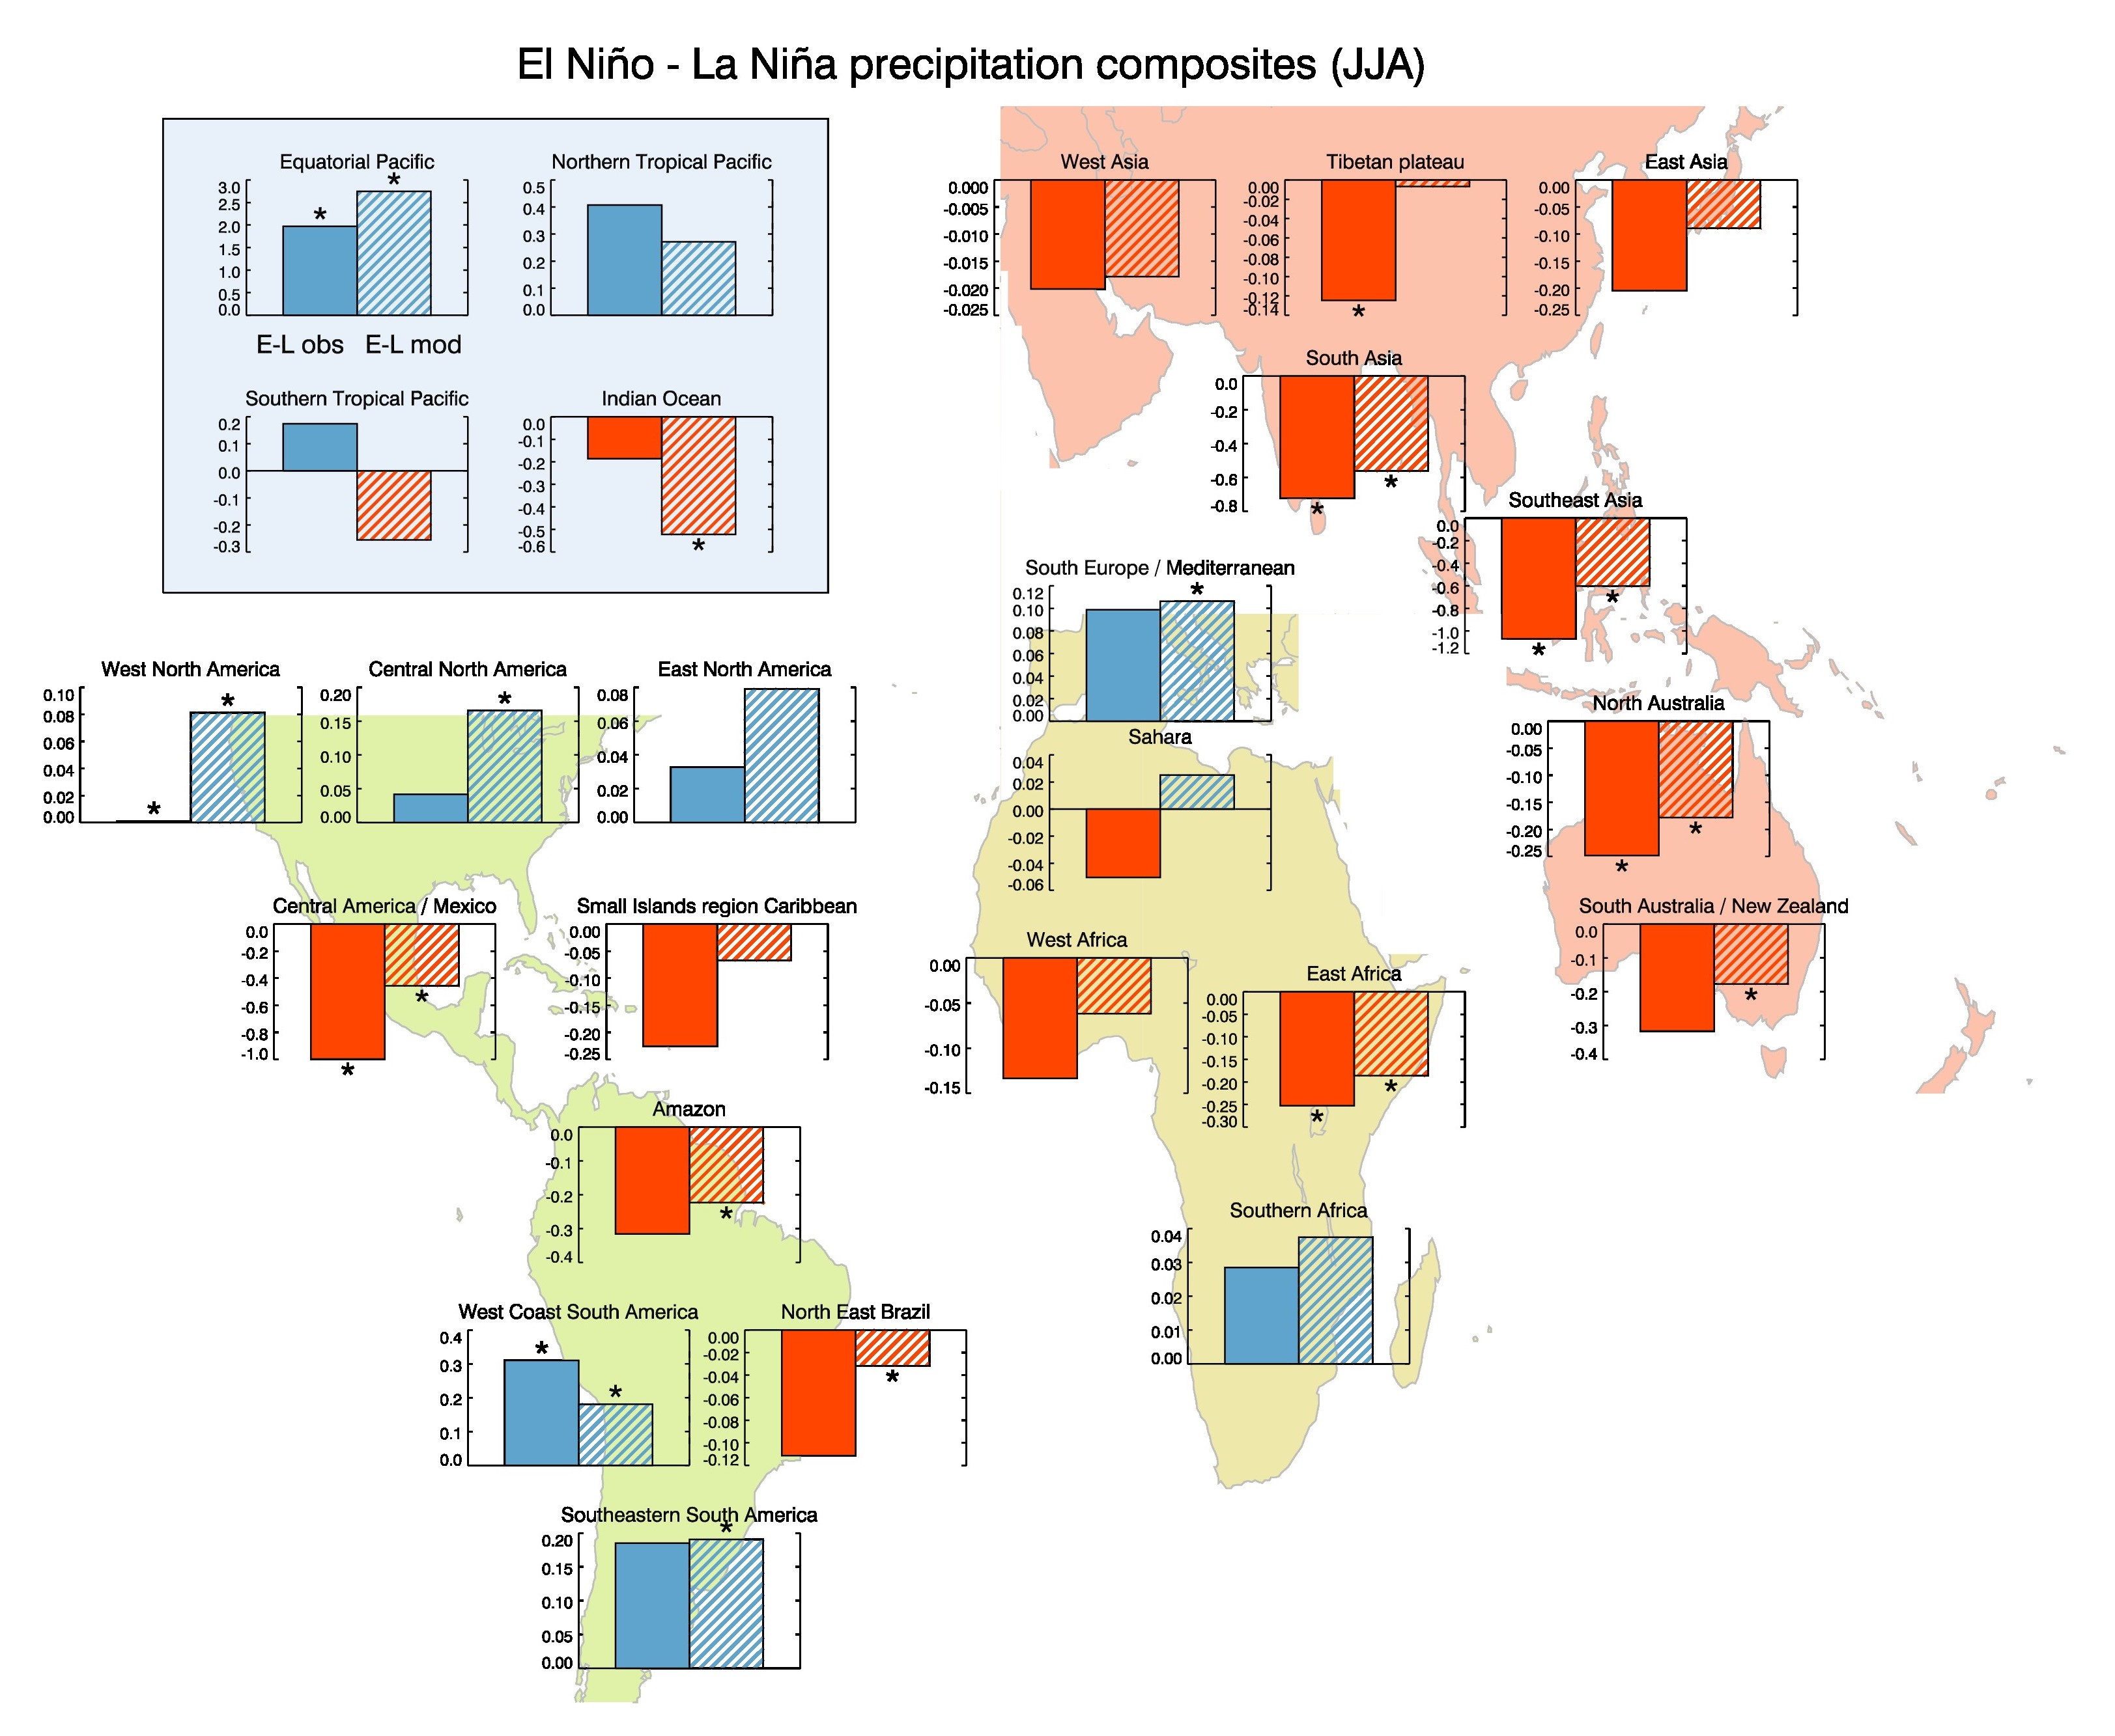
ENSO precipitation variability in observations and models
Left: Observations
Right: Multi-model average of CMIP5 Climate Models
Notes:
Figure 4 Histograms representing the difference between composites of JJA precipitation during El Niño and La Niña years (i.e., E-L). Observations (solid), Multi-Model Mean (MMM, striped). Observational data used as in Fig. 3. Observational and modelled composites have the same sign in 23 of the 25 regions. A star above observational composites indicates that the five or more of the six El Niño events that occur during the period analysed have precipitation deviations of the same sign. A star above modelled composites indicates that the sign of E-L is the same in two-thirds or more of the 36 models used (i.e., 24 or more models). This corresponds to a statistical significance level of approximately 95% under the assumption of model independence. Because models exhibit co-dependencies the corresponding statistical level is likely overestimated. See Power et al. (2012) for further details. Data: GPCC (Schneider et al. 2011) for land regions, CMAP (Xie and Arkin 1997) for ocean regions, Rayner et al. (2002) for SST data used to calculate the EOFs employed to categorize El Niño and La Niña years.

Slide 11
Sign of El Niño-La Niña rainfall composites correct in 23 out of 25 regions!
Notes:
Figure 4 Histograms representing the difference between composites of JJA precipitation during El Niño and La Niña years (i.e., E-L). Observations (solid), Multi-Model Mean (MMM, striped). Observational data used as in Fig. 3. Observational and modelled composites have the same sign in 23 of the 25 regions. A star above observational composites indicates that the five or more of the six El Niño events that occur during the period analysed have precipitation deviations of the same sign. A star above modelled composites indicates that the sign of E-L is the same in two-thirds or more of the 36 models used (i.e., 24 or more models). This corresponds to a statistical significance level of approximately 95% under the assumption of model independence. Because models exhibit co-dependencies the corresponding statistical level is likely overestimated. See Power et al. (2012) for further details. Data: GPCC (Schneider et al. 2011) for land regions, CMAP (Xie and Arkin 1997) for ocean regions, Rayner et al. (2002) for SST data used to calculate the EOFs employed to categorize El Niño and La Niña years.

Slide 12
What happens to ENSO-driven precipitation variability in other parts of the world, beyond the equatorial Pacific?

Slide 13
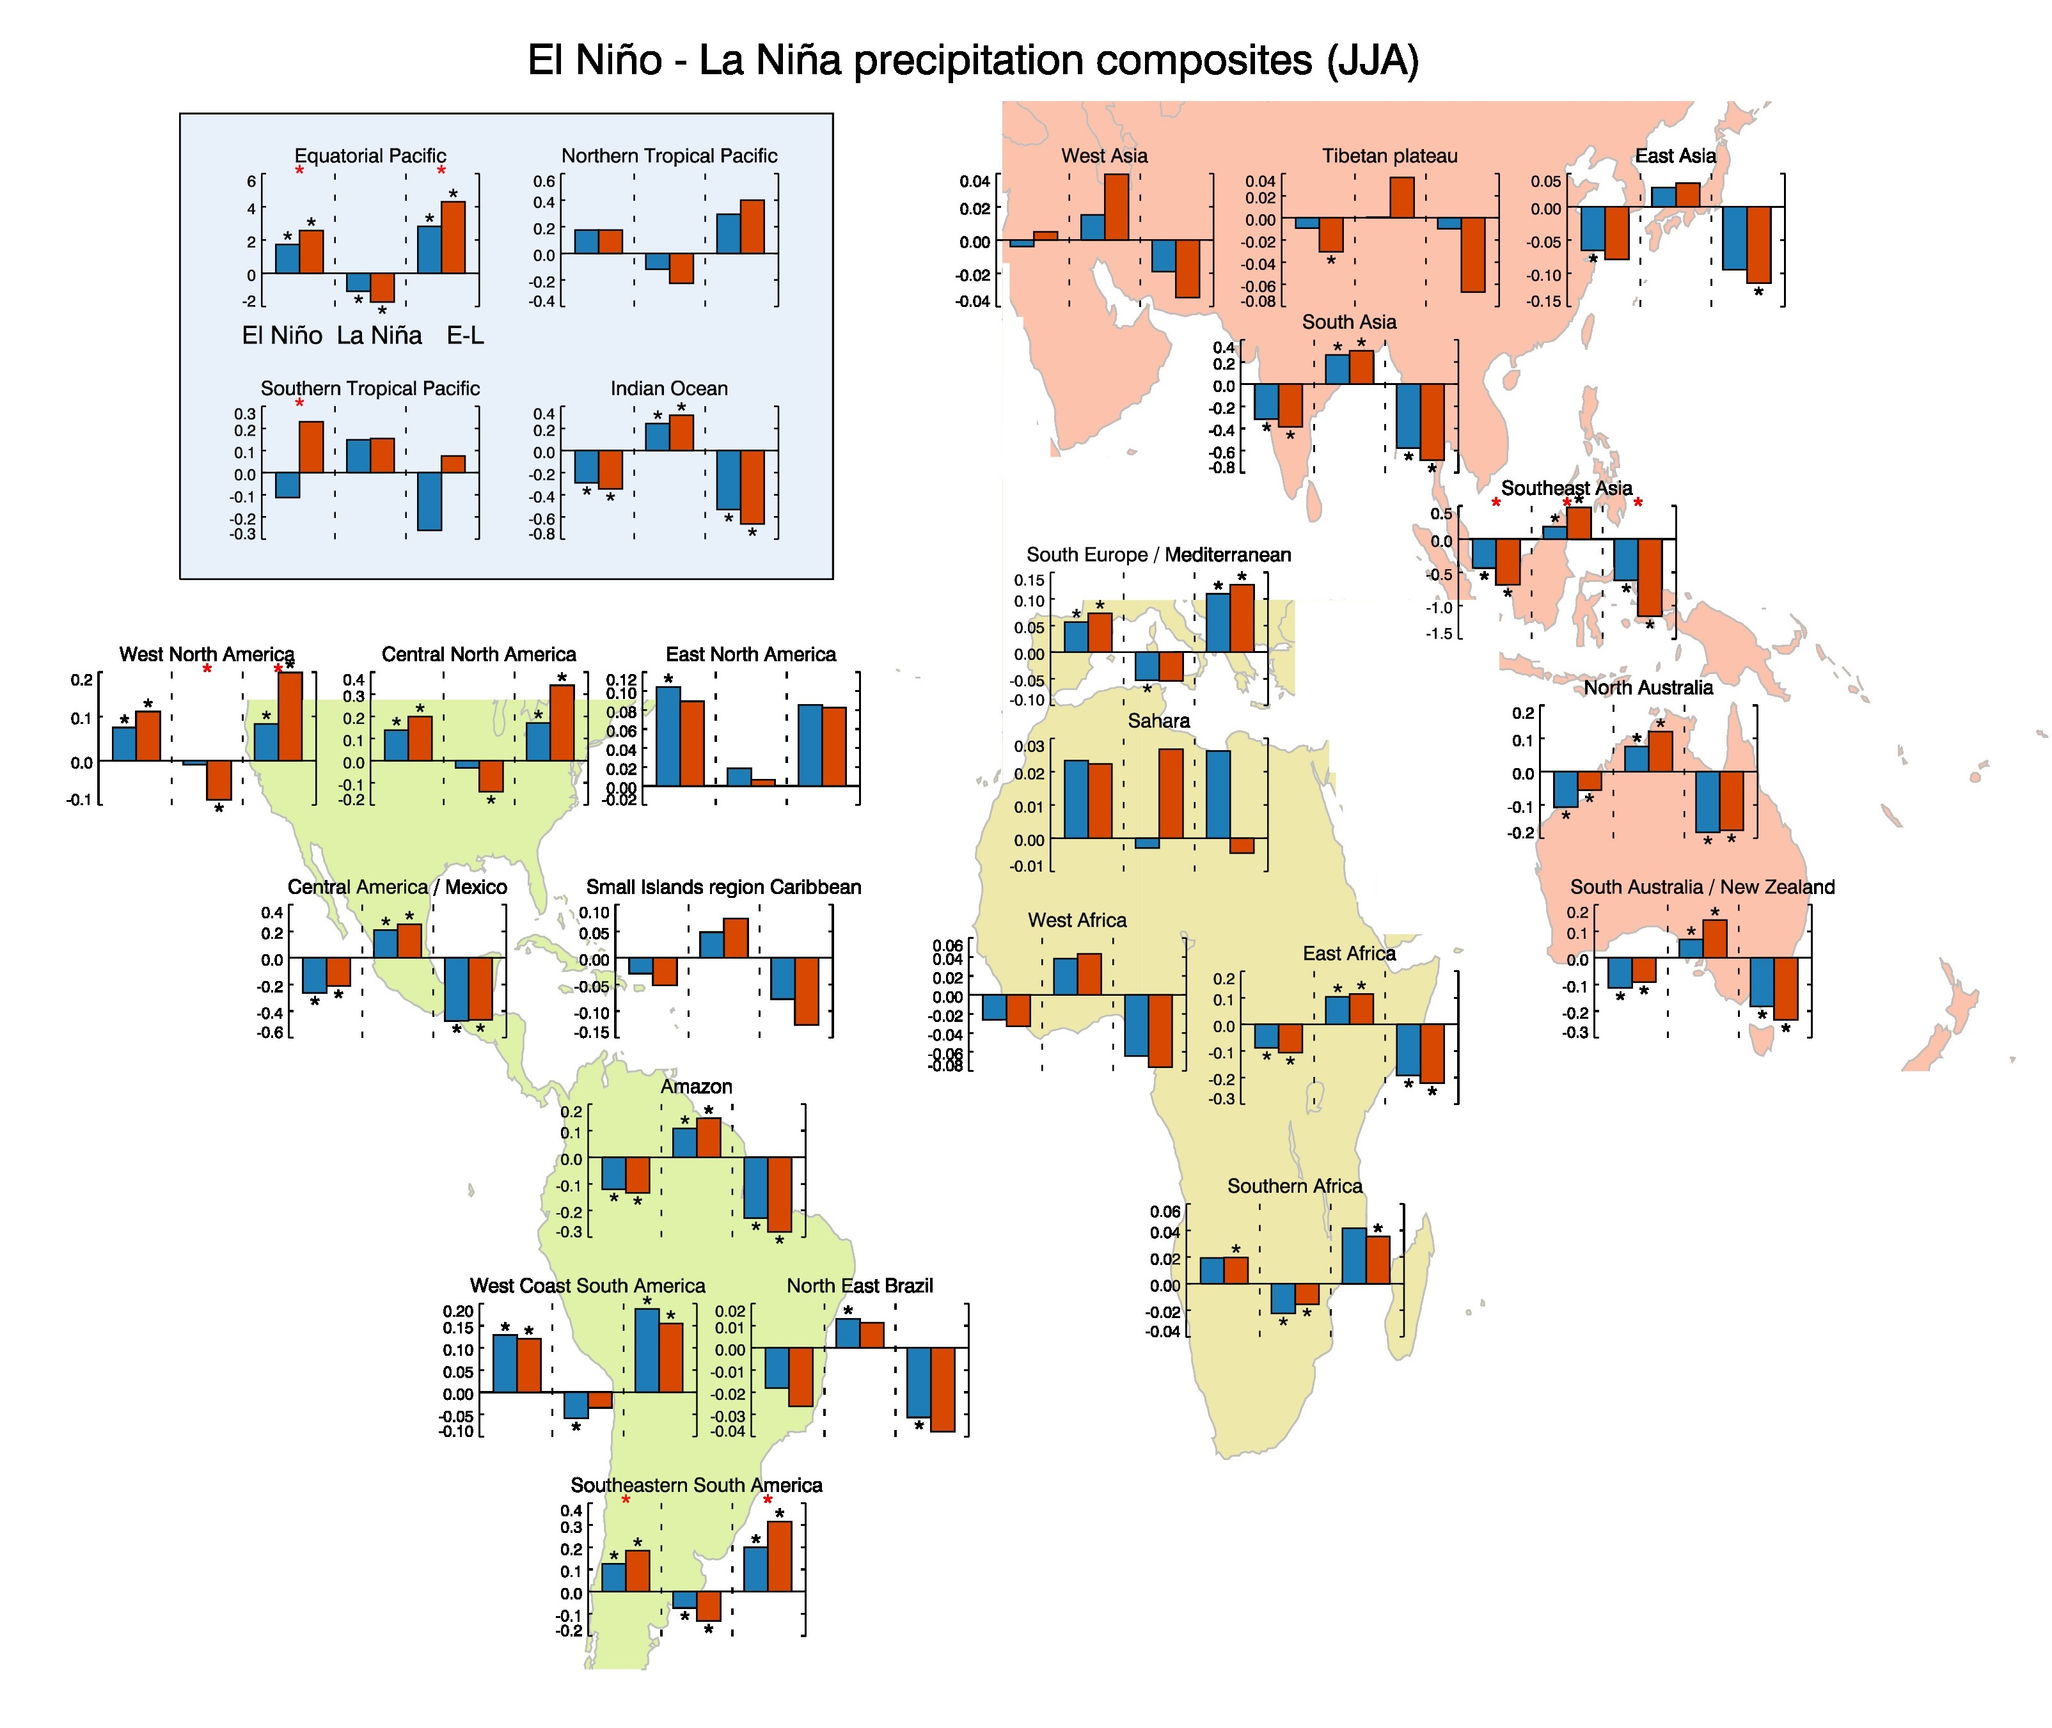
Notes:
Figure 11 Histograms representing regional averages of MMM El Niño (blue and red bars on far right of each panel) and La Niña (two middle bars) precipitation anomalies, and ENSO-driven variability (two bars to the right in each panel), in the 20th and 21st centuries. Results for JJA are depicted. Units: mm/day.

Slide 14
Magnitude of ENSO-driven precipitation variability increases in 19 out of 25 regions (JJA)
Notes:
Figure 11 Histograms representing regional averages of MMM El Niño (blue and red bars on far right of each panel) and La Niña (two middle bars) precipitation anomalies, and ENSO-driven variability (two bars to the right in each panel), in the 20th and 21st centuries. Results for JJA are depicted. Units: mm/day.

Slide 15
Changes in ENSO-driven precipitation variability away from the Pacific
JJA
In the 14 regions with robust 20th C signals:
Variability increases in 12 regions (sig level = 99.9%)
21% median increase on ENSO variability
DJF
In the 19 regions with robust 20th C signals
Variability increases in 14 regions (sig level >99%)
Median increase = 16%

Slide 16
What is the combined impact of :
ENSO-driven variability changes
Changes in rainfall during neutral years
in southern Australia/NZ?

Slide 17
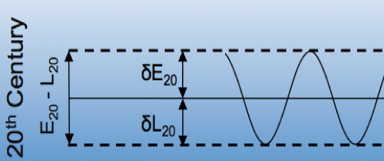
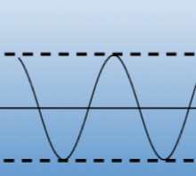
Southern Australia/NZ– summary for JJA
20th C
La Niña
21st C
Neutral
La Niña
El Niño
Neutral
El Niño

Slide 18
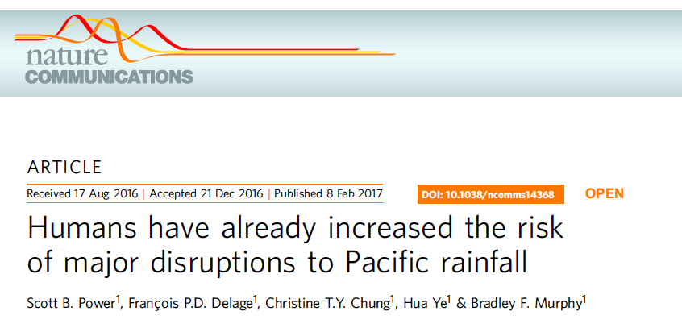

Slide 19
Caveats
Simulations of:
Pacific mean-state
ENSO variability
multidecadal changes in the Pacific
in CMIP5 models are imperfect
We are looking forward to examining CMIP6 simulations to see if they are better
Multi-model ensembles will continue to be crucial, given model-to-model difference and often modest signal-to-noise ratios when dealing with precip

Slide 20
Summary
Models do reasonably well simulating the sign of ENSO precipitation teleconnections
The magnitude of ENSO-driven precipitation variability generally increases around the world (JJA, RCP8.5)
Results consistent with there being a modest increase in ENSO-driven variability of order 15-20% by the end of the 21st century
Global warming had already increased the risk of major disruption to Pacific rainfall by the end of the 20th century
In southern Australia/NZ
no robust change in variability
El Niño, La Niña and neutral years all tend to be drier
La Niña years are about as wet as 20thC neutral years

Slide 21
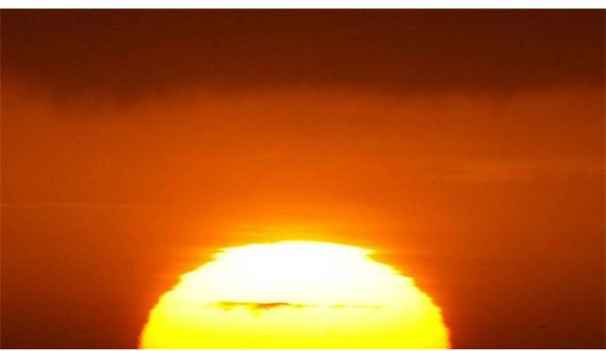
Thank you for listening!
Changes in ENSO teleconnections
Power and Delage 2018: J. Climate
Humans have already inflated risk of major disruption to Pacific rainfall
Power et al. 2017: Nature Communications
Power et al. 2017: The Conversation, February 9
Nonlinear intensification of ENSO rainfall anomalies in Pacific
Power et al. 2013: Nature
Chung et al. 2014: Climate Dynamics
Chung and Power 2015: J. Climate.
scott.power@bom.gov.au
Notes:
Image:

