Slide 1
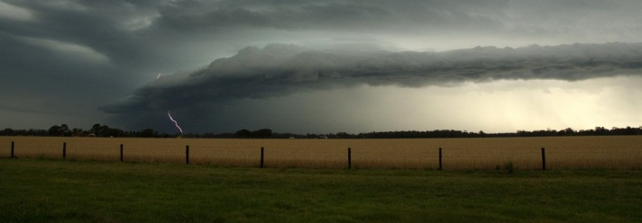
Using ensembles in climate sensitivity and feedbacks
Rob Colman
Plus thanks to: Scott Power, Lawson Hanson, Jo Brown, Michael Grose¹, Charmaine Franklin and others..
Climate Research Section, StS, Bureau of Meteorology
¹CSIRO

Slide 2
Outline
Motivation: why should we care about climate sensitivity and feedbacks?
Why is the spread so large and what do ensembles tell us?
Use of ensembles – strengths and weaknesses
Where to in future?
Conclusions
Notes:
Fig. 5 Projected change in surface air temperature a observed Australian
temperature from the Australian Climate Observations Reference
Network—Surface Air Temperature (ACORN-SAT, Trewin
2013) and projection from the ACCESS-1.0 model (with the offset
to ACORN-SAT removed), and that model scaled to an ECS of 1.5
and 6 °C using the additive scaling and to 6 °C using the proportional
scaling (marked ECS6*), b the projection of Australian and Global
temperature from 1986–2005 to 2080–2099 for RCP8.5 from CMIP5
models. The subset of models used here and those models scaled to
emulate various ECS values. The median is shown by a black circle
in each case. Blue circles indicate the unscaled model values from all
CMIP5 models, and the subset for which ECS is available. Red circles
denote results scaled to various values within the likely range,
and purple circles are results scaled to the <5 % case of ECS 6. In all
cases left symbols indicate global, and right is Australian

Slide 3
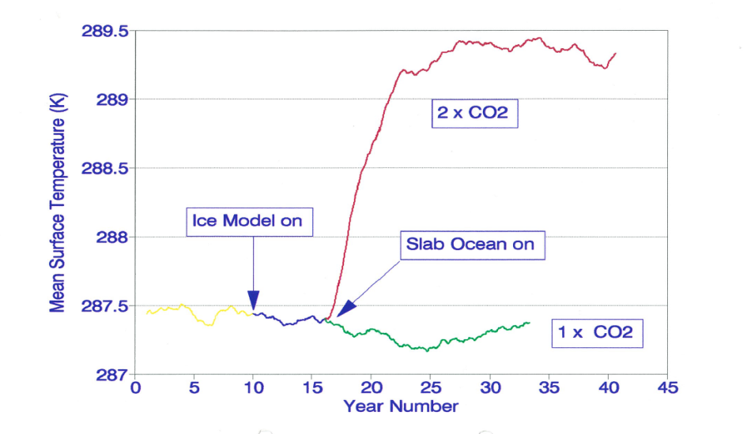
ECS: Equilibrium climate sensitivity
ECS: equilibrium climate sensitivity
AGCM coupled to mixed layer ocean, 2xCO₂
→ Equilibrates in decades
Notes:
(1) Understanding and (2) reducing uncertainties in the CC projections. ROB COLMAN
Introduction
Climate sensitivity = the degree warming per unit of forcing (i.e. doubling CO2) for each model.
(this excludes the CC-feedback which sits on top of that).
Requires two-pronged attck: (1) understanding the model ensemble and (2) understanding the process in our model
Sensitivity has come down only marginally, much larger than inter-model variability.
Mainly due to feedback, mainly clouds(+/-), water vapour(++), surface albedo(+) and laps rate(-).
If we had an analogue for this in the current climate, that would be very useful.

Slide 4
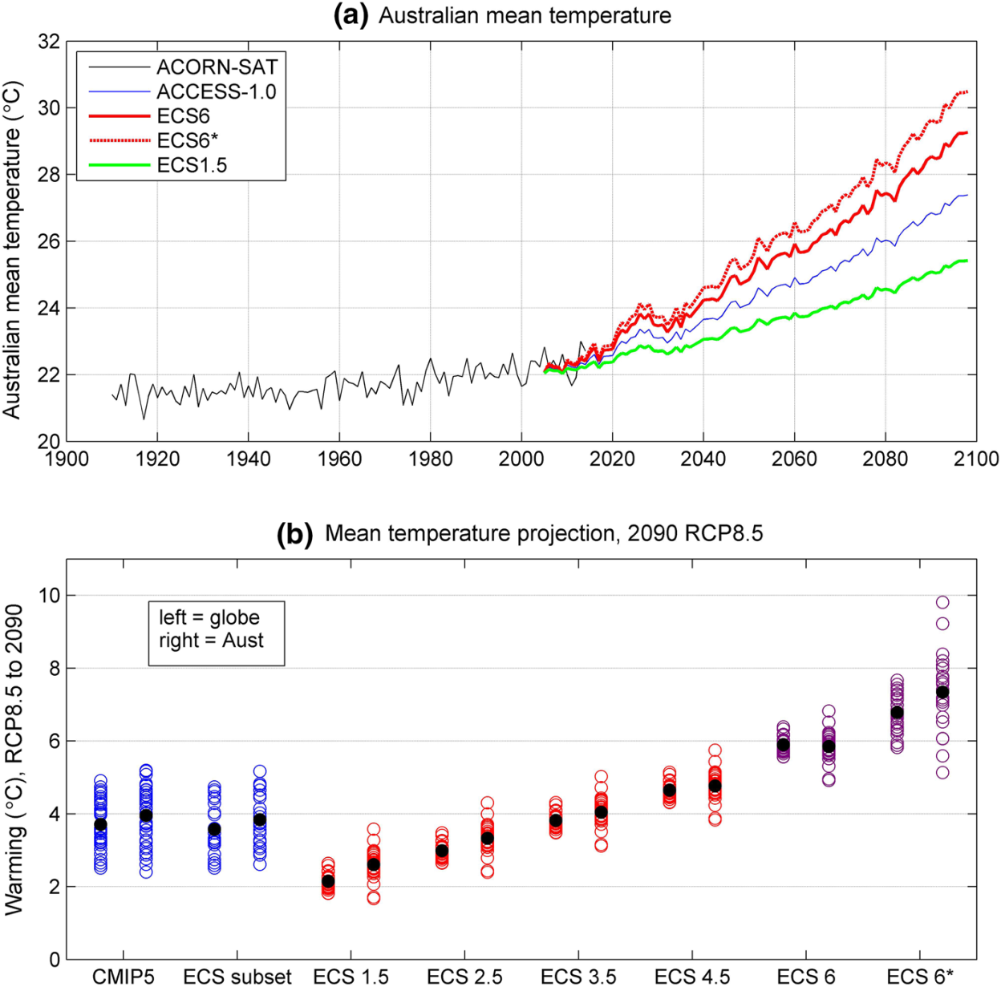
Knowing ECS would drop Australian ΔT 5-95% range by a factor of ~3
From this … to, say, this
Grose et al., 2016: Limits to global and Australian temperature change this century based on expert judgment of climate sensitivity, Climate Dynamics
Notes:
Fig. 5 Projected change in surface air temperature a observed Australian
temperature from the Australian Climate Observations Reference
Network—Surface Air Temperature (ACORN-SAT, Trewin
2013) and projection from the ACCESS-1.0 model (with the offset
to ACORN-SAT removed), and that model scaled to an ECS of 1.5
and 6 °C using the additive scaling and to 6 °C using the proportional
scaling (marked ECS6*), b the projection of Australian and Global
temperature from 1986–2005 to 2080–2099 for RCP8.5 from CMIP5
models. The subset of models used here and those models scaled to
emulate various ECS values. The median is shown by a black circle
in each case. Blue circles indicate the unscaled model values from all
CMIP5 models, and the subset for which ECS is available. Red circles
denote results scaled to various values within the likely range,
and purple circles are results scaled to the <5 % case of ECS 6. In all
cases left symbols indicate global, and right is Australian

Slide 5
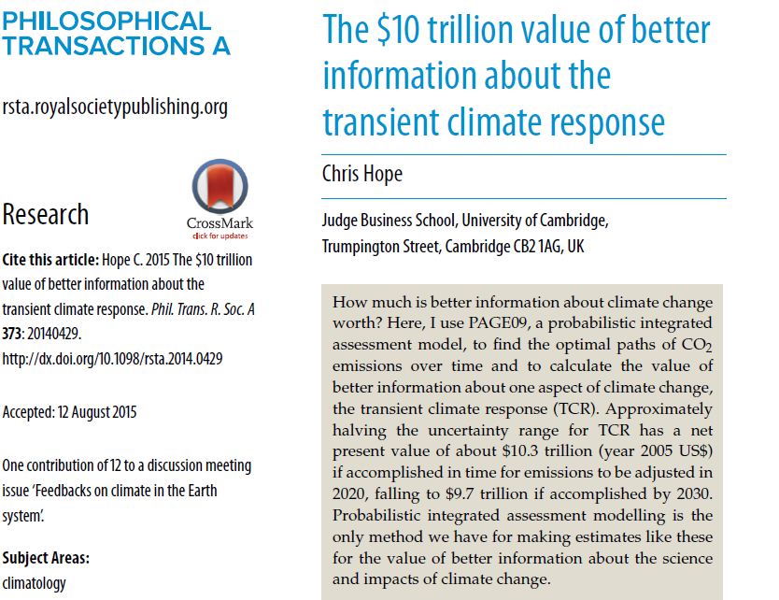
Potentially worth a few $$$...
Halving uncertainty in TCR by 2020 → save $10T by end of century
Notes:
(1) Understanding and (2) reducing uncertainties in the CC projections. ROB COLMAN
Introduction
Climate sensitivity = the degree warming per unit of forcing (i.e. doubling CO2) for each model.
(this excludes the CC-feedback which sits on top of that).
Requires two-pronged attck: (1) understanding the model ensemble and (2) understanding the process in our model
Sensitivity has come down only marginally, much larger than inter-model variability.
Mainly due to feedback, mainly clouds(+/-), water vapour(++), surface albedo(+) and laps rate(-).
If we had an analogue for this in the current climate, that would be very useful.

Slide 6

Estimates of ECS…. history
International assessments
1.5 to 4.5 °C : National Academy of Science (US), 1979
1.5 to 4.5 °C : IPCC 1st Assessment Report, 1990
1.5 to 4.5 °C : IPCC 2nd Assessment Report, 1996
1.5 to 4.5 °C : IPCC 3rd Assessment Report, 2001
2.0 to 4.5 °C : IPCC 4th Assessment Report, 2007 (best estimate 3°C)*
1.5 to 4.5 °C : IPCC 5th Assessment Report, 2013**
* >90% likely that >1.5 °C
** Range of >66% likelihood. <5% chance of >6 °C.
CMIP5 model range 2.1 to 4.7 °C
Jule Charney
(1917-1981)
(IPCC, 2001)

Slide 7
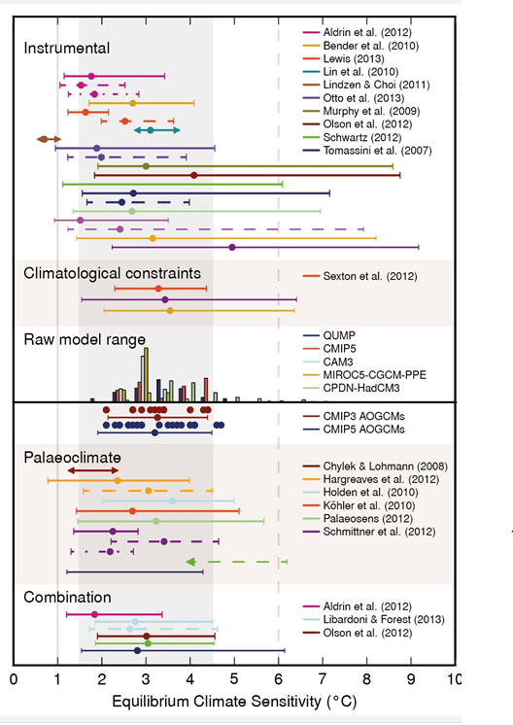
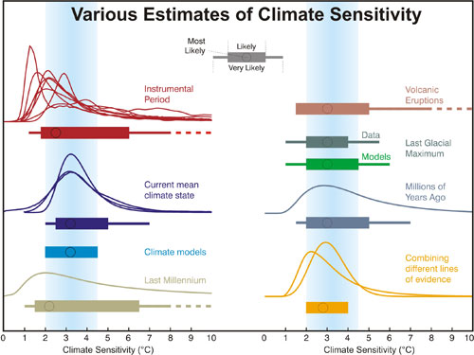
IPCC ECS estimates are always based on
ensembles³
Knutti and Hegerl (2008)
AR5, Box 12.2 Figure 1 (2013)
Notes:
(1) Understanding and (2) reducing uncertainties in the CC projections. ROB COLMAN
Introduction
Climate sensitivity = the degree warming per unit of forcing (i.e. doubling CO2) for each model.
(this excludes the CC-feedback which sits on top of that).
Requires two-pronged attck: (1) understanding the model ensemble and (2) understanding the process in our model
Sensitivity has come down only marginally, much larger than inter-model variability.
Mainly due to feedback, mainly clouds(+/-), water vapour(++), surface albedo(+) and laps rate(-).
If we had an analogue for this in the current climate, that would be very useful.

Slide 8
What does each ensemble give us and what are the strengths/weaknesses?
Multi-model ensemble (CMIPx):
'ensemble of opportunity' based on intense partially independent model development efforts, which are not focussed on sensitivity
Ad hoc group, no systematic exploration of feedbacks and processes
Perturbed physics ensembles
Carefully constructed sampling of parameter uncertainty
Does not sample 'structural' differences
Very host model dependent for unclear reasons

Slide 9
What does each ensemble give us and what are the strengths/weaknesses?
Sensitivity estimated from observational record
Looks at real time changes
Forcing poorly known, so many different estimates used
Estimates from paleo record
Real world response
Forcing is different, long terms feedbacks (e.g ice sheets) come into play, paleo reconstructions differ

Slide 10
What does each ensemble give us and what are the strengths/weaknesses?
Constraints from volcanic eruptions
Forcing different, and poorly constrained
Response rapid and transient, not involving deep ocean
Analogues/constraints from unforced variability
Possible to constrain feedbacks from observations
'Forcing' is different, and surface temperature pattern differs (although some overall similarities)

Slide 11
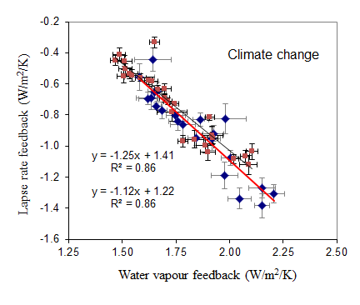
What do ensembles of GCMs tell us about sensitivity and feedbacks?
They reveal critical physical processes and their relationships
Colman and Hanson, 2016: On the relative strength of radiative feedbacks under climate variability and change, Climate Dynamics
Blue = CMIP3
Red = CMIP5

Slide 12
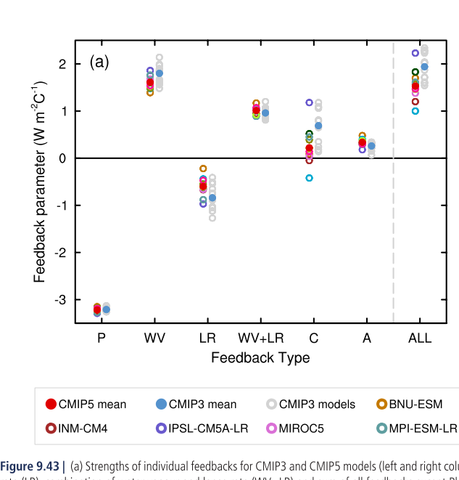
What do ensembles of GCMs tell us about sensitivity and feedbacks?
They reveal where the biggest uncertainties come from
IPCC AR5 (2013) Chapter 9

Slide 13
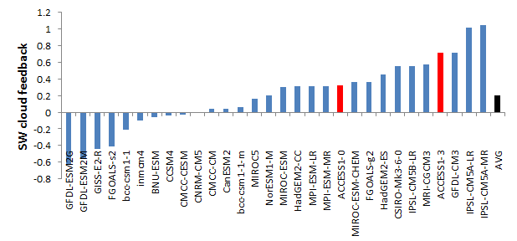
Cloud feedbacks vary a lot, and are not well constrained:
Short Wave cloud feedback in CMIP5 GCMs
Colman, Brown, Franklin, Hanson, Ye and Zelinka (2018)
Evaluating cloud feedbacks and rapid responses in the ACCESS model
(submitted)
Notes:
We would like to know the exchanges of carbon and water everywhere, all the time. To create this knowledge we need to integrate tower observations (good in time), remote sensing (spatial coverage) and modeling.
Remote sensing observations are rich in spatial information and can be used to ‘scale up’ from local to larger scales.
13

Slide 14
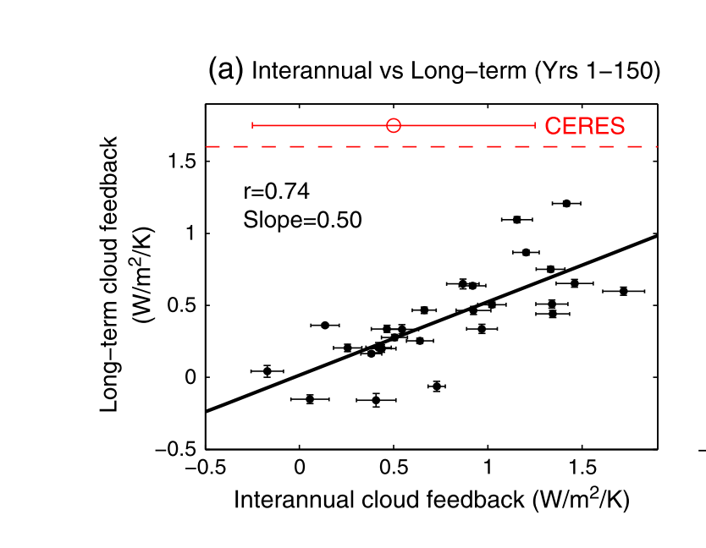
What do ensembles of GCMs tell us about sensitivity and feedbacks?
They suggest possible constraints
Zhou et al., 2015
Interannual cloud feedback and climate change cloud feedbacks are correlated across GCMs

Slide 15
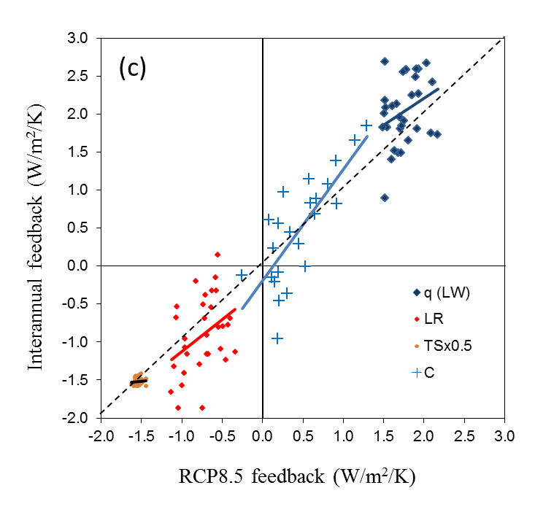
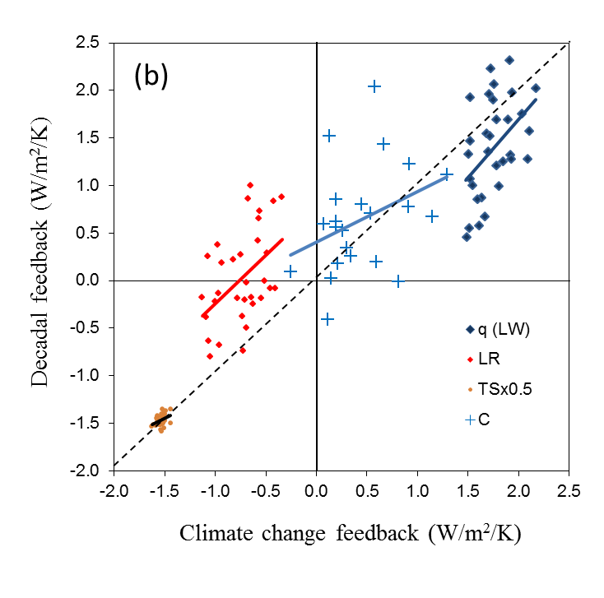
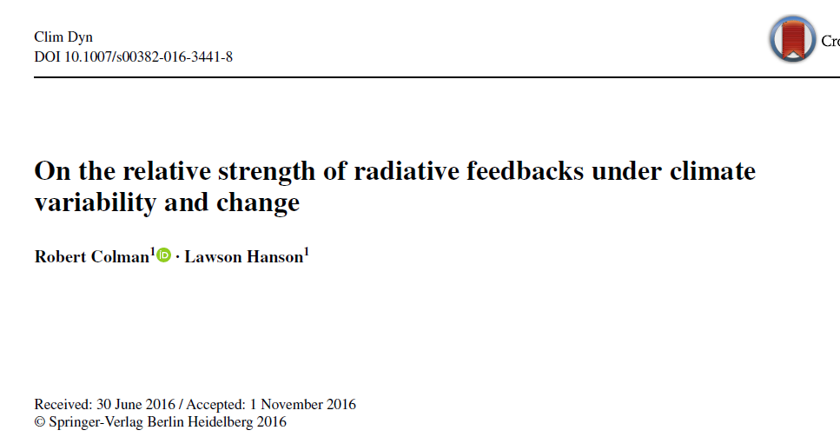
Q: What model-for-model correspondences exist for cloud (and other)
feedbacks in CMIP5 between climate variability and change?
A: A lot, as it turns out!
Interannual
Decadal
= statistically significant correlation
Each point is a CMIP5 model
Notes:
Decadal cloud fit:
R=0.35
R^2 =0.13
Just signif diff from zero at the 90% level

Slide 16
Does all this correlation mean variability and ECS are linked?
✓
ECS
Tropical decadal variability
Notes:
Tropical variability around 0.9x global variability (MMM of CMIP5)

Slide 17
Does this hold for earlier models?: no for CMIP3!
✓
✗
Colman and Power, 2018: What can decadal variability tell us about climate feedbacks and sensitivity? Climate Dynamics
CMIP6? Let's see…
Notes:
Tropical variability around 0.9x global variability (MMM of CMIP5)

Slide 18
Conclusions
ECS a critical parameter for understanding the magnitude of projected regional and global climate change
ECS 'range' traditionally estimated from an 'ensemble assessment of an ensemble of ensembles'
Hasn't shifted much over >35years, but major advances have been made in the understanding of/confidence in the processes (feedbacks) controlling climate sensitivity.
Ensembles of many different types have been the key to progress so far, and will be the key to future progress.
Diversity is good, a single world 'super model' would be a disaster.
Notes:
Fig. 5 Projected change in surface air temperature a observed Australian
temperature from the Australian Climate Observations Reference
Network—Surface Air Temperature (ACORN-SAT, Trewin
2013) and projection from the ACCESS-1.0 model (with the offset
to ACORN-SAT removed), and that model scaled to an ECS of 1.5
and 6 °C using the additive scaling and to 6 °C using the proportional
scaling (marked ECS6*), b the projection of Australian and Global
temperature from 1986–2005 to 2080–2099 for RCP8.5 from CMIP5
models. The subset of models used here and those models scaled to
emulate various ECS values. The median is shown by a black circle
in each case. Blue circles indicate the unscaled model values from all
CMIP5 models, and the subset for which ECS is available. Red circles
denote results scaled to various values within the likely range,
and purple circles are results scaled to the <5 % case of ECS 6. In all
cases left symbols indicate global, and right is Australian

Slide 19

Thank you

Slide 20
Notes:
Fig. 5 Projected change in surface air temperature a observed Australian
temperature from the Australian Climate Observations Reference
Network—Surface Air Temperature (ACORN-SAT, Trewin
2013) and projection from the ACCESS-1.0 model (with the offset
to ACORN-SAT removed), and that model scaled to an ECS of 1.5
and 6 °C using the additive scaling and to 6 °C using the proportional
scaling (marked ECS6*), b the projection of Australian and Global
temperature from 1986–2005 to 2080–2099 for RCP8.5 from CMIP5
models. The subset of models used here and those models scaled to
emulate various ECS values. The median is shown by a black circle
in each case. Blue circles indicate the unscaled model values from all
CMIP5 models, and the subset for which ECS is available. Red circles
denote results scaled to various values within the likely range,
and purple circles are results scaled to the <5 % case of ECS 6. In all
cases left symbols indicate global, and right is Australian

Slide 21
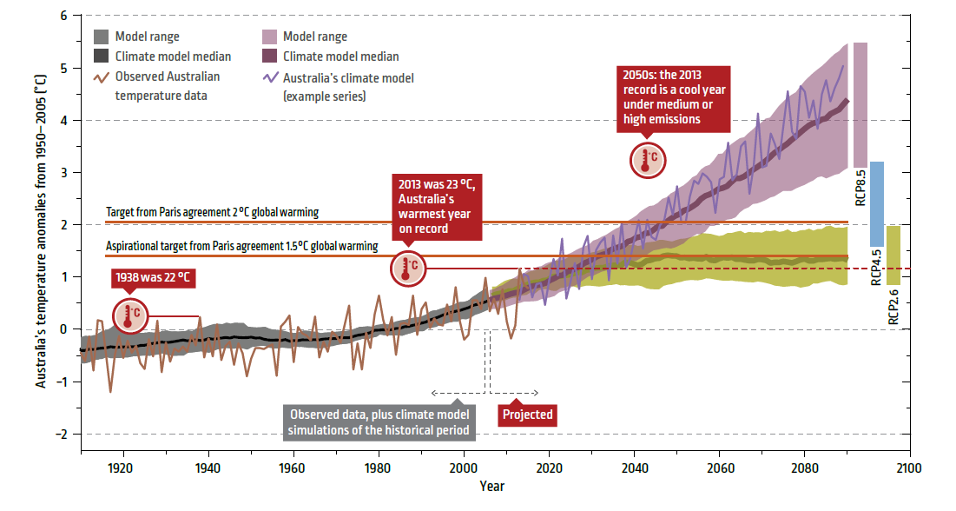
Notes:
Fig. 5 Projected change in surface air temperature a observed Australian
temperature from the Australian Climate Observations Reference
Network—Surface Air Temperature (ACORN-SAT, Trewin
2013) and projection from the ACCESS-1.0 model (with the offset
to ACORN-SAT removed), and that model scaled to an ECS of 1.5
and 6 °C using the additive scaling and to 6 °C using the proportional
scaling (marked ECS6*), b the projection of Australian and Global
temperature from 1986–2005 to 2080–2099 for RCP8.5 from CMIP5
models. The subset of models used here and those models scaled to
emulate various ECS values. The median is shown by a black circle
in each case. Blue circles indicate the unscaled model values from all
CMIP5 models, and the subset for which ECS is available. Red circles
denote results scaled to various values within the likely range,
and purple circles are results scaled to the <5 % case of ECS 6. In all
cases left symbols indicate global, and right is Australian

