Slide 1
Case studies (from the small to the large scale):
Sydney (28 Nov 2018),
TC Debbie and TC Irma (2017),
Japan floods and Kerala floods (2018)
Roberto Buizza^{1,2}
(1): Scuola Superiore Sant’Anna (Pisa, Italy)
(2): ECMWF (Reading, UK)

Slide 2
Case studies (from the small to the large scale)
The ECMWF forecast system
Case studies:
  Sydney flood event (28-29 Nov 2018)
  TC Debbie (Australia, 28 March 2017)
  Hurricane Irma (US, 10 Sept 2017)
  Japan flood (28 June to 7 July 2018)
  Kerala flood and the Indian monsoon (~ 15 August 2018)

Slide 3
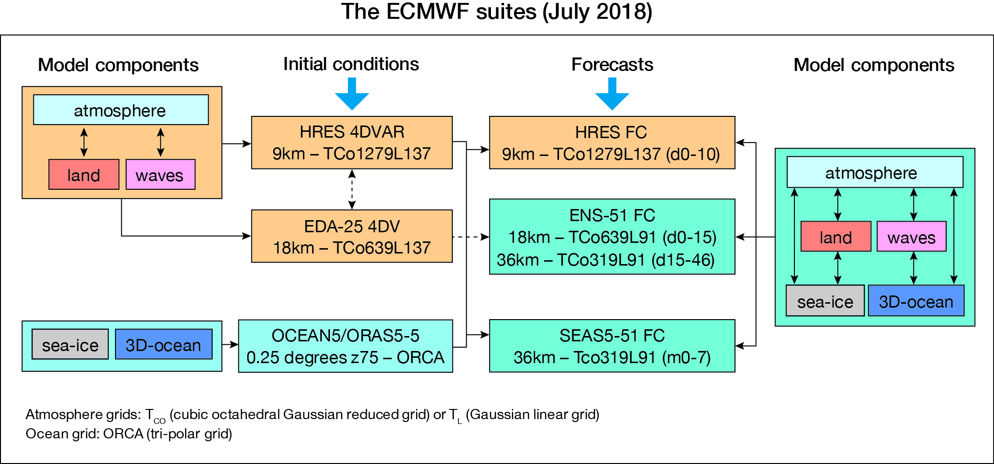
Ensembles are key (the ECMWF o-suite in 2018)

Slide 4
Key characteristics of the 4 ECMWF ensembles
Ensemble | # | Atmosphere Resolution | Ocean Resolution | Sea-ice | OBS and IC unc | Model unc | Frequency
4DVAR HRES(d0-10) | 1 | Tco1279L137 (9km) | 0.25deg-z75 (25km) | LIM2 | -- | -- | 4/day
EDA | 25 | Tco639L137 (18km) | -- | -- | OBS | SPPT(3L) | 2/day
ENS (d0-15) | 51 | Tco639L91 (18km) | 0.25deg-z75 (25km) | LIM2 | IC | SPPT(3L) | 2/day (4/day to d6.5)
ENS (d15-46) | 51 | Tco319L91 (36km) | 0.25deg-z75 (25km) | LIM2 | IC | SPPT(3L) | 2/week
SEAS5 (m0-7/13) | 51 | Tco319L91 (36km) | 0.25deg-z75 (25km) | LIM2 | IC | SPPT(3L) & SKEB | 1/month
OCEAN5 | 5 | -- | 0.25deg-z75 (25km) | LIM2 | OBS | N | 1/day

Slide 5
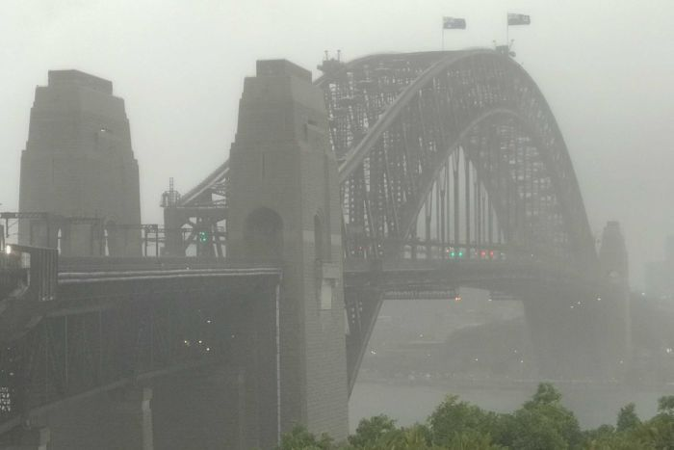
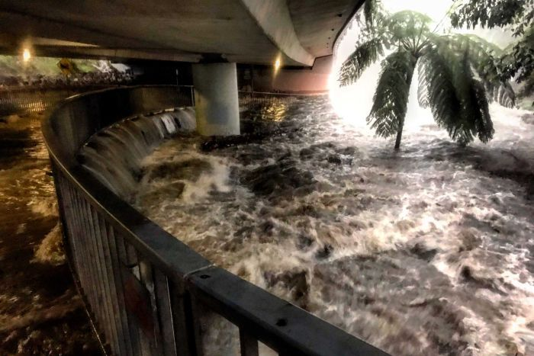
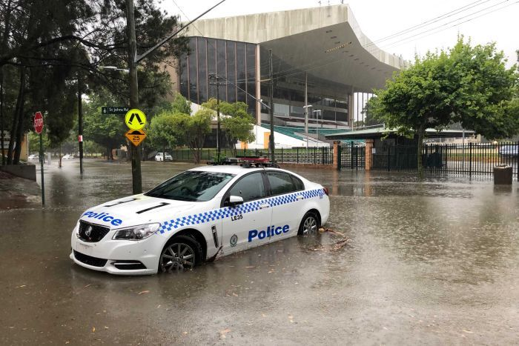
Sydney flood (28-29 Nov 2018)
ENS medium-range forecasts from 25 March at 00 to 28 March at 12 UTC.

Slide 6
Sydney (EFI: 23@12+132h vt 28@00-29@00)
Sydney

Slide 7
Sydney (EFI: 24@12+108h vt 28@00-29@00)
Sydney

Slide 8
Sydney (EFI: 25@12+84h vt 28@00-29@00)
Sydney

Slide 9
Sydney (EFI: 26@12+60h vt 28@00-29@00)
Sydney

Slide 10
Sydney (EFI: 27@12+36h vt 28@00-29@00)
Sydney

Slide 11
Sydney (EFI: 27@12+36h vt 28@00-29@00)
Sydney

Slide 12
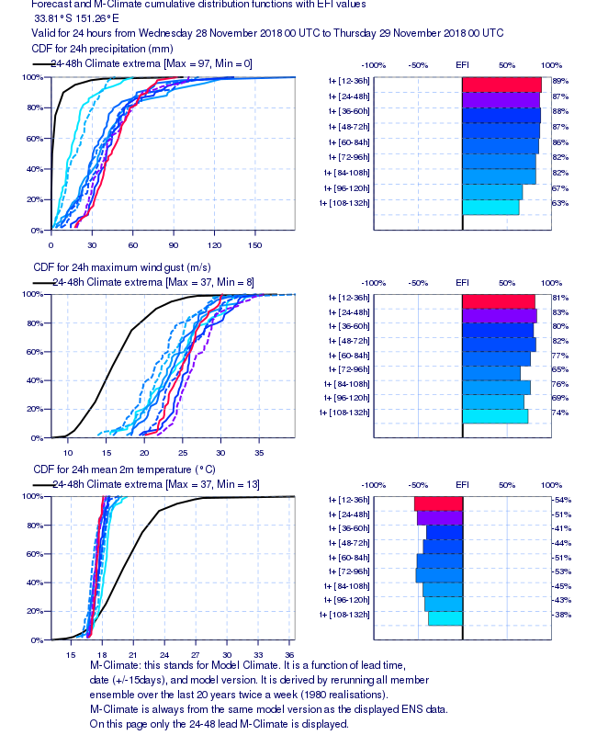
Sydney (CDF+EFI: vt 28@00-29@00)

Slide 13
Sydney (CDF: vt 28@00-29@00)
Max 91 > 180 mm

Slide 14
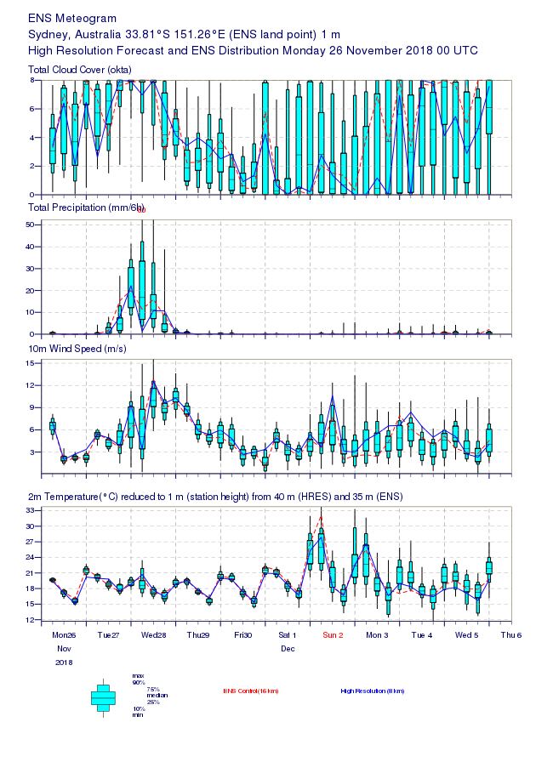
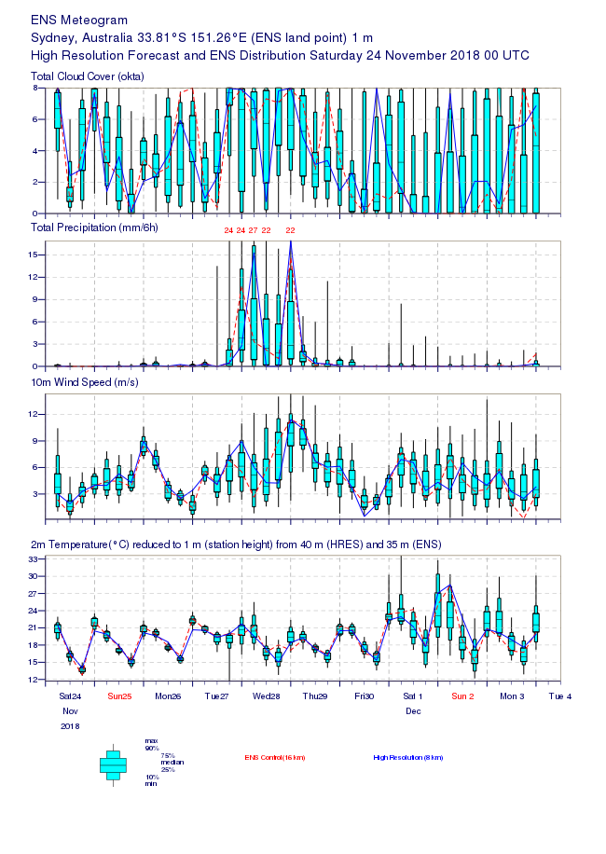
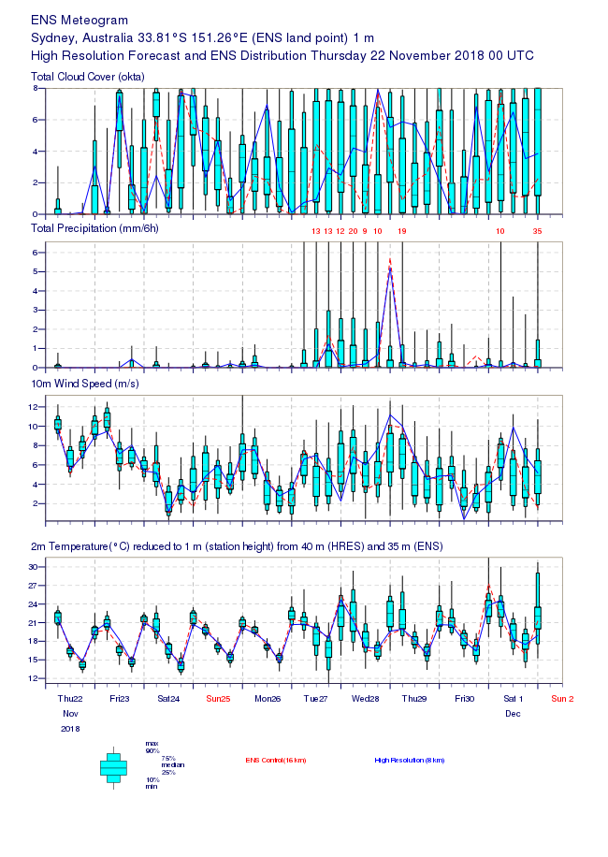
Sydney (ENSgram: from 22@00+6d to 26@00+2d)
26@00 +2d
24@00 +4d
22@00 +6d
28
28
28

Slide 15
Sydney (ENSgram: from 22@00+6d to 26@00+2d)
24@00 +4d
10mm
28
26@00 +2d
10mm
28

Slide 16
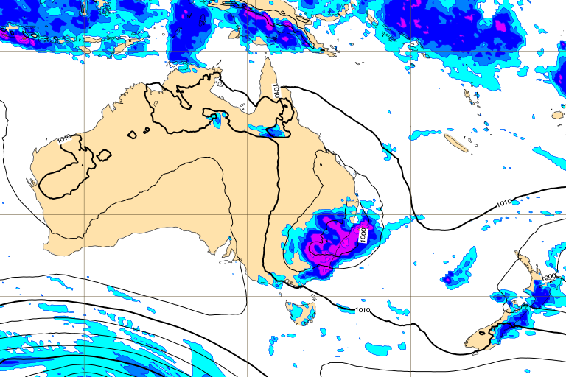
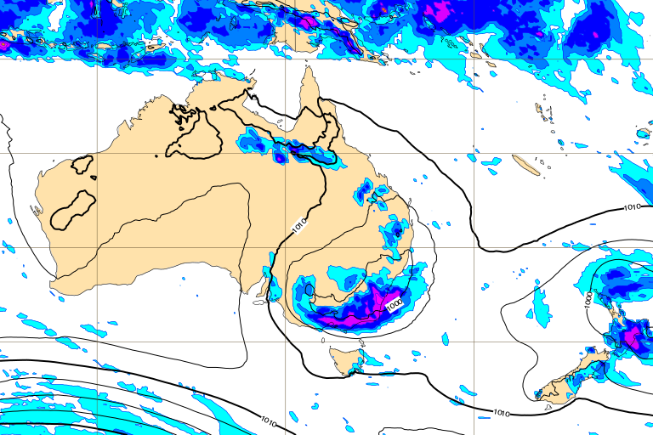
Sydney (ENSgram: from 22@00+6d to 26@00+2d)
HRES: 26@12+36h (6h accumulated)
HRES: 23@12+108h (6h accumulated)

Slide 17
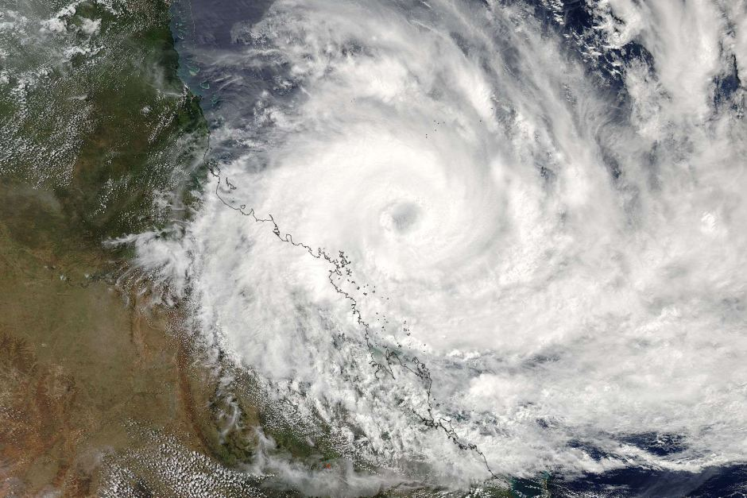
TC Debby (28 March 2017)
ENS medium-range forecasts from 25 March at 00 to 28 March at 12 UTC.

Slide 18
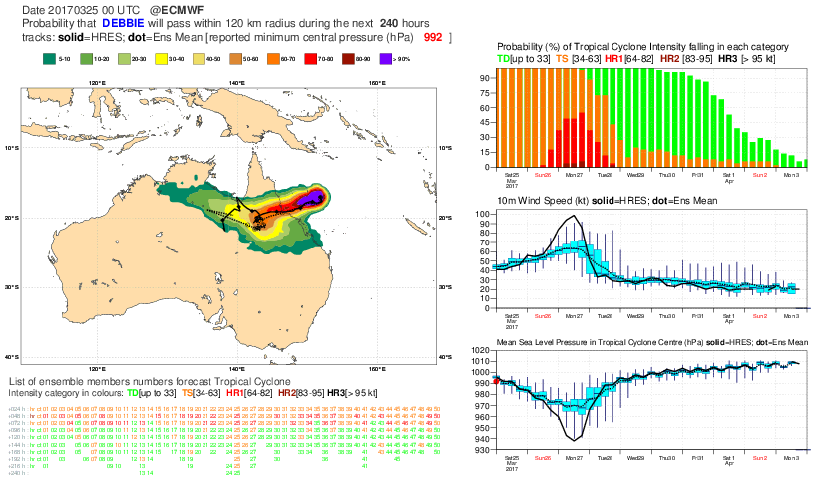
TC Debbie (ENS fc: 25@00+10d)

Slide 19
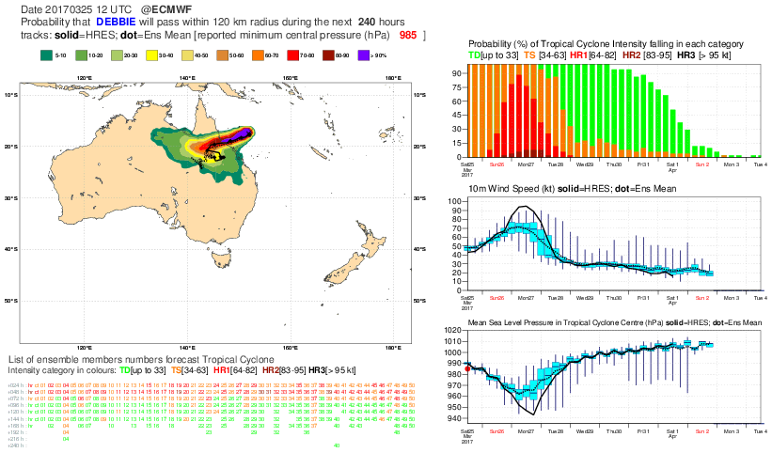
TC Debbie (ENS fc: 25@12+10d)

Slide 20
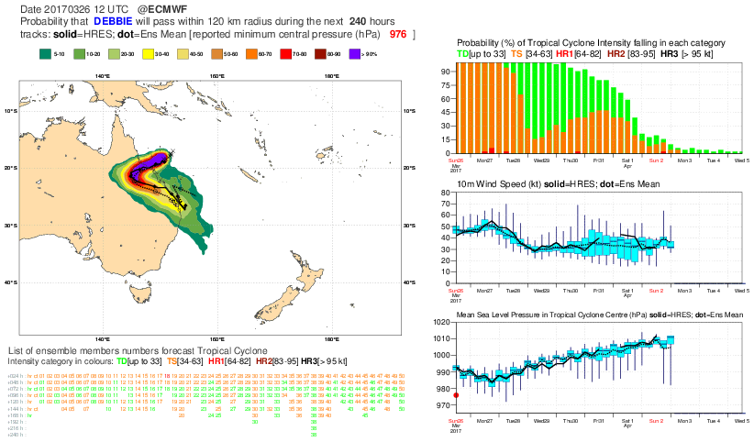
TC Debbie (ENS fc: 26@12+10d)

Slide 21
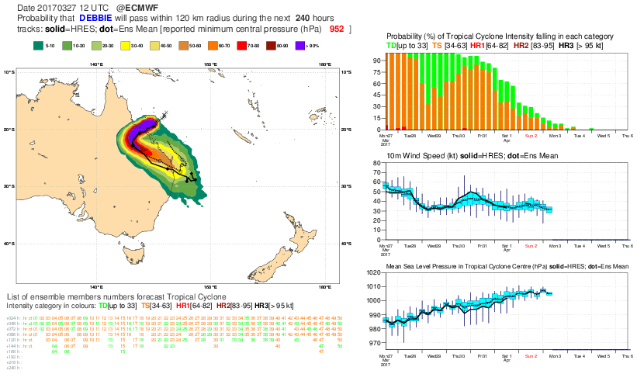
TC Debbie (ENS fc: 27@12+10d)

Slide 22
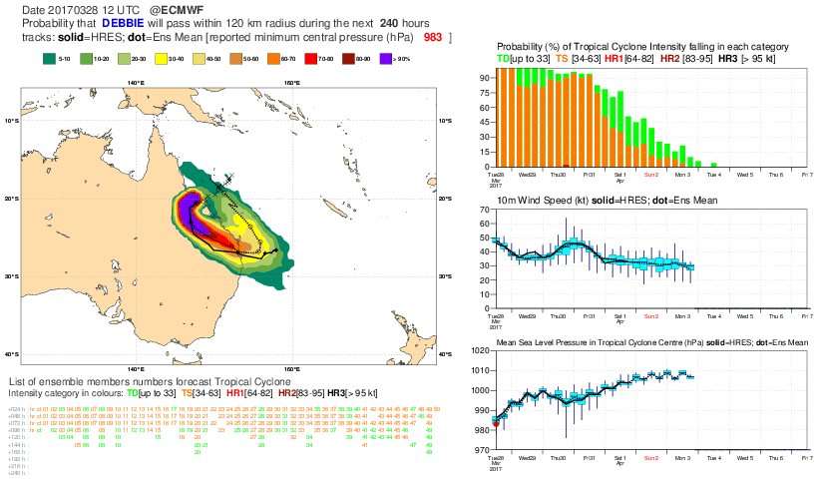
TC Debbie (ENS fc: 28@12+10d)

Slide 23
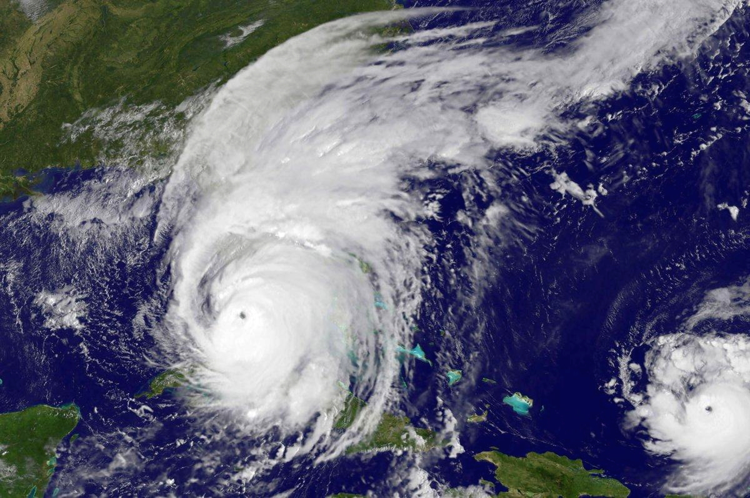
Hurricane Irma (10 Sep 2017)
ENS medium-range forecasts from 31 August at 00 UTC, to 10 September at 00 UTC.

Slide 24
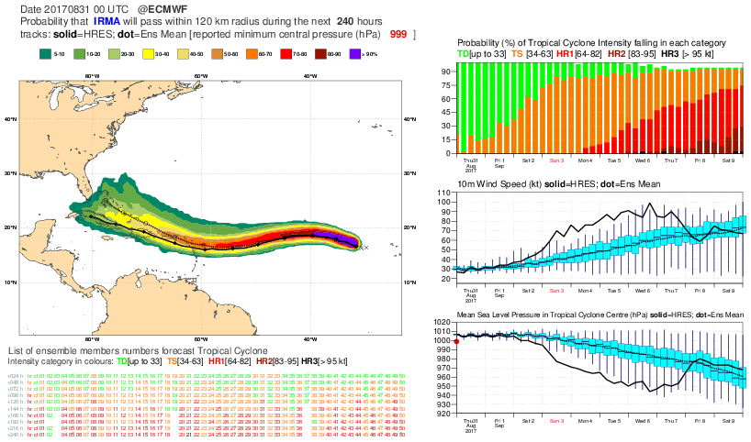
Hurricane Irma (ENS fc 31/10@00+10d)

Slide 25
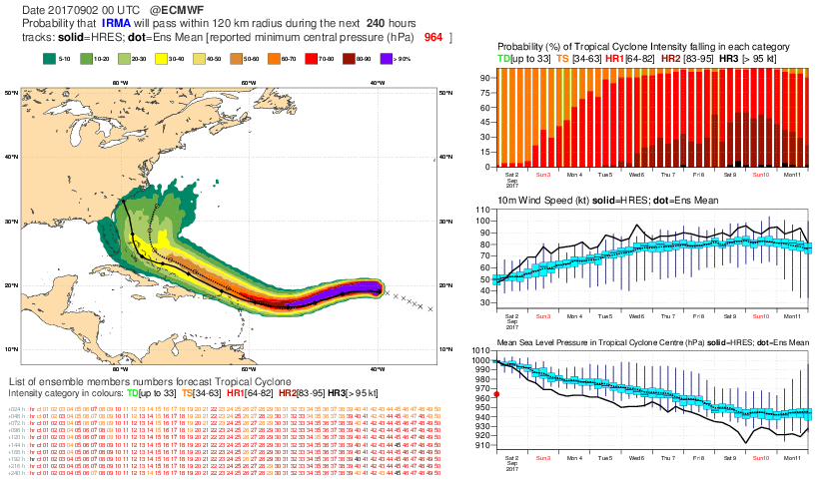
Hurricane Irma (ENS fc 2@00+10d)

Slide 26
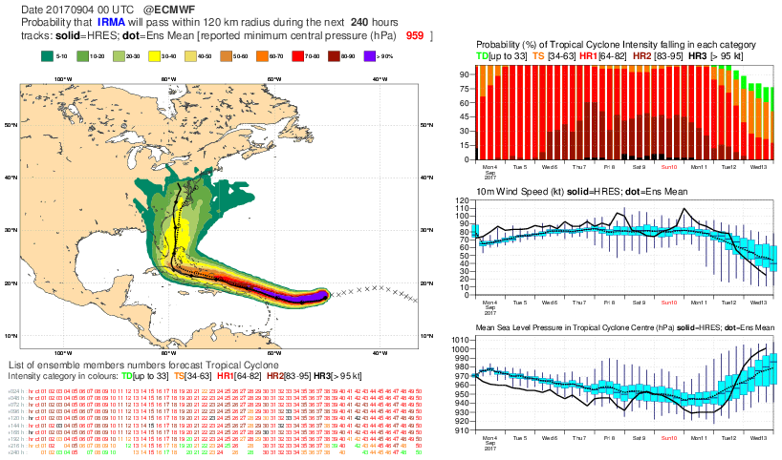
Hurricane Irma (ENS fc 4@00+10d)

Slide 27
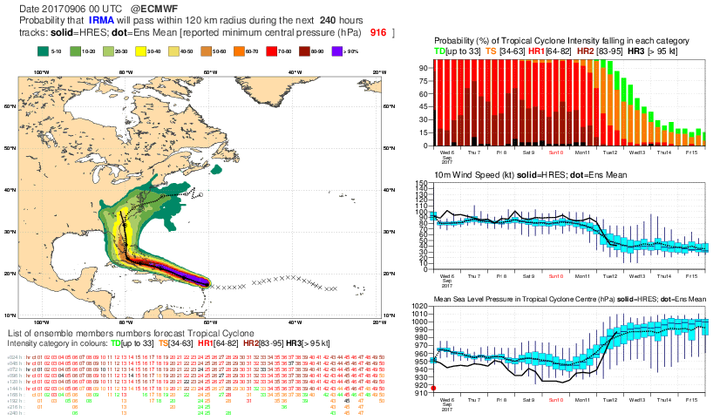
Hurricane Irma (ENS fc 6@00+10d)

Slide 28
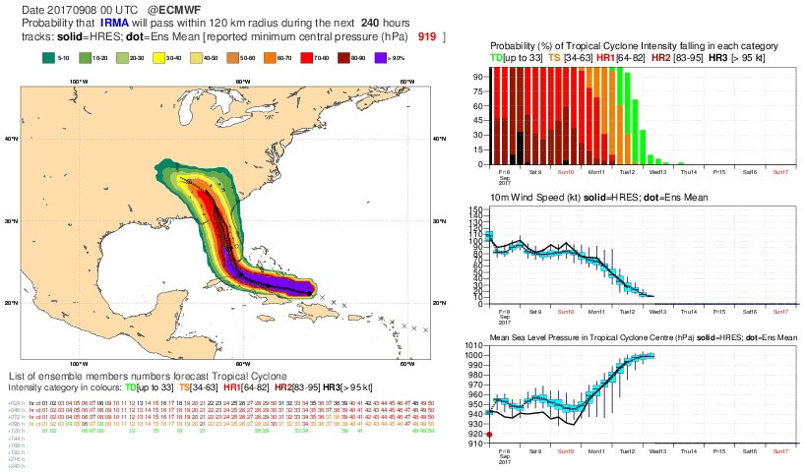
Hurricane Irma (ENS fc 8@00+10d)

Slide 29
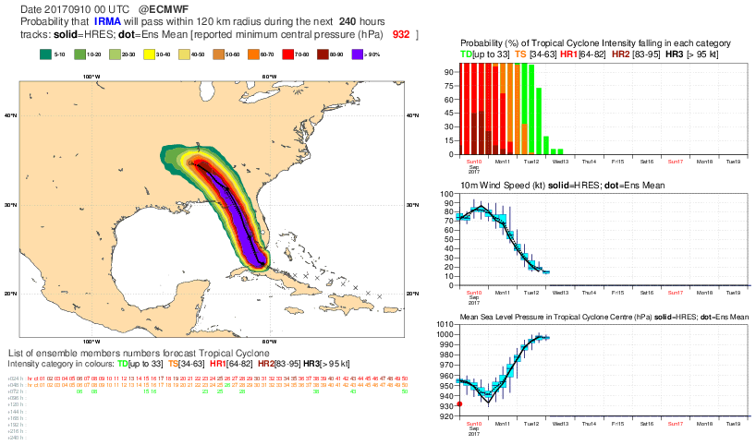
Hurricane Irma (ENS fc: 10@00+10d)

Slide 30
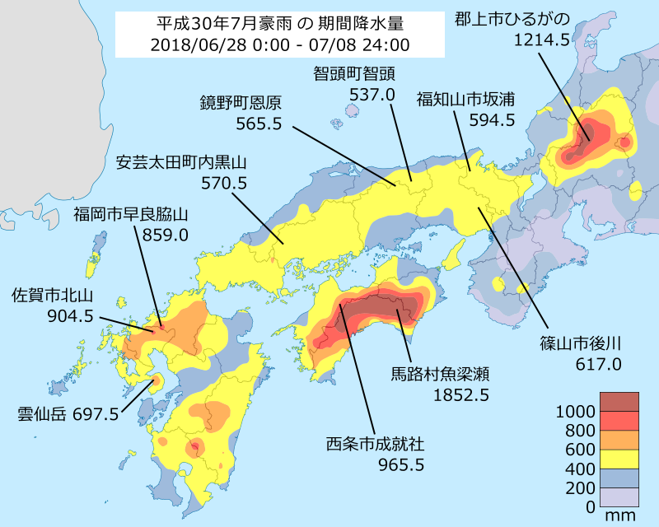
Japan floods (July 2018): ENS TP monthly fcs
ENS weekly-average forecasts from 11 June at 00 UTC, to 17 July at 00 UTC.
(Source: JMA)

Slide 31
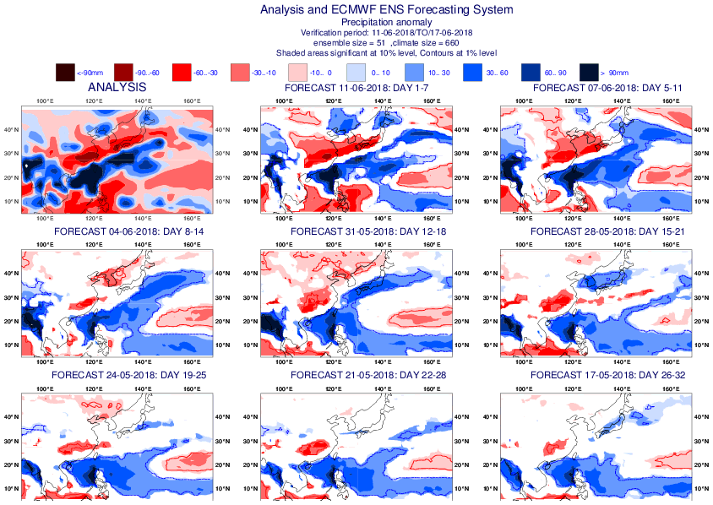
ENS weekly TP fc over EA for 20180611-0617

Slide 32
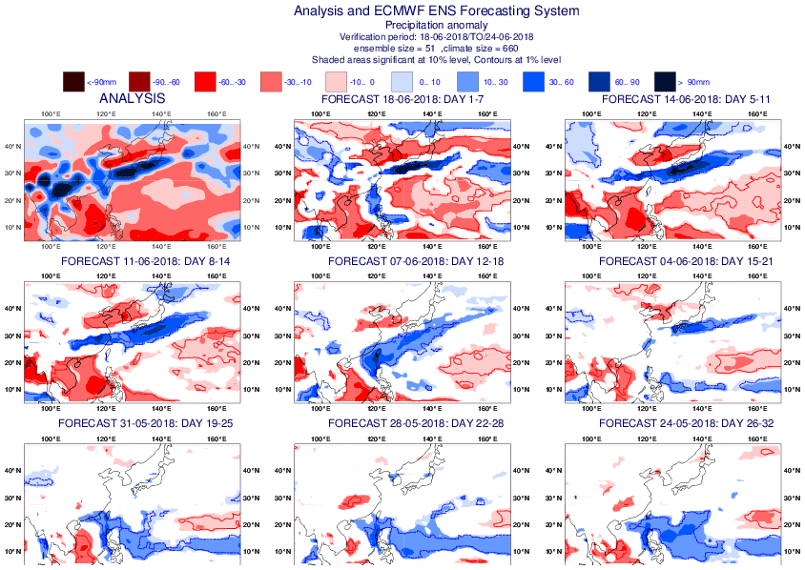
ENS weekly TP fc over EA for 20180618-0625

Slide 33
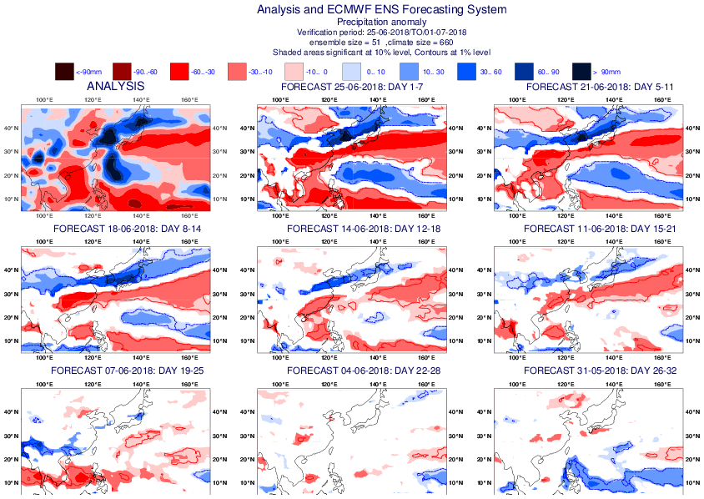
ENS weekly TP fc over EA for 20180625-0701

Slide 34
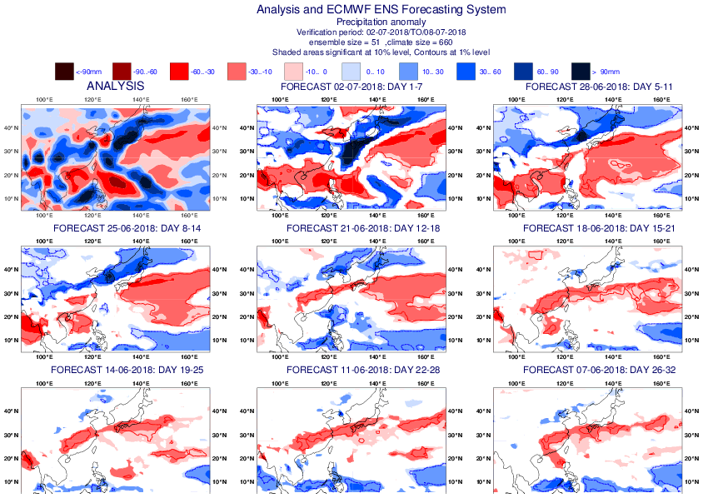
ENS weekly TP fc over EA for 20180702-0708

Slide 35
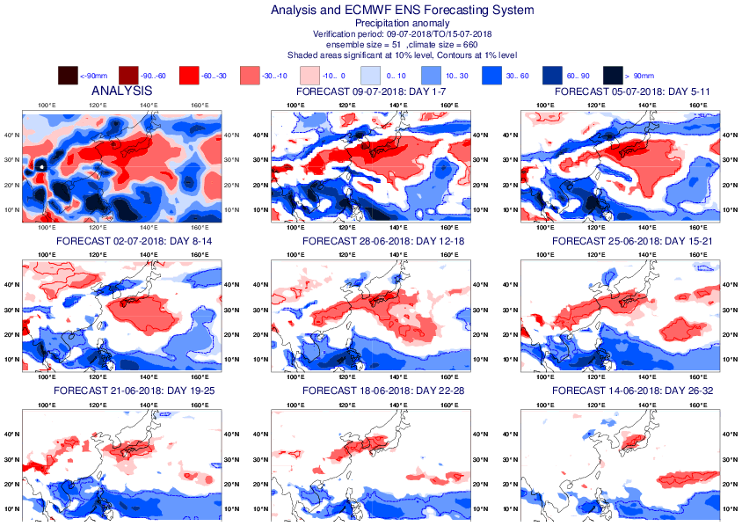
ENS weekly TP fc over EA for 20180709-0715

Slide 36
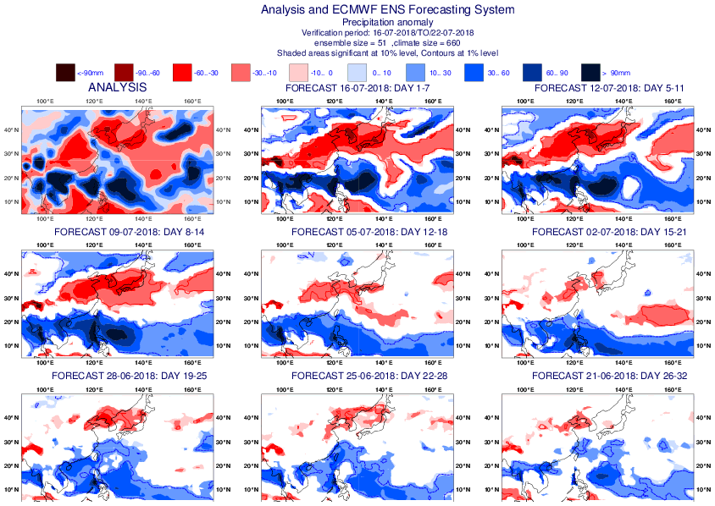
ENS weekly TP fc over EA for 20180716-0722

Slide 37
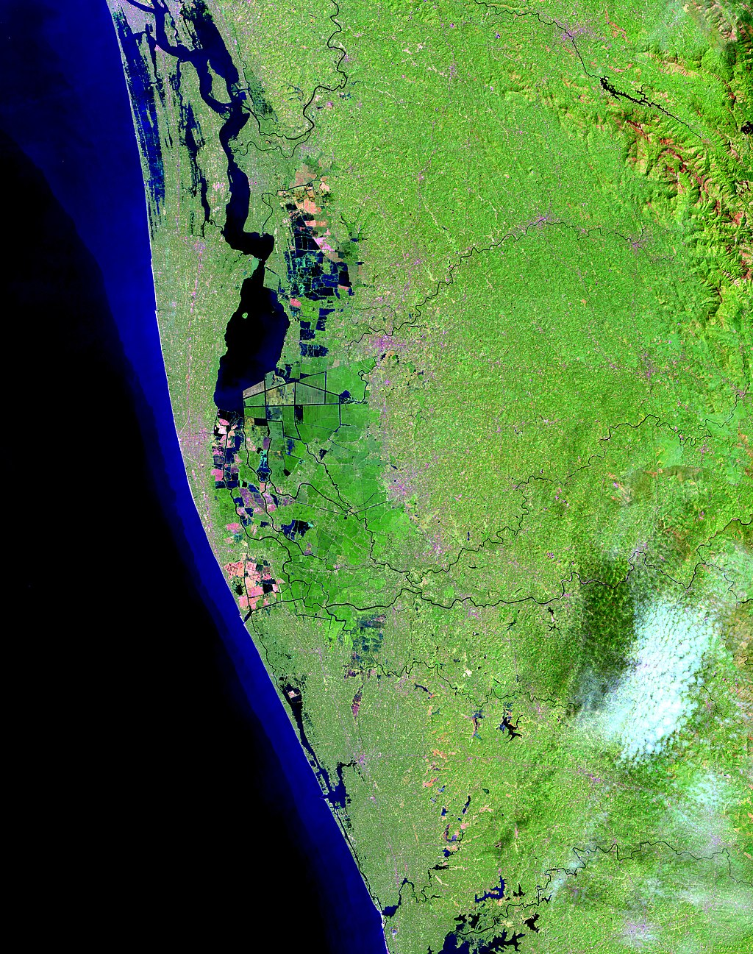
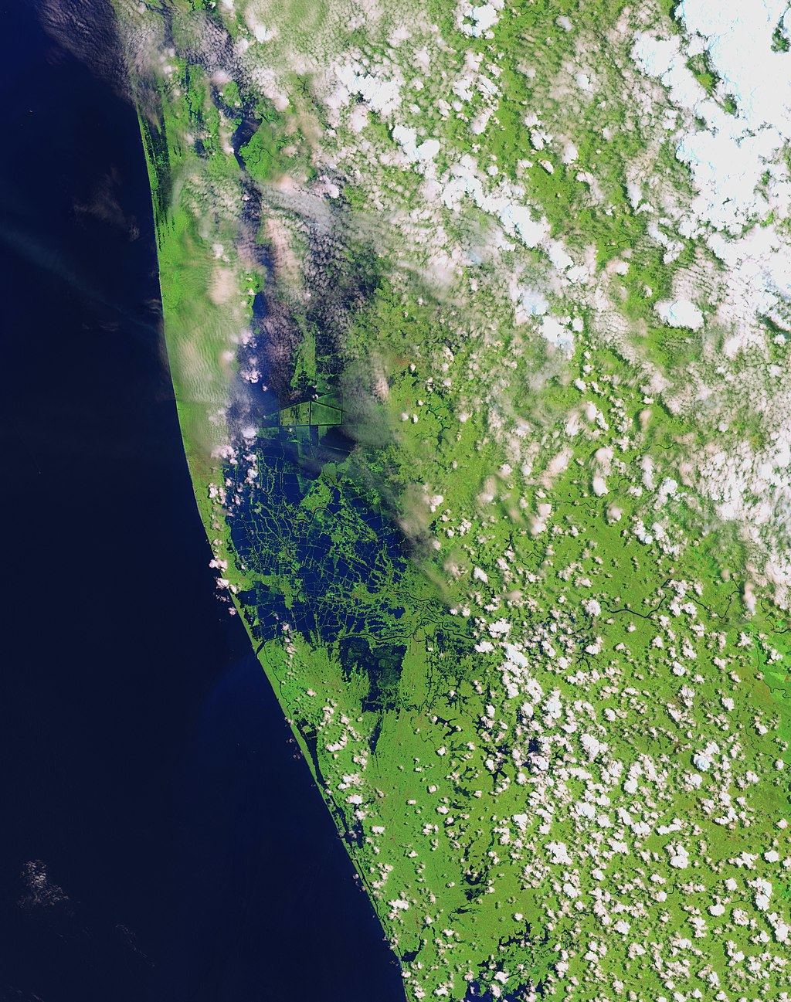

Kerala floods (15 Aug 2018): ENS TP monthly fcs
ENS weekly-average forecasts from 30 April at 00 UTC, to 20 August at 00 UTC.
NASA satellite image: before and after the floods

Slide 38
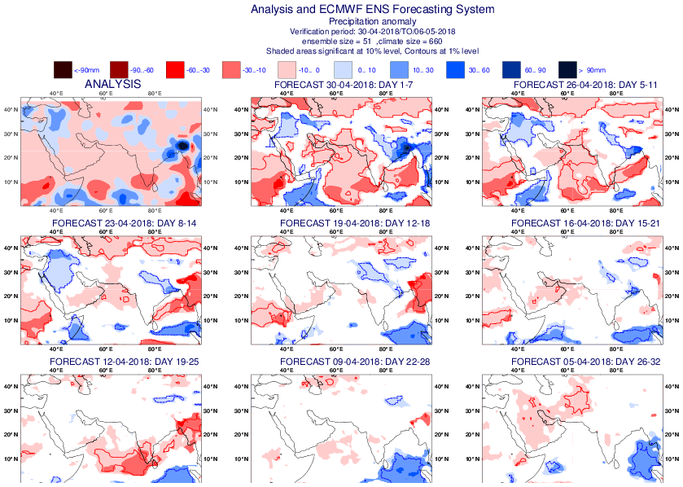
ENS weekly TP fc over India for 20180430-0506

Slide 39
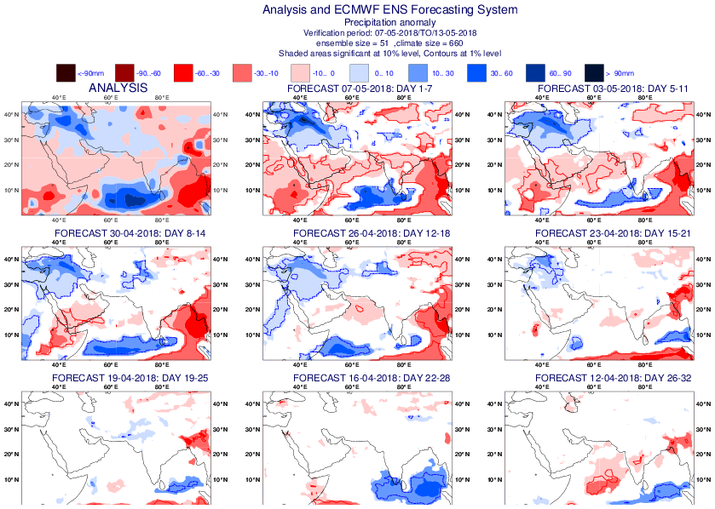
ENS weekly TP fc over India for 20180507-0513

Slide 40
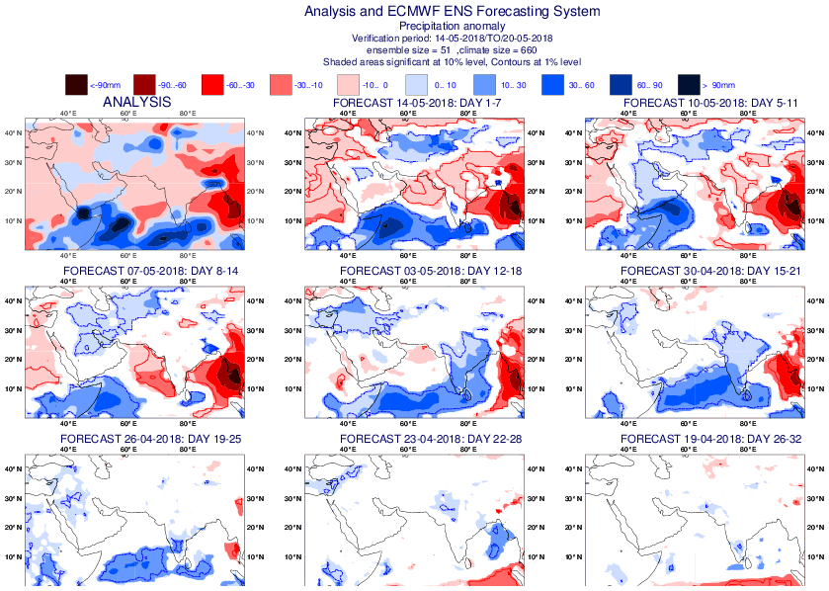
ENS weekly TP fc over India for 20180514-0520

Slide 41
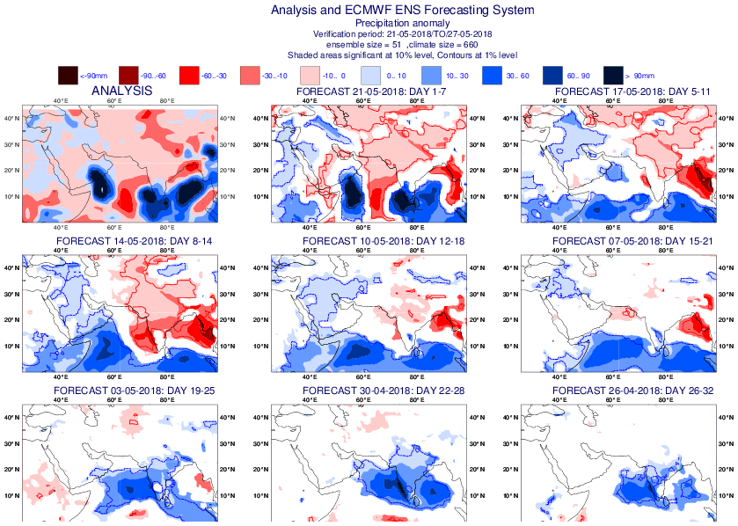
ENS weekly TP fc over India for 20180521-0527

Slide 42
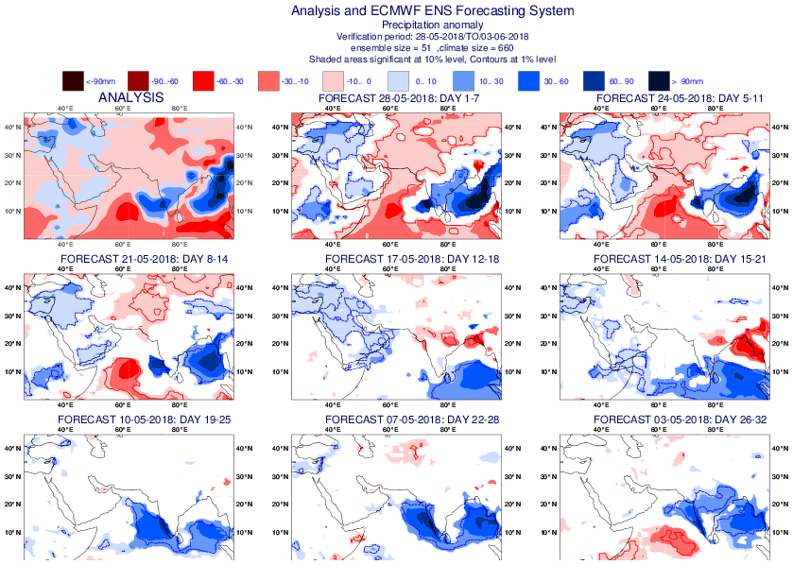
ENS weekly TP fc over India for 20180528-0603

Slide 43
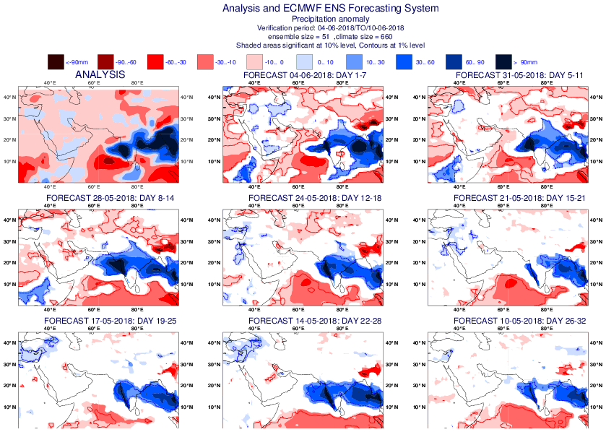
ENS weekly TP fc over India for 20180604-0610

Slide 44
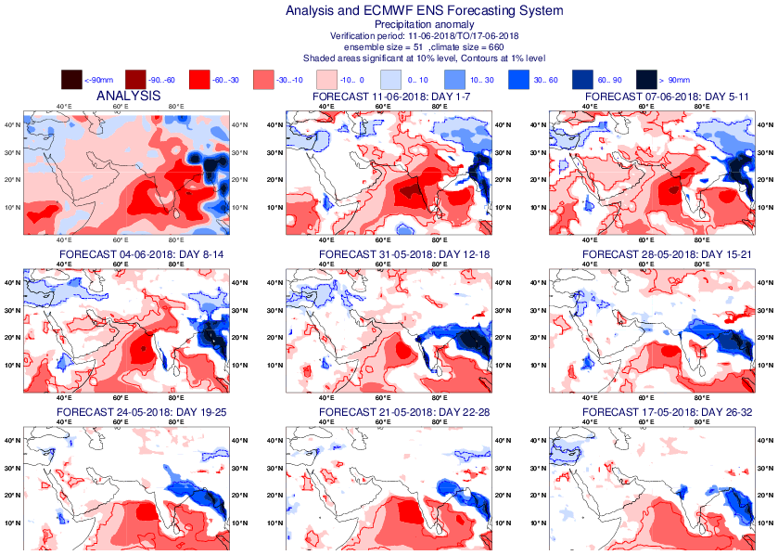
ENS weekly TP fc over India for 20180611-0617

Slide 45
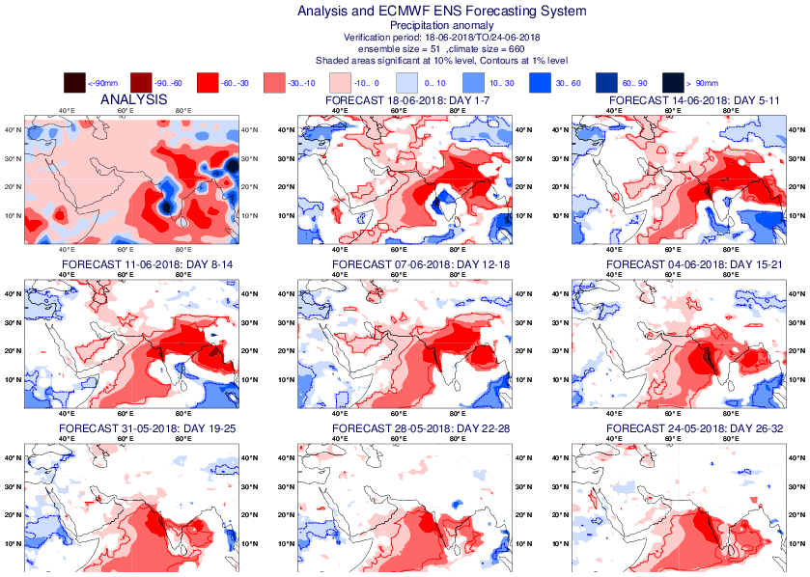
ENS weekly TP fc over India for 20180618-0624

Slide 46
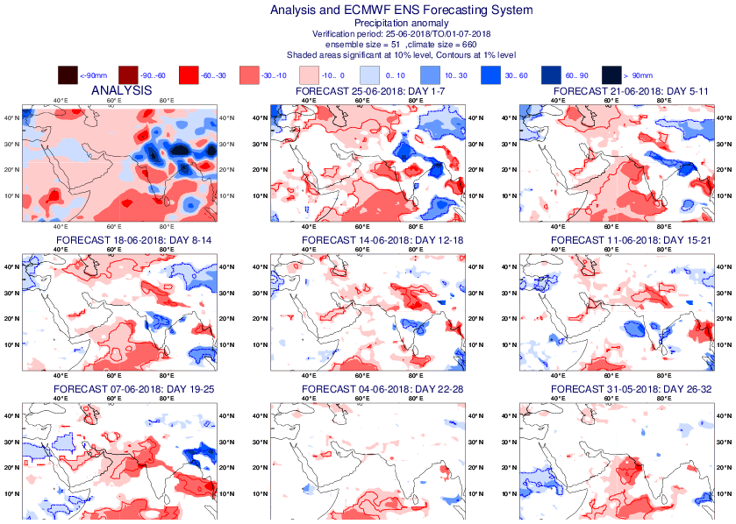
ENS weekly TP fc over India for 20180625-0701

Slide 47
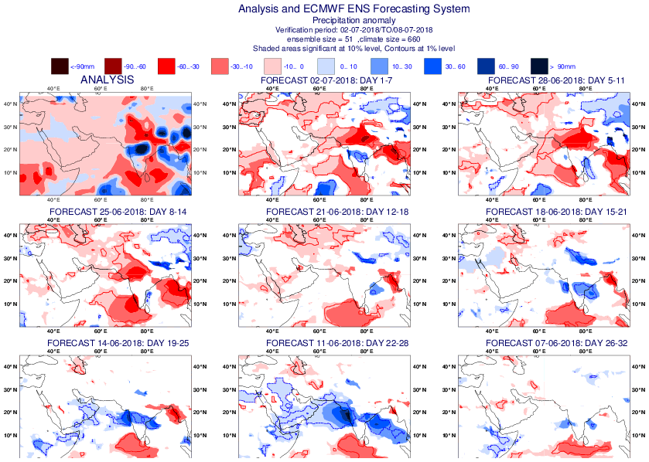
ENS weekly TP fc over India for 20180702-0708

Slide 48
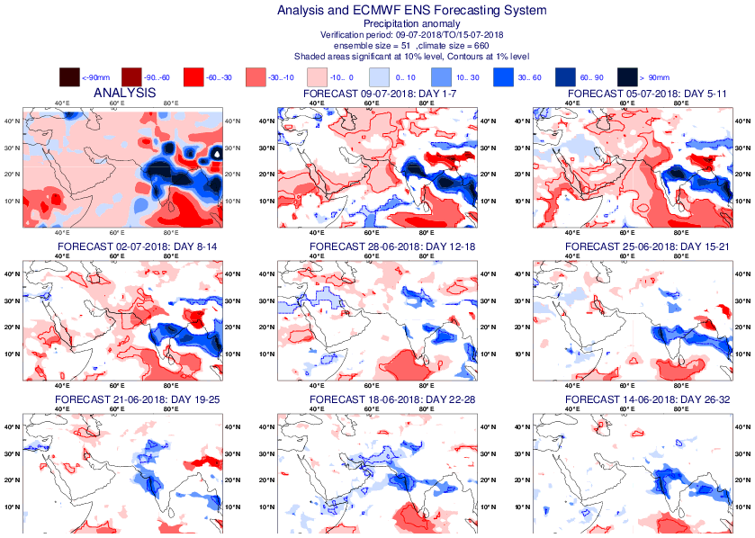
ENS weekly TP fc over India for 20180709-0715

Slide 49
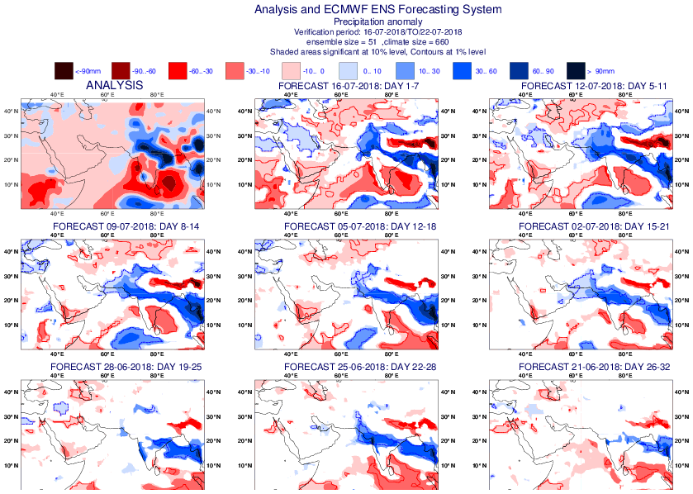
ENS weekly TP fc over India for 20180716-0722

Slide 50
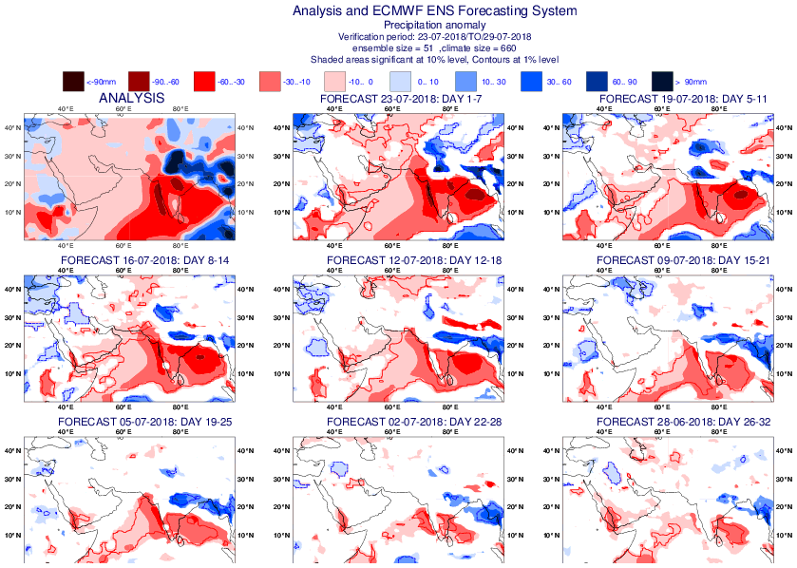
ENS weekly TP fc over India for 20180723-0729

Slide 51
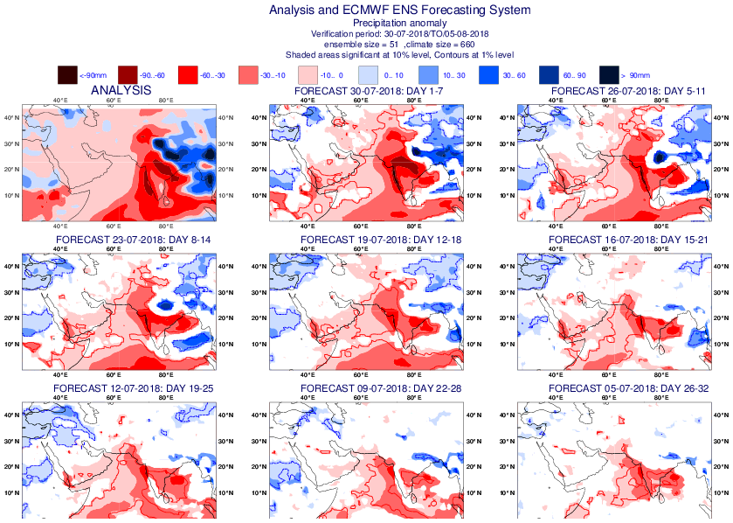
ENS weekly TP fc over India for 20180730-0805

Slide 52
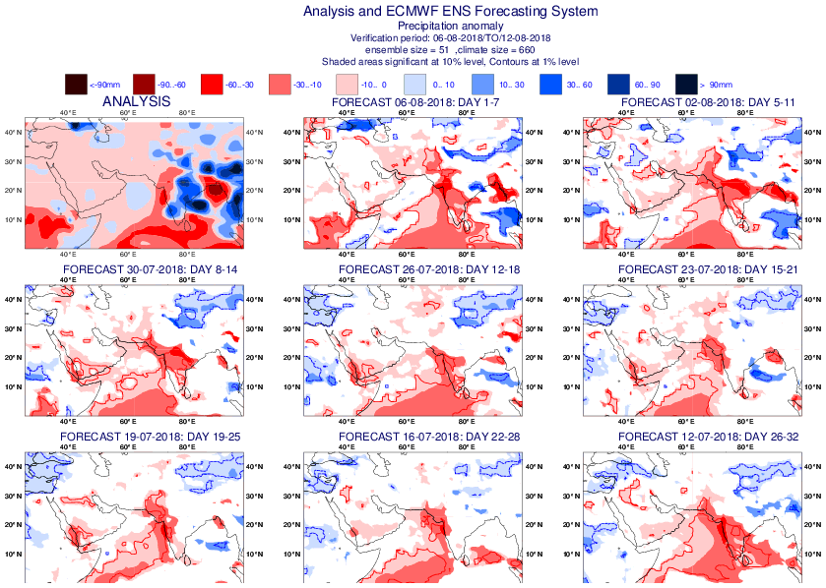
ENS weekly TP fc over India for 20180806-0812

Slide 53
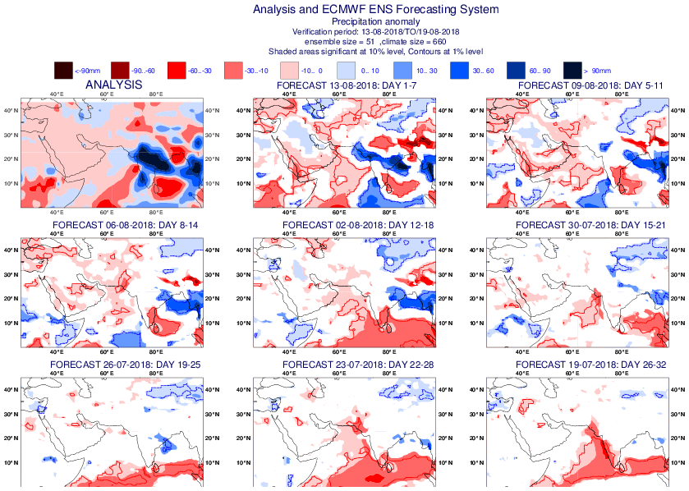
ENS weekly TP fc over India for 20180813-0819

Slide 54
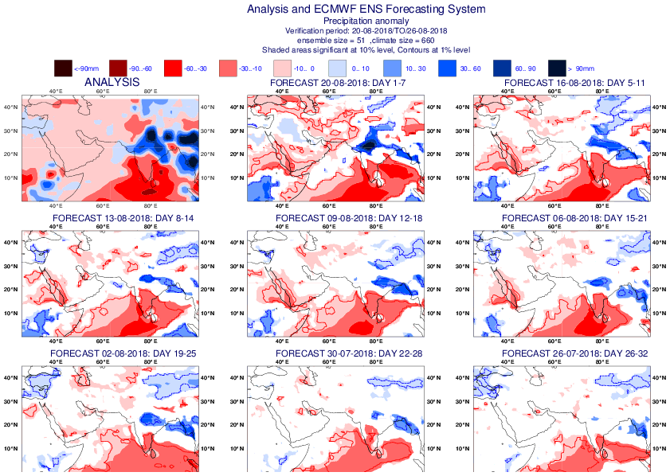
ENS weekly TP fc over India for 20180820-0826

