Slide 1
The Forecast Skill Horizon
Roberto Buizza^{1,2}
(1): Scuola Superiore Sant’Anna (Pisa, Italy)
(2): ECMWF (Reading, UK)

Slide 2
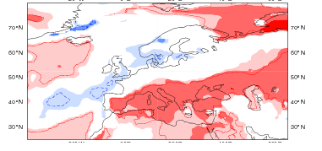
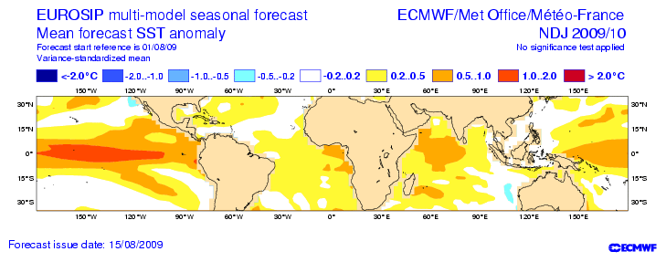
One key question
Does the forecast skill horizon depend on the spatio-temporal scale of the event we are aiming to predict?
Local,
instantaneous
wind-speed
Weekly-mean,
regional
temperature anomaly
Monthly-mean,
continental-scale
rain anomaly
10 100 1000 10000 km
0.1 1 10 100 days

Slide 3

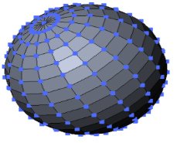
The forecasts: ensemble-based probabilistic
Forecasts are ensemble-based, probabilistic to take into account observation (IC, DA, ..) and model uncertainties
Ensemble-based probabilistic forecasts are more accurate and reliable than single-based forecasts, and are more consistent (i.e. consecutive forecasts jump less)
All forecasts represent average values over a 4-dimensional space-time volume: even an instantaneous, local value represents an implicit spatial and temporal average
Δt
Δt

Slide 4
The skill of ENS fcs is measured with CRPS
ENS forecast probabilities are compared with observations (a very narrow Gaussian). A climatological distribution is used as a reference fc.
Accuracy is measured using the Continuous Ranked Probability Score
A forecast is skilful if CRPS(ENS fc) < CRPS(climatological ensemble)
ENS +5d
ENS +10d
ENS + … d?
CLI
CLI
CLI
obs
obs
obs

Slide 5
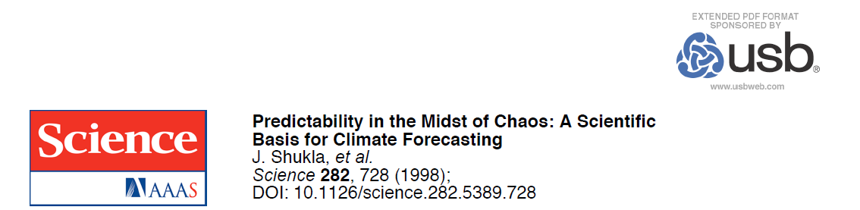
‘Predictability in the midst of chaos’ (Shukla, 1998)
‘… It is now clear that certain aspects of the climate system have far more predictability than was previously recognized. It also should be recognized that some aspects of the climate system will always be difficult to predict.’
‘… it should be possible to predict the large-scale tropical circulation and rainfall for as long as the ocean temperature can be predicted. If changes in tropical Pacific sea-surface temperature are quite large, even the extratropical circulation over some regions, especially over the Pacific–North American sector, is predictable.’

Slide 6
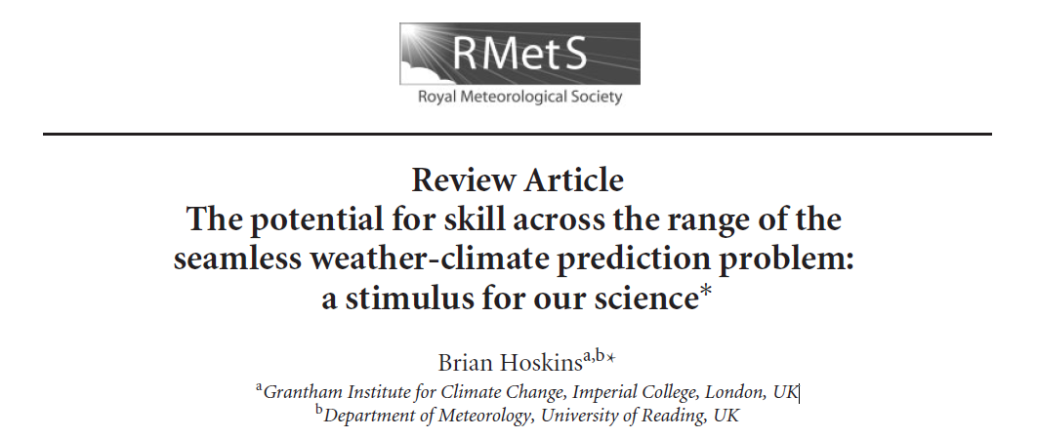
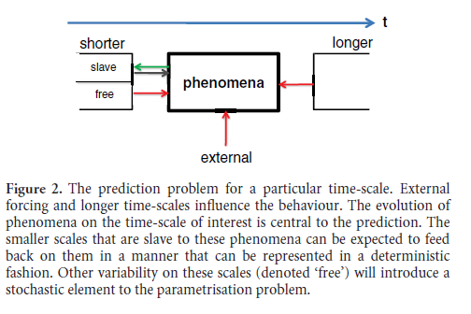
‘Noise and music’ (Hoskins 2013)
‘… despite the prevalence of chaos and turbulence in weather and climate, the optimistic notion has been developed that there could be predictive power on all time-scales.’
‘… On all scales, there are phenomena and external conditions that may give predictability.

Slide 7
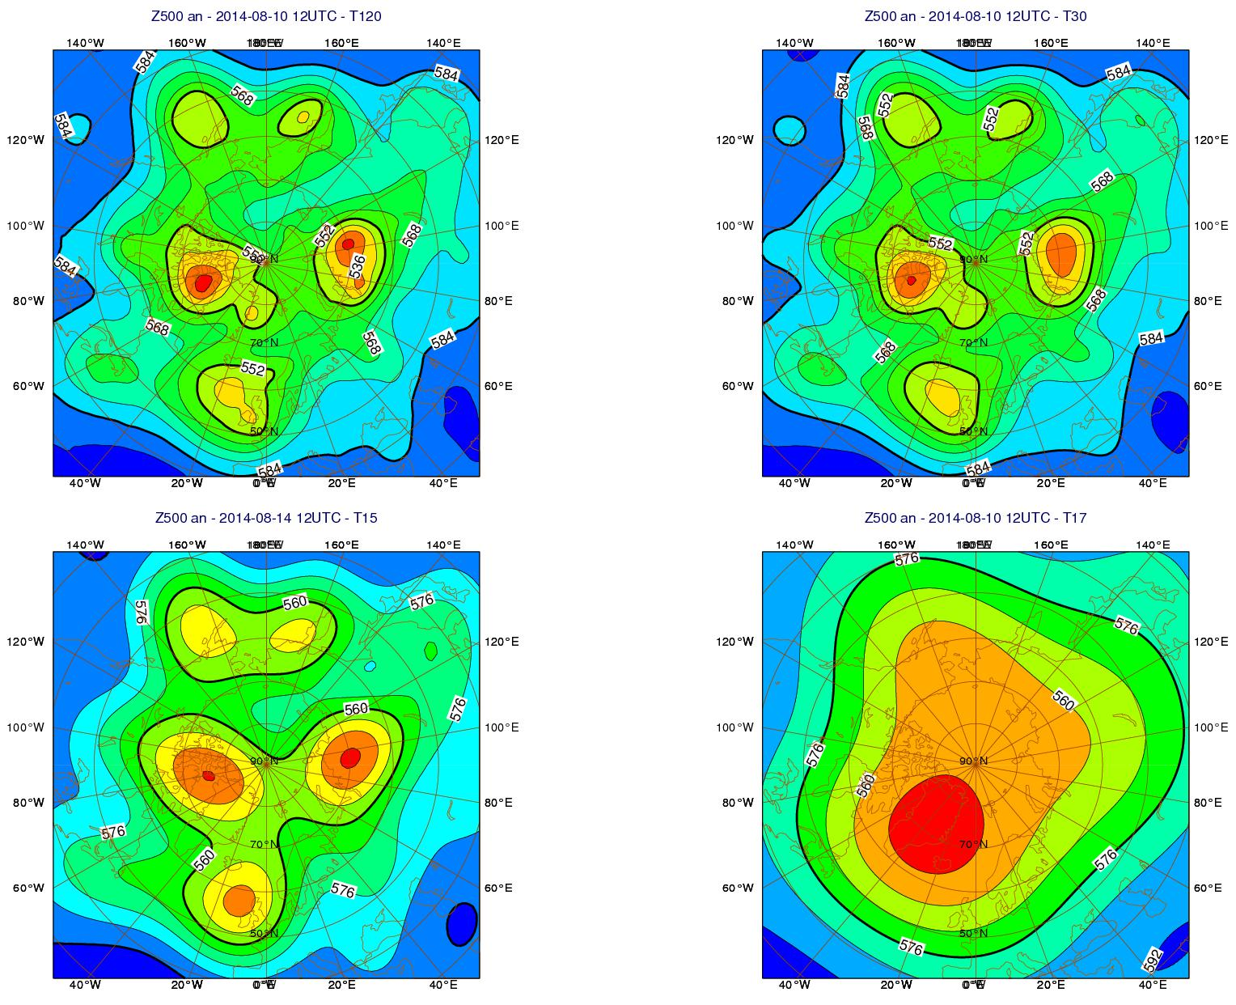
Scale-dependency of the Forecast Skill Horizon
We have considered increasingly coarser fields:
Spatially: spectrally truncated from T120 (180km) to T60 (360km), T15, T7, T3
Temporally: from 2Δt (40 minutes) to 1, 2, 4 and 8 day averages
2Δt - T120
(180km)
2Δt - T30
(720km)
2Δt - T15
(1500km)
2Δt - T7
(3000km)

Slide 8
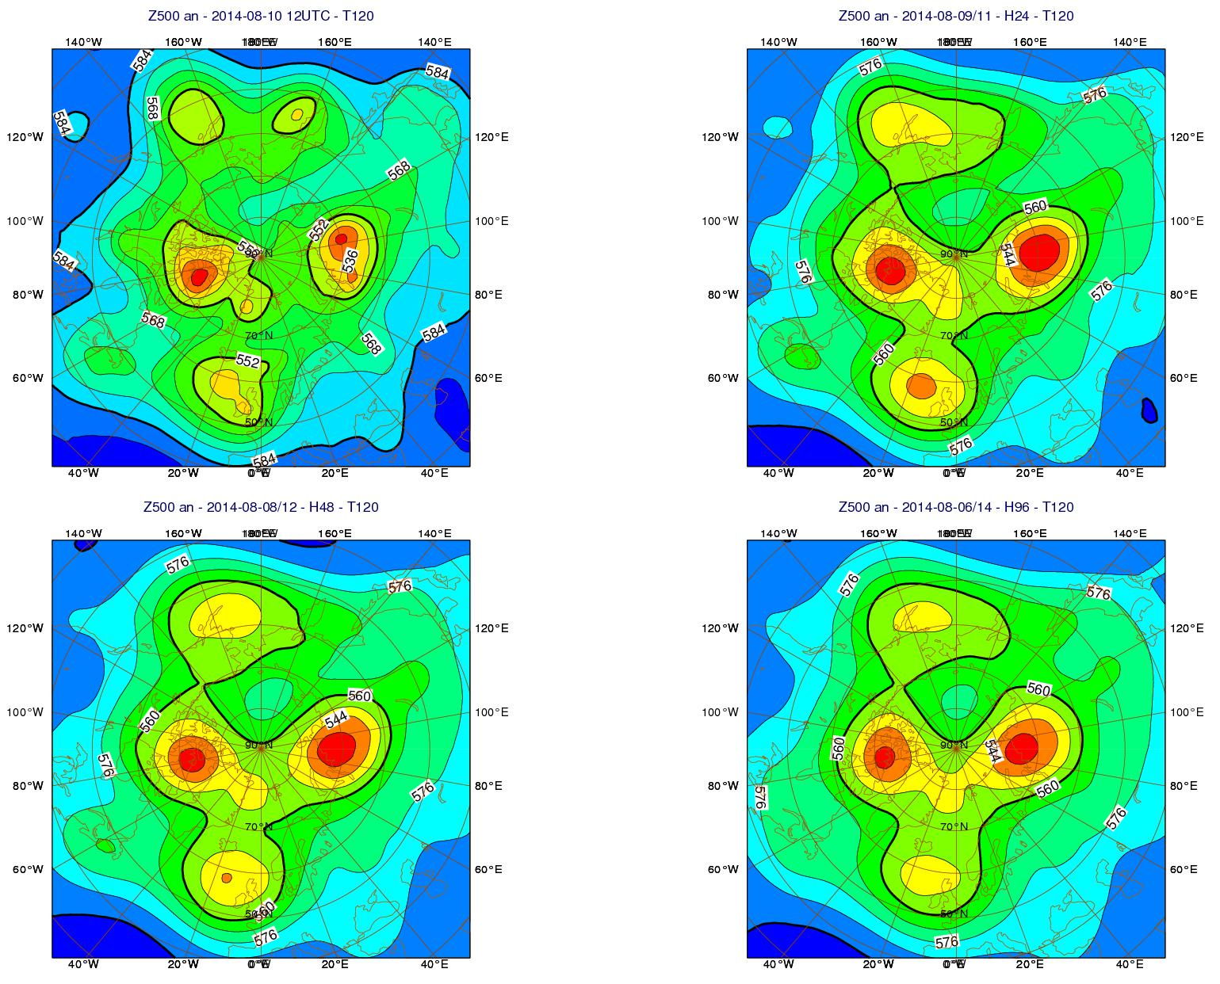
Scale-dependency of the Forecast Skill Horizon
We have considered increasingly coarser fields:
Spatially: spectrally truncated from T120 (180km) to T60 (360km), T15, T7, T3
Temporally: from 2Δt (40 minutes) to 1, 2, 4 and 8 day averages
2Δt – T120
(180km)
2d – T120
(180km)
4d – T120
(180km)
8d – T120
(180km)

Slide 9
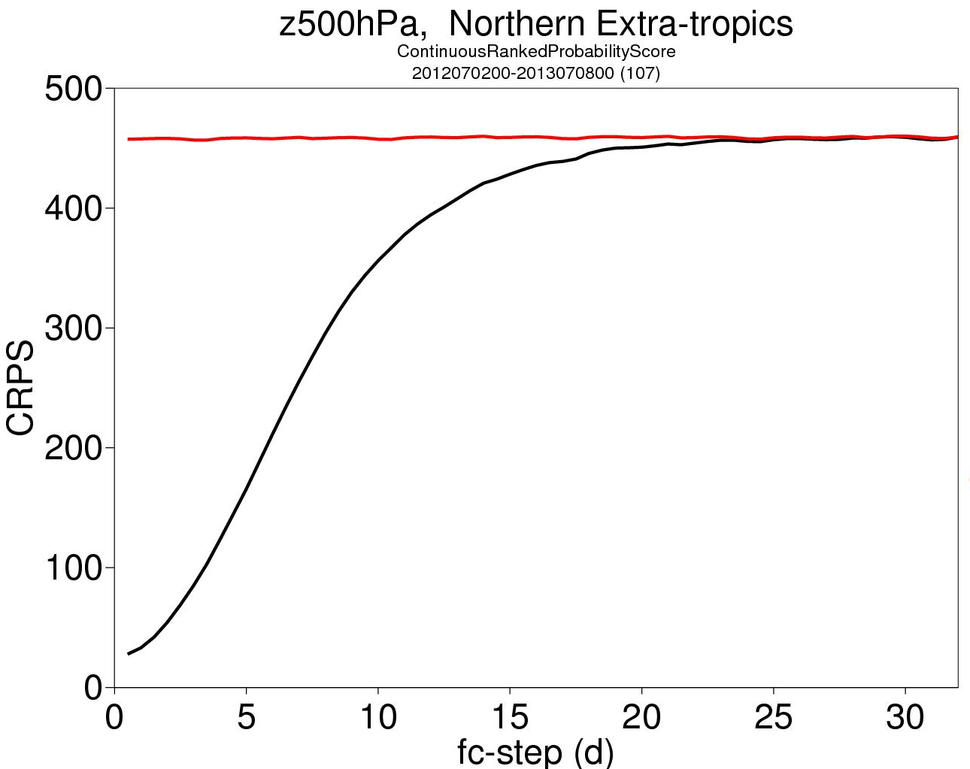
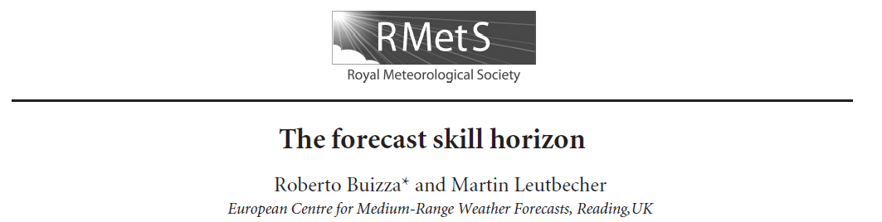
The skill horizon for Z500 over NH is at ~22 days
We showed that grid-point forecasts of Z500 over NH, the forecast skill horizon is about 22 days.
ENS fc

Slide 10
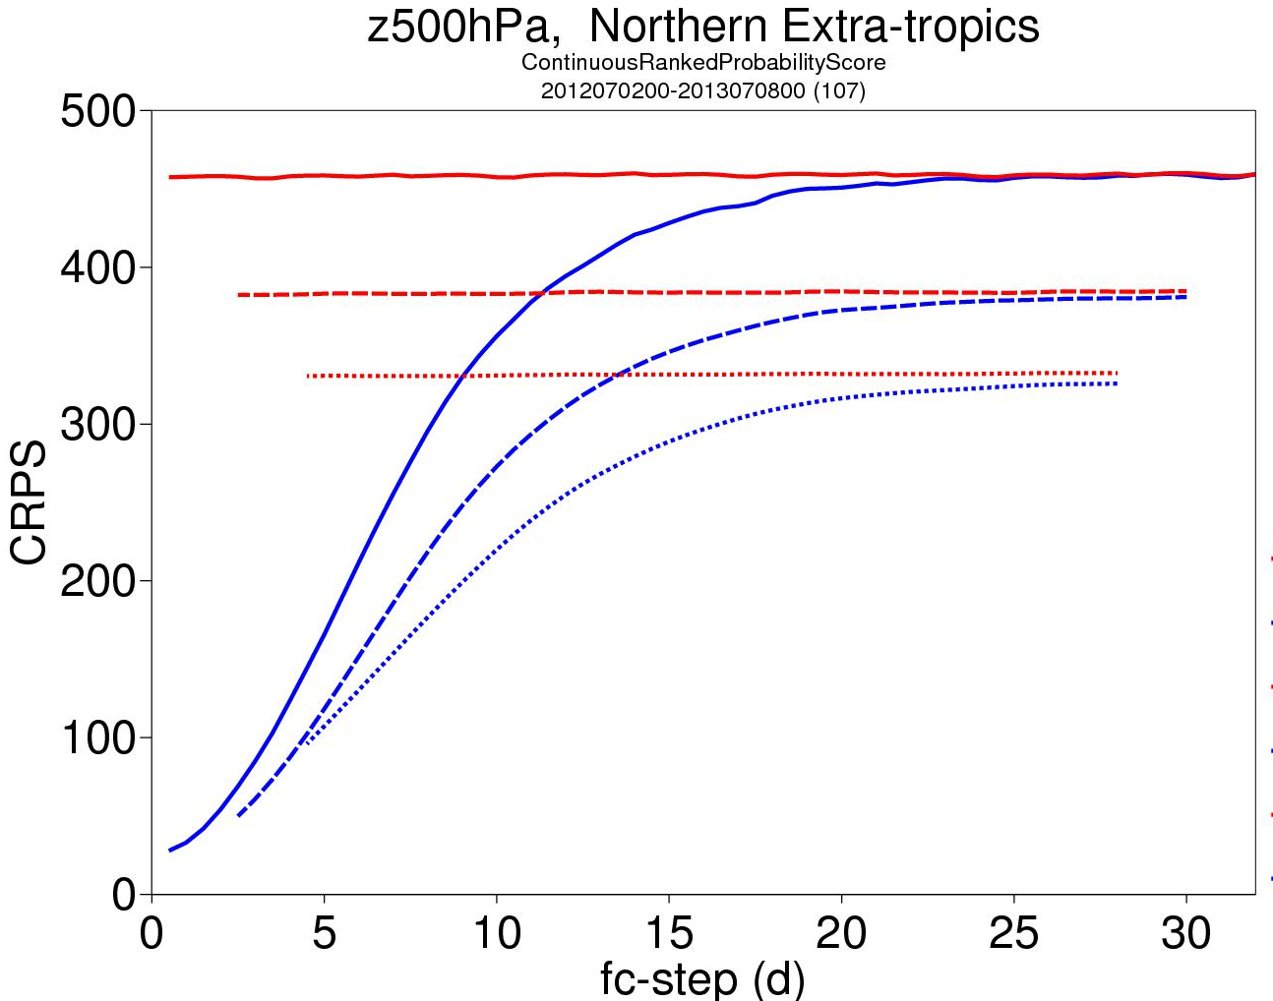
The kill horizon is scale-dependent
The skill horizon is longer for the large-scale, low-frequency phenomena.
2Δt average
4-day average
(d-2;d+2)
8-day average
(d-4,d+4)

Slide 11
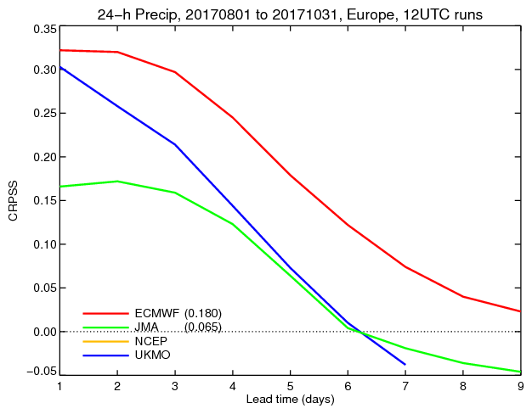
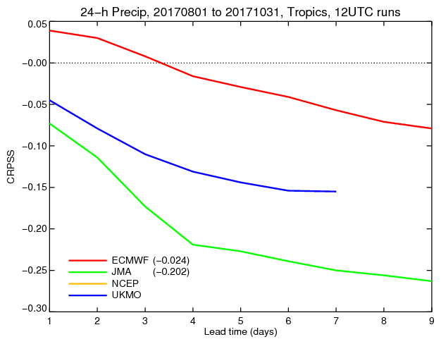
The kill horizon is still low for precipitation

Slide 12
The Forecast Skill Horizon framework
Unresolved
No skill
1 year
1 season
1 month
From finer to larger scales
(ECMWF Newsletter 145, 2015)

Slide 13
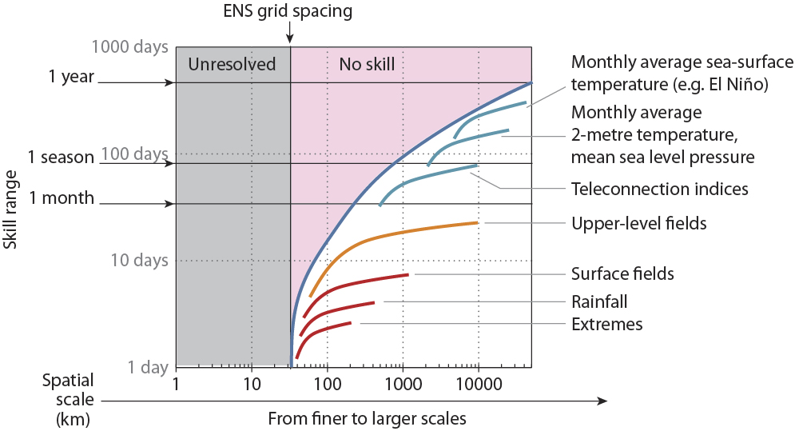
Scale-dependency of the skill horizon
(ECMWF Newsletter 145, 2015)

Slide 14
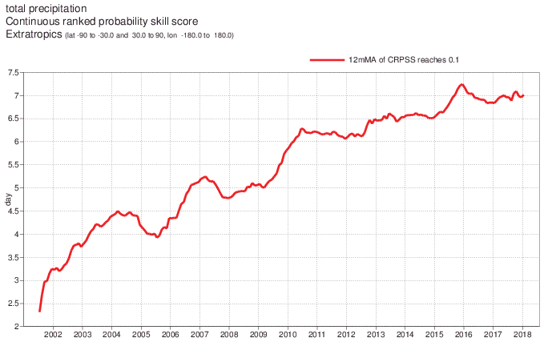
Precip: we have gained ~ 2 days in the past 10y
The problem is very difficult for small scales (eg precip)
~ +2
days/decade
(verified against synop obs)

Slide 15
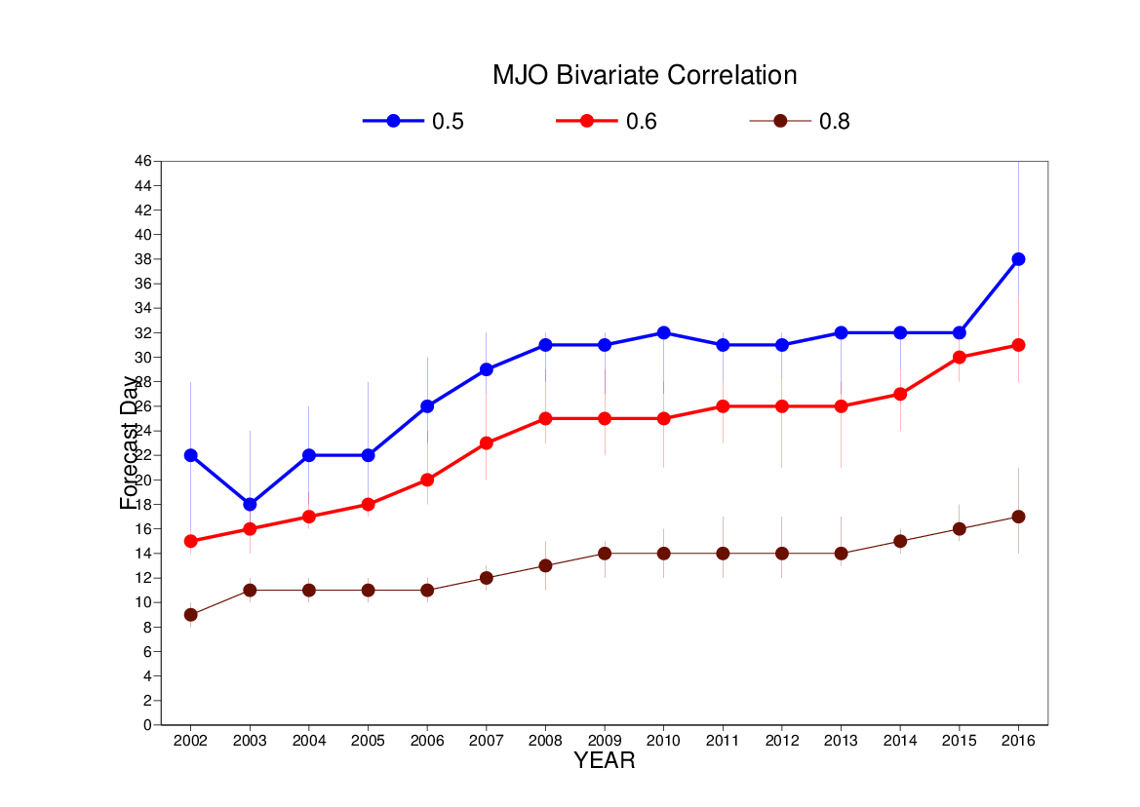
MJO: we have gained ~ 12 days (!!) in the last 10y
The problem is ‘easier’ for larger scales (eg MJO)
~ +12 days/decade
(verified against analyses)

Slide 16
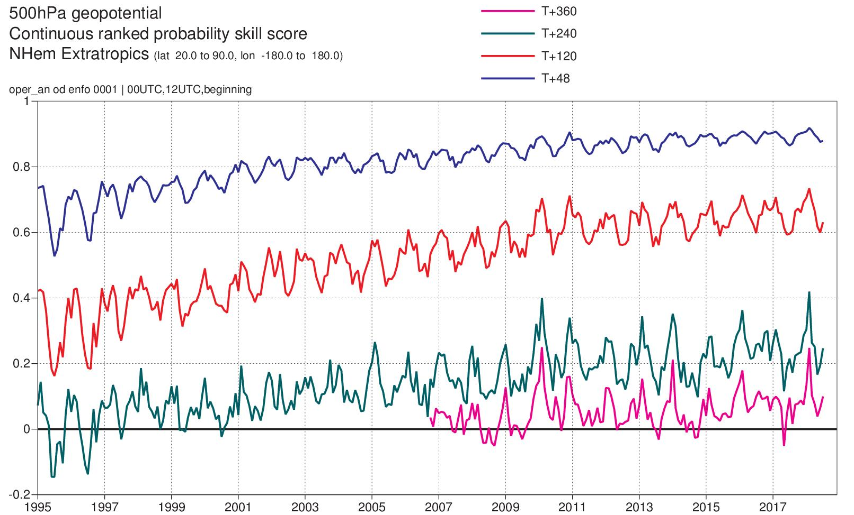
NH X-TR: we have gained ~ 2+ days per decade
For the X-tropics we have been improving by ~2 days per decade
+3d/22y
+5d/22y
(verified against analyses)

Slide 17
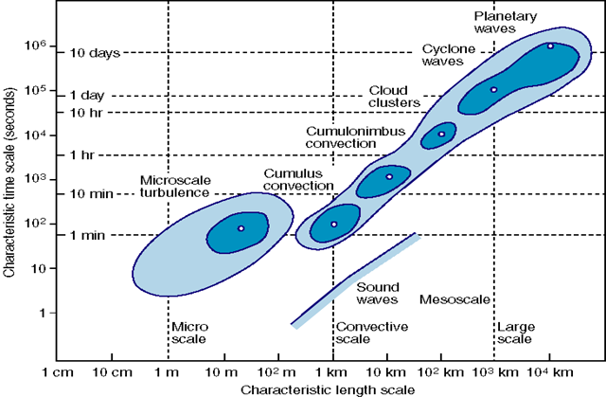
Predictable signals versus errors
Predictable signals propagate from the better-initialized and more predictable scales (‘mainly’ the large scales, the slowly evolving components) to the less predictable (small/fast) scales
Errors propagate from poorly initialized scales (‘mainly’ the smaller scales) thus reducing the predictive skill
(R Buizza and M Leutbecher, QJRMS 2015)

Slide 18
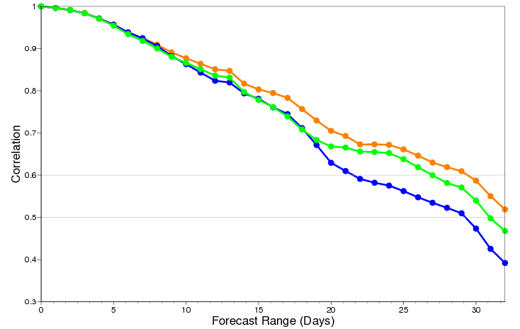
Example: the role of the 3D-ocean …
The coupling of the atmosphere to the NEMO 3-dimensional ocean led to better MJO fcs (results based on 80 ENS, starting 1st F/M/A/N 1989-2008).
MJO Bivariate Correlation
Coupled to NEMO
Observed SSTs
Persisted SSTs
(F Vitart)

Slide 19
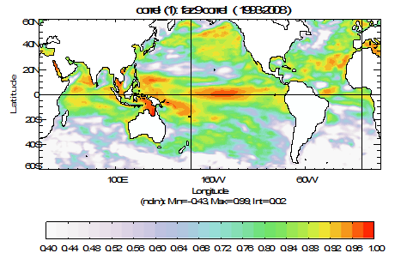
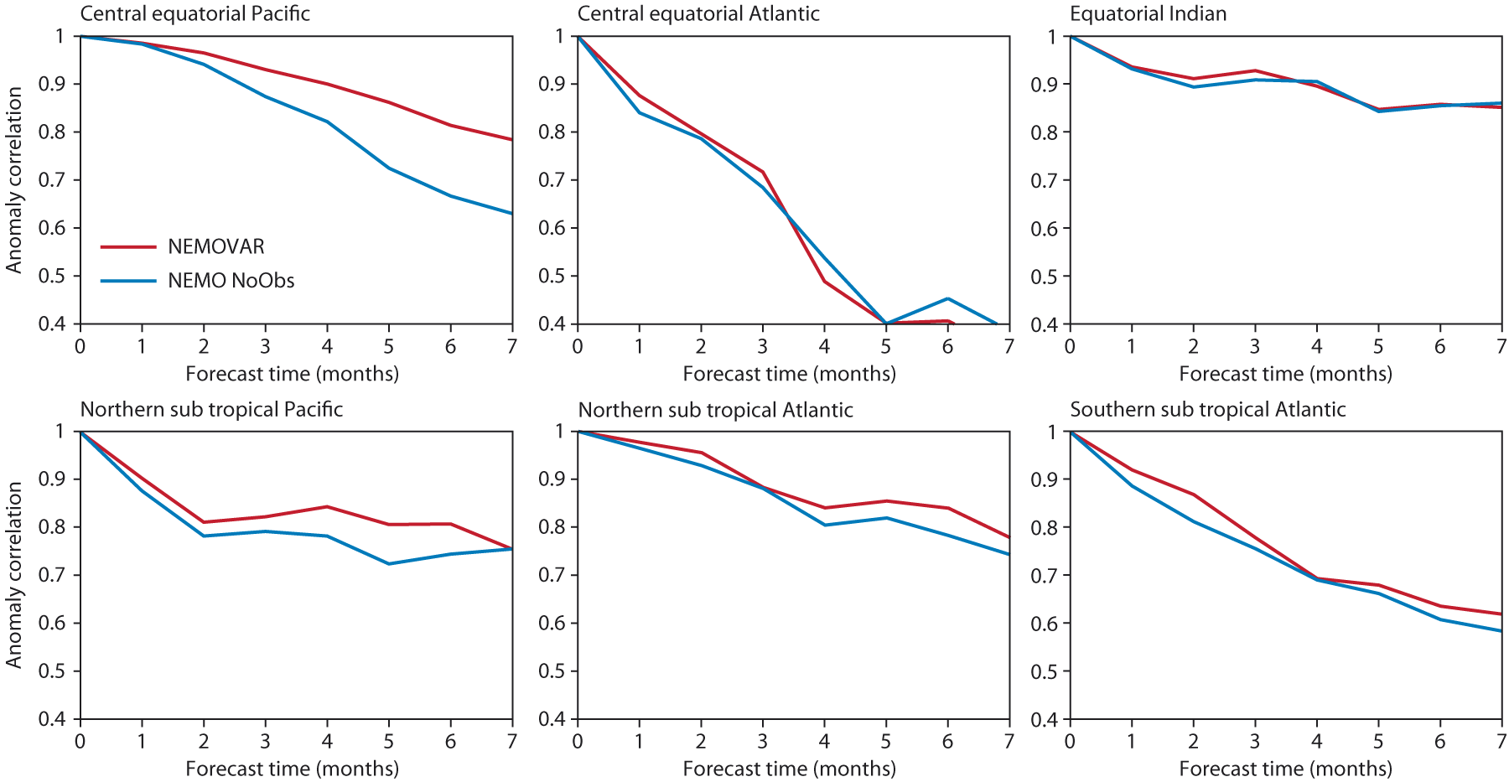
Example: the role of ocean ICs …
NEMO (no obs)
NEMOVAR: T+S+Alti
A proper initialisation played a key role.
(F Vitart, M Alonso-Balmaseda)

Slide 20

Five areas of work to further advance
As stated in our strategy 2016-2015, by:
Improving our model (processes, uncertainty est) and assimilation system
Assimilating more observations
Building more consistent Earth-system ensembles of analyses and forecasts
Increasing the ensembles’ resolution
Understanding predictability

Slide 21
Sea-ice and tropo-stratosphere interactions
Ruggeri et al (2016, JGR) have shown that sea-ice concentration anomalies in the Barents-Kara seas in late autumn/early winter has an impact on weather variability over the Euro-Atlantic sector in late winter.

Slide 22
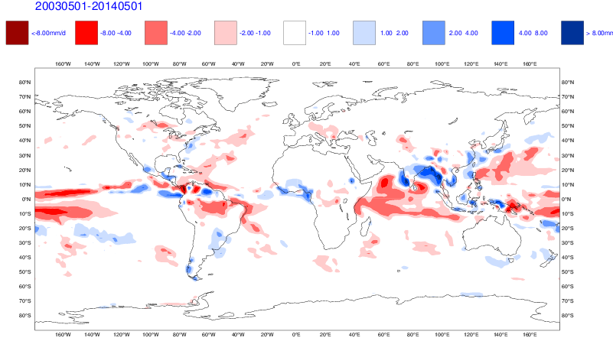
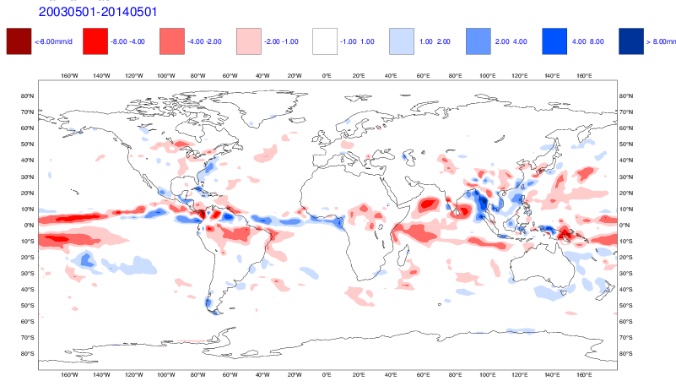
Aerosols
Preliminary results show a positive impact (reduction in bias on meteorological fields, e.g. precipitation) of using an interactive aerosols. More prominent (positive) impact can be detected over the Indian Ocean and to a lesser extent in other areas, which is also consistent with earlier results.
CONTROL RUN – PRECIPITATION BIAS WEEK 4
INTERACTIVE AEROSOL RUN – PRECIPITATION BIAS WEEK 4

Slide 23
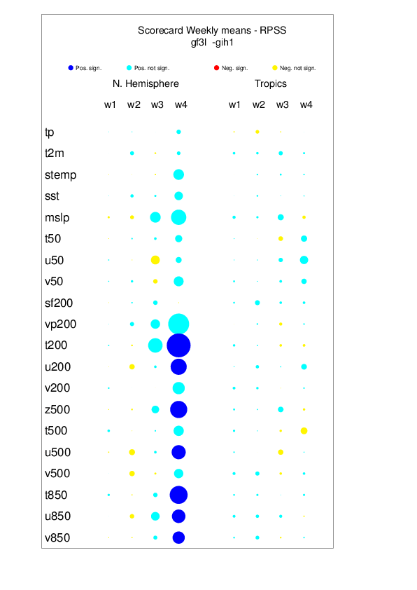
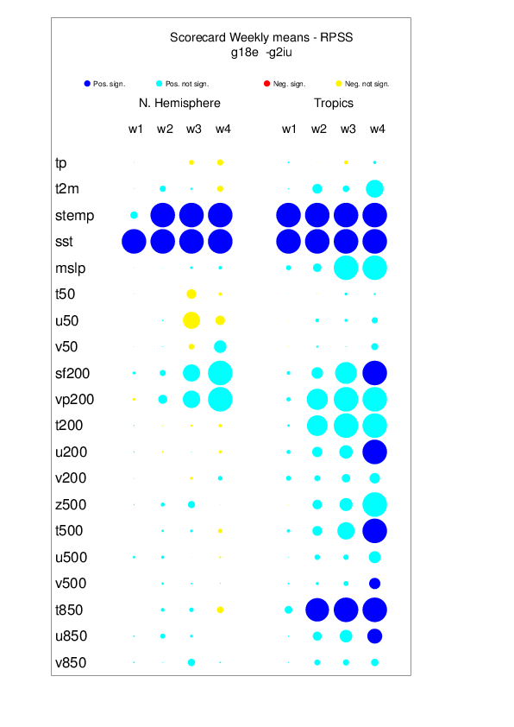
Aerosols
Preliminary results indicate that aerosols have an impact comparable to coupling.
Caveat: May start dates only
2003-2015 period
Observed (prescribed) Fire emission
Coupled vs pers SST
Active aerosols

Slide 24
Thank you for your attention …

