Slide 1
Ensemble spread
Aurore Porson, Anne McCabe
26th-30th November 2018
Bureau of Meteorology R&D workshop

Slide 2
A) What metrics to use to determine the ensemble spread?
Standard deviation to control or ensemble mean?
New techniques to study spread for precipitation (dFSS, SAL, others?).
How do you determine spread for other non-continuous fields as clouds, fog?

Slide 3
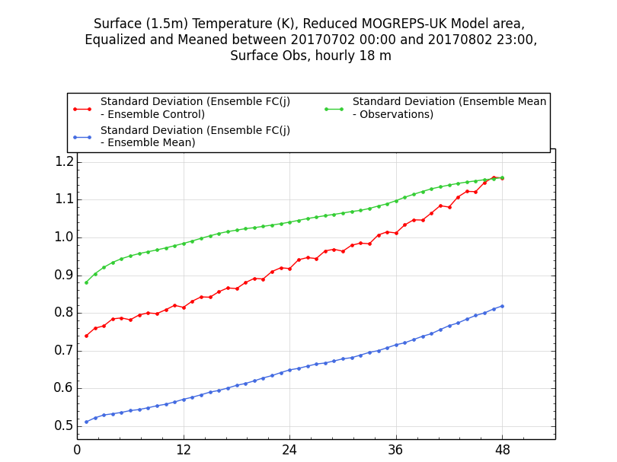
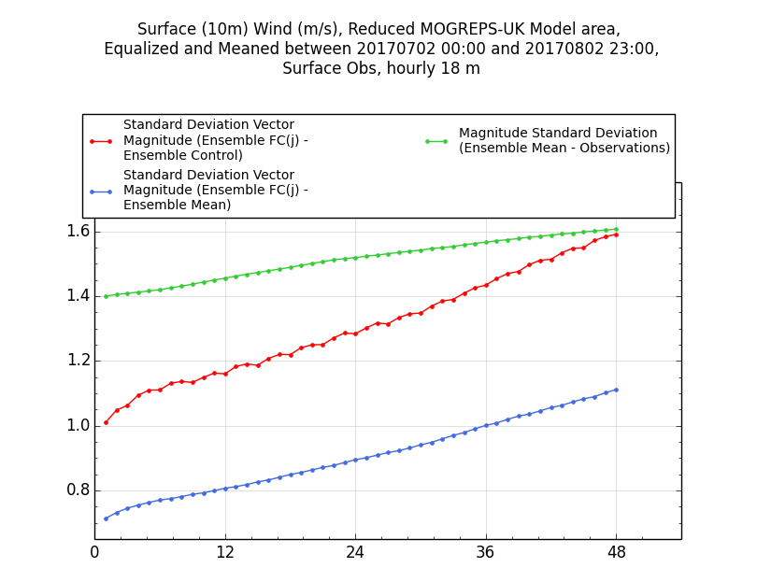
Example of metric with Impact on spread
The choice of which metric to use to represent the ensemble spread is important.
Ensemble still underspread overall. But depending on the metric, this changes with increasing lead times.
Forecast range (h)
Forecast range (h)

Slide 4
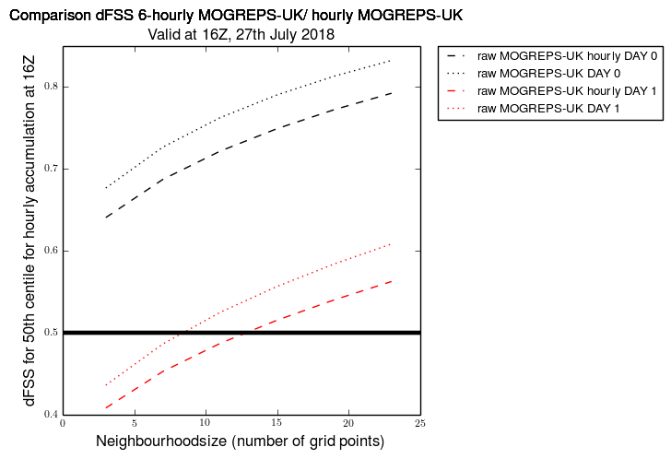
Dispersion metric to represent spatial spread of the ensemble for fields as precipitation
How do the 2 models compare in terms of spread?
First results point towards an increase of the ensemble spread (ie, reduction in ensemble fss). Dey et al. (2014)
www.metoffice.gov.uk © Crown Copyright 2018, Met Office

Slide 5
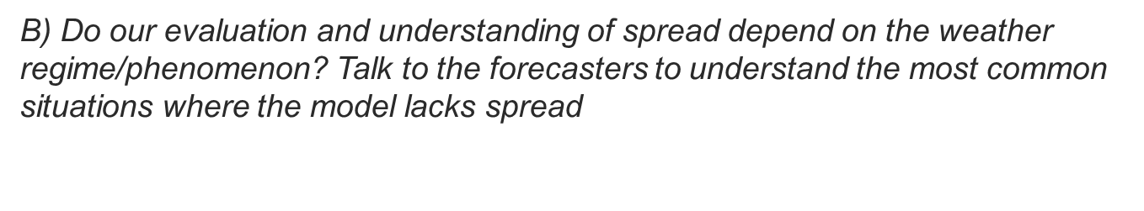

Slide 6
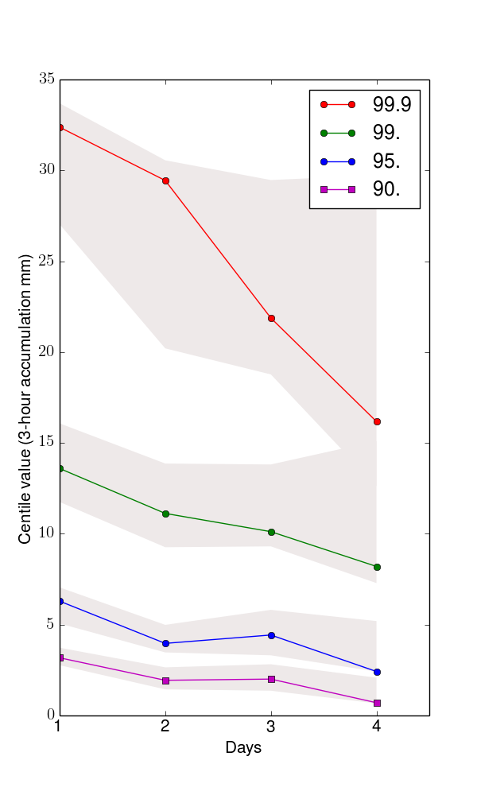
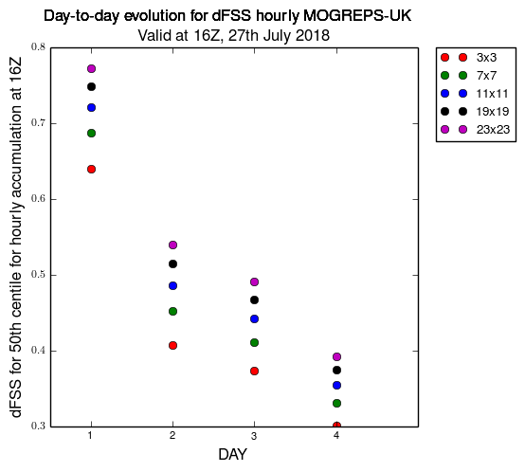
What happens from Day 1 to Day 4 for a severe convective case?
Less confidence in the prediction of severe events. Spread in the organisation of the convection between the members.
Spatial variability (spread) between members increasing (based on the 50th centile).
Ensemble spread
Control member
99.9th centile
Control member
99th centile
Ensemble spread

Slide 7
C) What techniques shall we use to address the lack of spread?
Model Configurations? For example, hourly cycling/ 6-hourly configurations/downscaler ensemble
More stochastic parameterizations, adapted for the convective scale?
Testing the nature of these perturbations (ie, different DA schemes for global model or different driving models)?
Testing the scales of these perturbations? Upscale versus downscale cascade of perturbation growth

Slide 8
Choose a subset of parameters from relevant parametrization schemes and vary them stochastically throughout the forecast
Random Parameter Scheme
Advantages:
Addresses knowledge uncertainty in physics parametrizations
Physically realistic tendencies
Conceptually simple and computationally cheap to implement
Can target specific physical processes
Difficulties:
Needs to be regularly reviewed / revised as parametrizations change
Choice of parameters and ranges can be subjective
Modest impact on spread and skill
Question of best time evolution of parameter values

Slide 9
Parameters are chosen to target uncertainty at the small scales

Slide 10
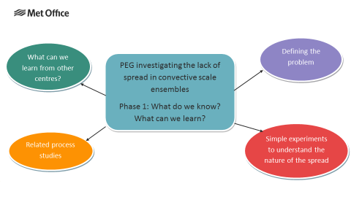
Investigating the lack of spread in convective-scale ensembles
Operational meteorologists have identified lack of spread in MOGREPS-UK as a top model development priority
A Process Evaluation Group (PEG) has been formed to investigate further
Aim: to bring together scientists and operational meteorologists to evaluate the ensemble and develop new strategies to improve the value of MOGREPS-UK to forecasters
First phase: to understand what we mean by ‘lack of spread’ and / or what is ‘the correct spread’ → any ‘improvements’ we make must translate to improvements for meteorologists

Slide 11
Lateral forcing applied
RP scheme
Phase 1: Exploring sensitivity to sources of uncertainty
Default ensemble
Same initial conditions
Back-to-basics sensitivity tests
Also …
Sensitivity to driving model → use nesting suite to drive MOGREPS-UK with ECMWF data
Tools to assess the spread, e.g. dFSS and SAL
Diagnostic tools for forecasters
For more information, see
https://code.metoffice.gov.uk/trac/rmed/wiki/pegs/ensemble_spread
Experiments | Start dump | LBCs | STPH
Exp 1 – uncertainty from initial conditions only | Perturbed | Control | Off
Exp 2 – uncertainty from LBCs only | Control | Perturbed | Off
Exp 3 – uncertainty from stochastic physics only | Control | Control | Perturbed

Slide 12
Thank you for your attention!
Any questions?
Aurore (aurore.porson@metoffice.gov.uk)
Anne (anne.mccabe@metoffice.gov.uk)
www.metoffice.gov.uk © Crown Copyright 2018, Met Office

